Slide 1
Introduction to Object-Oriented Programming
Understanding the Fundamentals of OOP

Slide 2
What is OOP?
Object-Oriented Programming (OOP) is a programming paradigm that uses objects to design applications and computer programs.
In OOP, objects are instances of classes that encapsulate data and behavior, allowing for modular and reusable code.
OOP focuses on concepts such as abstraction, encapsulation, inheritance, and polymorphism to organize code and improve software design.

Slide 3
Key Concepts of OOP
Abstraction allows programmers to hide complex implementation details and only show the necessary features of an object.
Encapsulation combines data and methods into a single unit, protecting data from outside interference and misuse.
Inheritance enables new classes to inherit attributes and methods from existing classes, promoting code reusability and hierarchy.

Slide 4
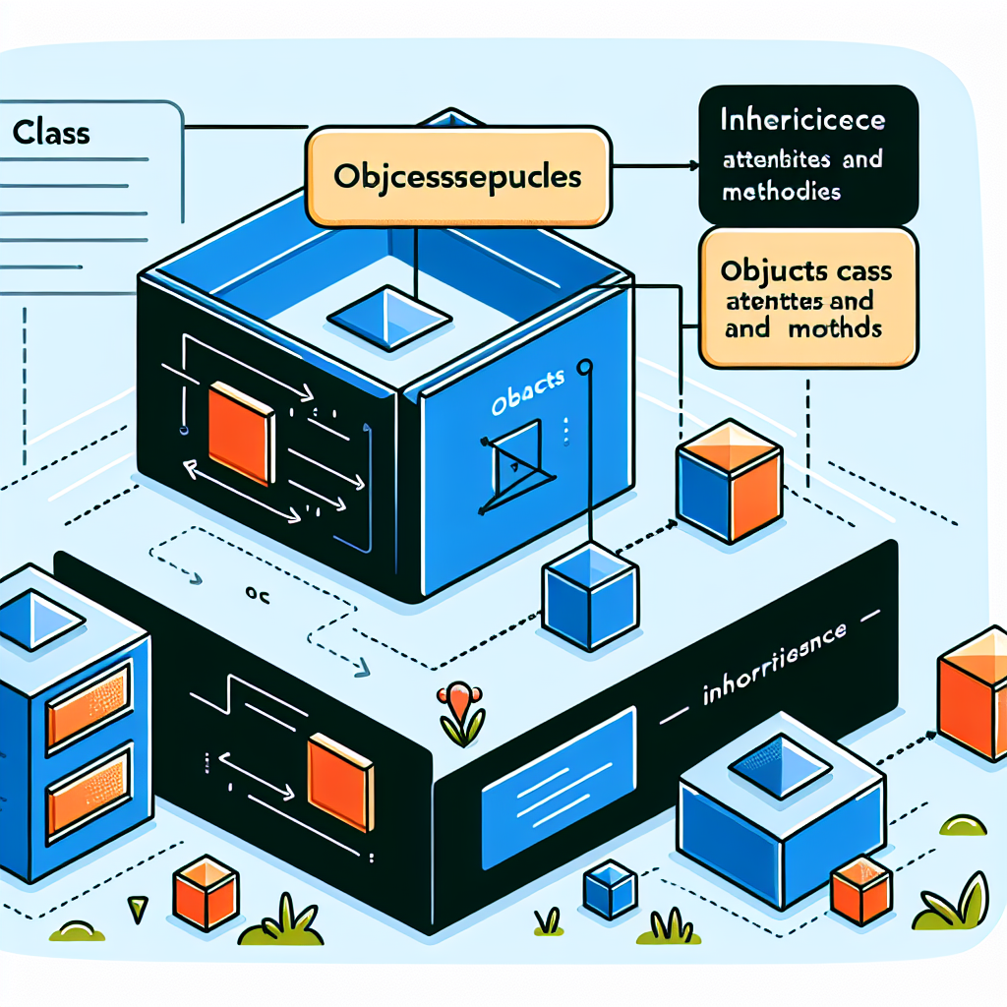
Classes and Objects in OOP
Classes are blueprints for creating objects, defining their structure and behavior.
Objects are instances of classes, representing real-world entities with attributes (data) and methods (behavior).
Inheritance allows classes to inherit characteristics from a parent class, promoting code reusability and modularity.
Class and Object Diagram

Slide 5
Polymorphism in OOP
Polymorphism enables objects to be treated as instances of their parent class, allowing for flexibility and dynamic behavior at runtime.
Method overloading and method overriding are common examples of polymorphism in OOP, providing different implementations of the same method.
Polymorphism simplifies code maintenance and promotes code reusability by facilitating flexibility and extensibility.

Slide 6
Benefits of OOP
OOP promotes code reusability, modularity, and flexibility, making it easier to maintain and update software.
Encapsulation enhances data security and reduces system complexity by hiding implementation details.
Inheritance simplifies code structure and promotes hierarchical relationships between classes, improving software design.

Slide 7
Challenges in OOP
Complexity in class hierarchies and relationships can lead to difficulties in understanding and maintaining OOP code.
Overuse of inheritance can result in tightly coupled classes, making code modification and extension challenging.
Proper design patterns and principles such as SOLID (Single Responsibility, Open/Closed, Liskov Substitution, Interface Segregation, Dependency Inversion) can help address these challenges.

Slide 8
Real-World Examples of OOP
Software applications like web browsers, graphic design tools, and word processors are often developed using OOP principles.
Game development, financial modeling, and enterprise software systems also leverage OOP for creating scalable and maintainable solutions.
Popular programming languages such as Java, C++, and Python support OOP features to facilitate software development.

Slide 9
Conclusion
In conclusion, Object-Oriented Programming provides a powerful framework for developing software systems by focusing on objects and classes.
By incorporating key concepts such as inheritance, encapsulation, and polymorphism, OOP promotes code reusability and modularity.
As software complexity grows, OOP remains a valuable approach for creating scalable, maintainable, and efficient applications.

Slide 10
Advanced Concepts of Inheritance in OOP
Inheritance in Object-Oriented Programming allows classes to inherit attributes and behaviors from parent classes.
This promotes code reusability, as common functionality can be defined once in a parent class and reused in child classes.
For example, in a hierarchy of classes representing vehicles, a base class 'Vehicle' can define common properties like 'color' and 'speed', which are inherited by subclasses like 'Car' and 'Truck'.

Slide 11
Challenges in Implementing Inheritance
While inheritance provides benefits such as code reuse and structure, it can introduce complexities and dependencies in the code.
Deep class hierarchies can lead to issues like the 'diamond problem' where multiple inheritance causes conflicts in method resolution.
Careful design and planning are necessary to ensure that inheritance relationships are logical and maintainable in the long term.

Slide 12
Best Practices for Inheritance
Avoid deep inheritance hierarchies to prevent complexity and confusion in the codebase.
Prefer composition over inheritance when classes have a 'has-a' relationship rather than an 'is-a' relationship.
Use interfaces or abstract classes to define common behavior without the constraints of single inheritance.

Slide 13
Real-World Examples of Inheritance in Applications
Inheritance is commonly used in software development to model relationships between entities and promote code reuse.
For instance, in a banking application, different account types like 'SavingsAccount' and 'CheckingAccount' can inherit common properties from a base 'Account' class.
This allows for consistent behavior across account types while enabling specific functionality in each subclass.

Slide 14
Conclusion on the Significance of Inheritance
The concept of inheritance plays a crucial role in shaping the structure and design of software systems.
By fostering code reusability, hierarchy, and extensibility, inheritance contributes to the development of maintainable and scalable applications.
Understanding and effectively implementing inheritance is essential for software engineers to create robust and efficient software solutions.

Slide 15
References
1. Deitel, P., & Deitel, H. (2009). Java: How to Program (8th ed.). Pearson Education, Inc.
2. Eckel, B. (2006). Thinking in Java (4th ed.). Prentice Hall.
3. Lethbridge, T., & Laganière, R. (2005). Object-Oriented Software Engineering: Practical Software Development Using UML and Java, 2nd Edition. McGraw-Hill.

Slide 16
Thank You
Thank you for exploring the concepts of Object-Oriented Programming and Inheritance!
Feel free to ask any further questions about OOP and inheritance.
Hope you found the presentation insightful and helpful!

