Slide 1
Introduction to Computer Networks
Understanding the Basics of Computer Networks

Slide 2
What are Computer Networks?
Computer networks are interconnected systems that allow multiple computers and devices to communicate and share resources.
These networks can range from small local networks within a home or office to large-scale networks spanning across cities or even continents.
The goal of computer networks is to enable efficient and reliable communication between various devices and facilitate the sharing of information and resources.

Slide 3
Why are Computer Networks Important?
Computer networks play a crucial role in our daily lives, enabling us to connect with others, access information, and perform various tasks.
They form the backbone of the internet, allowing us to browse websites, send emails, stream videos, and engage in online activities.
Moreover, computer networks are essential in businesses and organizations, facilitating seamless collaboration, data sharing, and efficient workflows.

Slide 4
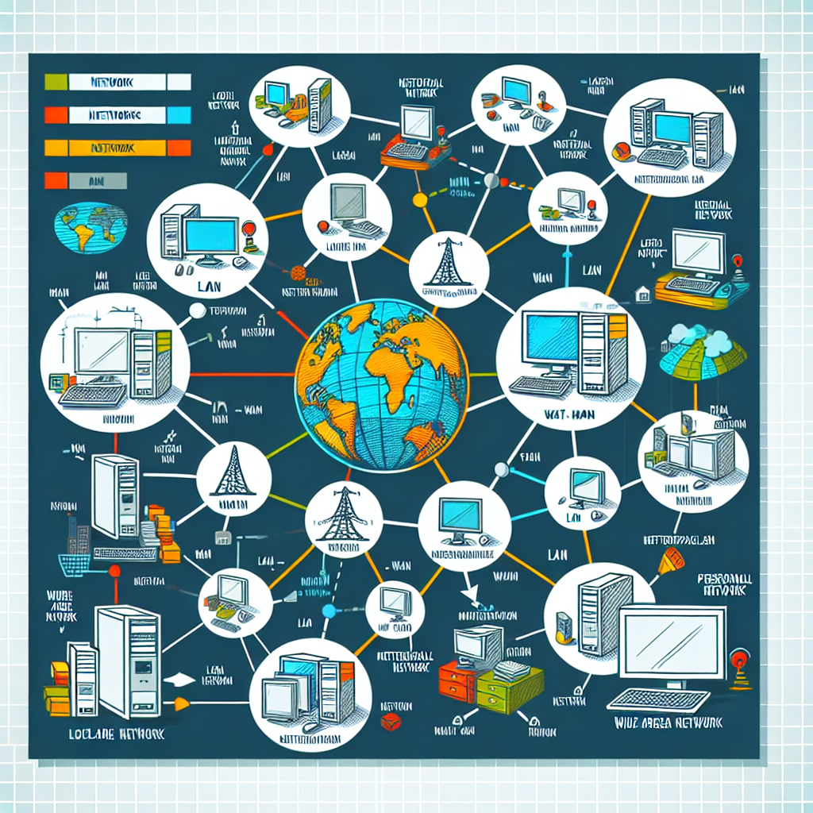
Types of Computer Networks
There are several types of computer networks, each catering to specific needs and requirements:
1. Local Area Network (LAN): A LAN connects devices within a limited area, such as a home, office, or building.
2. Wide Area Network (WAN): A WAN spans a larger geographical area, connecting multiple LANs and enabling long-distance communication.
3. Metropolitan Area Network (MAN): A MAN covers a city or metropolitan area, linking multiple LANs.
4. Personal Area Network (PAN): A PAN is a network used for personal devices, such as smartphones and tablets, to communicate with each other.
Types of Computer Networks

Slide 5
Network Topologies
Network topologies refer to the physical or logical arrangement of devices and connections in a computer network.
Some common network topologies include:
- Bus Topology: All devices are connected to a single cable, called a bus. Data is transmitted in a linear fashion.
- Star Topology: All devices are connected to a central hub or switch. Data is transmitted through the hub.
- Ring Topology: Devices are connected in a circular manner, forming a closed loop. Data is transmitted in one direction.

Slide 6
Network Protocols
Network protocols are a set of rules and standards that define how devices communicate and exchange data in a computer network.
Some commonly used network protocols include:
- TCP/IP (Transmission Control Protocol/Internet Protocol): The foundation of the internet, TCP/IP ensures reliable and secure data transmission across networks.
- HTTP (Hypertext Transfer Protocol): HTTP is used for transmitting web pages and resources over the internet.
- SMTP (Simple Mail Transfer Protocol): SMTP is responsible for sending and receiving emails over a network.

Slide 7

Network Security
Network security is a critical aspect of computer networks, ensuring the protection of data and systems against unauthorized access and attacks.
Some key network security measures include:
- Firewalls: Firewalls act as a barrier between a network and external threats, filtering incoming and outgoing traffic.
- Encryption: Encryption techniques are used to secure data transmission and prevent unauthorized interception and access.
- Access Control: Access control mechanisms, such as passwords and user authentication, restrict network access to authorized users.
Network Security

Slide 8
Network Hardware
Network hardware refers to the physical components that are used to build and connect devices in a computer network.
Some common network hardware includes:
- Routers: Routers are devices that forward data packets between networks, enabling communication between devices in different networks.
- Switches: Switches connect devices within a network, allowing them to communicate with each other.
- Network Cables: Ethernet cables are used to establish physical connections between devices in a network.

Slide 9
Network Troubleshooting
Network troubleshooting involves identifying and resolving issues that can occur in computer networks.
Some common network troubleshooting techniques include:
- Ping: The ping command is used to test network connectivity and measure the round trip time of packets.
- Traceroute: Traceroute helps identify the route that packets take from the source to the destination, revealing potential network issues.
- Resetting Network Devices: Power cycling or resetting network devices can help resolve temporary network issues.

Slide 10
Emerging Trends in Computer Networks
Computer networks continue to evolve, driven by emerging technologies and new requirements.
Some emerging trends in computer networks include:
- Internet of Things (IoT): IoT networks connect and enable communication between physical devices, leading to increased automation and connectivity.
- 5G and Beyond: 5G networks promise faster speeds and lower latency, unlocking new possibilities for applications and services.
- Software-Defined Networking (SDN): SDN separates the network control plane from the data plane, allowing more flexible and programmable network management.

Slide 11
Conclusion
In conclusion, computer networks are essential for modern communication and data sharing.
They enable us to connect and collaborate with others, access information, and perform various tasks.
As technology continues to advance, computer networks will play an increasingly integral role in our lives, supporting new applications and driving innovation.

Slide 12
References
1. Kurose, J. F., & Ross, K. W. (2021). Computer Networking: A Top-Down Approach. Pearson.
2. Tanenbaum, A. S., & Wetherall, D. J. (2011). Computer Networks. Pearson.

Slide 13
Thank You
Thank you for your attention!
Any questions?

