Slide 1
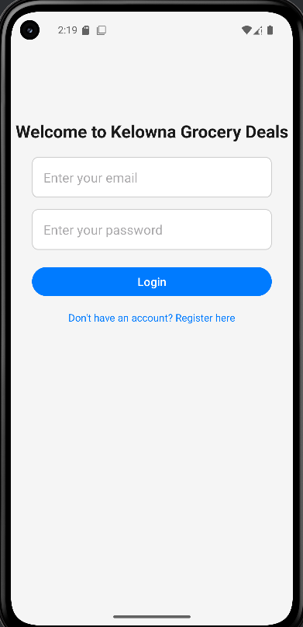
Group 22 - Kelowna grocery deals
Presentation
Naman Arora
Misha Gavura
Ritvik Khurana
Luis Wen
November 6, 2024

Slide 2
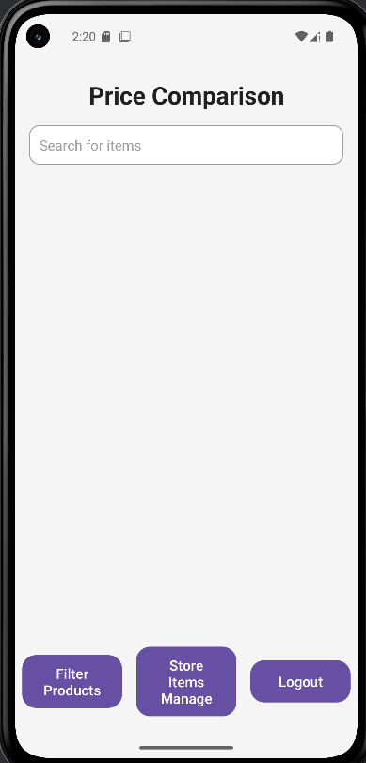
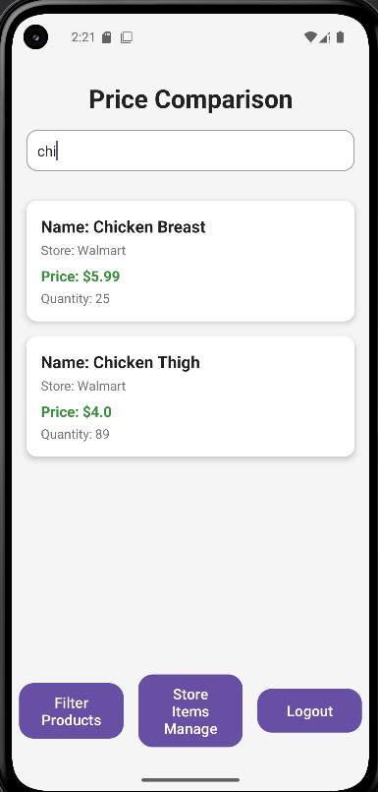
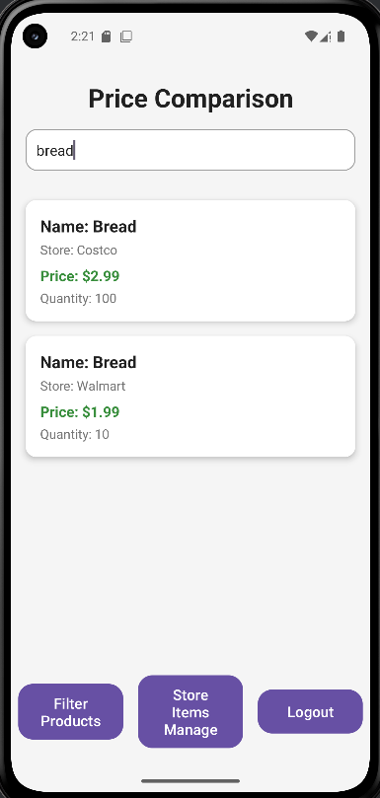
Task 1 - Price Comparison
Allow users to search for a product and view comparative prices across various stores. This task focuses on helping users quickly see the best prices.

Slide 3
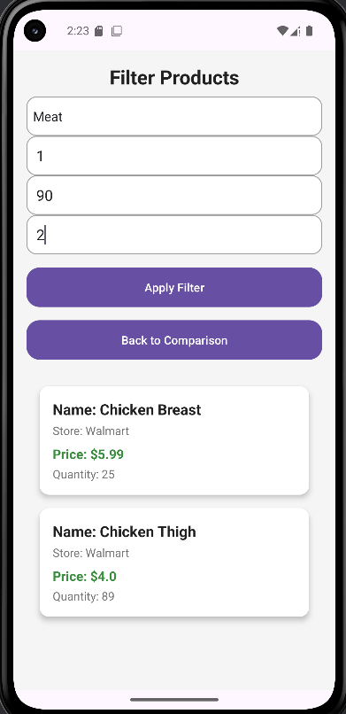
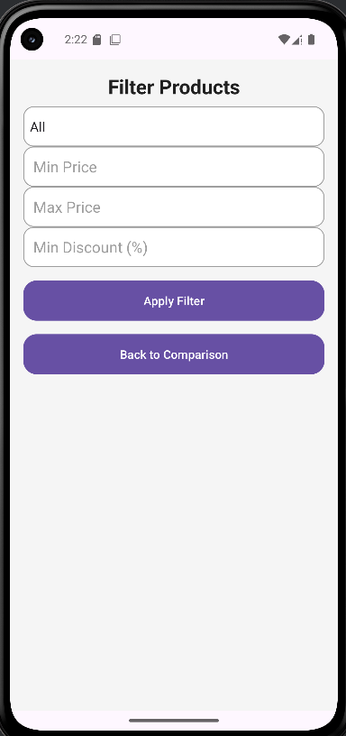
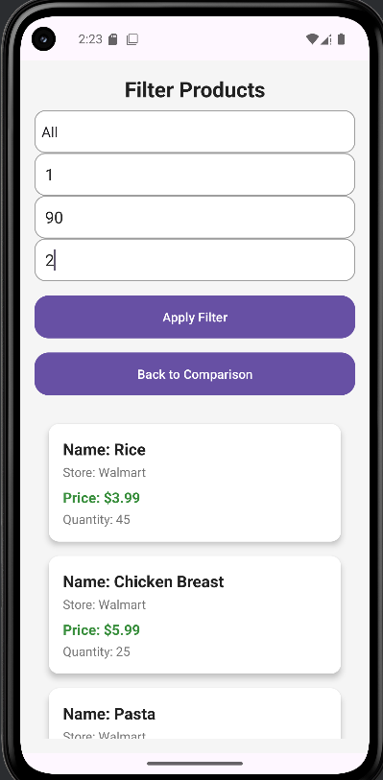
Task 2 - Filtering
Enable users to filter items by criteria such as category, discount percentage, lowest price, and maximum price.

Slide 4
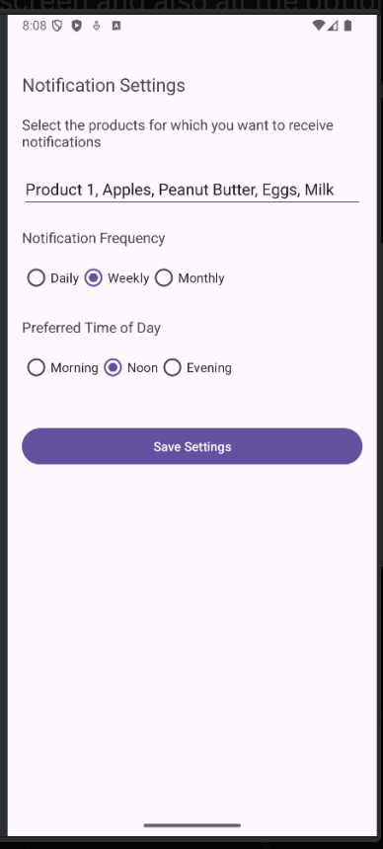
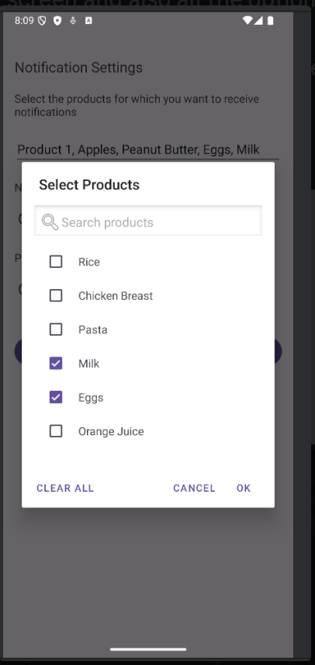
Task 3 - Notification Setup Screen
Users can select specific items or categories to follow for deals and set frequency preferences for notifications.

Slide 5
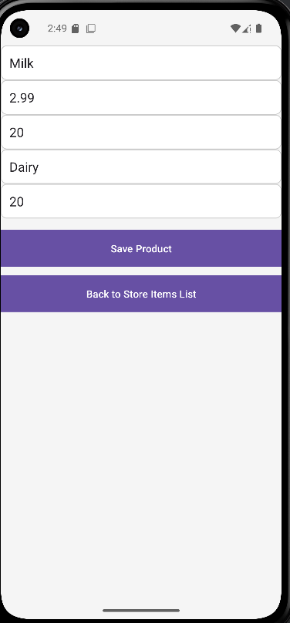
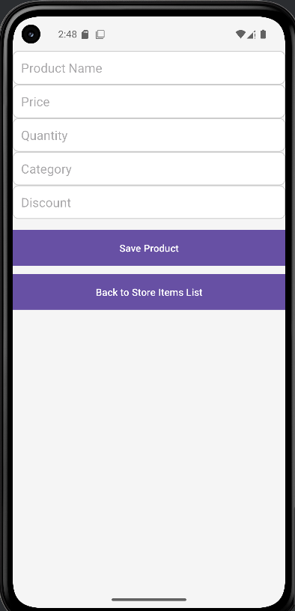
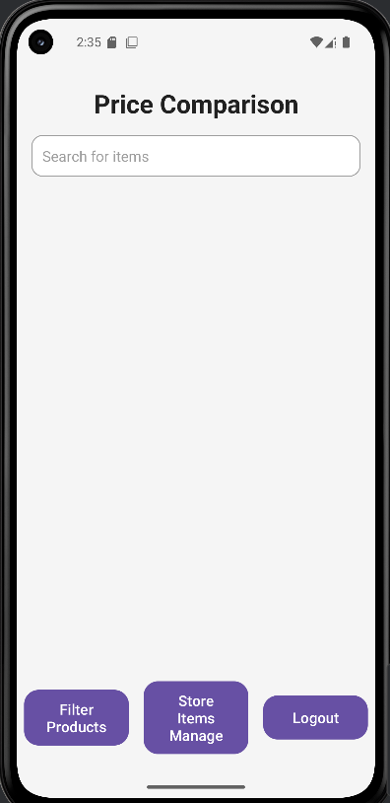
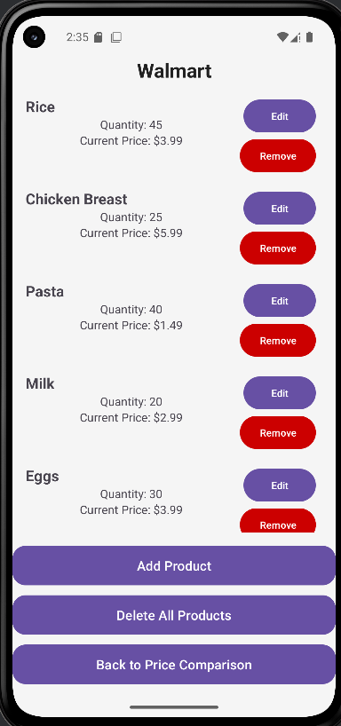
Task 4 - Store Inventory Updates
This task is designed for store managers, allowing them to easily update their store’s inventory and pricing in real-time.

Slide 6
Demo of prototype
https://youtu.be/rxu4KICLqac

Slide 7
Heuristic evaluations
Recognition Rather Than Recall
Missing visual cues or icons to ease usage
Consistency and Standards
Consistent design throughout the app
Help and Documentation
Lack of helpful information that indicates how the interface works
Error Prevention
Minimize the chances of users making mistakes

Slide 8
Q&A

