Slide 1

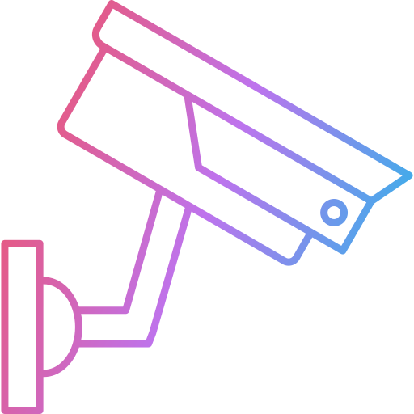
Video Surveillance System: Anomaly Detection
TOPIC

Slide 2




About the project
There are all kinds of video surveillance systems, and each one is designed for a given environment having features suited to that particular area. Such areas include, commercial use, private household use, corporate use, military use, and personal security/theft. Through technological advancements these systems have become a major lifeline for all fields, not only in general security, but in safety measures as well.
Commercial
Household
Corporate
Military

Slide 3



About the project
Given the very broad scope of video anomaly detection, choosing to focus on one of these fields allows a more defined audience and features that should be implemented. Choosing a commercial focus, the design will need to handle warehouse or construction type anomalies, from theft protection, to label/facial recognition, and low-light detection.

Slide 4
7 Major Features
1
Ability to remotely access the video footage
2
Video enhancement capabilities ( Night Vision, HD Resolution, etc. )
3
Object Detection
4
Facial Recognition
5
Ability to capture greater field of view using a wide-lens camera
6
Backup storage using a standard database
7
Weather Resistence

Slide 5

Mentcare: A healthcare support system
CASE STUDY

Slide 6



About the case study
Mentcare is a secondary-safety critical system that is responsible for transcribing details of doctor-patient consultations and generate accurate letters and reports based on the information recorded. It also ensures that laws in relation to mental health are obeyed by the staff treating the patients.

Slide 7
How does this relate to our project?
One aspect that is found common in both the topic of our research and the case study is the “lack of trust”. This can be attributed to the inaccuracies caused by human error, which results in incorrect data being collected by the system. This issue can be solved by additional supervision of the data collected and by making the required changes. The Mentcare system is prone to inaccuracy in data by human error in forms of unclear speech, poor recording conditions, overlapping of voices etc. This is solved by verifying the contents of the final generated transcript, doctors and patients can mutually agree on the statements produced. Similarly, our Video Surveillance system may also suffer from human/environmental/technical error in forms of improper camera vision/resolution , poor weather conditions etc. To resolve this, a secondary system will be put in place to cross reference the data recorded by the VS system to verify accuracy of data. Examples of this include an air quality measurement tool paired with a system to detect gas leak anomalies with an IR camera, or a motion detector paired with a standard camera to detect trespassing on private property.

Slide 8
Credits
Case study analysis - Sam Walters
Project writeup – Brendan Michaud
Video script & presentation – Suyash Aminbhavi
Images used
Designed by Freepik

