Slide 1
Contributions
Tryingtograduate Memebers: Kristal Bledsoe & Josh Peck

Slide 2
Project Manager
Leadership
Decision Making
Delegation
Scheduling
Follow-up
Group Communications

Slide 3
Design
Collaboration on website STRUCTURE
Number of pages on the site.
How each page interacts with the user and database.
Collaboration on website AESTHETICS
Continuity of color, font, buttons, location, and functionality.
Intuitive navigation and ease of use.
Collaboration on project ARCHITECTURE
Input on design of our project as a whole.
Tyler presenting detail.

Slide 4
Code Dashboard & Collaboration on Homepage
HTML (Front End)
Used to build our website from scratch.
Raw text areas, buttons, forms, headers, tables, etc…
CSS
Used to give life to the raw html code.
Allows for visually pleasing webpage design.
Javascript
Mostly used to hide and display html forms.
PHP (Intermediary)
Used to establish a connection to our database.
Passes information from our database to PHP then outputs with HTML
SQL (Back End)
Used by PHP to query our database to add, remove, update, or get information.

Slide 5
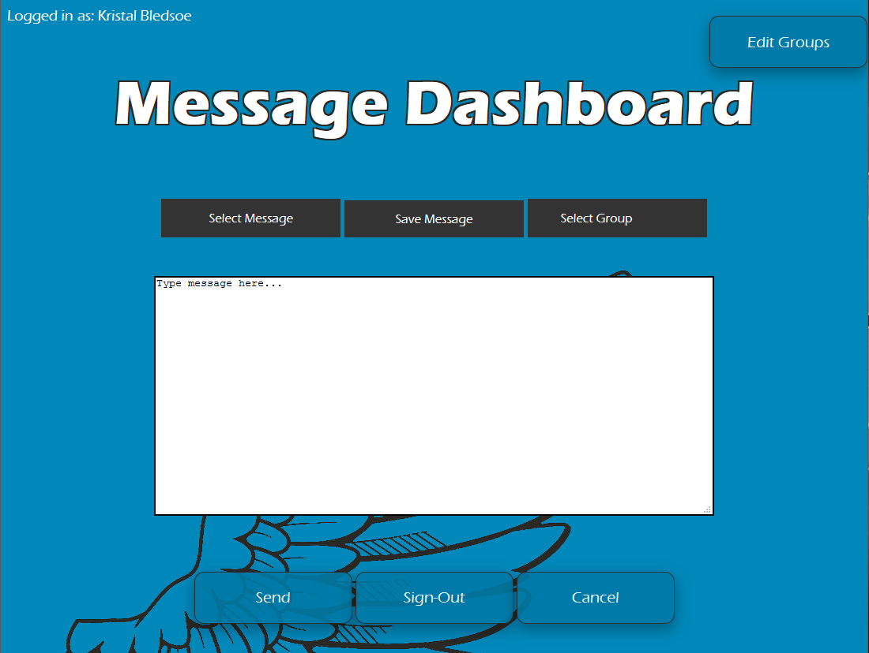
Main Focus

Slide 6
Josh Peck

