Slide 1

Hyperparameter Optimization in Machine Learning
Iran Izadyari
Practical Machine Learning
Dr. Lars Kotthoff
Spring 2024

Slide 2
Objective
Determine the best ML algorithm and hyperparameter setting at the same time for the “winequality-red” dataset

Slide 3
Problem Statement
Challenge: Hyperparameters significantly impact the performance of ML models. However, finding optimal settings is often a complex and computationally expensive task.
Necessity for advanced techniques: An advanced optimization technique, namely Bayesian optimization, to find optimum hyperparameters faster and more efficiently than traditional methods.

Slide 4
Dataset & Pre-processing
Dataset overview: The "winequality-red" dataset includes 1,599 different red wine samples and 11 features for each sample
Target feature: quality rating as the target variable on a scale of 0 -10.
Data splitting: 80% training and 20% testing, stratified by wine quality to maintain uniform distribution.
Preprocessing step:
Log transformation to reduce skewness in features such as residual sugar and free sulfur dioxide
Standard scaling to ensure features contribute equally to the model's learning process

Slide 5
Methodology
Programming tools: Utilized Python with libraries such as Pandas for data handling, Scikit-learn for model implementation, Scikit-optimize for performing Bayesian optimization, etc.
Model selection:
Random Forest
SVM
Logistic Regression
Hyperparameter tuning technique:
Bayesian optimization via the 'BayesSearchCV' interface with random states of 24 and 42
Ten iterations of hyperparameter adjustments
5-fold cross-validation framework

Slide 6
Results : Adjusted Hyperparameter
Classifier | Parameter | Default value | Range explored | Tuned value
Random Forest | n_estimators | 100 | 100 to 500 | 300
 | max_depth | None | 10 to 50 | 30
 | min_samples_split | 2 | 2 to 10 | 4
Support Vector Machine (SVM) | C | 1.0 | 0.1 to 10 | 5.0
 | gamma | 'scale' | ['scale', 'auto'] | 'auto'
Logistic Regression | C | 1.0 | 0.1 to 10 | 2.5

Slide 7
Results: Accuracy Scores
Initial Findings: Random Forest initially outperformed SVM and Logistic Regression in terms of mean cross-validation accuracy.
Improvements in accuracy:
Random Forest: Showed the highest baseline performance and maintained superiority post-tuning
SVM: Exhibited the greatest improvement post-tuning, making it competitive with Random Forest
Logistic Regression: Slight improvement in training, but a decrease in test accuracy, indicating potential limitations in hyperparameter selection or model fit for the dataset.
Classifier |  |  |  |  | Improvement on test accuracy (%)
 | Default – training | Tuned – training | Default – test | Tuned – test
Random Forest | 0.6779 | 0.6873 | 0.6469 | 0.6656 | +0.0188 (2.9)
Logistic Regression | 0.6044 | 0.6076 | 0.5719 | 0.5625 | -0.0094 (-1.6)
SVM | 0.5943 | 0.6216 | 0.5750 | 0.6094 | +0.0344 (6.0)

Slide 8
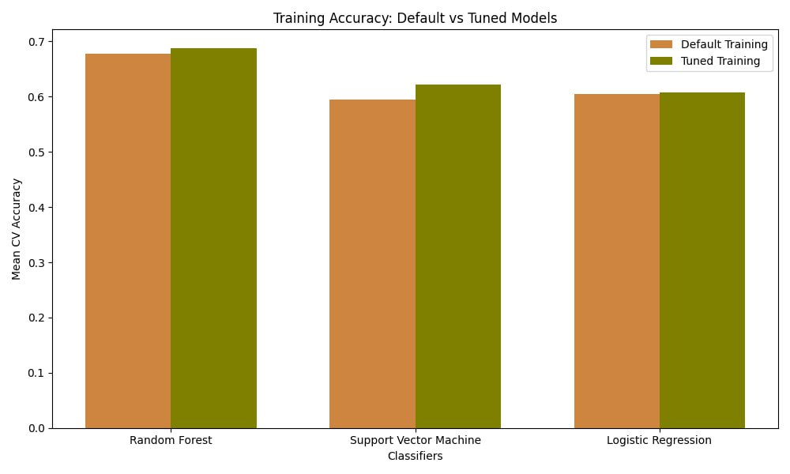
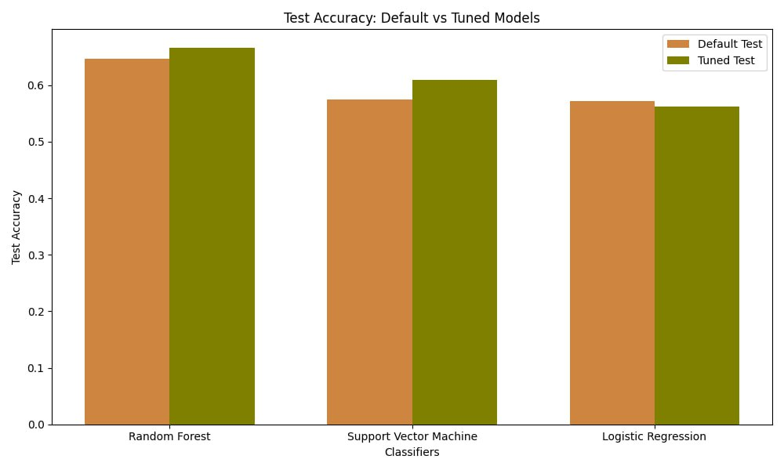
Results: Accuracy Scores

Slide 9
Further Analysis
Hyperparameter tuning for the “Logistic Regression” method resulted in a negative effect on test accuracy:
Preprocessing: simplify preprocessing: (i) no preprocessing; and (ii) only scaling – None of them showed positive outcomes
Impact of random state: Modifying the random state from 42 to 24 – Positive result was obtained
Hyperparameter optimization with a random state of 24
Classifier |  |  |  |  | Improvement on test accuracy (%)
 | Default – training | Tuned – training | Default – test | Tuned – test
Random Forest | 0.6802 | 0.6927 | 0.6469 | 0.6500 | +0.0031 (0.46)
Logistic Regression | 0.5934 | 0.6177 | 0.5781 | 0.5813 | +0.0031 (0.48)
SVM | 0.5943 | 0.6177 | 0.5563 | 0.6031 | +0.0469 (8.4)

Slide 10
Conclusions
The study highlighted that hyperparameter optimization improved the performance of ML models
Training accuracy was improved in all cases at any random state
Random Forest outperformed other models before and after hyperparameter optimization
We observed a better improvement in test accuracy for SVM at random state = 42, whereas the Logistic Regression was improved at a random state =24

Slide 11
References
Domingos, P. "A few useful things to know about machine learning." Communications of the ACM.
Kim, D., Koo, J., & Kim, U.-M. "A Survey on Automated Machine Learning." HCI International Conference Proceedings.
"A Comprehensive Guide on Hyperparameter Tuning and its Techniques." Analytics Vidhya.

Slide 12
Middle Bakken
Three Forks
Thank you!

