Slide 1
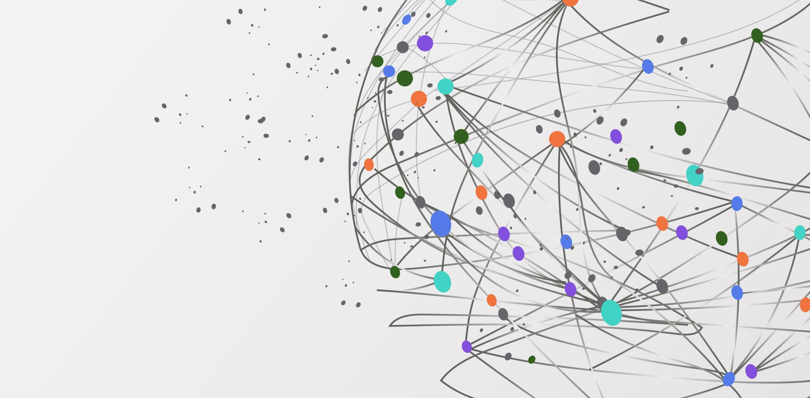
COSCRAD
Powering a web of knowledge

Slide 2
COSCRAD
Collaboration of
Open
Source
Cultural
Research
Application
Developers

Slide 3
Command Based Interface
Each updates is
Intentional
Fine Grained
Reflect actions taken in the domain
Captured in an audit log via an event history

Slide 4
web of knowledge
Resources
Notes
Context
Tags
Graph!

Slide 5
Resources
A Resource is a Node in the graph that is the web of knowledge
Terms
Vocabulary Lists
Songs
Digital Texts
Bibliographic Citations
Spatial Features

Slide 6
Notes
A note can be a
Summarizing Note
Contextualizing Note
A note is an edge in the graph that comprises the web of knowledge

Slide 7
Context
Context is key
Otherwise, we just have hyperlinks and the world wide web
Example A summarizing note, “This is where the final battle is described.”, about `digital-text/123` might have the following context:
type: “page range”, page-range: [“44”,”45”,”47”]

Slide 8
Connections with Context
Example 2 A connecting note, “This passage of the book inspired the scene in the video.”, connecting `digital-text/123` to might have the following context:
member: `digital-text/123`
type: “page range”, page-range: [“44”,”45”,”47”]
,
member: `video/11`
type: “time range”, time-range: { inMs: 1200, outMs: 3255 }

Slide 9
Tags
Resources and Notes can be tagged
This allows us to filter queries
Including graph traversal queries
A tag + resource type combo can be used to create multiple pseudo resource types on the client side

Slide 10
Graph
Collectively, these elements form a graph
In the UX, the user traverses this graph via:
Index to detail flow
Summary Notes Panel
Connections Panel

