Slide 1
Mitosis Simulation in Unity
Ethan Hicks, Rachel Reed, Forrest Sable
CS340 23 April 2018

Slide 2


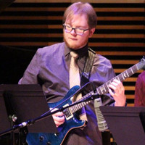
Meet the Team
Ethan Hicks:
-Junior in CS Dept.
-Has worked with Unity before
-Semi-Pro gamer in Paladins
Rachel Reed:
-Senior in CS Dept.
-Has used Github extensively
-Does yoga at 5am
Forrest Sable:
-Senior in CS Dept.
-Has developed games in Unity and with Blender
-Has a double major in Jazz

Slide 3
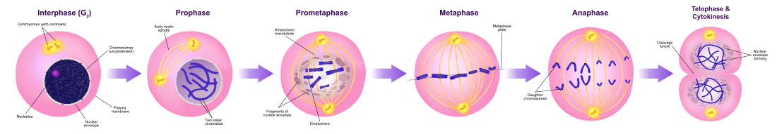
Project Overview
Our team has decided to implement a virtual biology simulation of the mitosis process.
Mitosis is the division and replication of cells.
Our team used the game engine Unity.
Why does it matter?

Slide 4


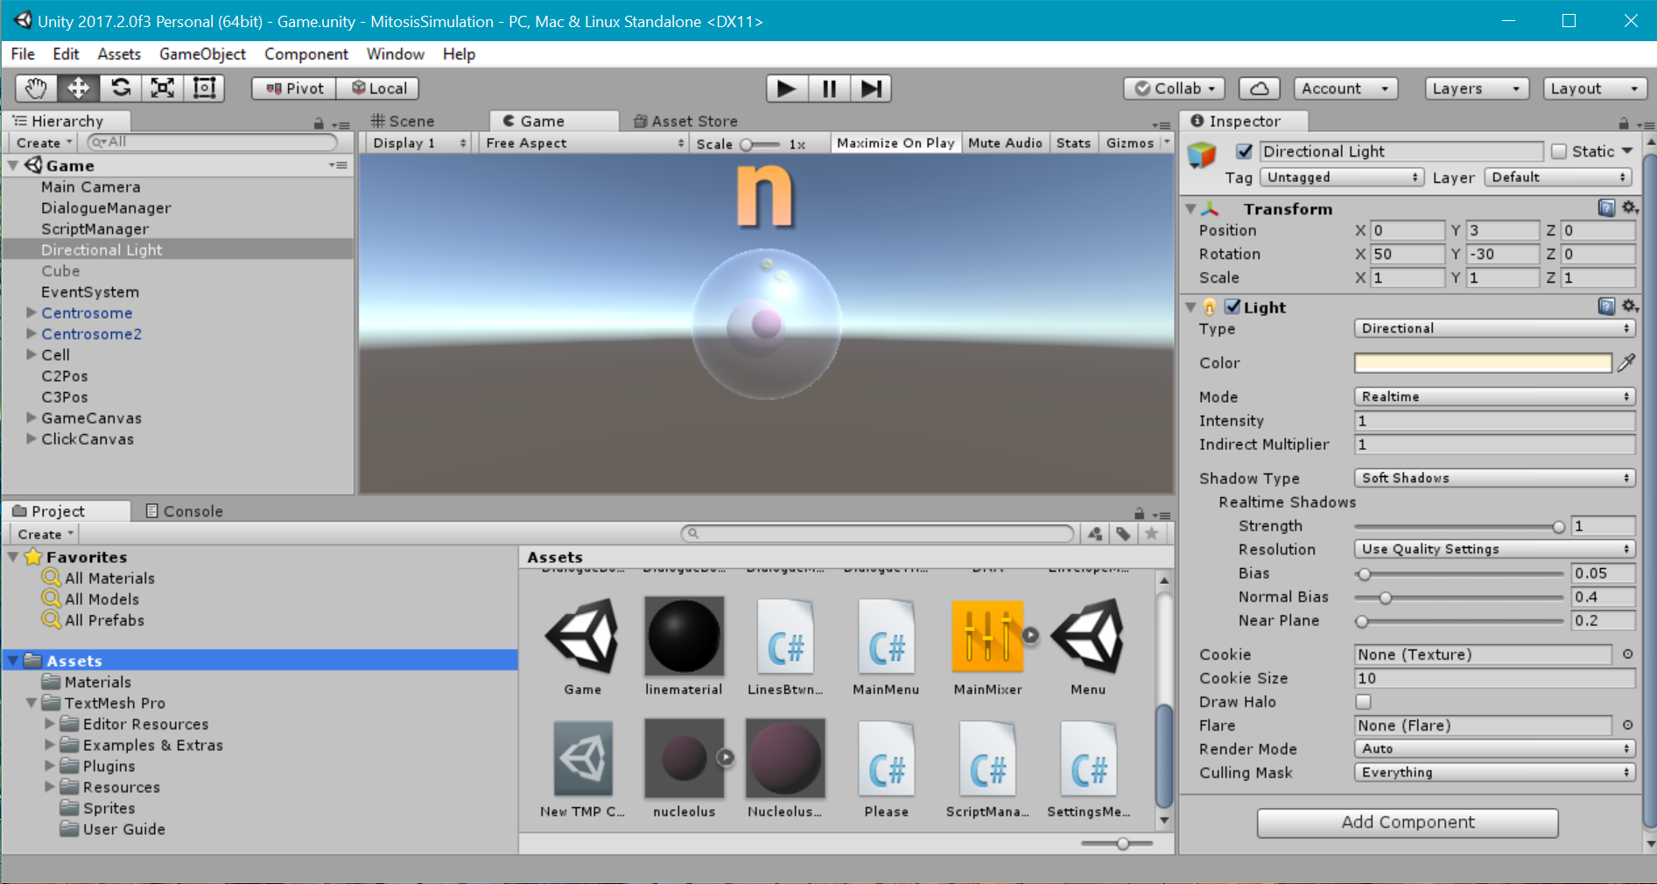


Technology Used

Slide 5
Project Timeline
Sprint #1
Create a finite state machine
Model organelles
Create text for describing cell process
Sprint #2
Model different mitosis stages
Create main menu
Implement text boxes
Sprint #3
Implement interactive clicking of organelles
Start animations
Final Sprint
Fix text box bug
Finish final animations
Create project presentation and final report

Slide 6
Challenges
Challenges
Unity and Github (is a love hate relationship)
Scenes and merging branches
Unity Teams is the way to go but it cost money.
free trial for only 30 days
My laptop (Ethan’s)
5 years old at least

Slide 7
Changes and Future Directions
What We Would Have Done Differently:
Used Unity Teams
Future Contributions:
Add music to the simulation
Implement more biology scenarios
Add a “text-to-talk” option for interactions

Slide 8
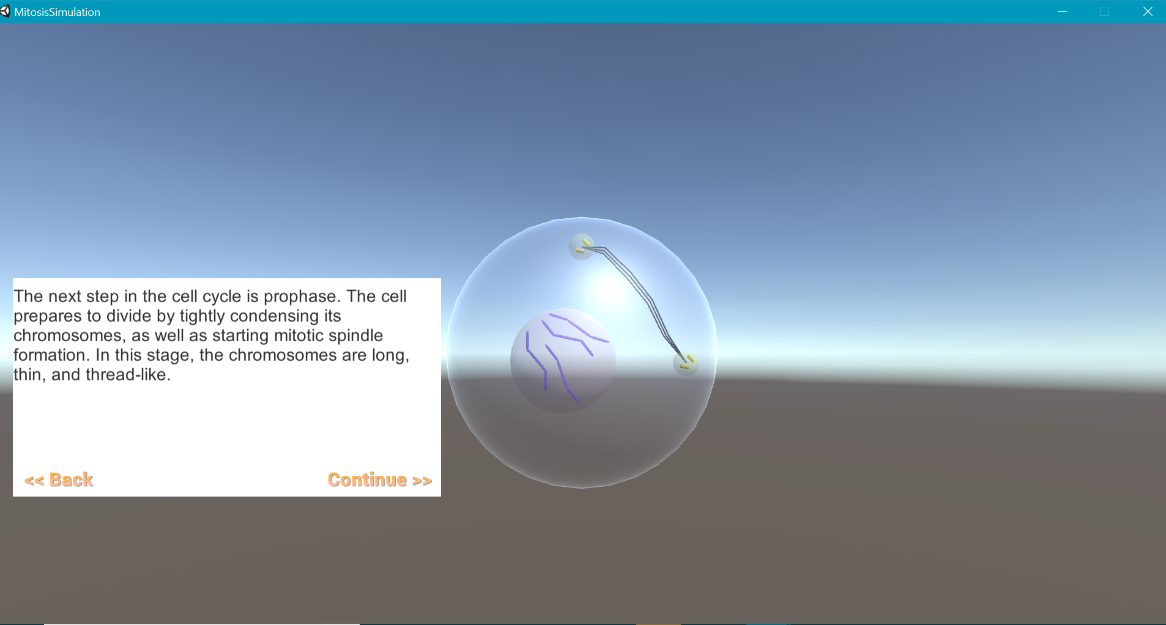
Thank You
That concludes our presentation. Any Questions?

