Slide 1
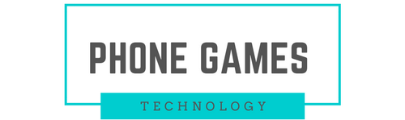
Phone Games
Jerry Duncan, Howard Choi, Cameron O’Neill and Preston Provins

Slide 2
What is Phone Games?
A project to modernize traditional table top games!
User Logs In
Repeat users can create a personal account
User Joins Lobby
User Creates a Lobby
Lobby Plays Game
From preset games, individuals can play together
Other users join using access code
Anyone can play Anonymously

Slide 3
Technology, Libraries, Languages
Meteor
CSS
HTML
.JS
Mongo DB
App Engine (Server)
VM (Database)
Client
Language and Libraries Used to implement Phone Games
Google Cloud Services used to Deploy Phone Games

Slide 4
Join us online!
Open your favorite browser, go to:
https://glass-tide.appspot.com/
Feel free to play a game with someone else, or join our lobby!

Slide 5
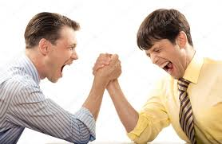

Project Difficulties
UI
Utility
Mobile Formatting
Database
Publishing
Subscribing
Game Design
Multiplayer
Polishing
Causes:
Familiarity
Planning
Testing
Communication

Slide 6
What would we implement next?
Beautify the Project
Fix UI Scaling
Make Game Content more Appealing
Add Further Utility to User Profile
Friends List
High Scores
Add “Sandbox” Games
Allow users to create new games from given tools
Allow users to share new games with others

