Slide 1
An Access Point That Moves
- 3G AP
Edward Ping-Da Chuang
edwardchuang@gmail.com

Slide 2
Agenda
Commercial Product
Open Source Solution
Further Application

Slide 3
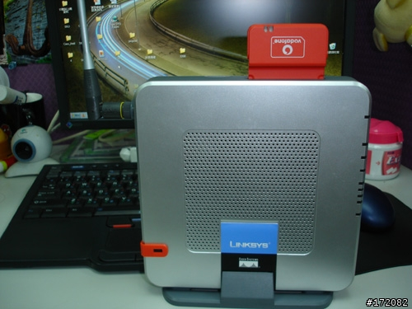
Commercial Product (1/4)
Linksys – WRT54G3G

Slide 4
Commercial Product (2/4)
BCM4712 integrated network processor
4 ports switching hub
Support limited 3G/UMTS NIC
OpenWRT (http://openwrt.org) have several hack for additional function
3.5G is support by particular firmware and T-Mobile/Vodafone 3.5G card

Slide 5
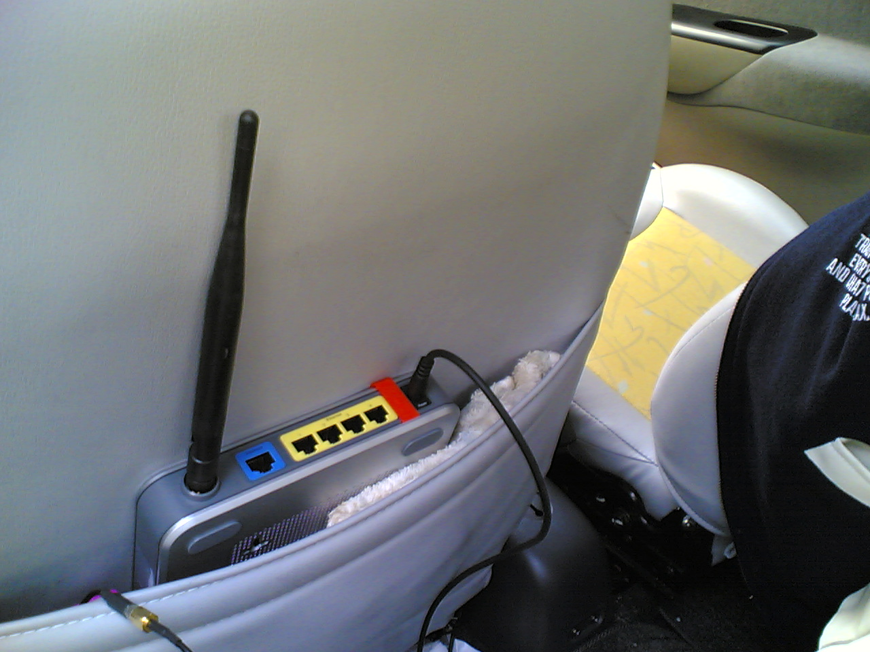
Commercial Product (3/4)
Mobilized Application (credit: Custom)
In-car power
adapter

Slide 6
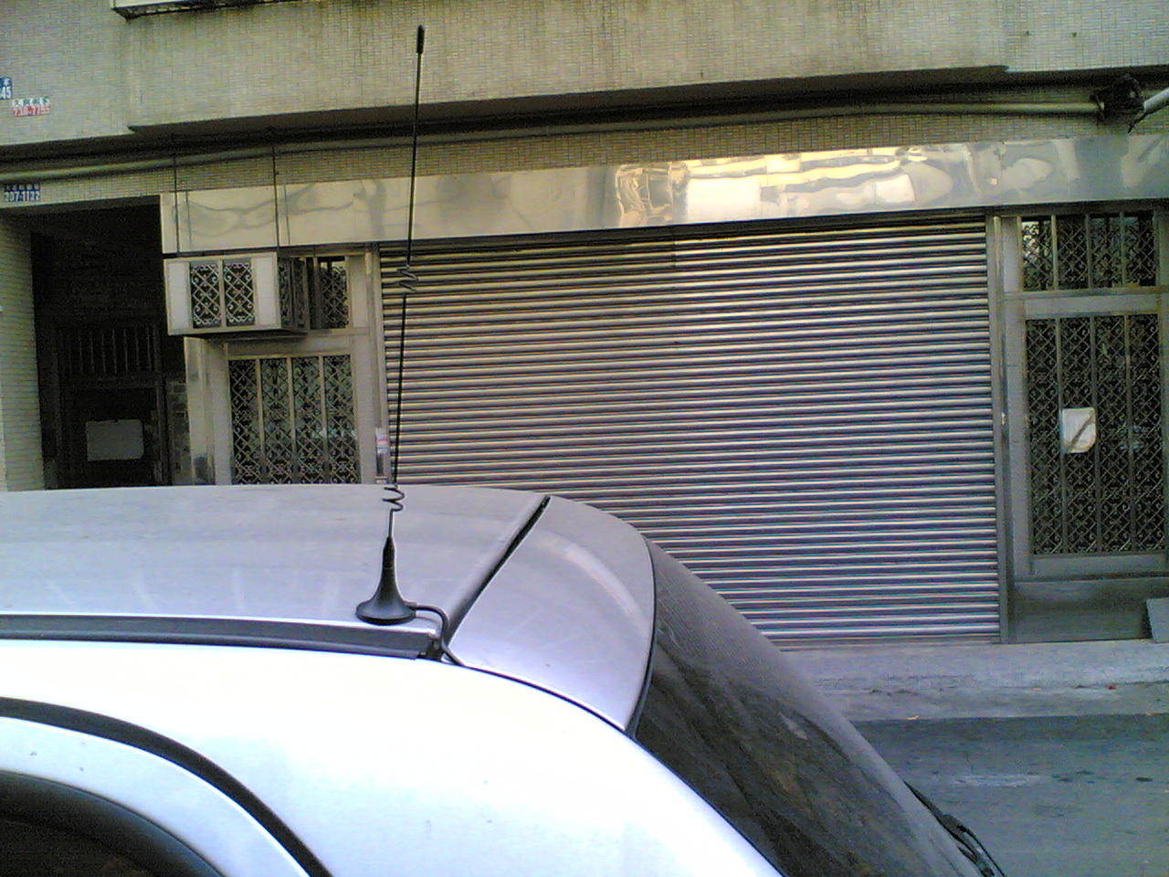
Commercial Product (4/4)
Mobilized Application (cont.)
Extensible
high-gain
antenna

Slide 7
Open Source Solution (1/2)
MobiWall – A variant of m0n0wall
Software aspect
  A middle ware and wrap-up for 3G/3.5G NIC operation
  Most of works are done by AT-command set
Hardware aspect
  Soekris NET-4521 Single Board Computer
  2 cardbus slot, one for WiFi, one for 3G

Slide 8
Open Source Solution (2/2)
Tested 3G NIC on MobiWall prototype
  Fusion/Option (GlobalTrotter) UMTS
  Fusion/Option (GlobalTrotter 3G+) 3.5G
  Sierra AC850 3.5G

Slide 9
Further Application
Provide wireless connectivity on mobile vehicles is possible
Open source solution can also put more flexible on development and deployment issue

Slide 10
Q&A

