Slide 1
Tuning Apache/MySQL/PHP
slzzp@slzzp.tw
COSCUP
2006/10/28
General Pudding Licence (請我吃布丁吧)
Non-Commercial Use

Slide 2
Outline
Simple Tuning Apache/MySQL/PHP
冗 in PHP code
贅 in SQL command
肥 in data set
External Tuning Apache/MySQL/PHP
Q&A

Slide 3
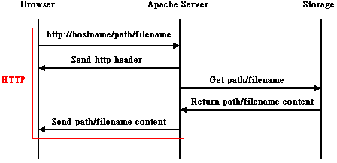
Apache – Static pages

Slide 4
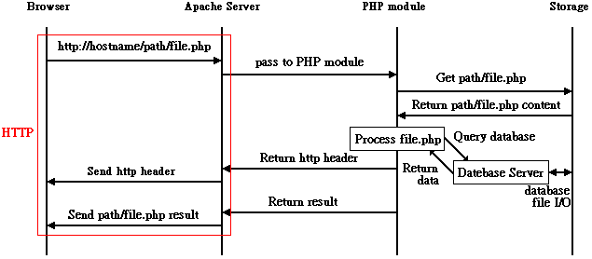
Apache – Dynamic Pages

Slide 5
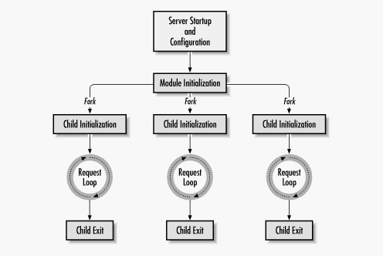
Apache – Life Cycle

Slide 6
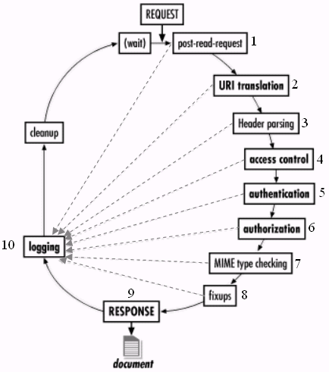
Apache – Request Loop

Slide 7
Apache – Tuning in httpd.conf (1)
MinSpareServers
  待命中的子程序的最小數量
MaxSpareServers
  待命中的子程序的最大數量
StartServers
  啟動時pre-fork指定數量的子程序
MaxClients
  同時間內最多能服務的連線數量

Slide 8
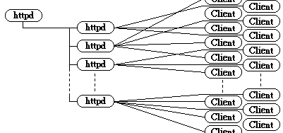
Apache – Tuning in httpd.conf (2)
StartServers
pre-fork
MinSpareServers
MaxSpareServers
MaxClients

Slide 9
Apache – Tuning in httpd.conf (3)
Remove useless module
  diet httpd memory size
VirtualHost / ErrorLog & CustomLog
  for Log Analysis
  Log file rotate(+gzip) faster

Slide 10
MySQL – Tuning (1)
Use my.cnf
  my-medium.cnf (128M)
  my-large.cnf (512M)
  my-huge.cnf (1G-2G)
  my-Custom.cnf (?)

Slide 11
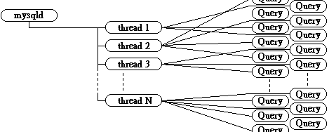
MySQL – Tuning (2)
Environment
  build with WITH_LINUXTHREADS (FreeBSD)
  Running on Linux, threading & file system

Slide 12
PHP - Tuning
Apache Module & CGI
  Less memory usage
Different CGI/CLI
  extensions.ini -> no different (FreeBSD)
Nothing to do?
  See Next Slide……

Slide 13
冗 in PHP code (1)
if ( isset($_GET[‘do_a’]))
{ N1 lines code; }
if ( isset($_GET[‘do_b’]))
{ N2 lines code; }
if ( isset($_GET[‘do_c’]))
{ N3 lines code; }
……………;
syntax check lines
L = N1+N2+N3+……
每次只執行其中一部分。
if ( isset($_GET[‘do_a’]))
{ require(‘do_a.php’); }
if ( isset($_GET[‘do_b’]))
{ require(‘do_b.php’); }
if ( isset($_GET[‘do_c’]))
{ require(‘do_c.php’); }
……………;
syntax check lines
L = 1+1+1+……
需要的部分才載入來執行。

Slide 14
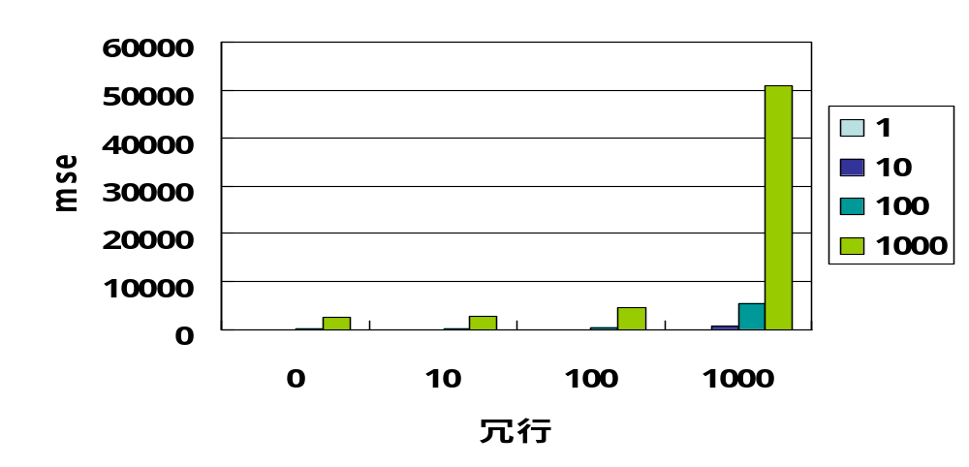
冗 in PHP code (2)

Slide 15
冗 in PHP code (3)
實際案例：futaba的imgboard.php
  單獨一隻PHP程式 (v0.8 lot.031015, 約1130行)
  瀏覽模式：0 (會產生 static html file使用)
  更新靜態檔案：執行約460行
  主題瀏覽模式：執行約380行
  上傳檔案：執行約930行
  使用者刪除檔案：執行約560行
  管理者瀏覽模式：執行約280行
  管理者刪除檔案：執行約760行

Slide 16
贅 in SQL command (1)
SELECT * FROM cddb JOIN composer; // m x n
if ( $cddb[‘cddb_id’] == 1 && $cddb[‘composer_id’] == 2)
echo( $cddb[‘composer_name’] );
SELECT * FROM cddb // O(m x n)
LEFT JOIN composer
ON composer.composer_id=cddb.composer_id;
if ( $cddb[‘cddb_id’] == 1 ) echo( $cddb[‘composer_name’] );
SELECT * FROM composer; // n
SELECT * FROM cddb; // m
if ( $cddb[‘cddb_id’] == 1 ) echo( $composer[$cddb[‘composer_id’]][‘name’] );

Slide 17
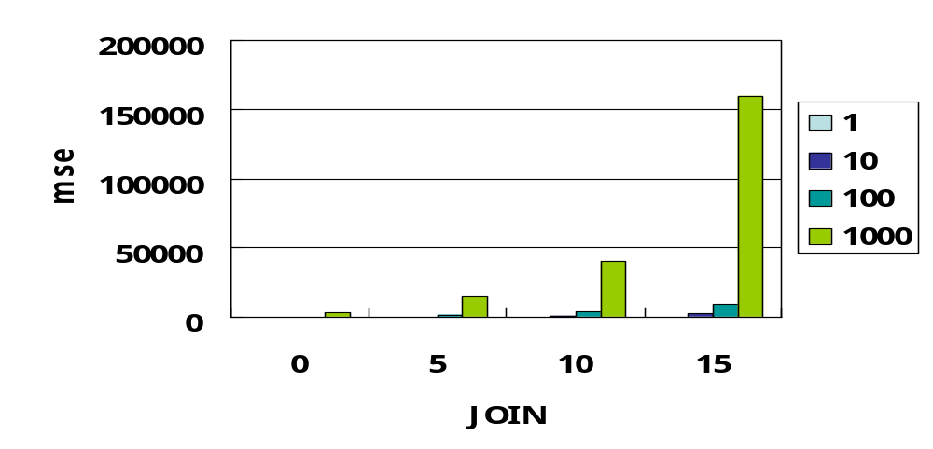
贅 in SQL command (2)

Slide 18
肥 in data set (1)
qid set index, O(log N) for select 1
SELECT * FROM Q500
WHERE qid IN (1,4,8,10,…); // select 50
-> 50 * O(log 500)
SELECT * FROM Q1M
WHERE qid IN (1,4,8,10,…); // select 50
-> 50 * O(log1000000)

Slide 19
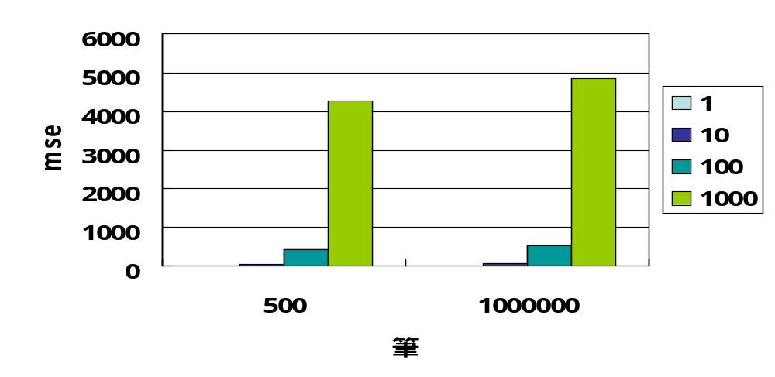
肥 in data set (2)

Slide 20
External Tuning - Apache
httpd.conf: MaxClients MAX value 512 ?
kqueue (FreeBSD)
Redirect to thttpd / lighttpd
  For static files

Slide 21
External Tuning - MySQL
Use the Money
  Powerful CPU, more CPU/HT/Core
  Much more RAM
  Faster I/O Storage

Slide 22

External Tuning - PHP
Operation/Object Code Improvement
  Zend Optimizer (www.zend.com)
  Turck-MMCache (SourceForge.net)
Data cache
  Memcached (www.danga.com)

Slide 23
Finally…
Q&A
(有問不一定有答)
(有答不一定正確)

Slide 24
The END
Thank You
提醒您：使用ab測試網站前請先告知網站的管理者，
不要像某名小站一樣無禮、強辯又曝露自己的無能。

