Slide 1
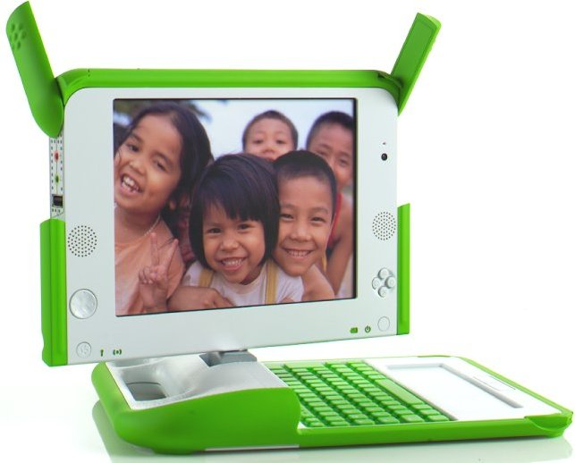
One Laptop Per Child
Giving Millions of Children
Access to Their Dreams

Slide 2
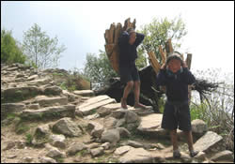
We Do Not Want to Build Laptops
We want to educate children
75 million with
No School

Slide 3
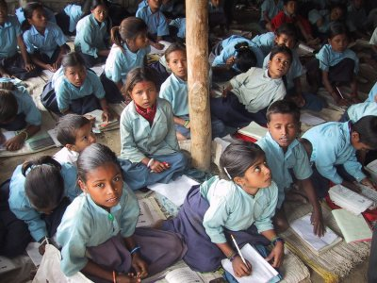
What's Missing?
Textbooks, Libraries, Desks, Paper, Electricity, Plumbing, Lights, Teachers
~$20/year

Slide 4
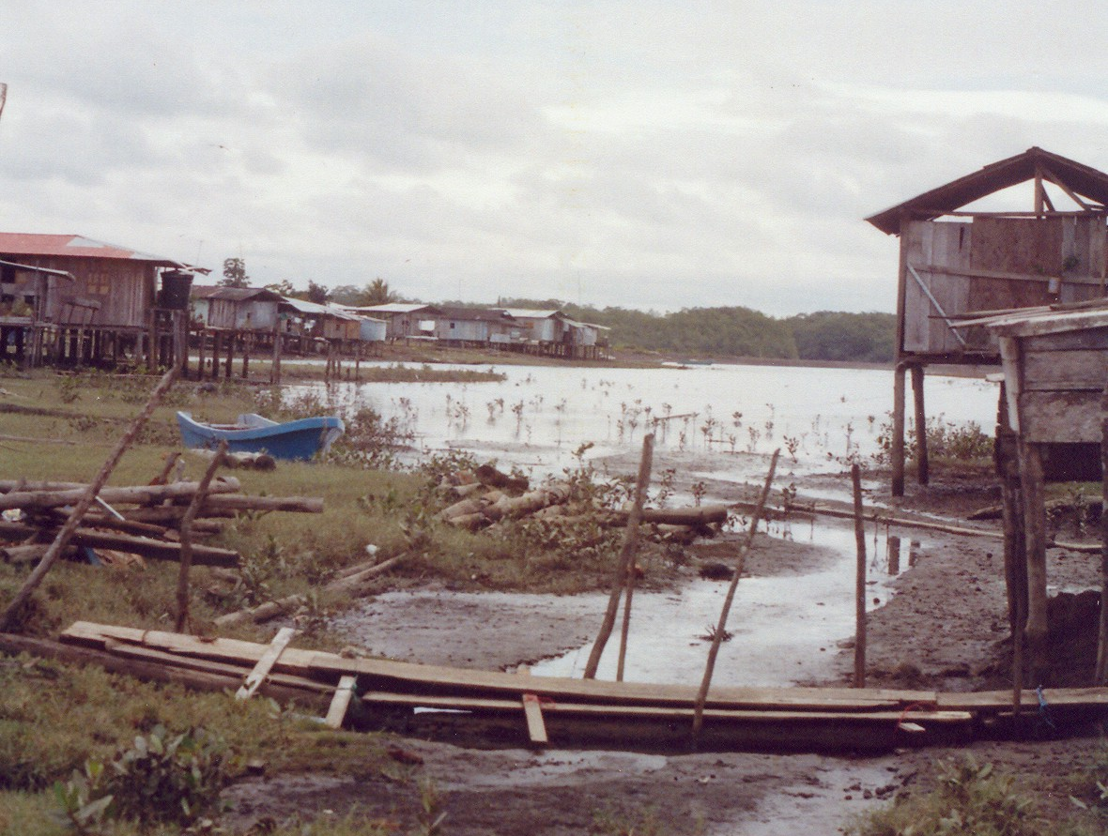
Environments
(standard computers don't work well)
  Monsoon Rains, Deserts,
  Oceans, Cliffs,
  Minimalist Buildings,
  Political Turmoil

Slide 5

Crime and Black Markets
Standard schools supplies
can be easily sold
Infrastructure Investment Drops
“Nothing can be done”

Slide 6
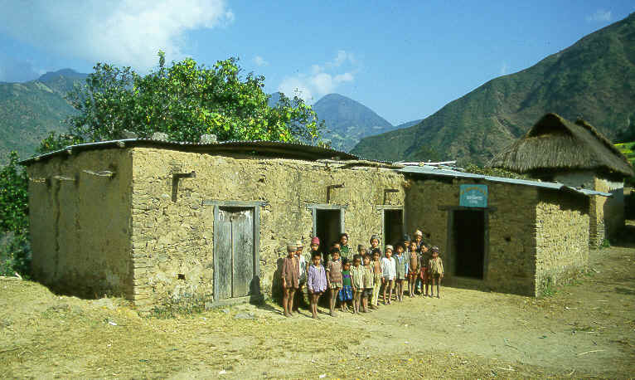
The Problem for Educators
Infrastructure build-out will take years
Educational reform will take decades

Slide 7
Goal
Provide access to knowledge today

Slide 8
Parameters
All Knowledge for All Years and All Interests
Easily Updated
Robust, Flexible, Off-grid Capable
Self-guided or Teacher-guided
Inexpensive, Easily Maintained

Slide 9
A Textbook Reader
More Importantly...
A Symbol of Hope
An Open Platform for Building

Slide 11
The Process
We provide an integrated, open, laptop design
Open Hardware, Open Source, Open Content
Open Project

Slide 12
We Don't Know Best
Local group plans deployment
Teacher Training, Network Connection,
Curriculum, Content, Rules

Slide 13
Commitment Required
Governments/benefactors provide funding
Considerable effort is required
Non-profit enterprise
Countries have to care about children's education

Slide 14
The Hardware
(What we need from manufacturers)

Slide 15
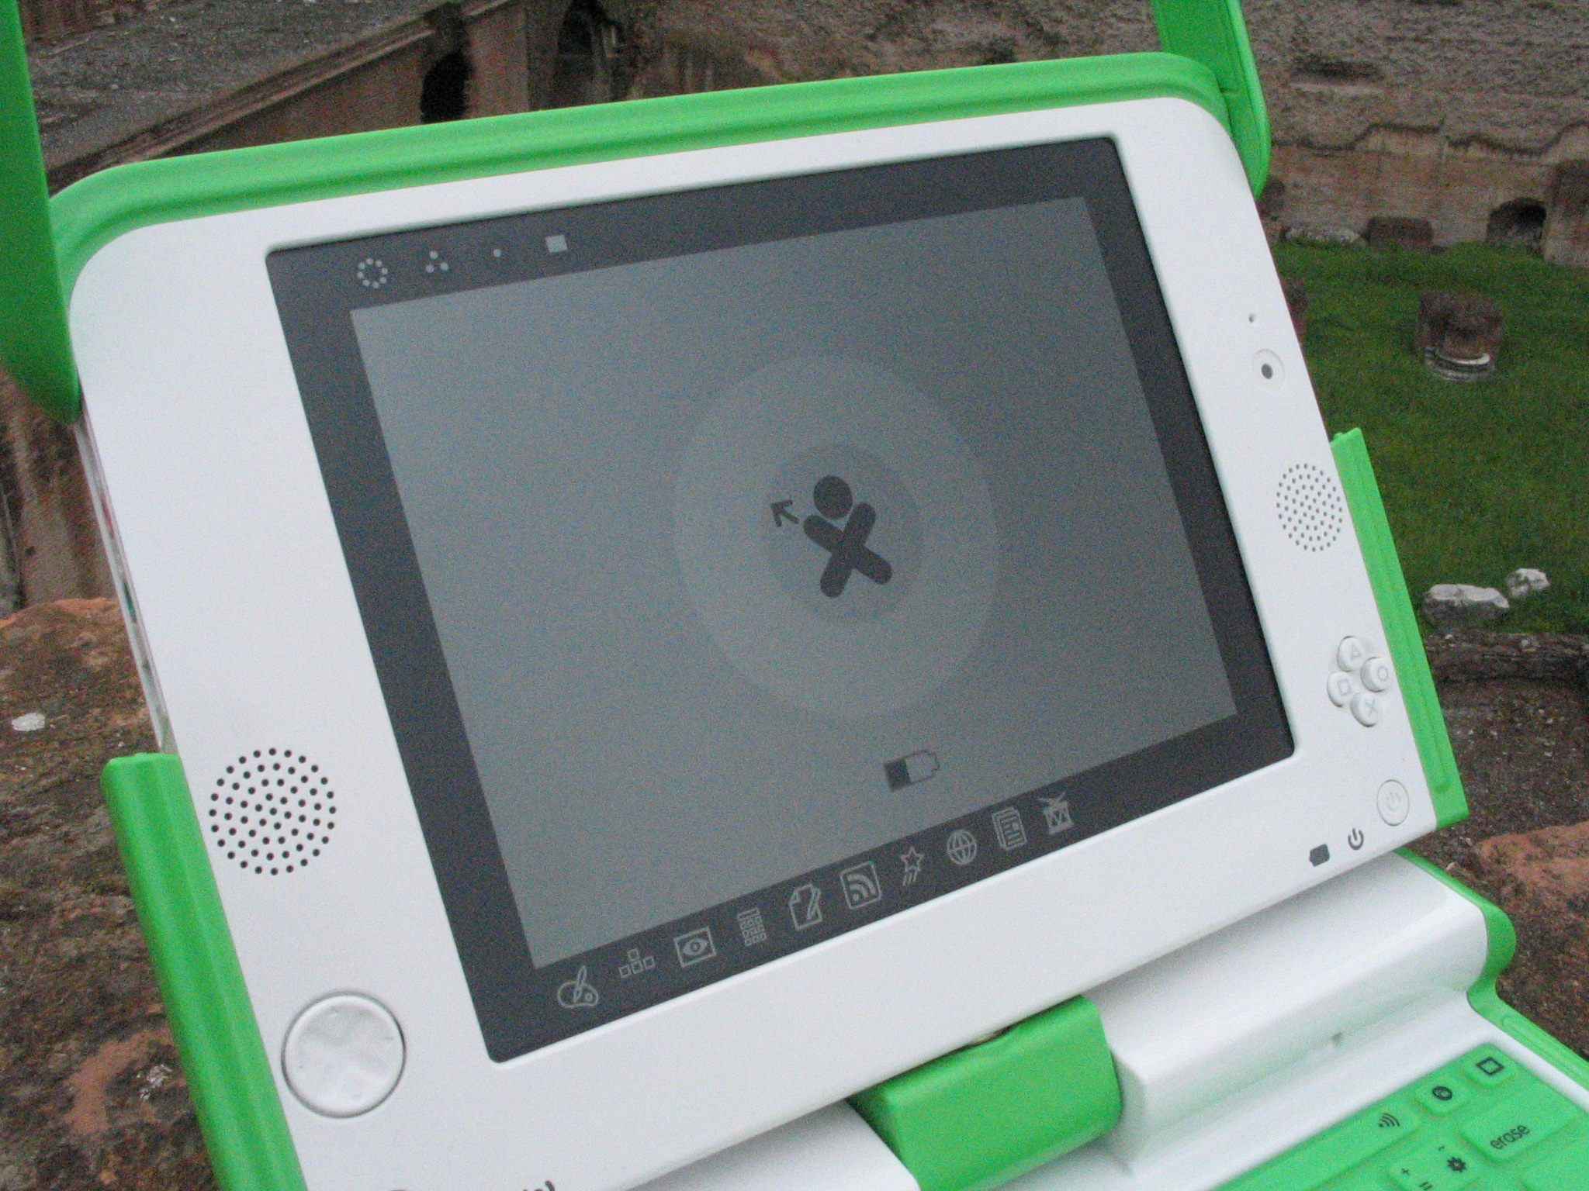
Sunlight Readable
200 DPI b/w
Most Common Use
Least Power Use

Slide 16
Power Envelope
Low Draw (< 2W average)
We want that to go down to ~1W or less

Slide 17
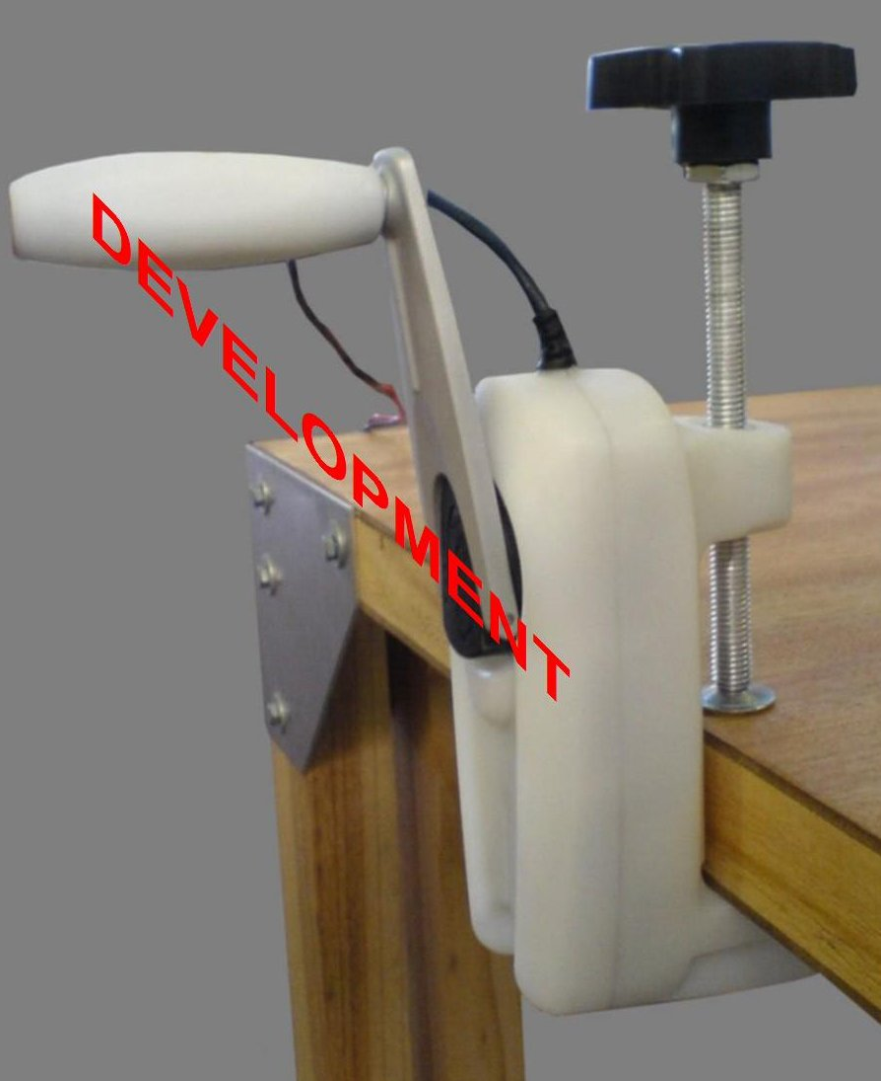
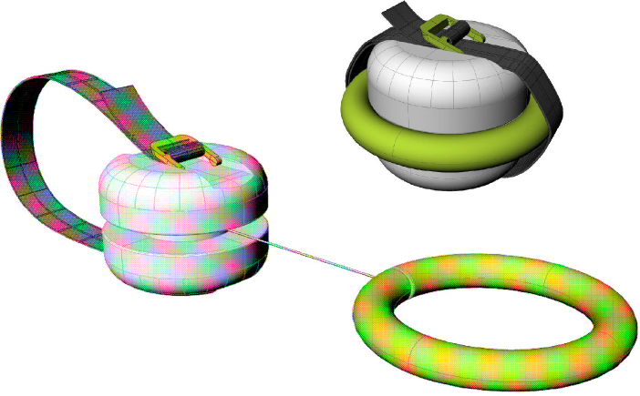
Power Sources
  Mechanical, Solar, Mains, Generators, Batteries
11 to 18V, max 15W
LiFePO4
22Wh rated

Slide 18
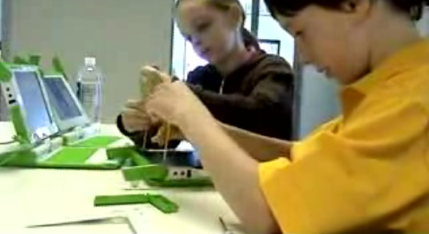
Resilient Design
Water and Dust
Reasonable Drops
Temperature
Field Repair by Children

Slide 19
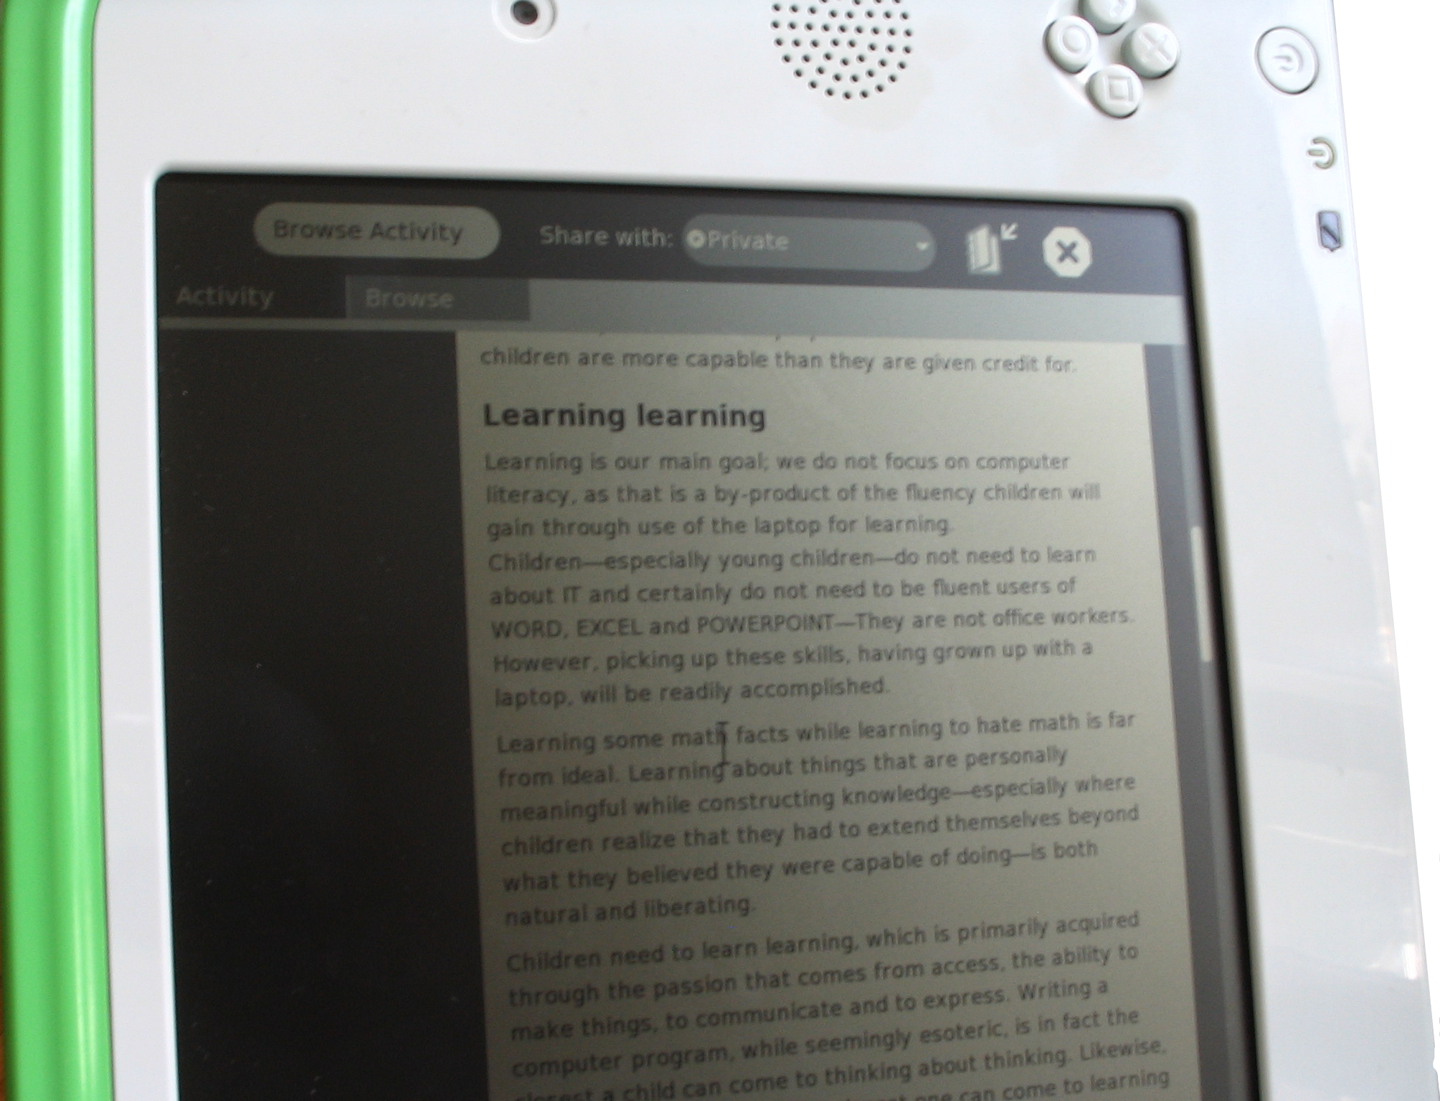
Software
Open Firmware
GNU/Linux
GTK, Cairo, Pango
Python, PyGame
Smalltalk, eToys
XUL Runner AbiWord
CSound

Slide 20
Sugar Shell/UI
Designed for a Concrete-Operational Learner

Slide 21
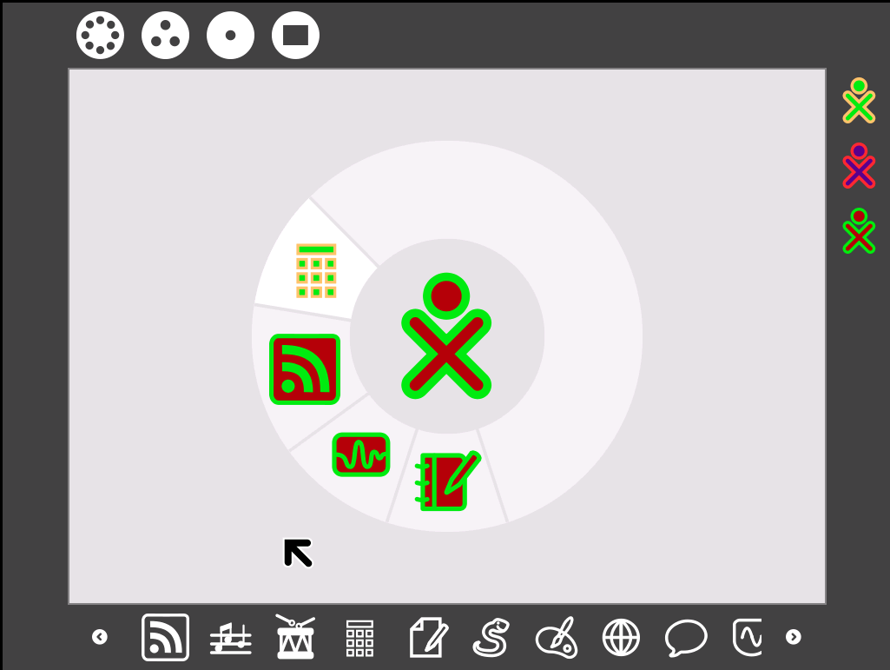
“Network” Zoom
Online Buddies
Running Activities
Available Activities

Slide 22
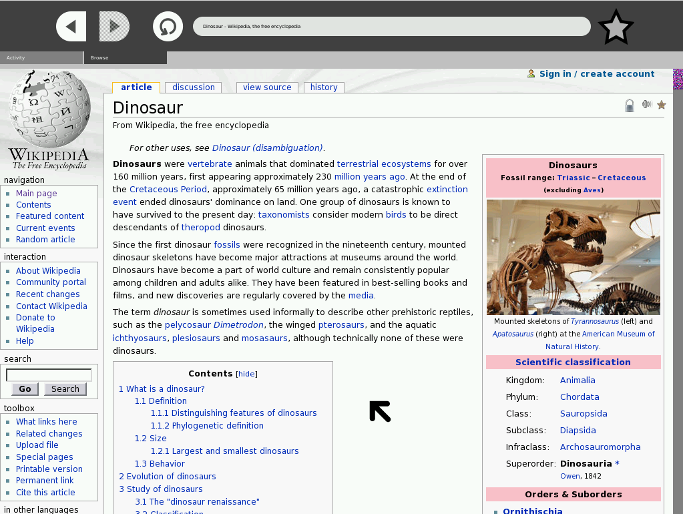

Slide 23
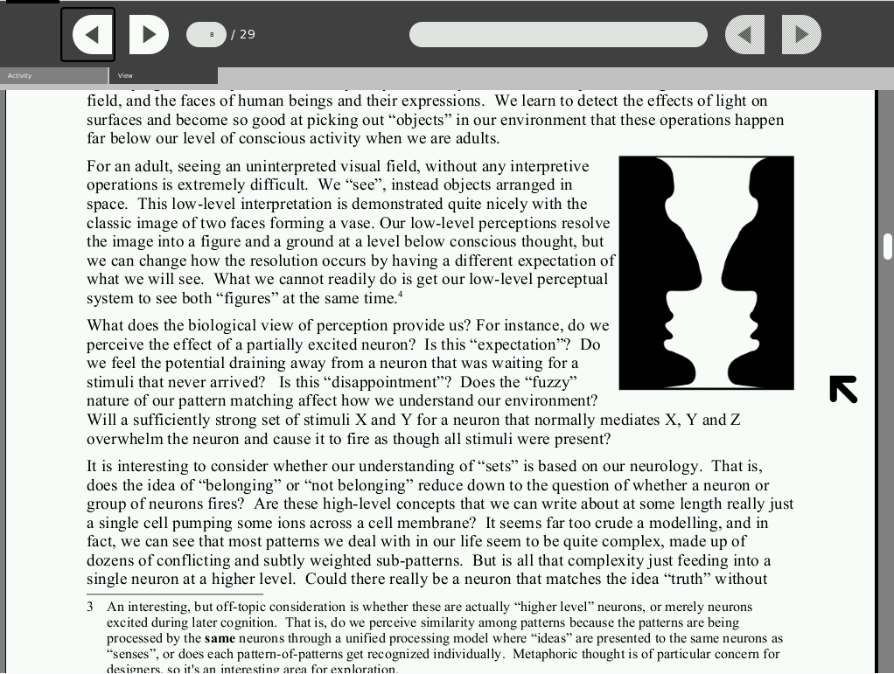

Slide 24
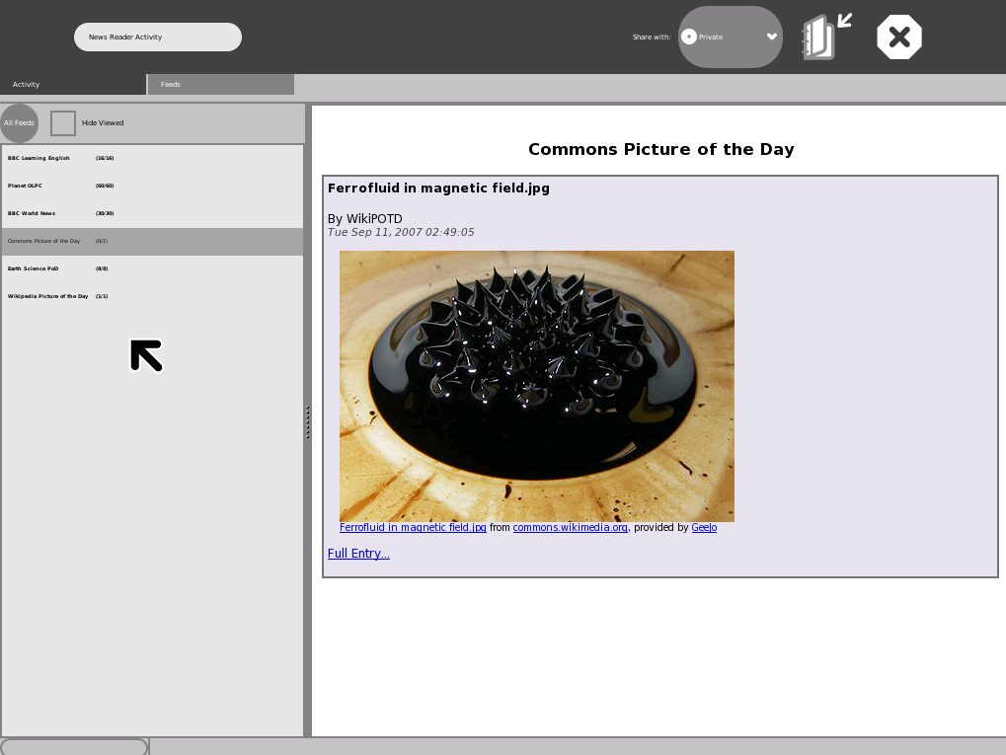

Slide 25
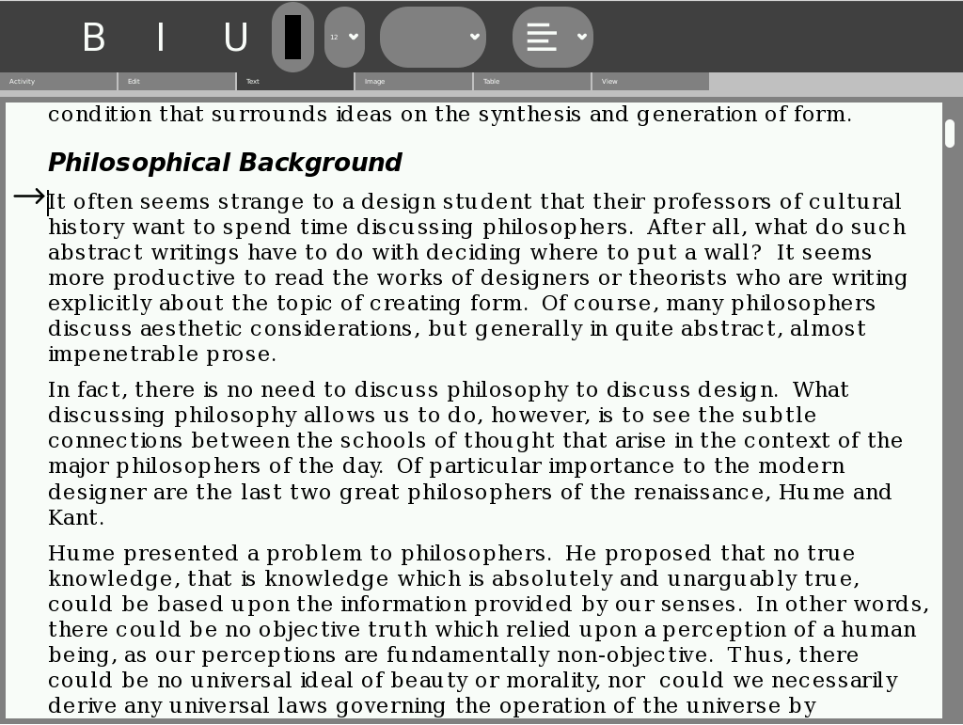

Slide 26
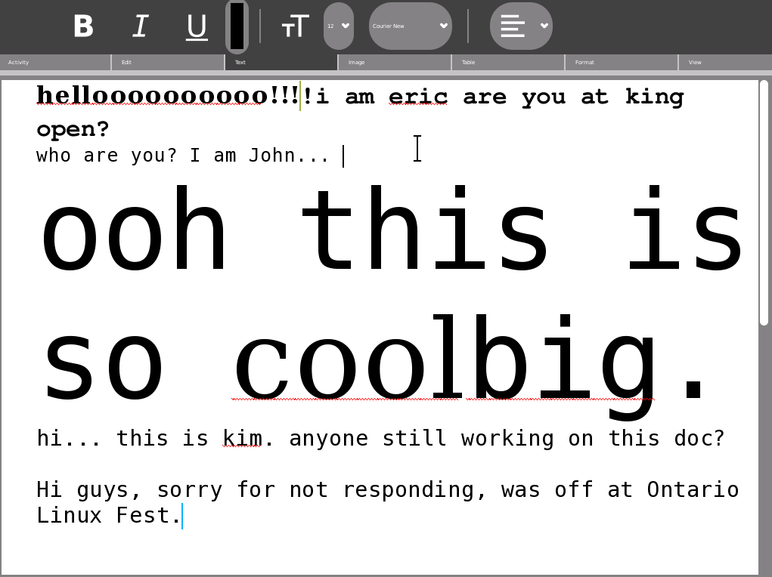

Slide 27
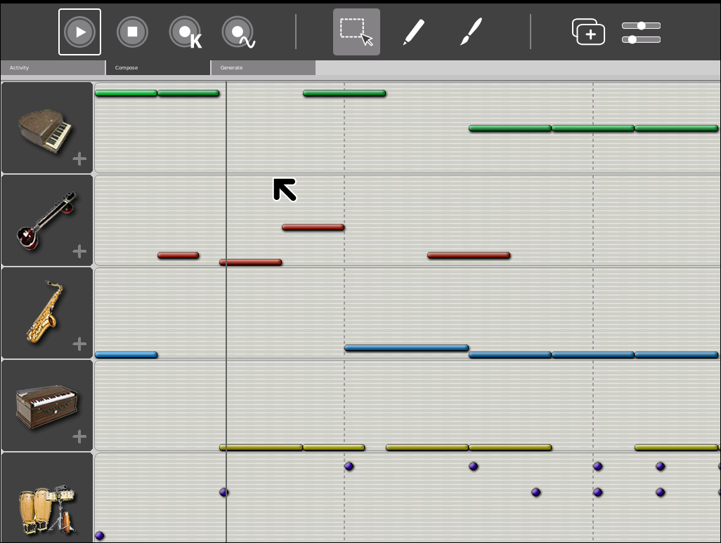

Slide 28
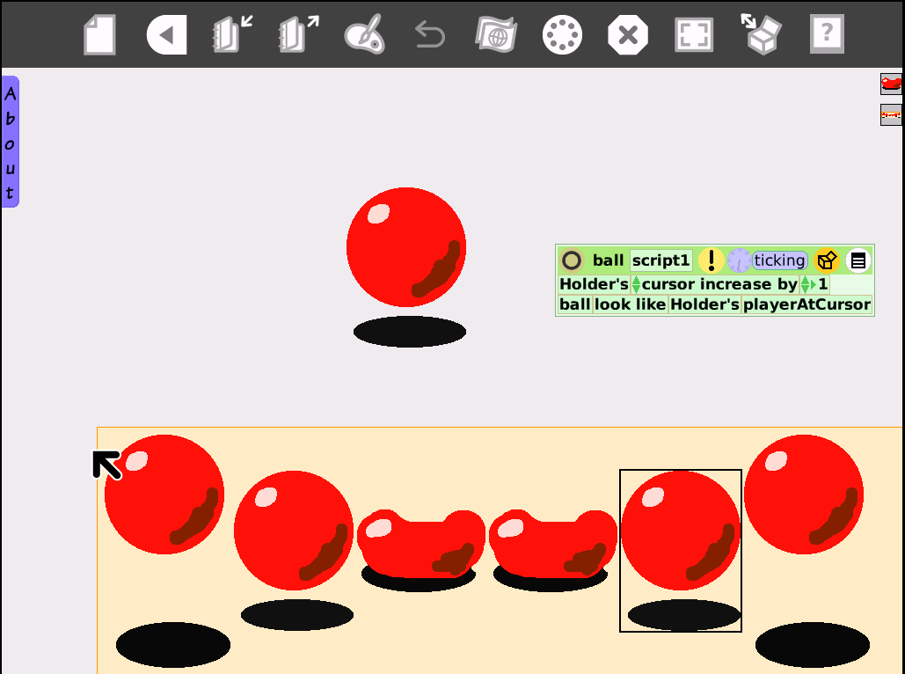

Slide 29
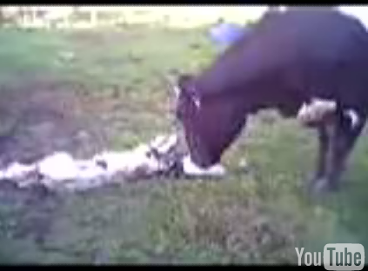
Observing
Video Camera
Still Camera
“Reporter” Activity

Slide 30

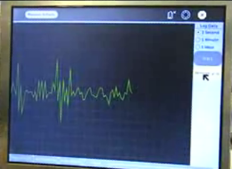
Exploring
  Inexpensive Probes
  (Think Oscilloscope)
  $1 Microscope

Slide 31
The World is a Dangerous Place
Bitfrost Security Platform
Theft Deterrents, Data/Privacy Loss, Integrity, Damage Control

Slide 32
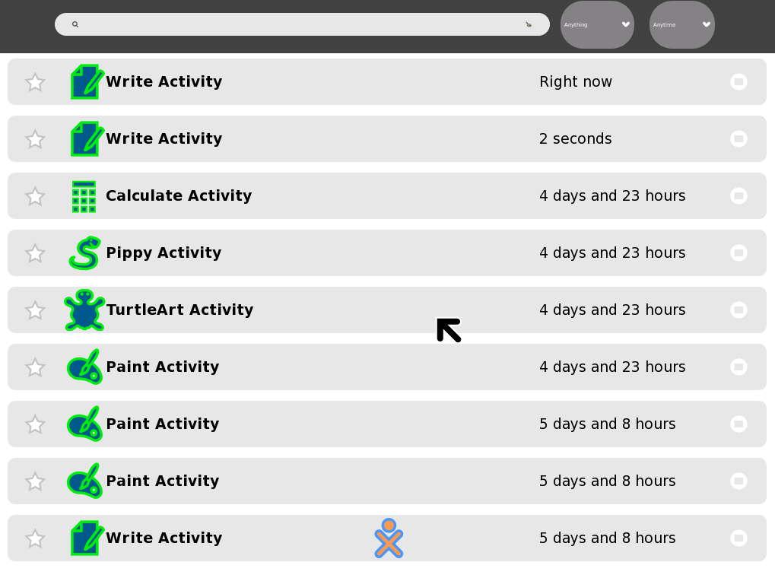
Automatic Backup & Journal

Slide 33
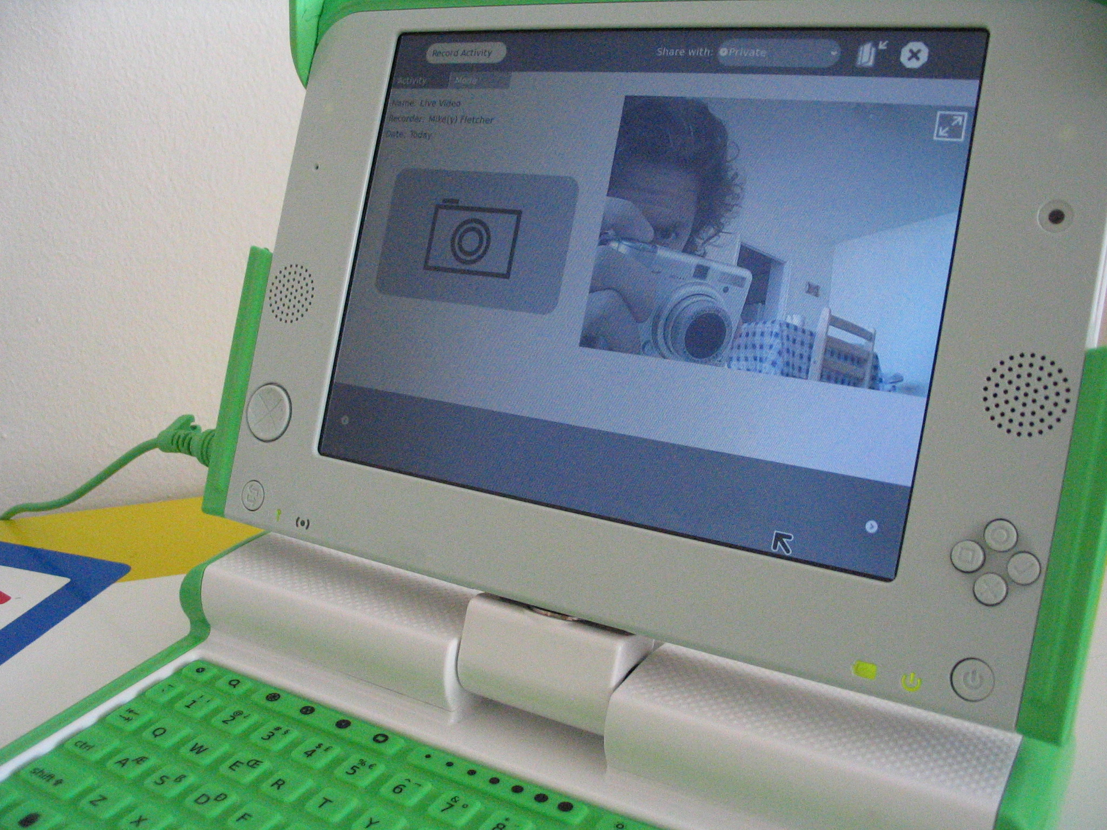
School Level Components
  Network Connectivity
  Backup/Updates
  Cache/Proxy
  Access and Content
  Registration

Slide 34

Content
Dozens of Institutions & Groups
Multiple Countries
Integration and New Creation
Primary Education, Public Health, Engineering, Science, General Knowledge, Entertainment

Slide 35
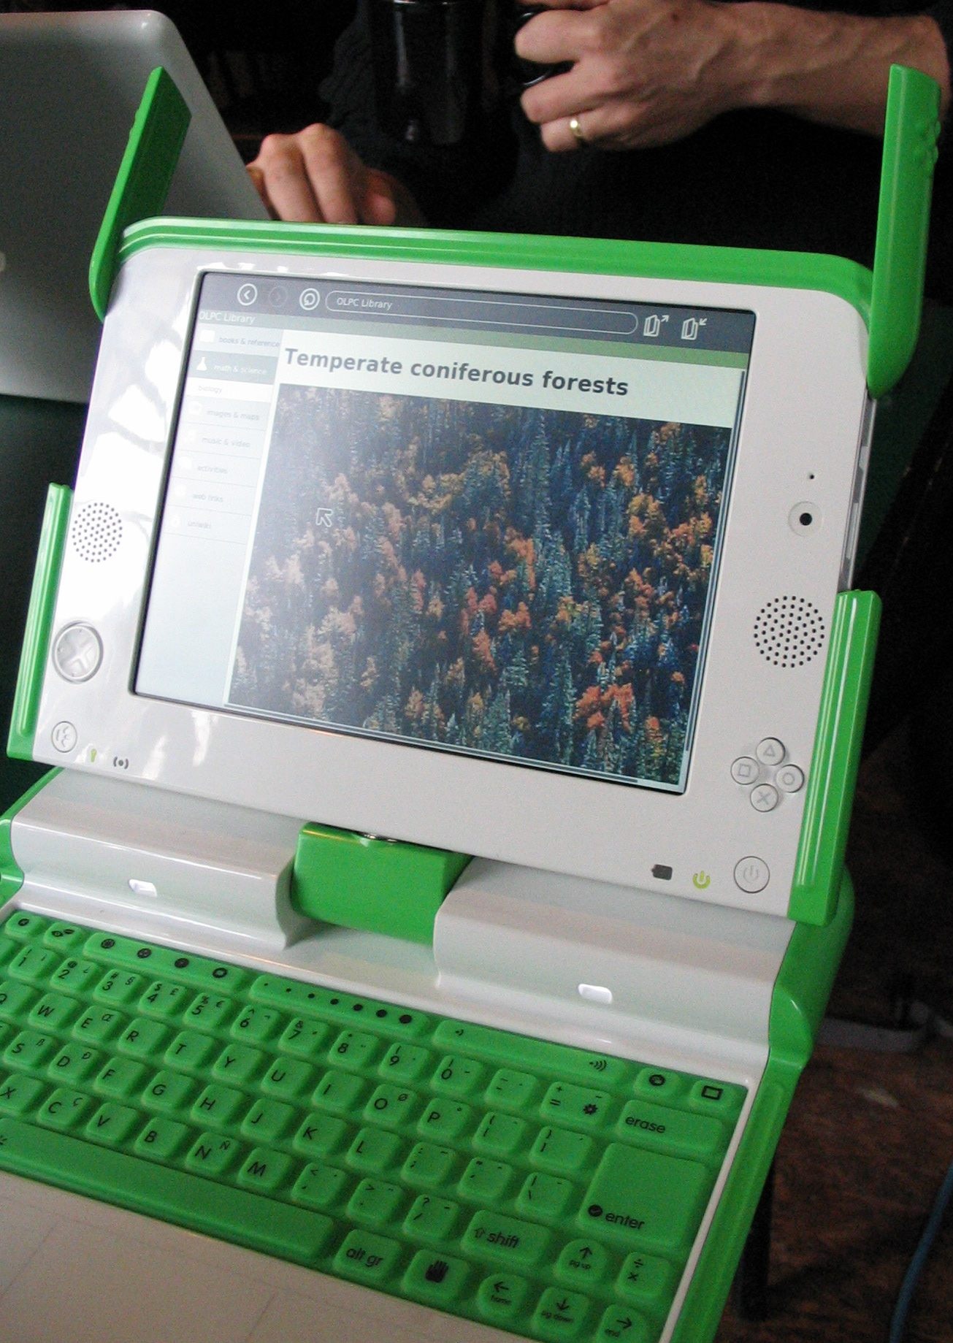
Moving Forward
  Unify “Open” Projects
  Content, Software, Connectivity
  Alternate Designs, Computer Labs,
  Thin Clients, Cell-phones
  Order XO-2's Off-the-shelf

Slide 36
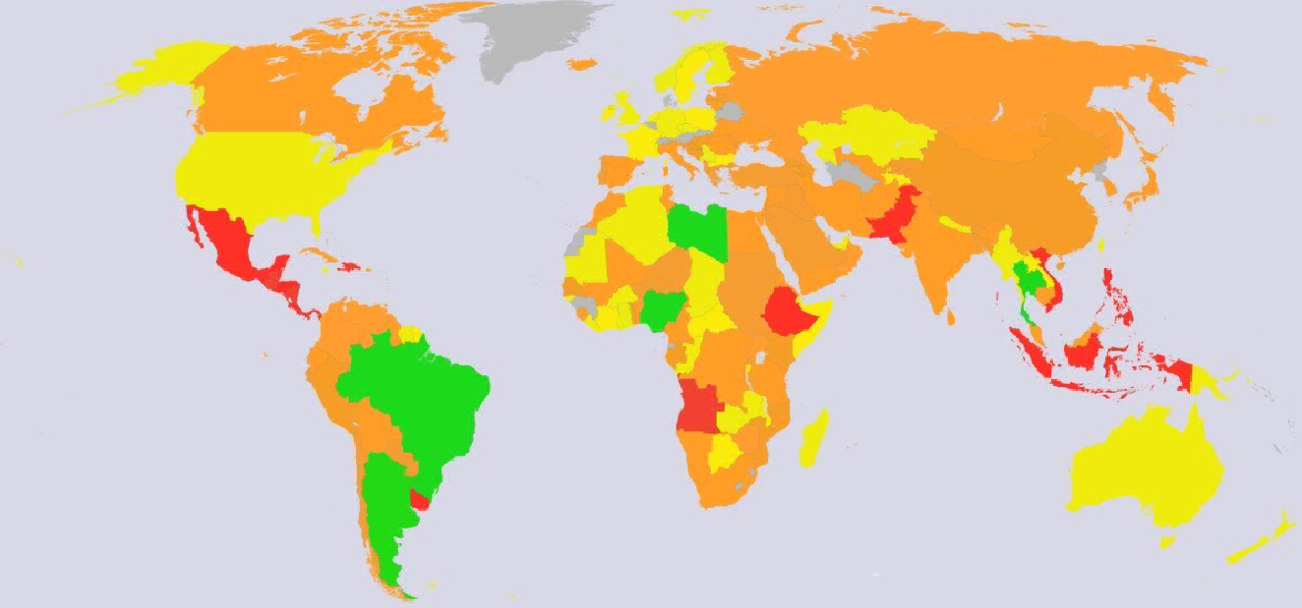
Lots of Work to Do
We're an Open Community
Join, Discuss, Act

Slide 37
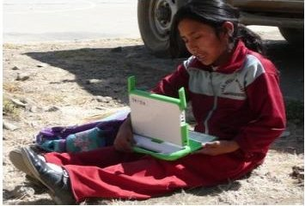
Thanks!
http://www.laptop.org
Image from OLPC Peru

