Slide 1
微軟在動態語言上的發展
王森
senwang@microsoft.com
Microsoft Corporation

Slide 2
開放原始碼與符合標準的動態語言
IronPython http://www.codeplex.com/IronPython
IronRuby http://www.ironruby.net/

Slide 3
IronPython Roadmap
IronPython 1.0
IronPython 1.1
April 2007
2.4 language
IronPython 2.0
Nov 2008
2.5 language
2.4 language
27/54 builtin modules
Sept. 2006
IronPython 3.0
Early 2009
Partial 2.5 support
More modules
Top user issues
More modules
3.0 language?
More modules
Internal architecture work
TBD
IronRuby Roadmap
IronRuby 1.0
Still Alpha
Dec 2008

Slide 4
架構
Dynamic Languages
VBx
JScript
3rd Party langs
IronPython
IronRuby
Tools
VS Integration
DLR
Frameworks
CLR
Scripting Hosts
ASP.NET
Silverlight
Applications

Slide 5
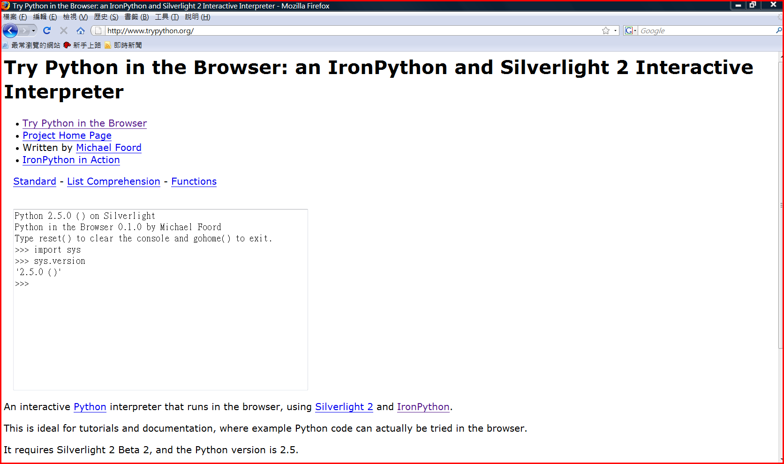
IronPython 應用
On-Line Python Console http://www.trypython.org/
Notes:
8/22/2008 10:18 PM
© 2005 Microsoft Corporation. All rights reserved.
This presentation is for informational purposes only. Microsoft makes no warranties, express or implied, in this summary.
5

Slide 6
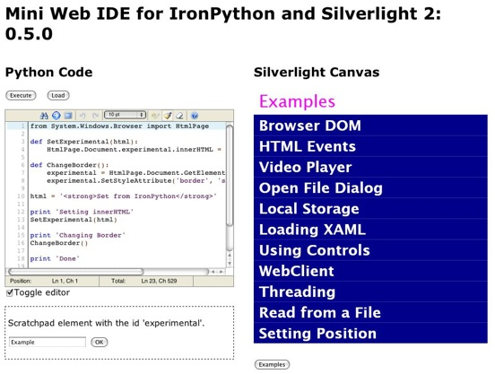
IronPython 應用
On-Line Development Tool (Web IDE)
http://www.voidspace.org.uk/ironpython/webide/webide.html
Notes:
8/22/2008 10:18 PM
© 2005 Microsoft Corporation. All rights reserved.
This presentation is for informational purposes only. Microsoft makes no warranties, express or implied, in this summary.
6

Slide 7
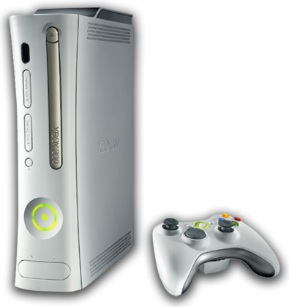


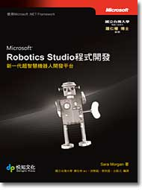
IronPython 在其它平台的應用
XBOX 360 - XNA
Robotic Studio
Notes:
8/22/2008 10:18 PM
© 2005 Microsoft Corporation. All rights reserved.
This presentation is for informational purposes only. Microsoft makes no warranties, express or implied, in this summary.
7

Slide 8
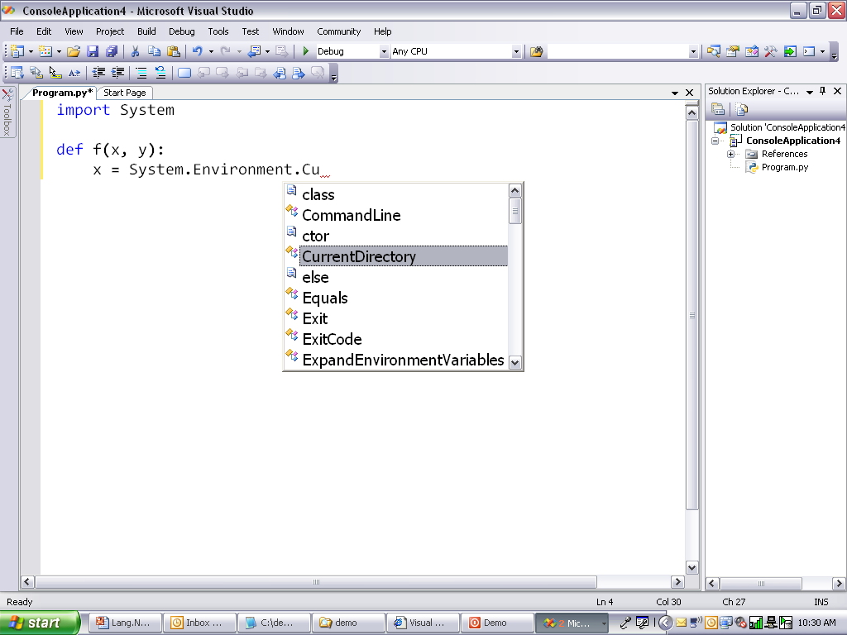
開發工具 : IronPython Studio
Notes:
8/22/2008 10:18 PM
© 2005 Microsoft Corporation. All rights reserved.
This presentation is for informational purposes only. Microsoft makes no warranties, express or implied, in this summary.
8

Slide 9
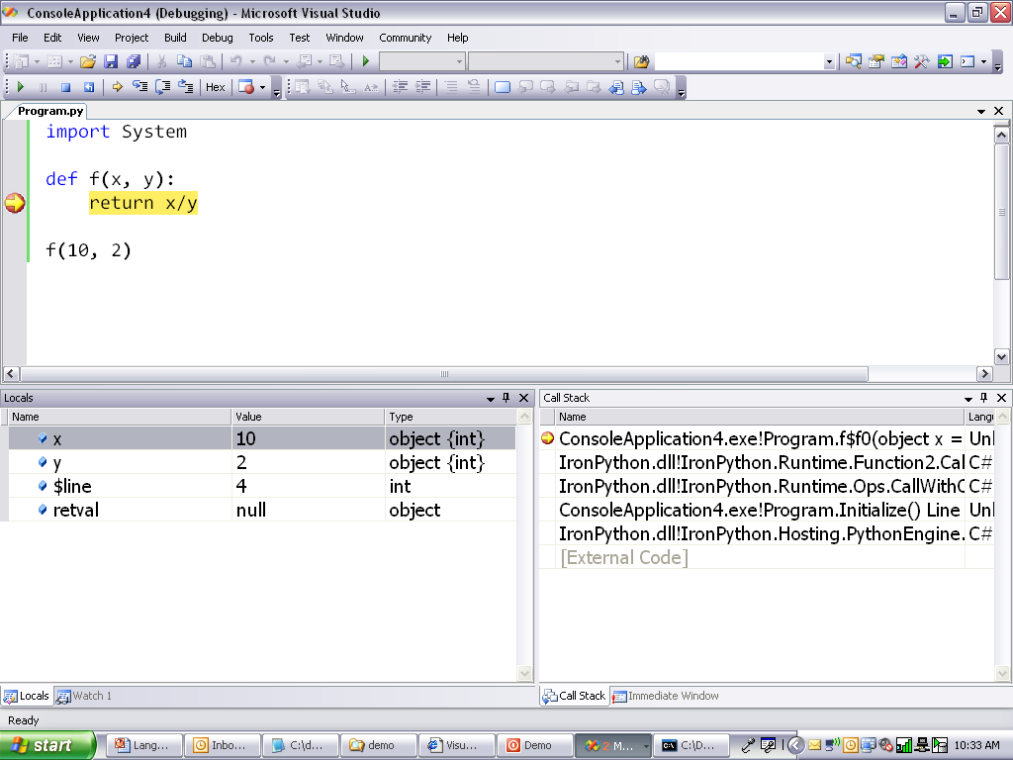

Slide 10
