Slide 1

Topic: Django Introduction
Authors: timchen119.nospam.at.gmail.com (使徒提姆)
Location: Taiwan COSCUP 2008
Date: 2008/08/23
Blog: http://timchen119.blogspot.com
This document has licensed as CC-SA 2.0

Slide 2
Topic
Django Overview
Introduce Django
Django Status
Install Guide
Quick Tutorial
form processing/generic view/session management/cache system/middleware
Django standard library
Conclude

Slide 3
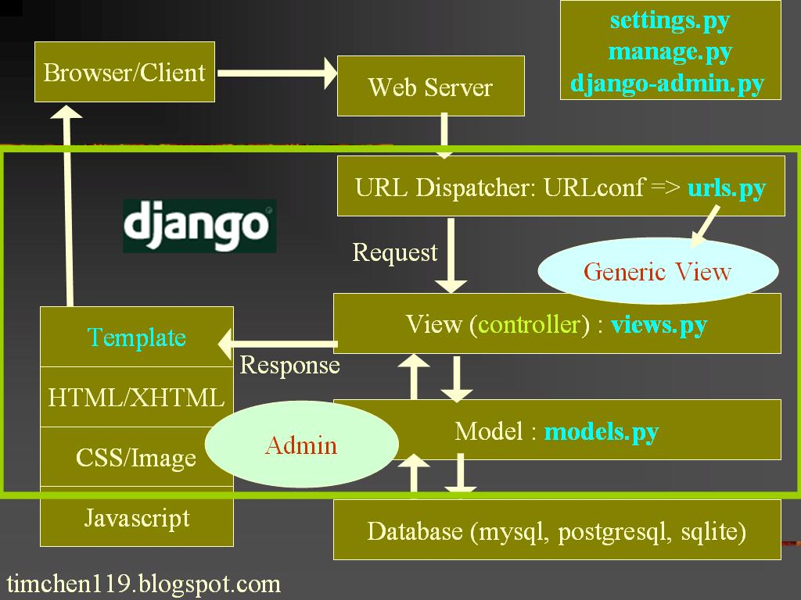

Slide 4
Django's MVC term
Model -> Model
View -> template
Controller -> View

Slide 5
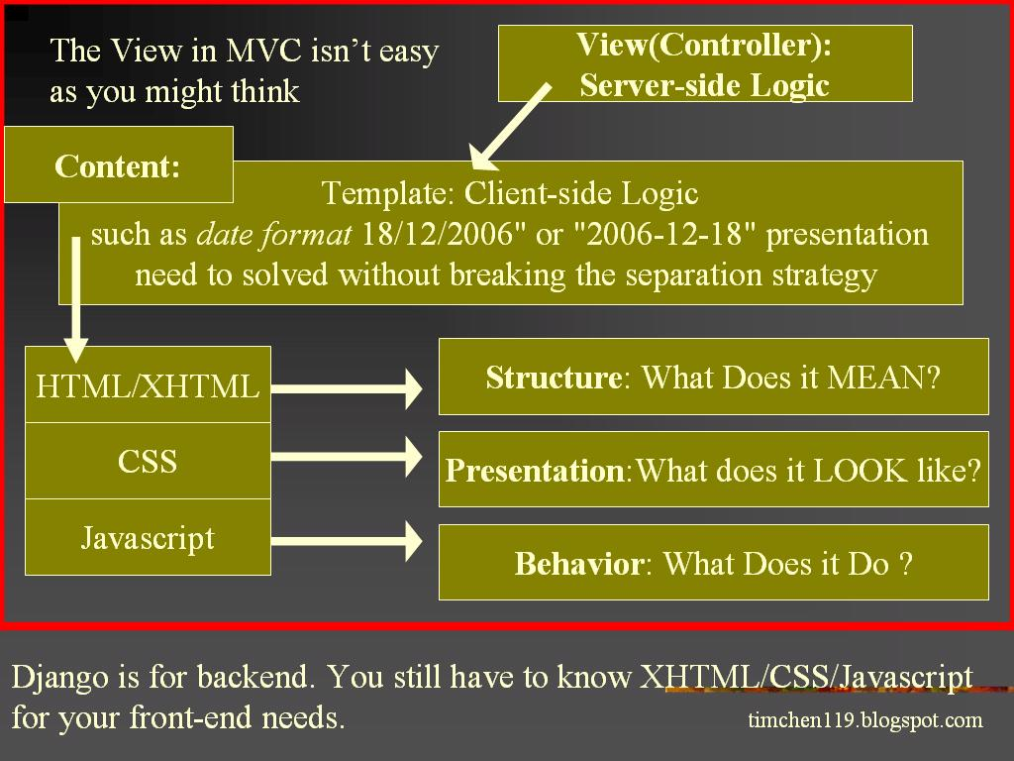

Slide 6
Web 「Framework」?
A web application framework is a set of software tools and libraries to make it easier to create web applications. They typically provide functionality such as database access, templating and session management. -- wikipedia

Slide 7
Why?
CGI
Scripting Language (perl,ASP,PHP)
Web Framework:
  Code reuse
  Separate environment
  Template
  MVC pattern

Slide 8
Why Django (and Python?)
Lots of Libraries
Automatic Admin Interface
Clean
Elegant
Template system
ORM
Clean URL
loosely coupled
Mature
i18n
Tight Integration
Good and Free Document
Cache System

Slide 9
Django or...? (Framework comparisons from Django Blog)
http://tinyurl.com/2f847c
Person 1: "What do you do for a living?"
Person 2: "I work with computers."
Person 1: "So do I! What do you do with computers?"
Person 2: "I'm a Web developer."
Person 1: "So am I! Design, client-side programming or server-side programming?"
Person 2: "Server-side programming."

Slide 10
Django or...? (cont.)
Person 1: "Same here! Do you use dynamically typed languages or statically typed languages?"
Person 2: "Dynamically typed languages."
Person 1: "So do I! Do you use a Web framework, or do you roll things on your own?"
Person 2: "I use a Web framework."

Slide 11
Django or...? (cont.)
Person 1: "So do I! Django or Rails?"
Person 2: "Django."
Person 1: "Die, heretic scum!"
(去死吧異教徒雜碎!)

Slide 12
Warning...
One thing is clear, though: everyone's getting stuff done, regardless of their language choice.
The whole debate isn't actually about productivity at all, even though most people still think it is.
It's about whether you can stand to live in a house where the bed isn't made.
-- Steve Yegge

Slide 13
Django's Status
January 11, 2006 -- 0.91
July 29, 2006 -- 0.95 ('magic-removal')
March 23, 2007 -- 0.96 (cleanup and stabilization 0.95)
August 14, 2008 -- 1.0 beta 1.
September 2, 2009 -- 1.0 release planned.

Slide 14
New in Django 1.0
newforms-admin
Improved Unicode handling
Automatic escaping of template variables
An improved Django ORM
django.contrib.gis -- (GeoDjango, merged into trunk on August 5th, 2008)
Pluggable file storage
Jython 2.5 support

Slide 15
Install guide
Python
Django
Database System + Database Python Bindings (mysql/postgres/sqlite/oracle)
Web Server (apache/lighttpd)
mod_python or fastcgi (WSGI actually)
Javascript Library (jquery/yui/dojo)
Windows -- http://www.instantdjango.com/

Slide 16
Stuff you need to start.
Learn Django management tools
  django-admin.py
  manage.py
Edit Settings.py (setup you env)
Basic Models Concept
Basic Template
Request and response object
URLconf (urls.py)
Sessions

Slide 17
Create Empty Project
django-admin.py startproject TestProj
TestProj/
__init__.py
manage.py
settings.py
urls.py

Slide 18
Start to create an application
python manage.py startapp TestAP
TestProj/TestAP/
__init__.py
views.py
models.py

Slide 19
How to Create your web application
Setup/Create Database
  Edit settings.py
  python manage.py syncdb
build your ORM model
  Edit models.py
  class Msg(models.Model):
  name = models.CharField(maxlength=64)
  date = models.DateTimeField('postdate')

Slide 20
How to Create your web application (cont.)
Write HTML Template
  <html><head><title>test</title></head><body>
  (insert template code here)</body></html>
  {%if msgs_list %}
{% for msg in msgs_list %}
{{ msg.name }} at {{msg.date}} </p>
<p> {{msg.msgtxt}} </p>
{% endfor %}
{%else %}
<p>No Announce are available
{%endif %}

Slide 21
How to Create your web application (cont.)
View (controller)
  Edit views.py
    def announce_index(request):
    latest_msg = Msg.objects.all().order_by('date')[:5]
    return render_to_response('announce.html', {'msgs_list': latest_msg})

Slide 22
How to Create your web application (cont.)
URLs management
  Edit urls.py
  urlpatterns = patterns(
'TestProj.TestAP.views',
(r'^$', 'announce_index'),
('abc', 'announce_index'), (r'^admin/',include('django.contrib.admin.urls')),
)

Slide 23
Run,See,and Believe.
python manage.py runserver
A builtin web server for development.
A full database admin console on http://127.0.0.1:8000/admin
No more php(xxx)admin!
python manage.py rundbshell
python manage.py runshell

Slide 24
Web Form Processing
Roll your own
oldforms
Newforms
  Accessibility
  Usability
  Validation
  Detailed error messages
Create forms from models: form_for_model()

Slide 25
Generic View
Provide common views of an object without actually needing to write any Python code
It's nothing about View in MVC, it’s about reuse controller logic.
It’s not MAGIC! Django provide most common patterns and you can extend it.

Slide 26
Reuse your logic
"Simple" generic views
Date-based generic views
List/detail generic views
Pagination
Create/update/delete generic views
You could use it in urls.py or views.py
Simple logic => just use it in urls.py!

Slide 27
stateful HTTP
Cookies
Django session framework
User and Auth framework
django.contrib.auth
Permissions
Groups
Messages
Profiles

Slide 28
Cache system
Different cache backend:
  Database
  Filesystem
  Memory
  Memcached
Different cache Scope:
  Per Site
  Per View
  Low Level Cache API to cache part of results (and any python object which can be safely pickled)

Slide 29
Middleware
MIDDLEWARE_CLASSES
Implies... Classes which is a Middleware
Methods middleware defines:
  __init__
  process_request
  process_view
  process_response
  process_exception
Django have lots of builtin Middlewares

Slide 30
Django Standard Library
django.contrib
  admin
  auth
  comments
  contenttypes
  csrf
  databrowse
  flatpages
  formtools
  humanize

Slide 31
Django Standard Library
  markup
  redirects
  sessions
  sitemaps
  sites
  syndication

Slide 32
Lots of Stuff in django You can Use/Learn/extends
User Registration
Custom Template Tags/Filters
Add Voting and Comments
Creating your own Admin Interface
Ajax via simplejson
Add Complex Model relations
RSS / Sitemap Framework
Test via Unit test
Write Middleware

Slide 33
Lots of Stuff You also need to learn
Django won’t magically turn you from newbie to Web pros. It just let your life easier.
Learn HTML / XHTML. (learn how to struct)
Learn CSS / Javascript and get your firebug. (CSS2.1/Prototype/Dojo/YUI/Mochkit/jQuery).
Learn Browser.(IE7, IE6, IE5.5, firefox [gecko], opera, Safari)
Learn SQL (learn how to maintain/transfer data)
Learn Apache / lighttpd / flup / mod_python / Http (learn how to scale)
Learn You’re not genius. Learn from other (genius) people. Don’t reinvent a WORSE wheel.

Slide 34


Thanks!

