Slide 1
自由軟體授權運用的重要概念、類型說明，以及常見爭議
Lucien C.H. Lin (林誠夏) from OpenFoundry
Except where otherwise noted, content on this slide is licensed under a Creative Commons Attribution-ShareAlike 3.0 Unported License.

Slide 2
Fundamental concepts, categories, and increasing issues about FOSS licensing
Lucien C.H. Lin (林誠夏) from OpenFoundry
Except where otherwise noted, content on this slide is licensed under a Creative Commons Attribution-ShareAlike 3.0 Unported License.

Slide 3
Chinese language

Slide 4
Chinese language
English slide

Slide 5
Ensuring Freedom of Action in Free Software Through Collaboration & Partnership
Shane Coughlan from Open Invention Network

Slide 6
GNU GPL Compliance in Embedded Devices
Harald Welte from gpl-violations.org

Slide 7
Implementation of a FOSS License Compliance Program
Soeren Rabenstein from ASUSTeK Computer Inc.

Slide 8
Better understanding

Slide 9
1. Fundamental Concepts

Slide 10
Softwares vs. Licenses

Slide 11
Softwares vs. Licenses
License: rights and obligations

Slide 12
Softwares vs. Licenses
License: rights and obligations
Licenses = Rules

Slide 13
Softwares vs. Licenses
License: rights and obligations
Licenses = Rules
Rules: MUST be followed

Slide 14
Softwares vs. Licenses
License: rights and obligations
Licenses = Rules
Rules: MUST be followed
Software goes to multiple copies

Slide 15
FOSS does that even more

Slide 16
Standing on the shoulders of giants

Slide 17
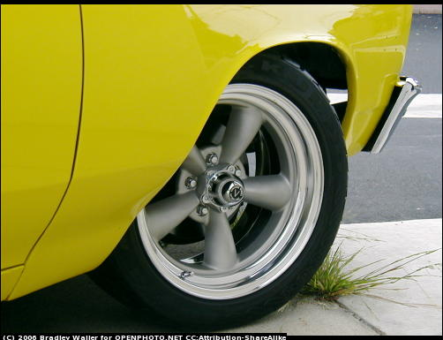

Slide 18
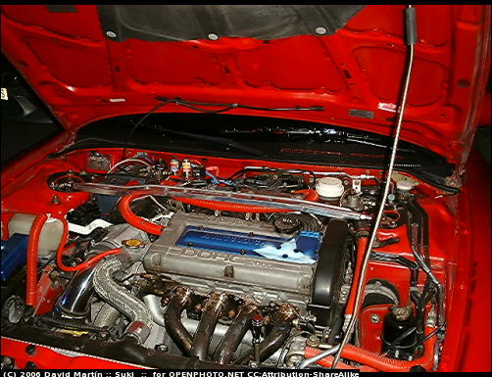

Slide 19
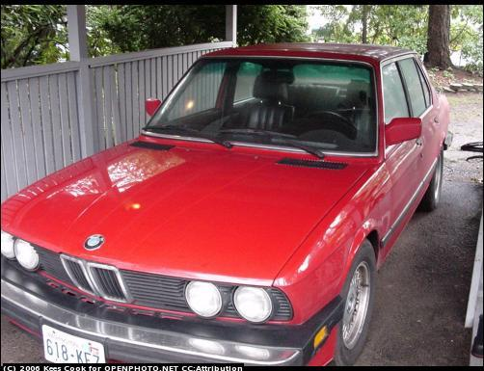

Slide 20

© Fair use, avaiable at: http://www.mysql.com/.

Slide 21
FOSS license leads to the basis of project cooperation

Slide 22
FOSS license is a MUST

Slide 23
COSCUP 2010 goes to legal session

Slide 24
FOSS license related IPRs

Slide 25
1. Copyright

Slide 26
1. Copyright
2. Patent

Slide 27
1. Copyright
2. Patent
3. Trademark

Slide 28
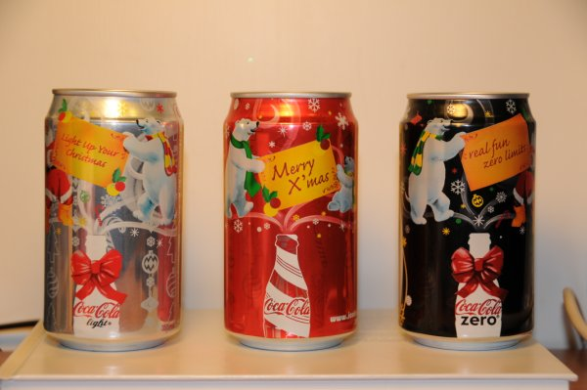
Picture and design: Copyright
© Fair use, avaiable at: http://byfiles.storage.live.com/y1p_GGIwBtrLLjVacYuiWIPhc8OVJta1Hw4r5Rr84yef7u3FggNVSHQbdlMmG4LulDuz7NKFe4g28k

Slide 29
Easy opening tab-patent
© Fair use, avaiable at: http://byfiles.storage.live.com/y1p_GGIwBtrLLjVacYuiWIPhc8OVJta1Hw4r5Rr84yef7u3FggNVSHQbdlMmG4LulDuz7NKFe4g28k

Slide 30
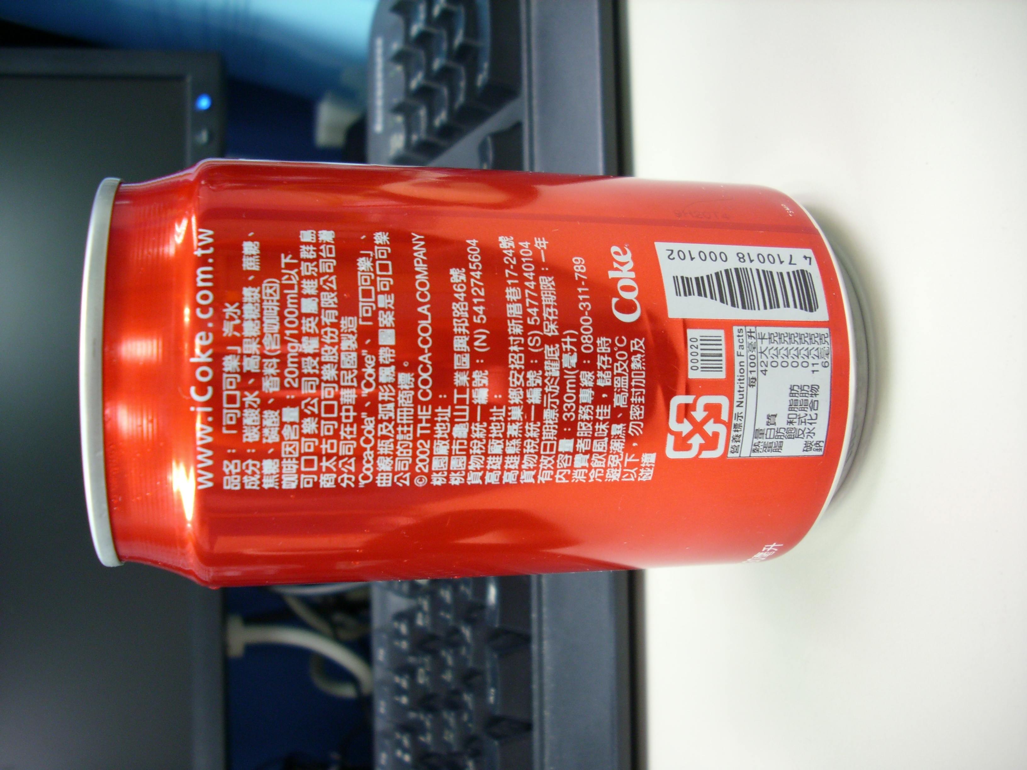
Product name & logo: trademark
1. Coca-Cola
2. Coke
3. Coca-Cola in Chinese
4. Shape design in curve bottle
5. Curving streamer pattern
© Fair use, this photo is original distributed by its photographer Richard Lin under a Creative Commons Attribution-Non Commerical 2.5 Taiwan License.

Slide 31
FOSS license vs. IPRs

Slide 32
FOSS license vs. IPRs
Based on IPRs

Slide 33
FOSS license vs. IPRs
Based on IPRs
Applying in non-traditonal way

Slide 34
Use Study
Modify Redistribute

Slide 35
1. Free Redistribution
2. Source Code
3. Derived Works
4. Integrity of The Author's Source Code
5. No Discrimination Against Persons or Groups
6. No Discrimination Against Fields of Endeavor
7. Distribution of License
8. License Must Not Be Specific to a Product
9. License Must Not Restrict Other Software
10. License Must Be Technology-Neutral

Slide 36
Academic Free License Adaptive Public License Apache Software License Apache License, 2.0 Apple Public Source License Artistic license Attribution Assurance Licenses New BSD license Computer Associates Trusted Open Source License 1.1 Common Development and Distribution License Common Public License 1.0 CUA Office Public License Version 1.0 EU DataGrid Software License Eclipse Public License Educational Community License Eiffel Forum License Eiffel Forum License V2.0 Entessa Public License Fair License Frameworx License GNU General Public License (GPL) GNU Library or "Lesser" General Public License (LGPL) Historical Permission Notice and Disclaimer IBM Public License Intel Open Source License Jabber Open Source License Lucent Public License (Plan9) Lucent Public License Version 1.02 MIT license MITRE Collaborative Virtual Workspace License (CVW License) Motosoto License Mozilla Public License 1.0 (MPL) Mozilla Public License 1.1 (MPL) NASA Open Source Agreement 1.3 Naumen Public License Nethack General Public License Nokia Open Source License OCLC Research Public License 2.0 Open Group Test Suite License Open Software License PHP License Python license (CNRI Python License) Python Software Foundation License Qt Public License (QPL) RealNetworks Public Source License V1.0 Reciprocal Public License Ricoh Source Code Public License Sleepycat License Sun Industry Standards Source License (SISSL) Sun Public License Sybase Open Watcom Public License 1.0 University of Illinois/NCSA Open Source License Vovida Software License v. 1.0 W3C License wxWindows Library License X.Net License Zope Public License zlib/libpng license

Slide 37
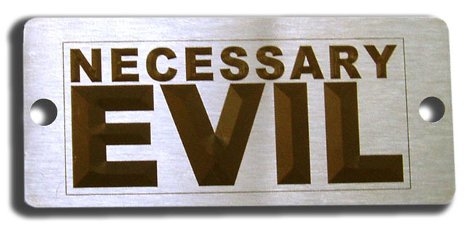
© Fair use, avaiable at: http://repairstemcell.files.wordpress.com/2009/04/necessary-evil.jpg.

Slide 38
2. License Categories

Slide 39
Frequently applied FOSS licenses
Category | Abbreviation | Full name of the FOSS licenses
BSD-like | Apache1.1 | Apache Software License 1.1
 | Apache2.0 | Apache License 2.0
 | BSD | New BSD License
 | MIT | MIT License
 | Zlib/libpng | Zlib/libpng License
GPL-like | GPL2/3 | GNU General Public License 2.0/3.0
 | LGPL3/3 | GNU Lesser Public License 2.1/3.0
 | AGPL3 | GNU Affero Public License 3.0
Others | CPL/EPL | Common Public License 1.0 Eclipse Public License 1.0
 | MPL | Mozilla Public License 1.1
 | CDDL | Common Development and Distribution License 1.0
 | QPL | Qt Public License 1.0
 | Artistic 2.0 | Artistic License 2.0

Slide 40
Strictly copyleft
Attribution-
based(C+D)
MPL/CDDL
LGPL
MIT/BSD
GPL-like
Others
BSD-like
GPL
EPL/CPL
Apache2.0
AGPL
File/module-
based copyleft
Proprietary Software License
Public Domain

Slide 41
1. Copyright Notice
2. Disclaimer
C＋D
MIT/BSD
Apache2.0

Slide 42









PuTTY

Slide 43
LGPL
1. Binary code to source code
2. License Capture / License Inheritance
GPL
AGPL3

Slide 44
Other softwares
Link, merge, combine
GPL Component

Slide 45
GPLed softwares
Link, merge, combine
GPL Component

Slide 46
If you redistribute the GPLed Softwares

Slide 47
(1) Source Code is a MUST
(2) GPL text is a MUST
(3) Derivative work is a MUST

Slide 48















Slide 49
1. Files / Modules based copyleft
2. The third way
MPL/CDDL
EPL/CPL

Slide 50








Slide 51
3. Applying Issues

Slide 52
(1) Software patent

Slide 53
(1) Software patent
(2) GPL enforcement

Slide 54
(1) Software patent
(2) GPL enforcement
(3) Supply chain collaboration

Slide 55
(1) Software patent

Slide 56
Patent: Technical Approach

Slide 57
Patent: Technical Approach
Open and for commercial usage

Slide 58
Patent: Technical Approach
Open and for commercial usage
Beware of the patent claims

Slide 59
Patent: Technical Approach
Open and for commercial usage
Beware of the patent claims
Software vs. patent

Slide 60
Patent: Technical Approach
Open and for commercial usage
Beware of the patent claims
Software vs. patent
Conflicts: very clear and obvious

Slide 61
Patent: Technical Approach
Open and for commercial usage
Beware of the patent claims
Software vs. patent
Conflicts: very clear and obvious

Slide 62
Modify & redistribute

Slide 63
Modify & redistribute

Slide 64
Patent counterclaim

Slide 65
Patent counterclaim
Patent pool

Slide 66
Patent counterclaim
Patent pool
Prior art disclosure

Slide 67
Ensuring Freedom of Action in Free Software Through Collaboration & Partnership
Shane Coughlan from Open Invention Network

Slide 68
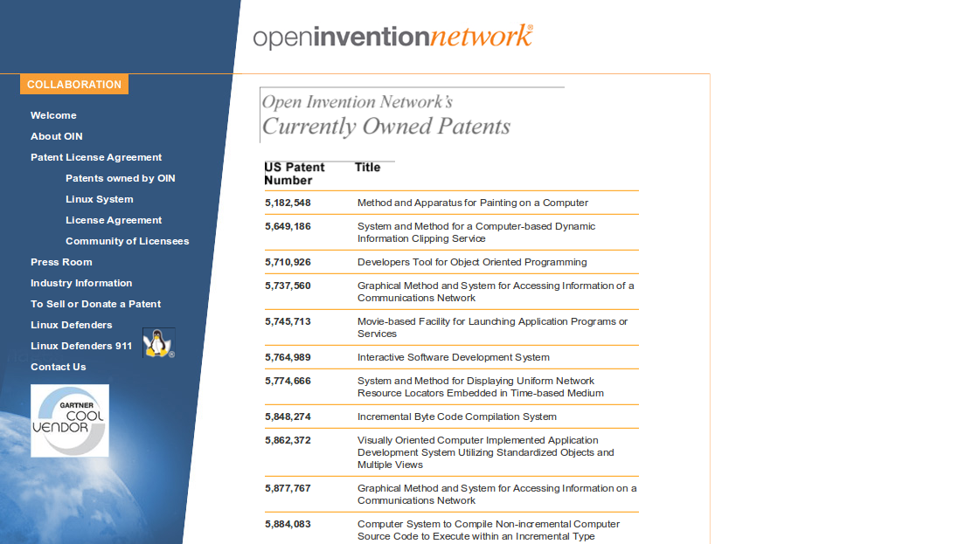

© Shane Coughlan, Licensed under CC-BY-ND 3.0 unported, avaiable at: http://www.binaryanalysis.org/images/shane.png

Slide 69
(2) GPL enforcement

Slide 70
不告而取謂之賊(Persons who take somebody else's property secretly are called thieves)

Slide 71
不告而取謂之賊(Persons who take somebody else's property secretly are called thieves)
X

Slide 72
Only if you follow the FOSS licenses

Slide 73
Useful Compliance Tips For Vendors
Copyright © 2001-2010 Free Software Foundation Europe.
Verbatim copying and distribution of this entire article is permitted in any medium, provided this notice is preserved.
Last changed: 2010-07-17 10:47:49 +0000 (Sat, 17 Jul 2010) (shane)

Slide 74
Basic Guidelines:
1. Check if the source code of the software is available to users.
2. Check if you are the copyright holder of the software and if you include Free Software copyrighted by third parties make sure you give proper credit.
3. Check if you are distributing the correct version of the source code. The source code shipped must be the same source code used to build the binary.
4. Check if you include the source code for any derivative works of the GNU GPL code you are using, not just of the third-party GNU GPL components themselves.
5. Check if you include the scripts used to control compilation and installation.
6. If the toolchain is released and contains tools under the GNU GPL (like the GCC compiler), check if the source code for those tools is also released.
Copyright © 2001-2010 Free Software Foundation Europe.
Verbatim copying and distribution of this entire article is permitted in any medium, provided this notice is preserved.
Last changed: 2010-07-17 10:47:49 +0000 (Sat, 17 Jul 2010) (shane)

Slide 75
Before shipping the product:
1. Check if your purchasing contracts require suppliers to disclose the presence of any GPL software.
2. Check if your suppliers provide all the materials you need to comply with the GNU GPL licence.
3. It helps to ensure that if your supplier turns out to not comply with the GPL they agree to rectify the situation in a timely fashion.
Copyright © 2001-2010 Free Software Foundation Europe.
Verbatim copying and distribution of this entire article is permitted in any medium, provided this notice is preserved.
Last changed: 2010-07-17 10:47:49 +0000 (Sat, 17 Jul 2010) (shane)

Slide 76
Shipping the product:
1. Check if a copy of the GNU GPL licence is shipped with the product.
2. Check if a copy of the source code is shipped with the product or that you include a written offer to provide the source code on a physical media like a CD ROM for no more than the cost of production and shipping.
3. Remember you cannot offer a download link to the source code instead of a written offer to ship the source code on physical media. You can supplement the written offer with a reference to a download site. This may reduce the number of requests for source code.
4. Remember that if you distribute binaries over the Internet you must host the source code on a server that you operate or that is operated by someone you have an explicit arrangement with.
Copyright © 2001-2010 Free Software Foundation Europe.
Verbatim copying and distribution of this entire article is permitted in any medium, provided this notice is preserved.
Last changed: 2010-07-17 10:47:49 +0000 (Sat, 17 Jul 2010) (shane)

Slide 77
GNU GPL Compliance in Embedded Devices
Harald Welte from gpl-violations.org

Slide 78
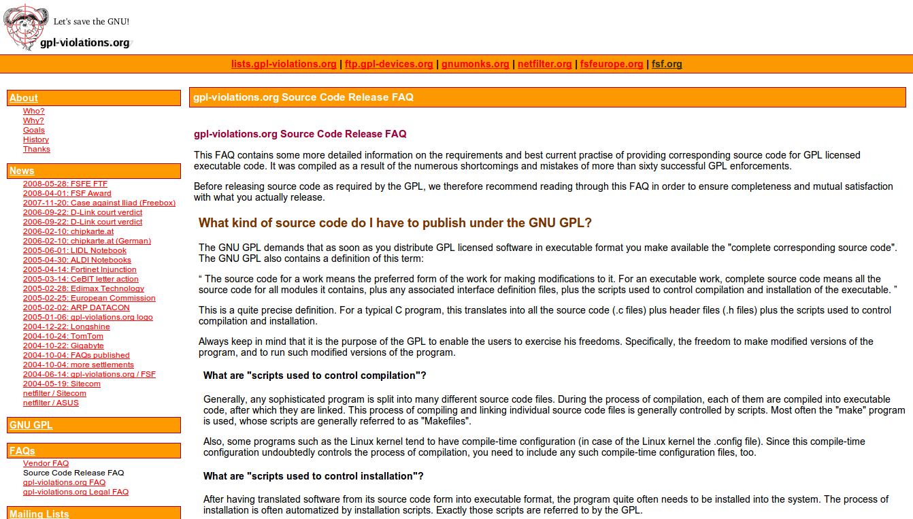
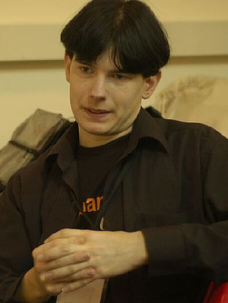

© Harikrishnan C. Licensed under CC-BY-SA 2.0 unported, avaiable at: http://commons.wikimedia.org/wiki/File:Harald_welte.jpg
© Fair use, available at: http://www.linux-magazin.de/NEWS/Skype-gegen-Harald-Welte-Skype-zieht-Einspruch-zurueck-GPL-bestaetigt.

Slide 79
(3) Supply chain

Slide 80
Trend

Slide 81
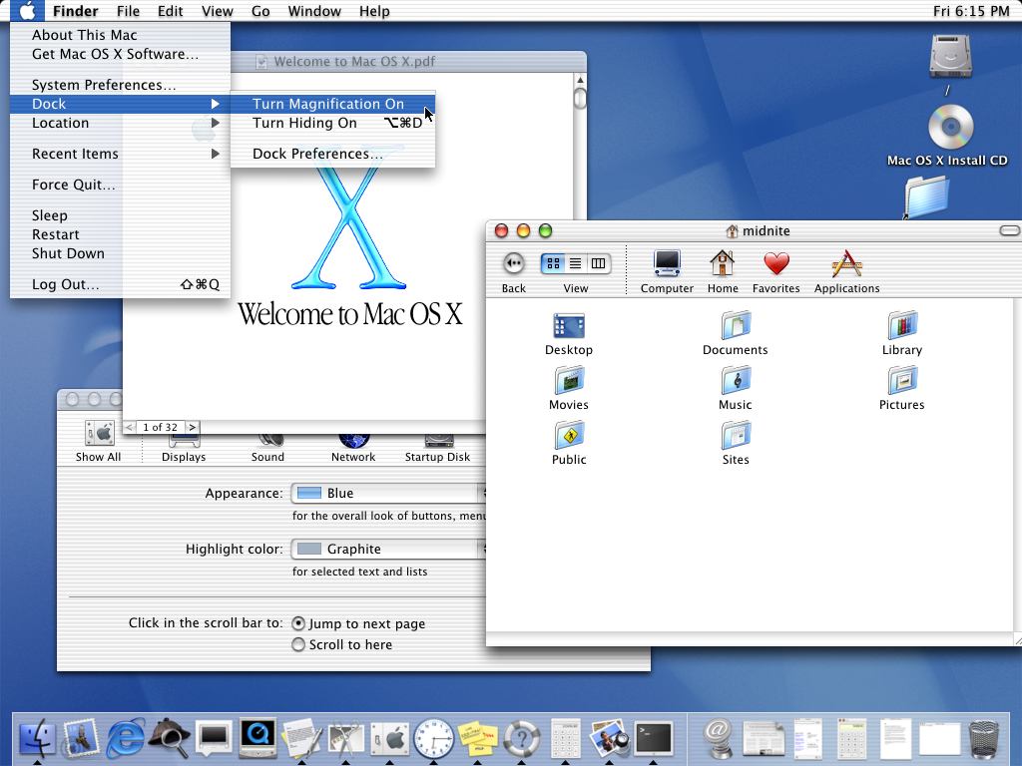

Slide 82
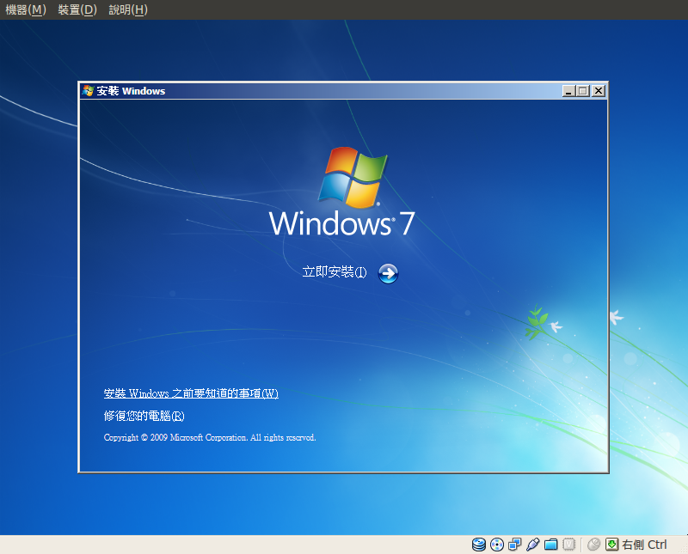

Slide 83
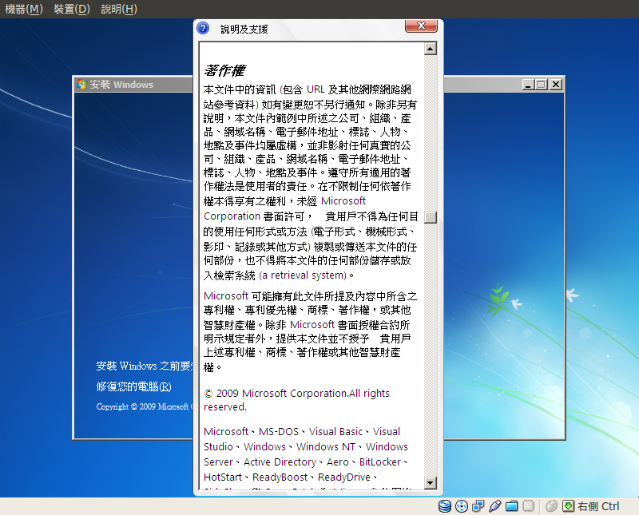

Slide 84
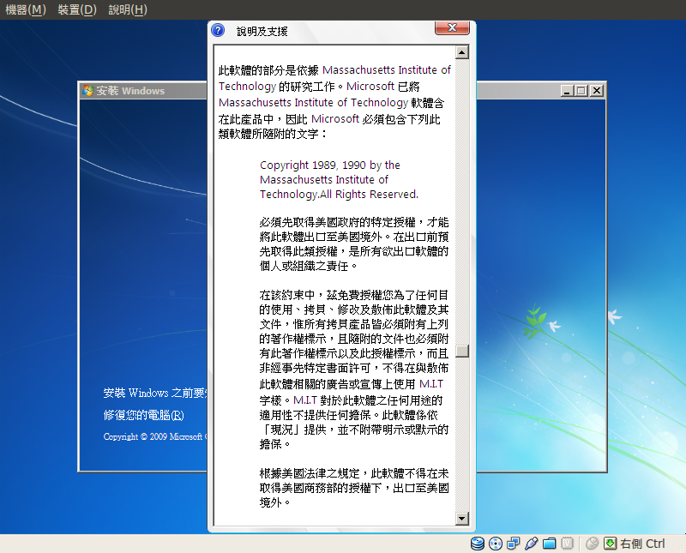

Slide 85
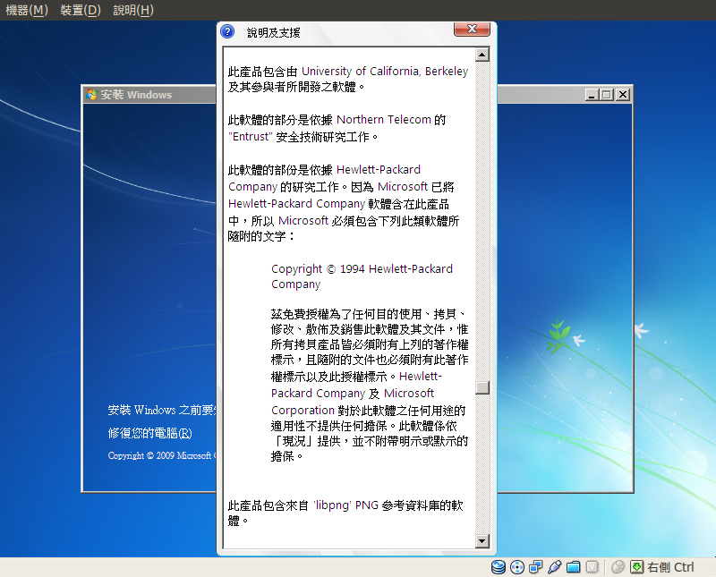

Slide 86
Start a project linking with Open Source components

Slide 87
Policy

Slide 88
Advantages & Disadvantages

Slide 89
When there are more advantages than disadvantages, it worths doing.

Slide 90
In early stages:
To release or not to release?

Slide 91
Nowadays:
How to release the source codes properly?

Slide 92
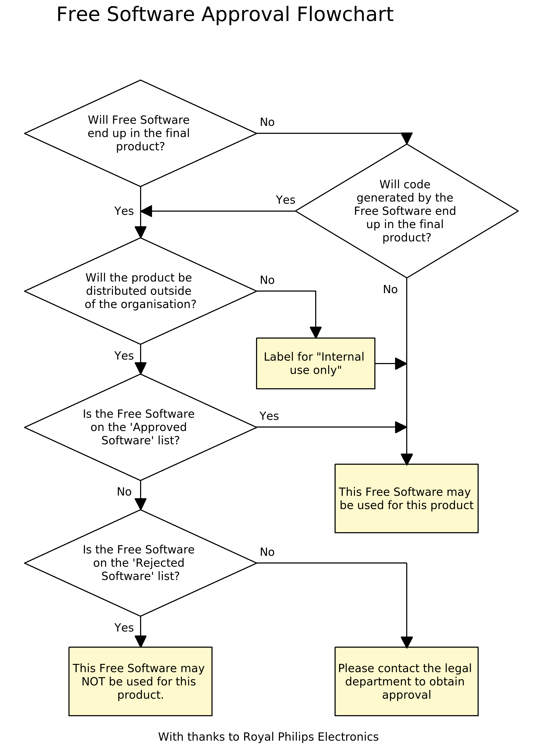
© CC BY-ND 3.0 Unported License, The chart is at p18 of the slide “Licensing Compliance as Business Intelligence”, http://www.openfoundry.org/component/option,com_docman/Itemid,112/gid,1095/task,doc_download/ .

Slide 93
How enterprises collaborate in the FOSS supply chain?

Slide 94
Implementation of a FOSS License Compliance Program
Soeren Rabenstein from ASUSTeK Computer Inc.

Slide 95
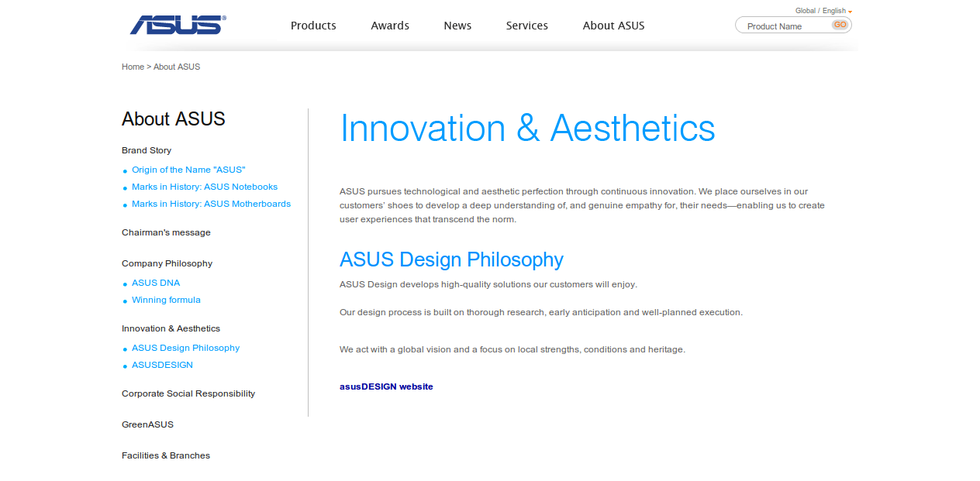

© Sören Rabenstein, fair use, avaiable at: http://media.linkedin.com/mpr/mpr/shrink_80_80/p/3/000/024/31b/18cc8b3.jpg

Slide 96
FOSSology 開放源碼軟體授權分析工具(2009)
Yi-Feng Tzeng(曾義峰, Ant)
http://www.youtube.com/watch?v=tz-Jj-VAkxA
http://www.openfoundry.org/of/projects/1342

Slide 97
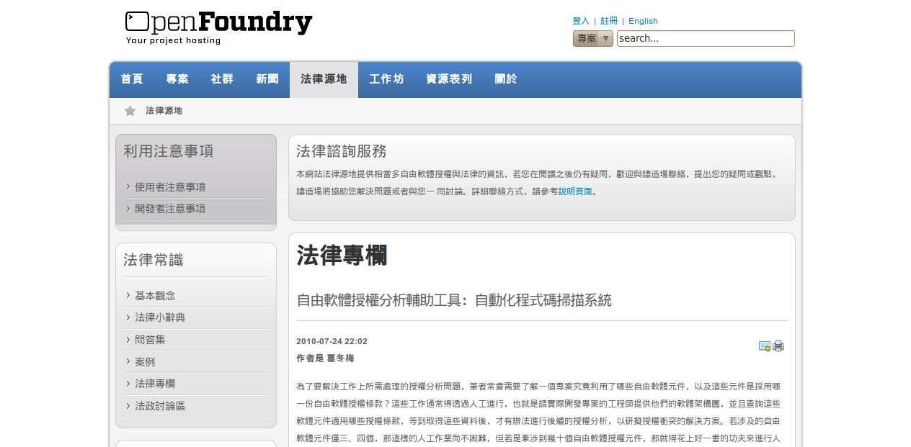
http://www.openfoundry.org/law-and-licenses
http://www.openfoundry.org/of/projects/1/rt/report
contact@openfoundry.org

Slide 98
OpenFoundry
contact@openfoundry.org
http://www.openfoundry.org/tw/law-and-license-forum
+886-2-27883799 EXT.1404、1474 (booth)

Slide 99
COPYING
Except where otherwise noted, content of this slide is licensed under a Creative Commons Attribution-ShareAlike 3.0 Unported License.
You are allowed to reproduce and distribute the content of this slide only if you preserve the author's attribution and distribute this slide and its derivative works precisely under the Creative Commons Attribution-ShareAlike 3.0 Unported License.
Some pictures and contents in this slide are downloaded from the internet, declaring as FAIR USE by the original slide author in FOSS promotion activities and can not allow to be redistributed continuously unless the redistributors also declare FAIR USE by themselves.
THANK YOU
Website: lucien.cc
Phone: 886-2-2788-3799 ext. 1404
Notes:
<編號>

