Slide 1
互動技術於自由軟體
Tai-Wei Kan
7533967@gmail.com

Slide 2
Interactive Technology
互動技術

Slide 3
Interactive Technology
OpenFramework
Laser Tag
Processing
Touchlib
Pure Data
Arduino
ARToolKit

Slide 4
Augmented Reality
擴增實境

Slide 5
What is
Augmented Reality?
The definition of Azuma [1997]:
“Augmented Reality is a technology which:
1. Combines real and virtual imagery [顯示設備]
2. Is interactive in real time [人機互動]
3. Registers the virtual imagery with the real world” [相機追蹤]

Slide 6
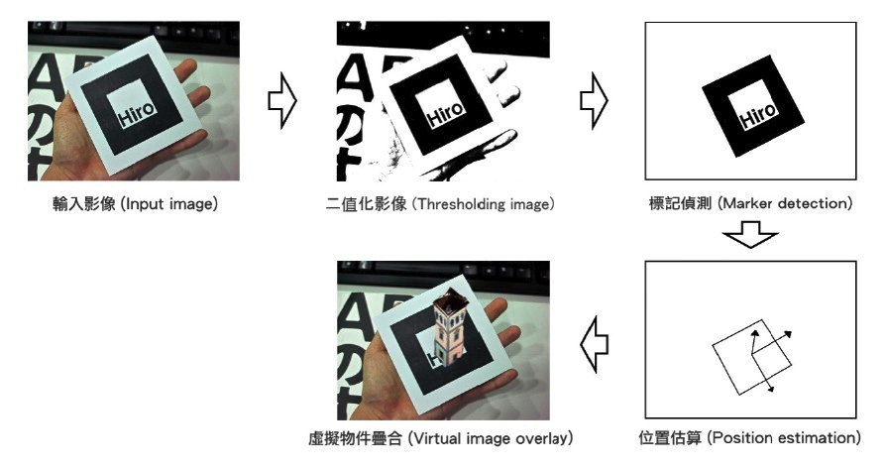
AR Tracking Work

Slide 7
What is
Augmented Reality?
Marker-based
Markerless
-Feature Point
-Location-based

Slide 8
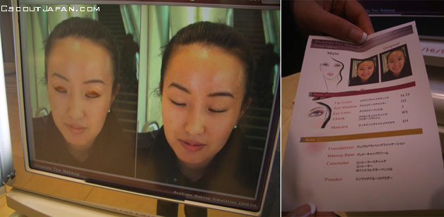
AR Cosmetic Mirror
擴增實境化妝鏡
http://www.youtube.com/watch?v=R5zZ5qZP5Ok

Slide 9
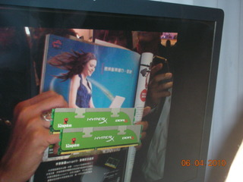
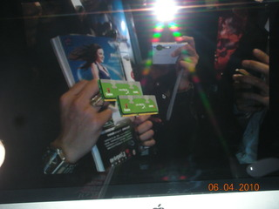
AR Advertisement
擴增實境廣告(GQ雜誌)
金士頓科技，http://kingston.oc.com.tw/article/?aid=42649

Slide 10
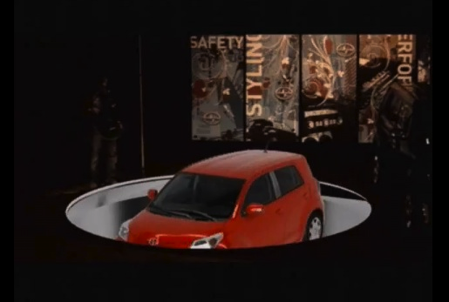
AR Interactive
Live Show
擴增實境展示
http://www.youtube.com/watch?v=bZ8htZMB0pY

Slide 11
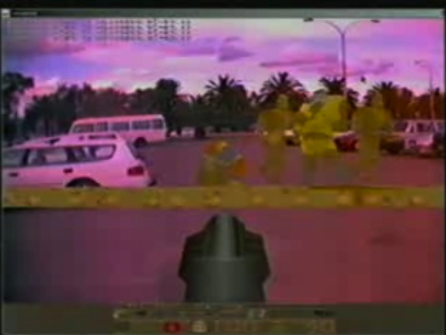
AR Quake
擴增實境遊戲
http://www.youtube.com/watch?v=Qb5rACCUC1g

Slide 12

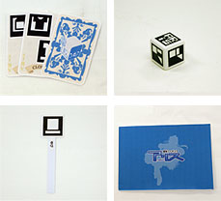
ARis
擴增實境遊戲
http://www.youtube.com/watch?v=yCCx7zANsGE

Slide 13
AR Urban Planning
擴增實境都市規劃
havnespil.dk
http://havnespil.dk/graphics/havnebilleder/artikler/wbi_presentation.pdf

Slide 14
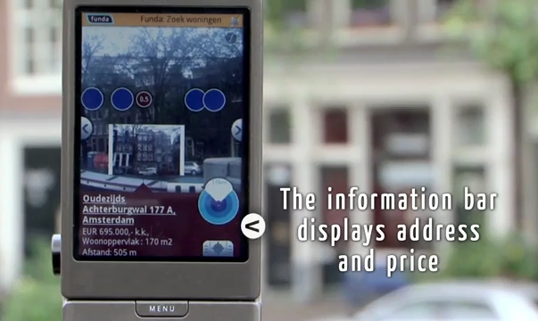
Location-based Mobile AR
適地性行動擴增實境
http://www.youtube.com/watch?v=b64_16K2e08

Slide 15
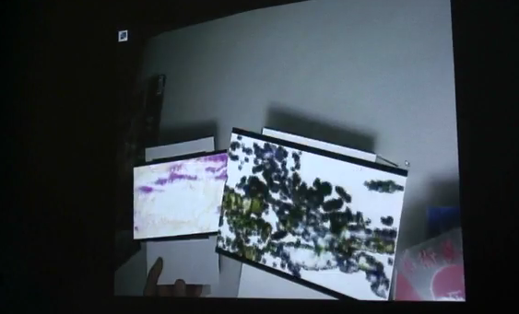
Digital Arts
數位藝術創作
繼續呼吸之層級美學
http://www.youtube.com/watch?v=b16PYbrpGLA

Slide 16
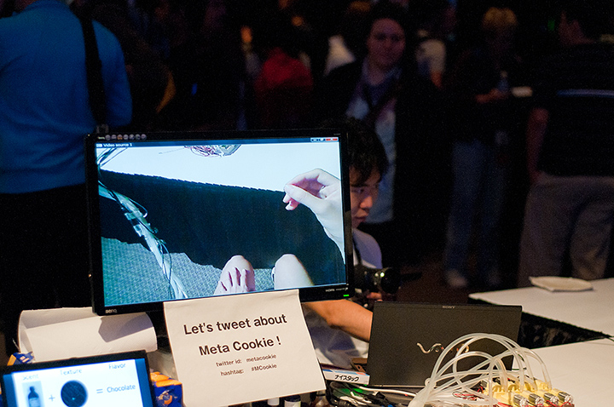
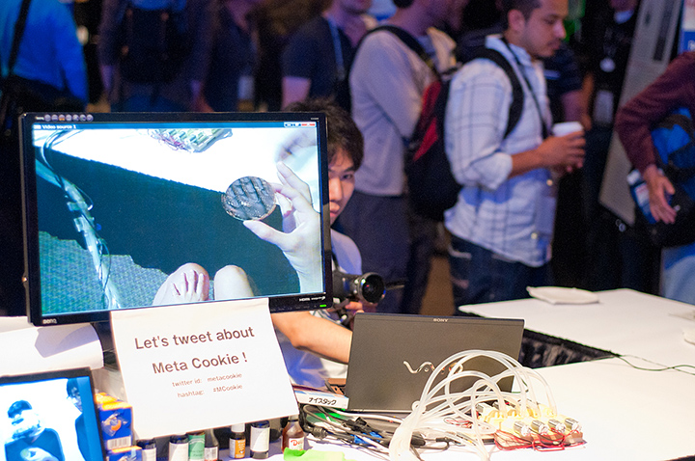
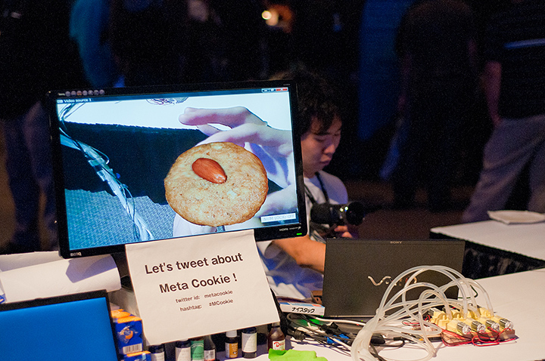
AR Tech in SIGGRAPH 2010

Slide 17
Augmented Reality
Games
Commercial
Educations
Medical Surgery
Mobile Applications
Urban Planning
Digital Arts

Slide 18
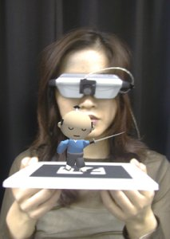
ARToolKit
ARToolKit是由日本加藤博一 (Hirokazu Kato)先生及華盛頓大學HITLab (Human Interface Technology Laboratory)於1999年所共同開發的一套以C/C++為開發語言的跨平台擴增實境函式庫。此函式庫可及時從輸入裝置(如攝影機)所輸入的影像中追蹤標記，並算出相機至實體標記之距離、位置及方向，最後再將虛擬三維物件繪於現實的標記上方
http://www.hitl.washington.edu/artoolkit/

Slide 19
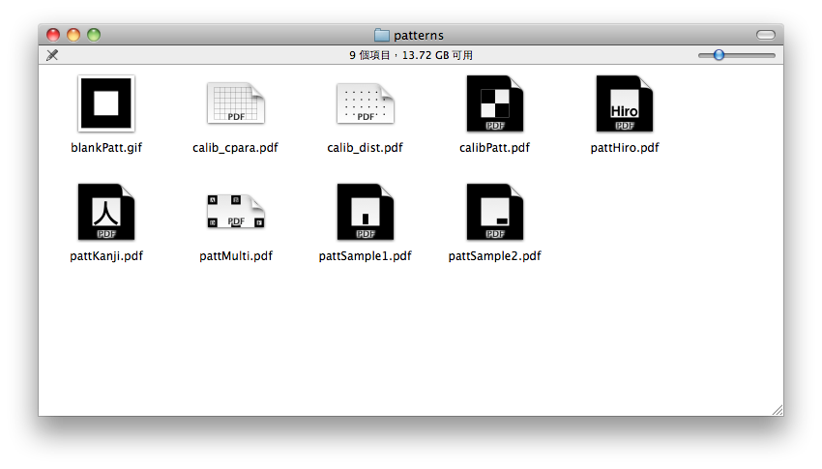
ARToolKit

Slide 20
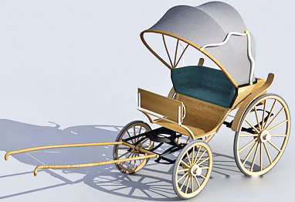


ARToolKit
3D Design
VRML/OpenGL
2D Design
Customized Markers

Slide 21
Others
DART
NyARToolKit
FLARToolKit
PozARToolKit
iPhone ARKit

Slide 22
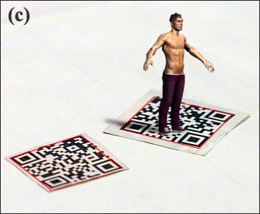
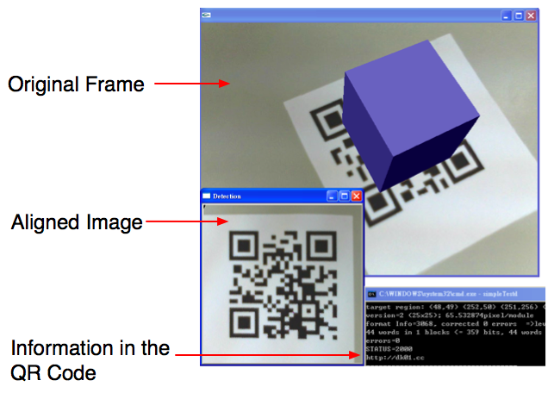
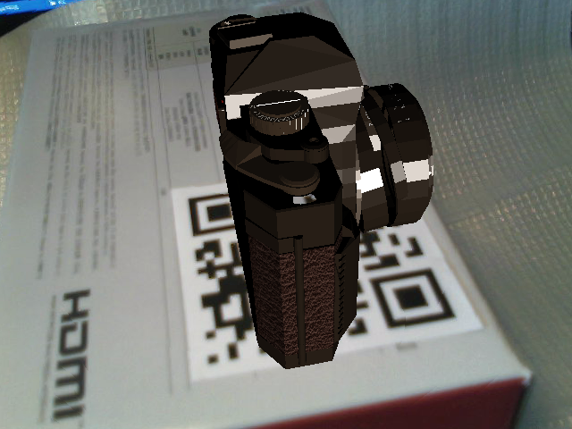
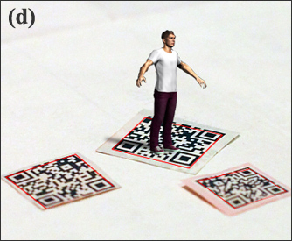
Our Works
Applying Universal QR Code
in Augmented Reality Applications

Slide 23
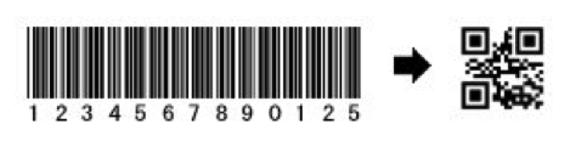
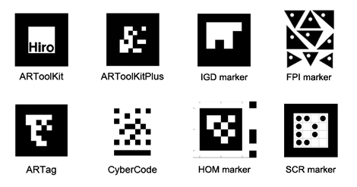
Our Works
Applying Universal QR Code
in Augmented Reality Applications
QR Code兼顧了：
1 高儲存容量
2 較小的圖形面積
3 較快的讀取速度
4 錯誤更正率最高可達30%

Slide 24

Our Works
Comparison of QR Code with fiducial markers

Slide 25
ARToolKit
Starting your first example on ARToolKit
ARToolKit HomePage http://www.hitl.washington.edu/artoolkit/
NyARToolKit http://nyatla.jp/nyartoolkit/wiki/index.php?FrontPage.en
DKBLOG http://jwill.pixnet.net
http://www.twkan.com

