Slide 1
Introducing GStreamer
The media framework on GNU/Linux
$4 @ COSCUP 2010

Slide 2
$4
http://fourdollars.blogspot.com
http://www.plurk.com/fourdollars
fourdollars@gmail.com

Slide 3
$4 → £4
英屬曼島商肯諾有限公司
Canonical Limited

Slide 4
Ubuntu Hardware Summit 2010
9月24日
免費報名參加
http://www.ubuntu.com/uhs2010
http://www.ubuntu.com/uhs2010-zh

Slide 5
Agenda
多媒體軟體介紹
多媒體影音格式
GStreamer 基本框架
GStreamer 簡單範例

Slide 6
多媒體播放器
Mplayer
  http://www.mplayerhq.hu/
VLC
  http://www.videolan.org/
Xine
  http://www.xine-project.org/
Totem
  http://projects.gnome.org/totem/

Slide 7
影音轉檔
Mencoder
  http://www.mplayerhq.hu/
VLC
  http://www.videolan.org/
FFmpeg
  http://ffmpeg.org/

Slide 8
影音串流
VLC
  http://www.videolan.org/
Flumotion
  http://www.flumotion.net/
Icecast
  http://www.icecast.org/

Slide 9
多媒體中心
Moovida (Elisa)
  http://www.moovida.com/
Enna
  http://enna.geexbox.org/

Slide 10
GStreamer based
多媒體播放器
  Totem
影音串流
  Flumotion
多媒體中心
  Moovida
視訊錄影
  Cheese
影音剪輯
  Pitivi
影音檔案管理
  Rhythmbox

Slide 11
多媒體影音格式
封裝格式
  影像格式
  聲音格式
  字幕格式
Container
Video
Audio
Subtitle
Container
Video
Audio
Subtitle

Slide 12
封裝格式Container
WebM
MOV - QuickTime
OGG
ASF
MKV - Matroska
MP4
RM
MPEG-TS
MPEG-PS
Container
Video
Audio
Subtitle
Container
Video
Audio
Subtitle

Slide 13
影像格式Video Codec
VP8
Theora/VP3
H.263 / H.261
MPEG-4
MPEG-2 / MPEG-1
DivX
WMV
RealVideo
Container
Video
Audio
Subtitle
Container
Video
Audio
Subtitle

Slide 14
聲音格式Audio Codec
MPEG audio
  AAC
  MP3
WAV
Vorbis
WMA
RealAudio
Container
Video
Audio
Subtitle
Container
Video
Audio
Subtitle

Slide 15
字幕格式Subtitle
VobSub
SubRip
SSA/ASS
SAMI
SUB
  MicroDVD
  MPSub
  SubViewer
XSUB
Container
Video
Audio
Subtitle
Container
Video
Audio
Subtitle

Slide 16
GStreamer 基本結構
Elements 元件
Pads 接口
Bins & Pipelines 容器與管線
Communication 通訊

Slide 17
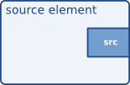
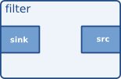
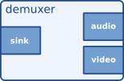
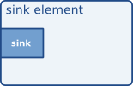
Elements元件
Source elements
Filters, convertors, demuxers, muxers and codecs
Sink elements

Slide 18
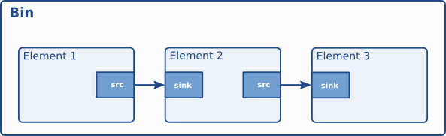
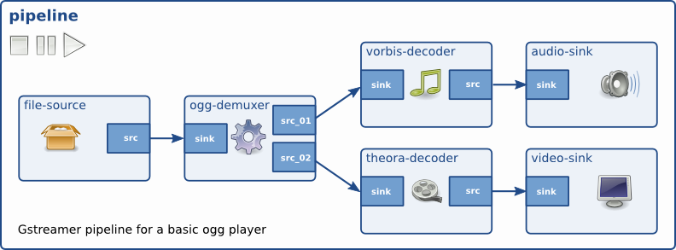
Bins & Pipelines容器與管線

Slide 19
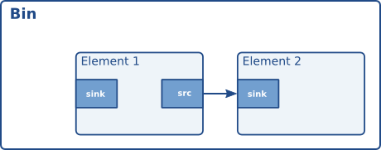
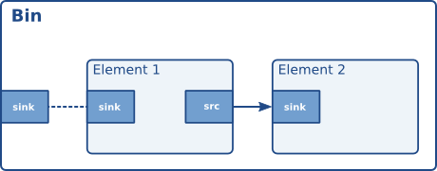
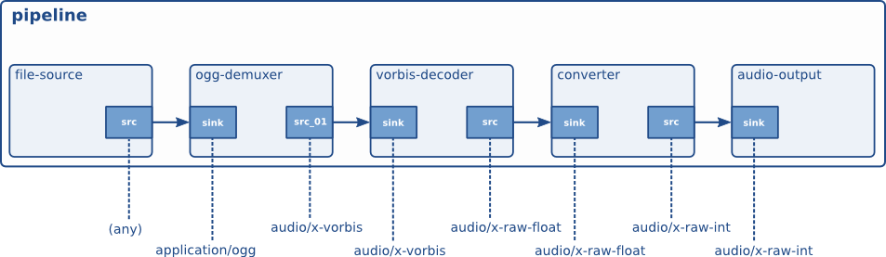
Pads 接口

Slide 20
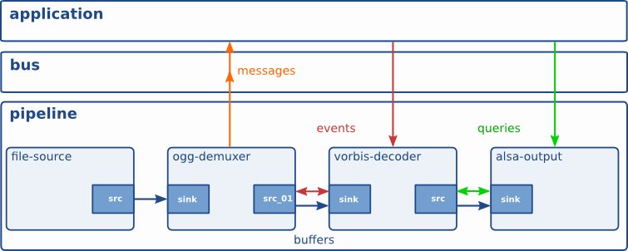
Communication 通訊

Slide 21
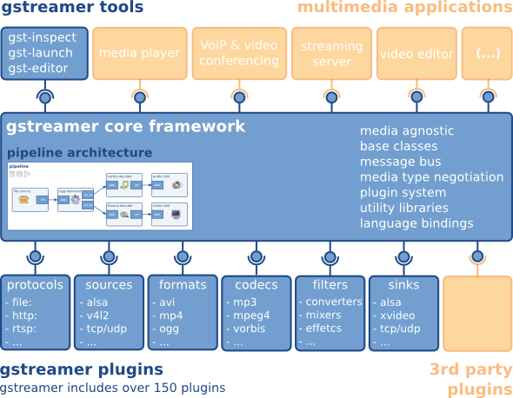
GStreamer Overview

Slide 22
GStreamer Package
gst-plugins-base
  必需的基本元件
gst-plugins-good
  在 LGPL 授權下品質良好的元件
gst-plugins-ugly
  在授權上有法律問題但是品質良好的元件
gst-plugins-bad
  品質差的元件

Slide 23
gst-inspect / gst-launch example-content
Debian / Ubuntu
  apt-get install gstreamer-tools
gst-inspect
  查詢GStreamer元件及插件資訊
gst-launch
  建立及執行GStreamer管線
example-content
  Ubuntu預設提供的範例檔案
PPA for GStreamer developers
  ppa:gstreamer-developers/ppa

Slide 24
videotestsrc / audiotestsrc
測試元件
videotestsrc / audiotestsrc
videotestsrc
xvimagesink
src
sink
audiotestsrc
pulsesink
src
sink
gst-launch videotestsrc ! xvimagesink audiotestsrc ! pulsesink

Slide 25
OGG Audio播放器
播放OGG Audio檔案
OGG audio player
filesrc
oggdemux
vorbisdec
pulsesink
src
sink
src
sink
src
sink
gst-launch filesrc location=FrustrationBlues-ColinRoss.oga ! oggdemux ! vorbisdec ! pulsesink

Slide 26
OGG Video播放器
播放OGG Video檔案
OGG video player
theoradec
xvimagesink
filesrc
oggdemux
sink
src
sink
src
sink
src
vorbisdec
pulsesink
sink
src
sink
gst-launch filesrc location=UbuntuIsHumanity.ogv ! oggdemux name=demuxer \
demuxer. ! queue ! theoradec ! xvimagesink \
demuxer. ! queue ! vorbisdec ! pulsesink

Slide 27
Radio
播放網路廣播
PTT Radio
souphttpsrc
mad
pulsesink
src
sink
src
sink
gst-launch souphttpsrc location=http://cast.ptt.cc:8000/yes ! mad ! pulsesink
KISS Radio
mmssrc
ffdemux_asf
ffdec_wmav2
pulsesink
src
sink
src
sink
src
sink
gst-launch mmssrc location="mmsh://bcr.media.hinet.net/RA000042\?MSWMExt\=.asf" ! ffdemux_asf ! ffdec_wmav2 ! pulsesink

Slide 28
WebCam
播放視訊鏡頭畫面
WebCam
v4l2src
filter
xvimagesink
src
sink
src
sink
gst-launch v4l2src ! 'video/x-raw-yuv,width=320,height=240' ! xvimagesink

Slide 29
Record
邊聽邊錄下網路廣播
Record
pulsesink
souphttpsrc
mad
tee
sink
src
sink
src
sink
src
audioconvert
vorbisenc
oggmux
filesink
sink
src
sink
src
sink
src
sink
gst-launch souphttpsrc location=http://cast.ptt.cc:8000/yes ! mad ! tee name=tee \
tee. ! queue ! pulsesink \
tee. ! queue ! audioconvert ! vorbisenc ! oggmux ! filesink location=record.oga

Slide 30
Mashup
pulsesink
souphttpsrc
mad
tee
sink
src
sink
src
sink
src
audioconvert
vorbisenc
sink
src
sink
src
oggmux
filesink
sink
src
sink
videorate
theoraenc
v4l2src
filter
tee
sink
src
sink
src
src
sink
src
sink
src
timeoverlay
xvimagesink
sink
src
sink
gst-launch --gst-debug-level=$LEVEL \
souphttpsrc location=http://cast.ptt.cc:8000/yes ! mad ! tee name=radio \
radio. ! queue ! pulsesink \
radio. ! queue ! audioconvert ! vorbisenc ! oggmux name=mux ! filesink location=mashup.ogv \
v4l2src ! 'video/x-raw-yuv,width=320,height=240' ! tee name=webcam \
webcam. ! queue ! timeoverlay ! xvimagesink \
webcam. ! queue ! videorate ! theoraenc ! mux.

Slide 31
Streaming
將視訊鏡頭的畫面轉成網路串流
網路視訊監控
Streaming
videotestsrc
filter
videorate
theoraenc
oggmux
shout2send
src
sink
src
sink
src
sink
src
sink
src
sink
gst-launch videotestsrc ! 'video/x-raw-yuv,width=640,height=480' ! videorate ! theoraenc ! oggmux ! shout2send mount=test

Slide 32
Mashup2
將網路廣播混合視訊鏡頭影像再轉成網路串流
souphttpsrc
mad
audiorate
audioconvert
vorbisenc
oggmux
shout2send
src
sink
src
sink
src
sink
src
sink
src
sink
src
sink
v4l2src
filter
videorate
theoraenc
src
sink
src
sink
src
sink
src
gst-launch souphttpsrc location=http://cast.ptt.cc:8000/yes ! mad ! audiorate ! audioconvert ! vorbisenc ! oggmux name=mux ! queue ! shout2send mount=mashup \
v4l2src ! 'video/x-raw-yuv,width=640,height=480' ! videorate ! theoraenc ! mux.

Slide 33
Thanks
CC-BY-SA
<(_::_)>

