Slide 1
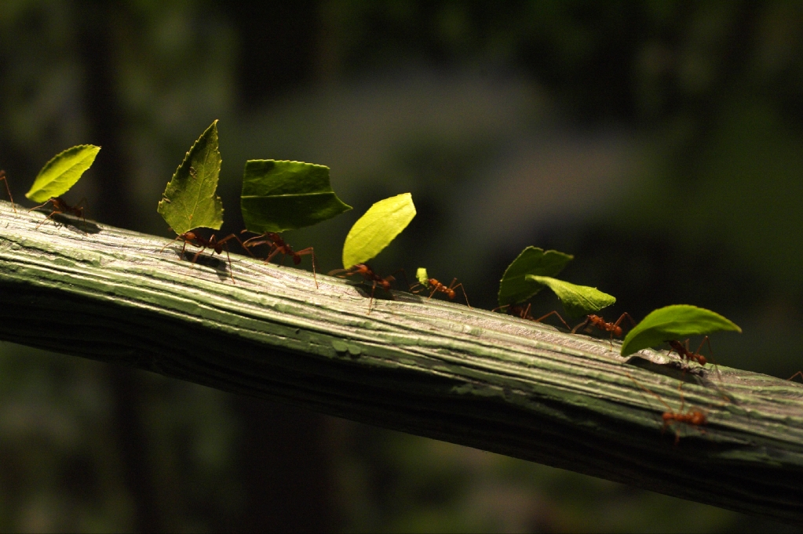

GNOME Build Env. on Solaris
OPENSOLARIS (PROJECT INDIANA)
PACKAGE DELIVERY
Dave Lin@GNOME.Asia
David Comay

Slide 2
Topics
Overview
Build Tools - CBE
Virtual Build Env. - Jail
Demo

Slide 3
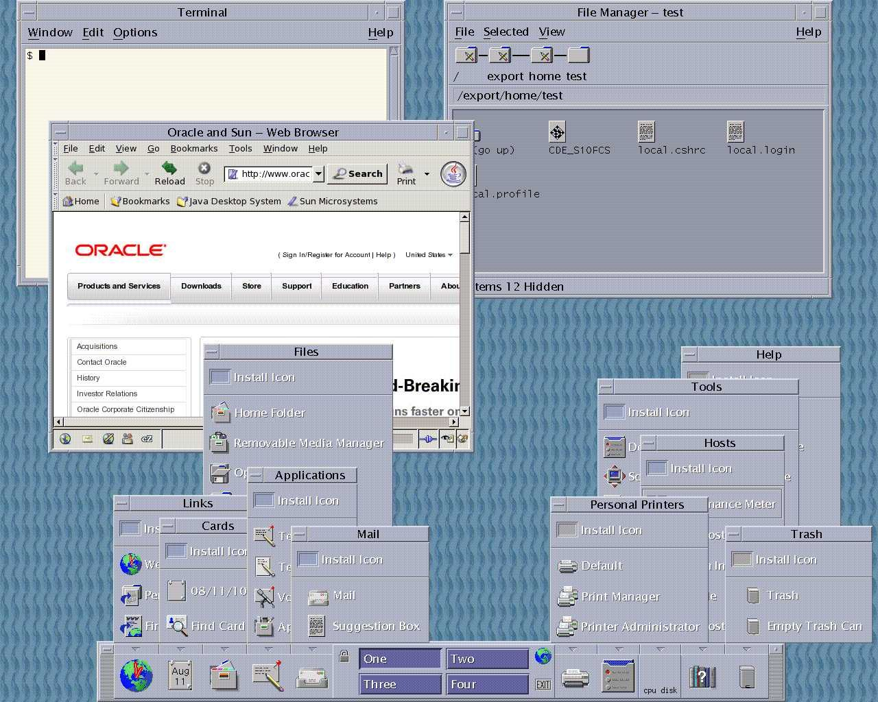
Overview - Solaris Desktop Yesterday

Slide 4







Overview
...
Open Source Communities
400 packages porting to Solaris
Solaris Deskop

Slide 5
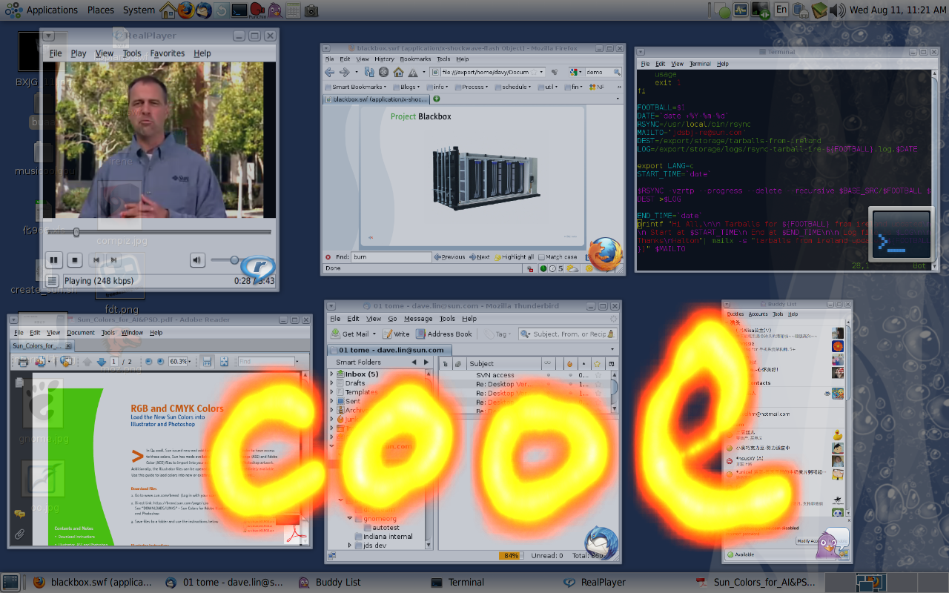
Overview - Solaris Desktop Today

Slide 6
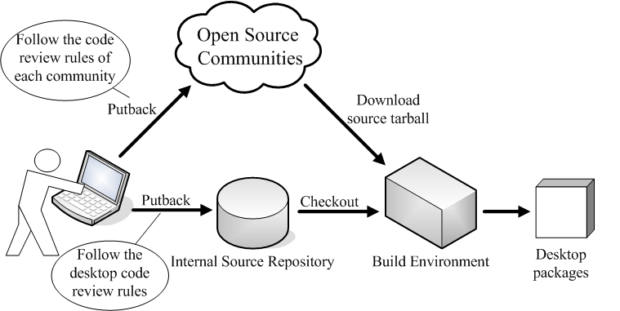
Overview
Work in Community Model

Slide 7

Overview
Internal Source Repository
RPM spec files
Internal patches
Docs
L10n files
License files

Slide 8

Overview
Upstream the patches
2.28
2.30
2.32
GNOME
upstreamed patches
internal patches
GNOME
upstreamed patches
internal patches

Slide 9
Build Tool – Common Build Env.
Common Build Tools
  pkgbuild(rpmbuild-like tool on Solaris)
  libtool, autoconf, automake, make, m4, ...
Common Env. Variables
  PATH, CC, CXX, LD, ...
Centralized Management of Configurations
  RPM spec file

Slide 10
Build Tool – pkgbuild
Rpmbuild-like Tool
Build Solaris Packages from RPM spec file
Community sources + internal patches

Slide 11
Build Tool – RPM spec file
Spec file Defines
  How to setup source tree
  How to apply patches
  How to build sources
  How to package the files
  Metainfo (name, version, etc.)

Slide 12
Build Tool – Spec file Example
Name: mypkg
Version: 1.0
Release: 1
License: CDDL
Source: http://mysite.org/mypkg-%version.tgz
Patch1: some-bugfix.diff
...
%prep
%setup -q
%patch1 -p1

Slide 13
Build Tool – Spec file Example(cont.)
%build
./configure --prefix=%{_prefix}
make
%install
make install DESTDIR=$RPM_BUILD_ROOT
%files
%{_libdir}/lib*.so

Slide 14






Build Tool – Hierarchical spec files
Solaris spec files
S-spec1
S-spec2
Solaris
packages
Linux spec files
L-spec1
L-spec2
Linux
packages
Commnunity
source tarballs,
internal patches,
...
patch3
tarball1
tarball2
patch2
patch2
patch1
patch1

Slide 15
Build Tool – Hierarchical spec files
In Solaris spec file, refer to tags/macros defined in Linux spec file(eg. foo.spec)
...
%use foo = foo.spec
...
%{foo.version}
%{foo.mymacro}
%{foo.build}
%{foo.package.summary}

Slide 16
Build Tool – Hierarchical spec files
Advantages
  Configure once, build on both Linux and Solaris
  Reuse configuraions
  Easy to maitain

Slide 17
Build Env. – Jail
What is Jail
  Based on chroot system call
  Light-weight Virtualization
  Isolated environment for running commands

Slide 18

Build Env. – Jail
/usr
/etc
/var
/jails/jail1/root/
| -- usr
| -- etc
| -- var
/jails/jail2/root/
| -- usr
| -- etc
| -- var
/usr
/etc
/var
chroot
jail1
/usr
/etc
/var
chroot
jail2
Host

Slide 19

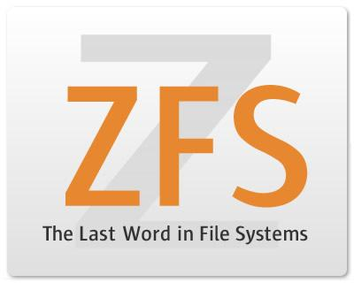
Build Env. – Jail on Solaris
Jail
?
+
=

Slide 20
Build Env. – Jail on Solaris
Take snapshot

Slide 21
Build Env. – Jail on Solaris
Clone jail (pretty fast)

Slide 22
Build Env. – Jail on Solaris
Roll back to previous snapshot

Slide 23
Demo

Slide 24
References
How to build GNOME on Solaris
  http://blogs.sun.com/mattman/entry/how_to_build_jds_on
Pkgbuild
  http://pkgbuild.sourceforge.net/
SourceJuicer
  http://jucr.opensolaris.org/home/
Maximum RPM
  http://www.rpm.org/max-rpm/index.html

Slide 25
Thank you !

