Slide 2
Javascript in Linux Desktop
Yuren Ju <yurenju@gmail.com>

Slide 3

Yuren Ju
Use Linux: 10 years
For Desktop: 7-8 years
Red Hat
Debian
Gentoo
Debian
Arch Linux
Ubuntu
Debian

Slide 4
Yuren Ju
Blog: Yuren's Info Area
Email: yurenju@gmail.com
社群
  Hacking Thursday, KaLUG
工作：ASUSTek
興趣：Python, 咖啡, Linux

Slide 5
Javascript always use in Web Applications.

Slide 6
Javascript in Linux Desktop
Web Application/Platform
Desktop Platform
Desktop Application

Slide 7









Internet
Application
Platform
.................................

Slide 8
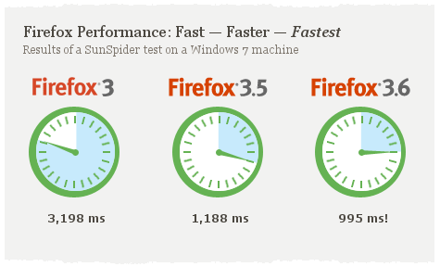
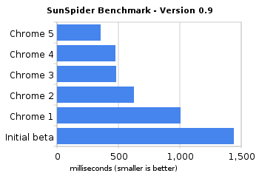
Performance

Slide 9


Opportunity!
Javascript for Web Application
Desktop Application

Slide 10
Javascript in desktop
?
Integration
Layout
Style/theme

Slide 11



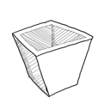
Web
Desktop
Application
Platform

Slide 12

Web Application
Layout
Style
Programming
HTML
+CSS
CSS
JS
Server side

Slide 13
Platform/Browser
Layout engine
Javascript engine
Layout
Style
Programming
HTML
+CSS
CSS
JS

Slide 14
Platform/Browser (2)
 | Firefox | Chrome
Layout engine | Gecko | Webkit
Javascript engine | SpiderMonkey | V8

Slide 15
To Desktop Application

Slide 16
Desktop - Platform
XULRunner (Mozilla platform)
GNOME Javascript runtime
  GJS/Seed

Slide 17
XULRunner
Programming in Web Browser!

Slide 18







Mozilla applications

Slide 19
XULRunner
Gecko layout engine
SpiderMonkey
Layout
Style
Programming
XUL
CSS
JS
DOM
Demo: http://www.hevanet.com/acorbin/xul/top.xul

Slide 20
Mozilla Platform - integration
Mozilla Application
XPCOM/NPAPI
C++/Javascript
System

Slide 21






Mozilla Platform - integration
D-BUS
VTE
notify
Glade
GTK

Slide 22


Javascript in GNOME
Seed
  based on WebKit's JavaScriptCore
GJS
  based on Mozilla's Spidermonkey engine

Slide 23
XULRunner
Gecko layout engine
SpiderMonkey
Layout
Style
Programming
XUL
CSS
JS

Slide 24
Javascript in GNOME
GObject introspection
Seed/GJS
Programming
System
library
JS
Layout
Style

Slide 25
Javascript in GNOME
Javascript application
Javascript desktop runtime
GObject
introspection
System library
Seed/GJS
C API: GTK, Gstreamer,
Clutter, Glib, etc.
Javascript engine
JavascriptCore/SpiderMonkey

Slide 26
Traditional arch.
Python/Perl/Ruby..., etc.
GTK
Clutter
VTE
notify
GStreamer
Native C API

Slide 27
GObject Introspection
JS
Java
Python
Perl
Ruby?
PHP?
GI
Native C API
GTK
Clutter
VTE
notify
GStreamer

Slide 28
Metadata
using annotations in the comments

Slide 29
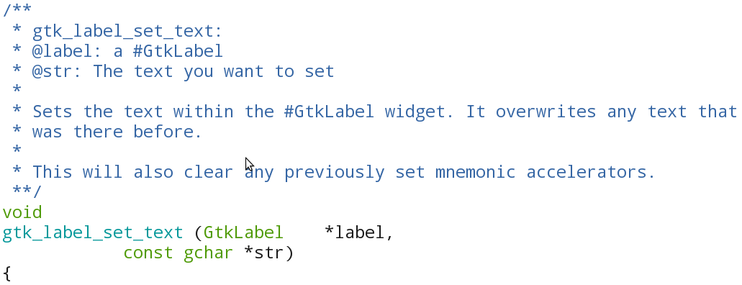
GObject Introspection
Sharing binding infrastructure work, and making the platform even more binding friendly

Slide 30
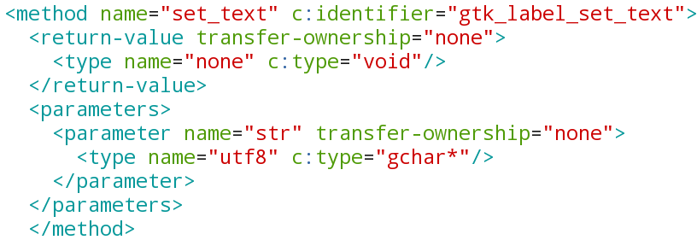
Annotations
g-ir-scanner
Gir xml file
g-ir-compiler
typelib
40 B2 02 00 10 B2........

Slide 31
GObject Introspection
foo.c
foo.h
Library source, with type annotations
Foo.gir
XML file
libfoo.so
Foo.typelib
Binary file
libffi.so
libgirepository.so
Specific language bindings

Slide 32
GObject Introspection
JS
Java
Python
Perl
Ruby?
PHP?
GI
Native C API
GTK
Clutter
VTE
notify
GStreamer

Slide 33

Seed/GJS
D-BUS
VTE
notify
Glade
GTK
$ aptitude search gir

Slide 34
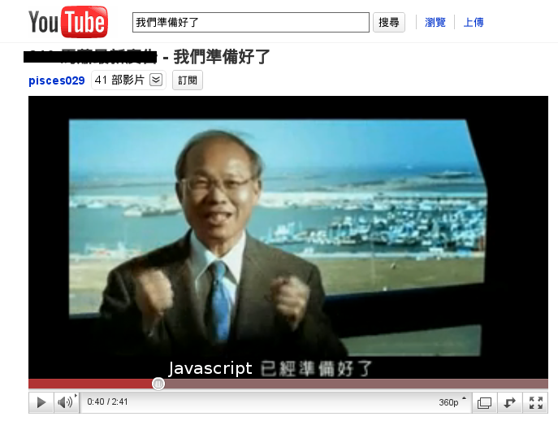
Javascript 已經準備好了！

Slide 35
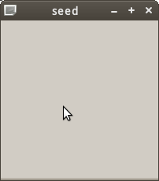
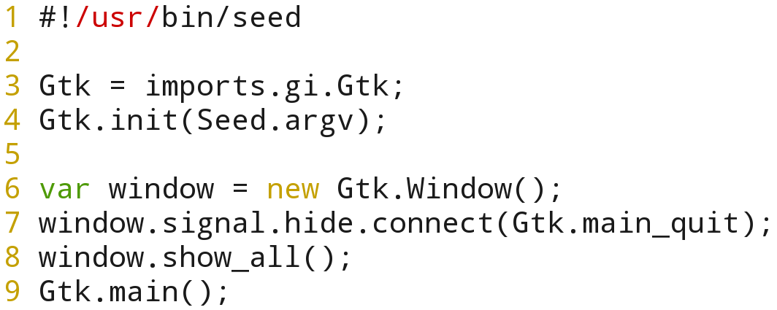
Hello world

Slide 36
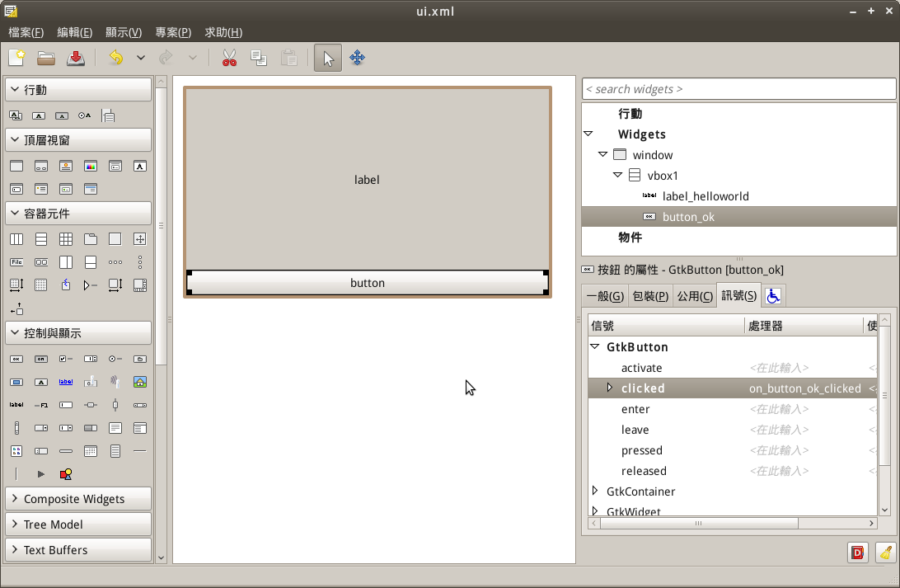
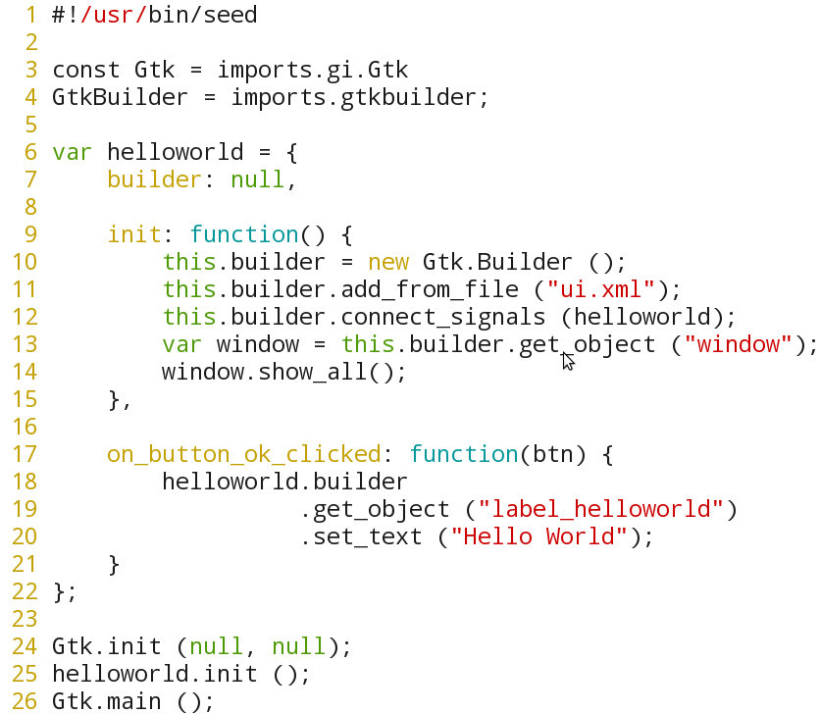
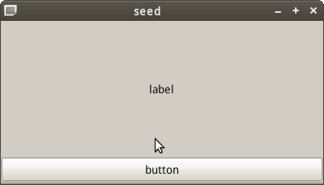
Hello world (2)

Slide 37
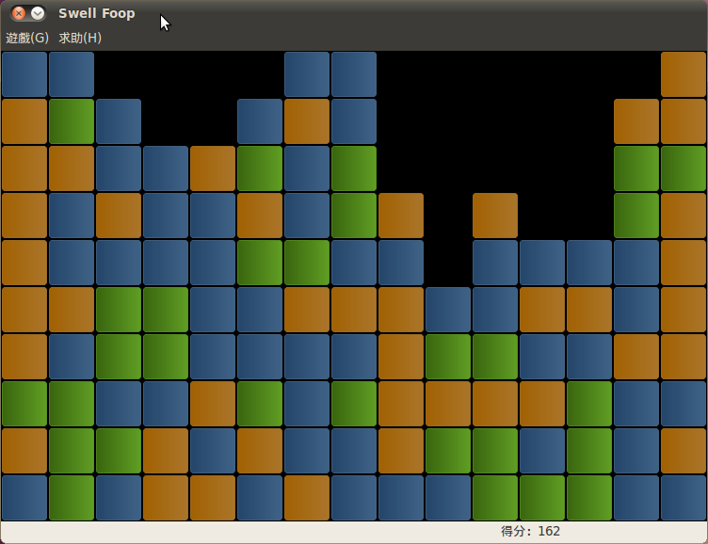
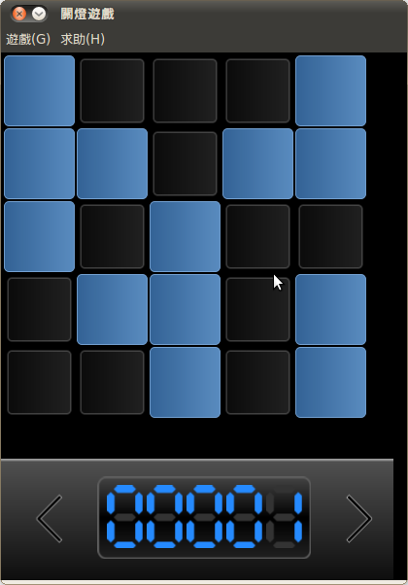
Applications based on Seed
Seed
  Swell-foop
  lightsoff

Slide 38
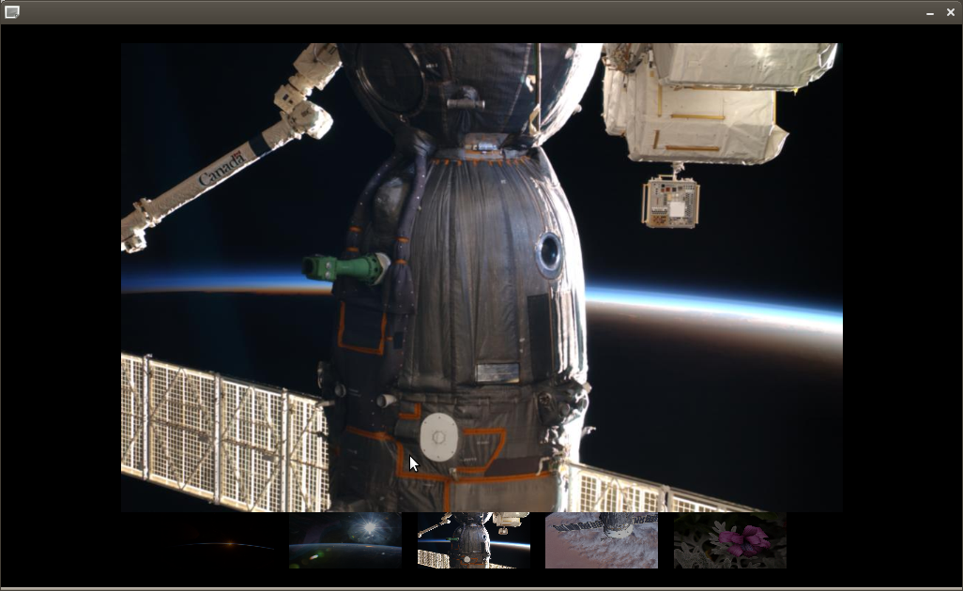
Demo - js-gallery

Slide 39
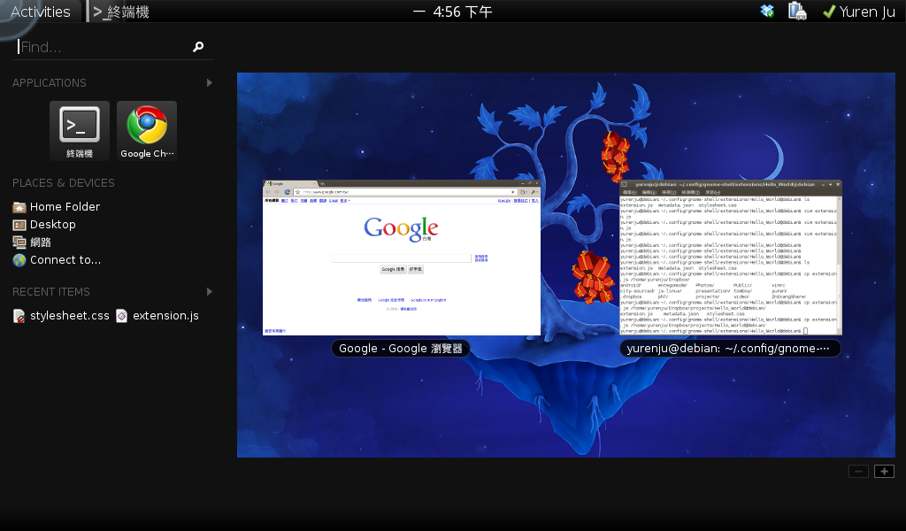
gnome-shell
Use javascript to control your desktop
file:///usr/share/gnome-shell/js/ui

Slide 40
Demo – gnome-shell extension

Slide 41
END
Thank you!

Slide 42
e.g. use native GTK API gtk_label_set_text
In java runtime

Slide 43
JNI
GI
Create a class that declares
The native method
Use javac to compile
If Java Runtime support GI...
GtkLabel label = new GtkLabel ();
label.setText ("hello");
Use javah to generate header
Write the C implementation
of the native method
Compile C code and
generate native library
JGIR
http://live.gnome.org/JGIR

Slide 44
But I have..., why GI?
Python-gtk
Ruby-gnome2
java-gnome
e.g. nautilus
  No python, ruby, java binding...

Slide 45
Layout/Theme
GTK – gtk-theme-engine
Gnome-shell (shell toolkit) – libcroco (CSS)
MX toolkit – CSS

Slide 46


GJS vs seed
EMCAScript support
  GJS support javascript 1.8.1 extensions
  Seed support javascript 1.5
  for each, let, etc.
  [item * 2 for each (item in list)]

Slide 47
Return values
GJS
  print (texture.get_base_size());
Seed
  var height = {}, width = {};
  texture.get_base_size (width, height);
  print (“width: ” + width.value + “, height: “ + height.value)

Slide 48
Clutter fine tune
GJS
  No Actor.animate function
Seed
  workaround for Actor.animate
  But seed-2.28/2.30 use different event mapping

Slide 49
Signal
GJS
  actor.connect ("signal-name", callback)
Seed
  actor.signal["signal-name"].connect (callback)
  actor.signal.destroy.connect (callback)

Slide 50
Presentation License
CC Attribution 3.0 Unported
http://creativecommons.org/licenses/by/3.0/

Slide 51

Images License
Creative Commons (Attribution-Share Alike 3.0 Unported)
http://www.iconfinder.com/search/?q=iconset:sketchy
http://www.iconfinder.com/search/?q=iconset:49handdrawing

