Slide 1

The Culture of Sharing
COSCUP / GNOME.Asia 2010

Slide 2
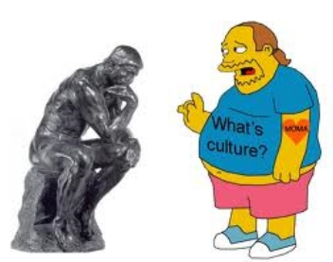
What is culture

Slide 3
What is culture
The set of shared attitudes, values, goals, and practices that characterizes an institution, organization or group

Slide 4
What is culture
The set of shared attitudes, values, goals, and practices that characterizes an institution, organization or group
An integrated pattern of human knowledge, belief, and behavior that depends upon the capacity for symbolic thought and social learning

Slide 5
Cultura
Colere

Slide 6
To cultivate

Slide 7
To cultivate
To inhabit

Slide 8
To cultivate
To inhabit
To admire

Slide 9

To care

Slide 10


Slide 11
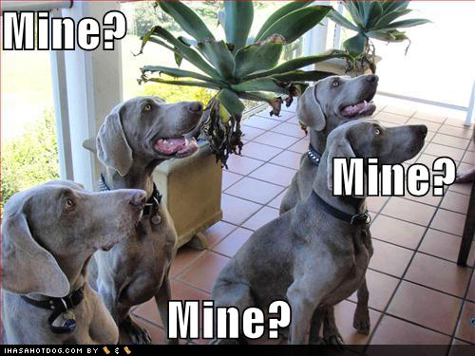

Slide 12
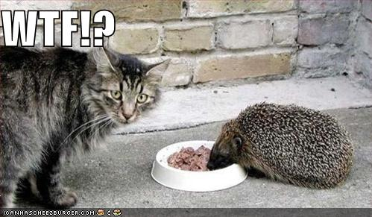

Slide 13
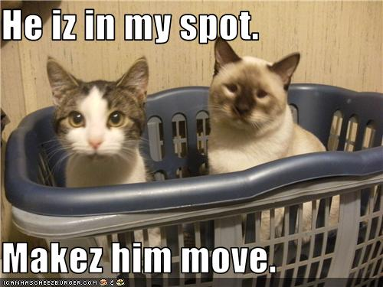

Slide 14


Slide 15
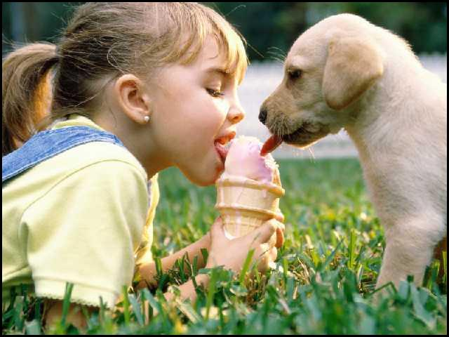

Slide 16
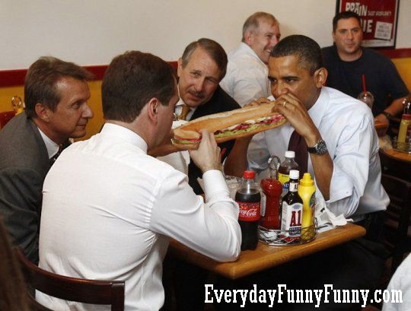

Slide 17
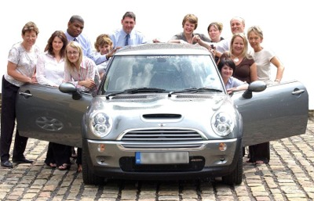

Slide 18


Slide 19


Slide 20


Slide 21


Slide 22


Slide 23


Slide 24


Slide 25


Slide 26


Slide 27







Slide 28


Slide 29
Crowdsourcing
and
Swarm Intelligence

Slide 30
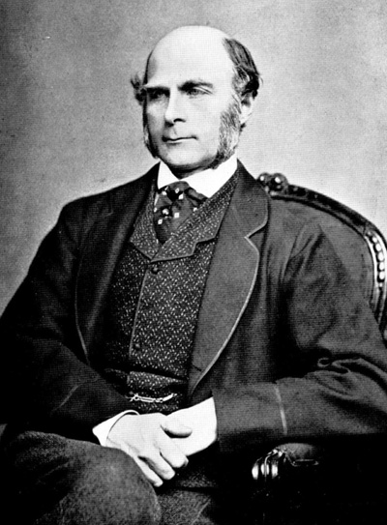
Francis Galton

Slide 31
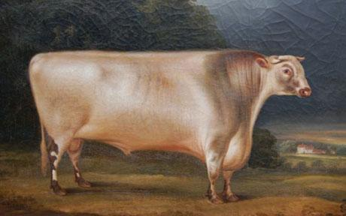

Slide 32
Guess the weight of the bull
800 participants

Slide 33
Guess the weight of the bull
800 participants
Average guessed weight: 1197 pounds

Slide 34
Guess the weight of the bull
800 participants
Average guessed weight: 1197 pounds
Weight of the bull: 1198 pounds

Slide 35
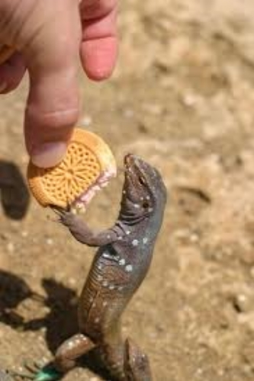
Sharing is caring!

Slide 36
follow me
Twitter: sascha_p
http://www.facebook.com/pallenberg
http://www.netbooknews.com

