Slide 1
A Beautiful Mistake
What was learned about App Engine with the registration system
Pingooo
(COSCUP team)
2010-08-15
COSCUP / GNOME.Asia 2010

Slide 2
Disclaimer (legal)
The content of this talk is the speaker's personal opinion and is not the opinion or policy of his employer or COSCUP Team.
The slide file is released under Creative Commons Attribution-ShareAlike 3.0 Unported License (CC-BY-SA).
The code mentioned in this slide is released under MIT license, available at http://code.google.com/p/eva-fun/.

Slide 3
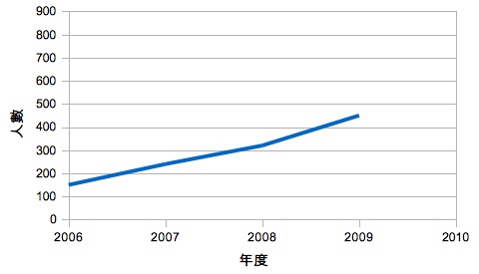
The Growth of COSCUP

Slide 4
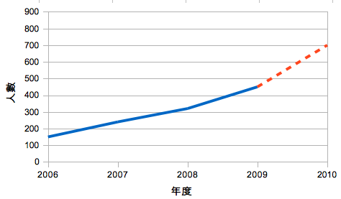
The Growth of COSCUP
?

Slide 5

總召Jouston:
「話說回來，若是可以辦到700人以上，
我就在2010慶功宴上倒立做伏地挺身。」
— 2009/08/24

Slide 6
行銷組的使命
「讓更多人知道COSCUP、
注意COSCUP、
報名COSCUP」

Slide 7
其實：讓Jouston倒立做伏地挺身

Slide 8
行銷組的努力
流了好多汗：
300張海報
98次噗浪
10次社群聚會宣傳
2份EDM，寄給2000多人

Slide 9
其實：讓Jouston倒立做伏地挺身

Slide 10
Decided to open up
610
slots

Slide 11
Traffic estimate
2009: 550 slots, registered in 4 hours 8 minutes.
  Average = 2.22/min
Prediction for this year:
  1.5x = 3.33/min
  Peak time 2x = 6.66/min

Slide 12
A small piece of cake

Slide 13
Flow of Registration
Fill e-mail, badge name and other fields on a web form and submit
The web site produces a URL containing a confirmation code and send it to the e-mail address.
Recipient of the e-mail clicks the URL to complete the registration process.

Slide 14
Really a small piece of cake.
Any computer science student can do it.

Slide 15
Other Requirements
I18n: English pages are needed, not just Chinese.
Reservation code: for important community members that can't go online when the registration opens. (different flow)
Questionnaire: collect data for marketing team and program committee.

Slide 16
Nothing but a small piece of cake.

Slide 17
App Engine i18n
Tasks:
  Enable i18n
  Internationalize messages in templates
  Translation of message files
  Browser language preference detection

Slide 18
Enable i18n in App Engine
More than one solutions
Babel: external, need download
Django: built-in, just enable the configuration
  po/mo
  make-messages.py -l zh_TW # updates django.po
  vim conf/locale/zh_TW/LC_MESSAGES/django.po
  compile-messages.py # makes django.mo

Slide 19
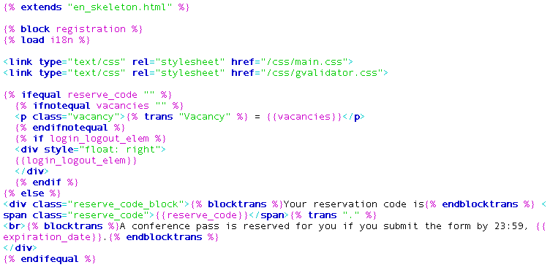

“Template Method” design pattern

Slide 20
“Template Method” design pattern
Load the i18n module

Slide 21
“Template Method” design pattern
Load the i18n module

Slide 22
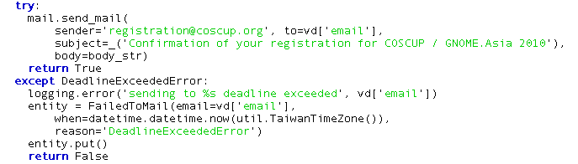
One more App Engine trick
Better have this for service calls.

Slide 23
Set the opening time
2010-07-05T20:00:00 +0800

Slide 24
But...
Need to pick up kids
Leave @ 19:45
Back @ 20:20

Slide 25
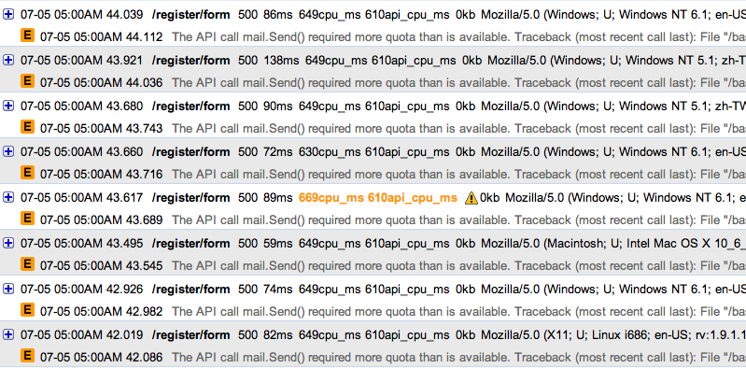
花生省魔術？
California time
Dashboard / Logs @ http://appengine.google.com/logs?app_id=foo&version_id=bar

Slide 26
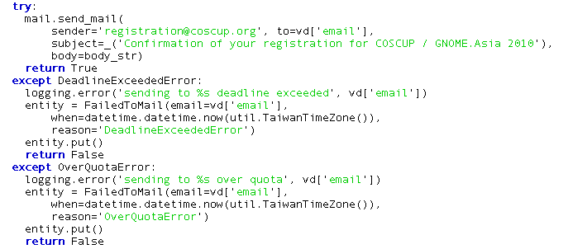

What was missing?

Slide 27
How can it be?

Slide 28
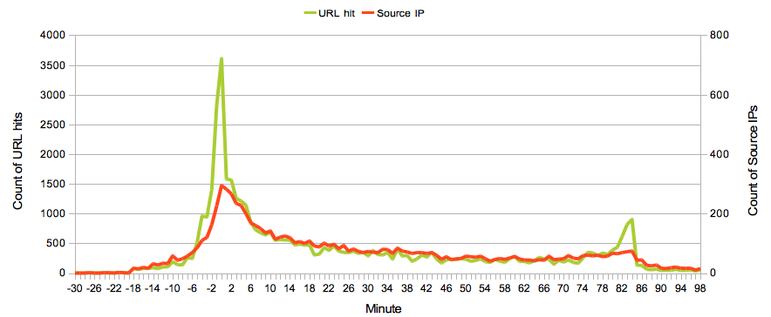
(3616 hits, 295 IPs) @ 20:00
Pingooo回到電腦前
Pingooo當司機

Slide 29
Yooooooooooooooooooooo!

Slide 30
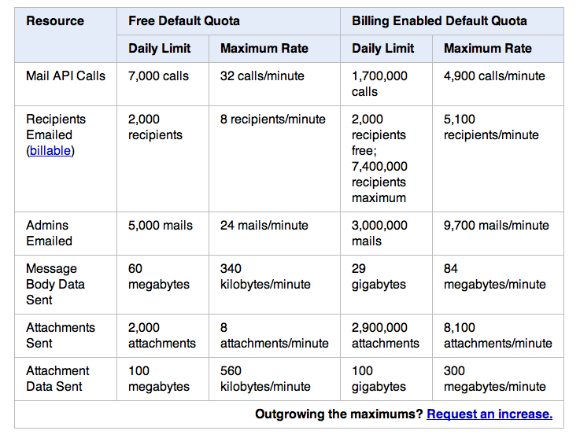
Quota?

Slide 31
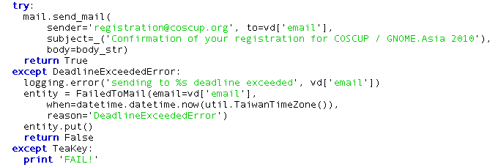
鐵齒leads to FAILURE

Slide 32



Slide 33
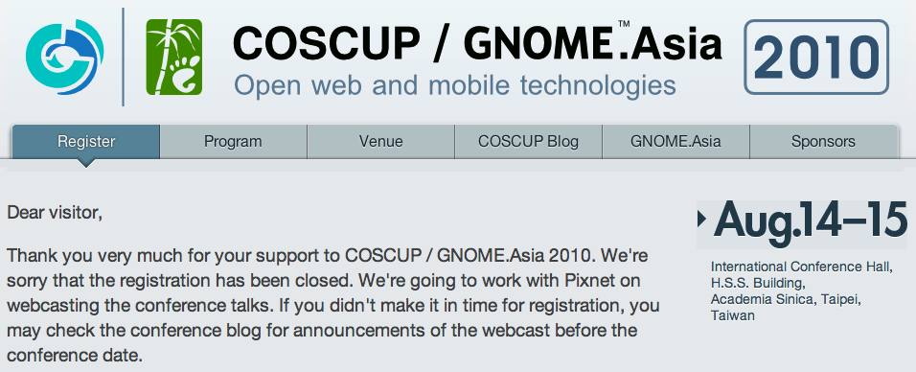
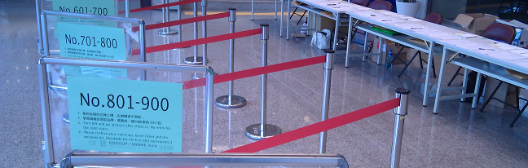
The fix: Task Queue
add
URL request
(Flow control)

Slide 34
Batch e-mails?
Can't send > 8 mails/minute
Can't run a process > 30 seconds
How to send reminder e-mails to N people?
  Submission: set up bookkeeping records in data store + add the queueing task to Task Queue.
  Queuing task: queue X e-mail tasks + self, update state in bookkeeping
  Email task: send the e-mail to one participant, update state.
Yes, you write 3 request handlers to send 1 batch of e-mails.

Slide 35
Conclusion
When using App Engine to develop your app:
You need to care where data are stored
You need to care how processes are run
You need to pay attention to quota
You need to handle exceptions for services
And you'll get scalability in return.

