Slide 1
GNOME in Asia
Emily Chen
emilychen522@gmail.com
August 15, 2010

Slide 2

Agenda
GNOME.Asia Summit
Beijing GNOME Users Group
Future Plan
Notes:
Build 72 announced available on Sept. 10, 2007 on OpenSolaris-announce forum

Slide 3
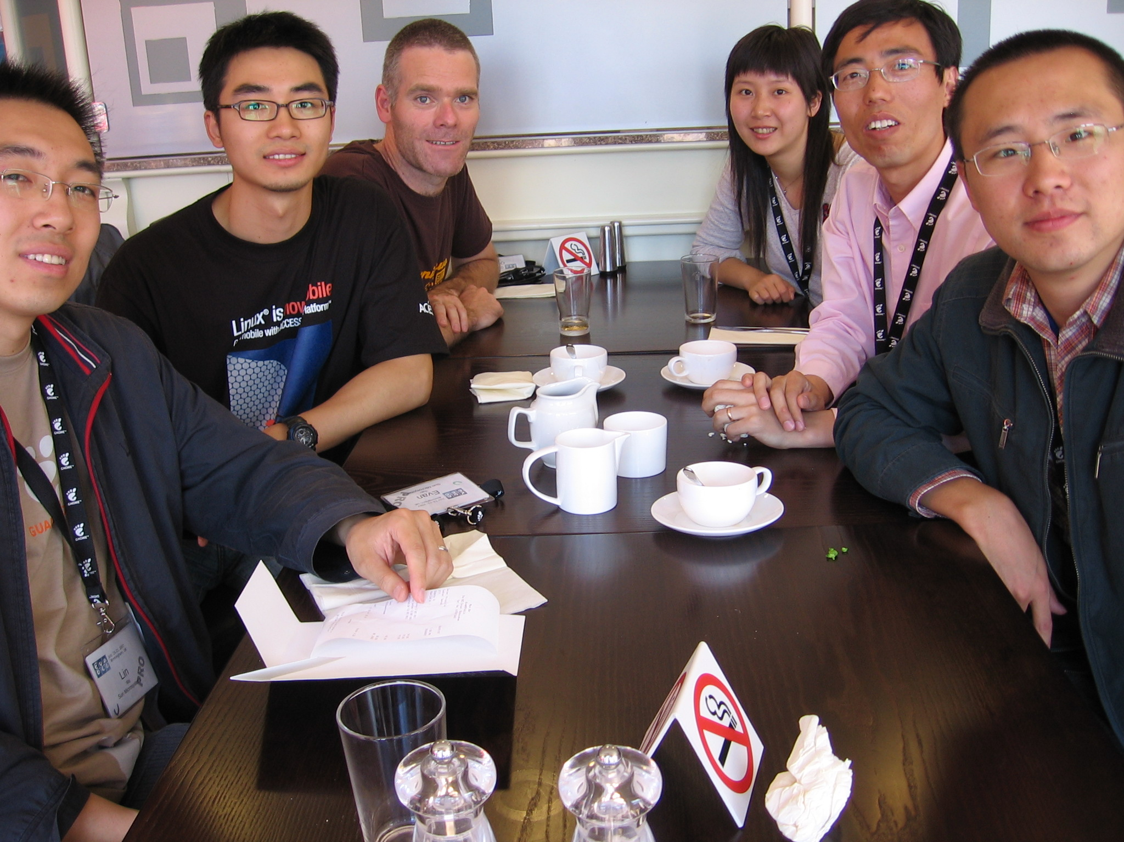
How we start it

Slide 4
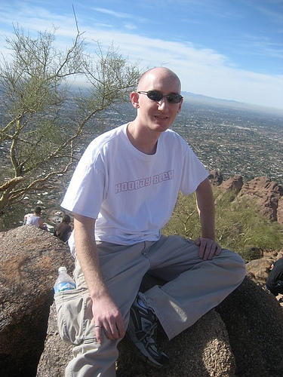



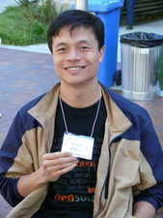

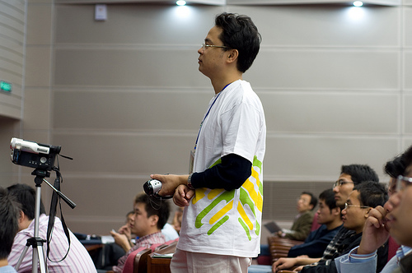
Joey
Will
Alfred

Slide 5


















Slide 6

Diki

Slide 7


Slide 8
Video of
GNOME.Asia Summit 2008

Slide 9


Slide 10
Statistics
Number of talks, workshops: 109
Speakers: 79 (34 foreigners, 8 from China)
Number of Volunteers: 138 (44, males / 94 females)
Participants countries: Vietnam, Australia, Singapore, Cambodia, India, China, Hong Kong, Taiwan, Belgium, Germany, USA, France, Ireland, and Canada
Number of participants: 1465

Slide 11

























Company & Community Participation

Slide 12
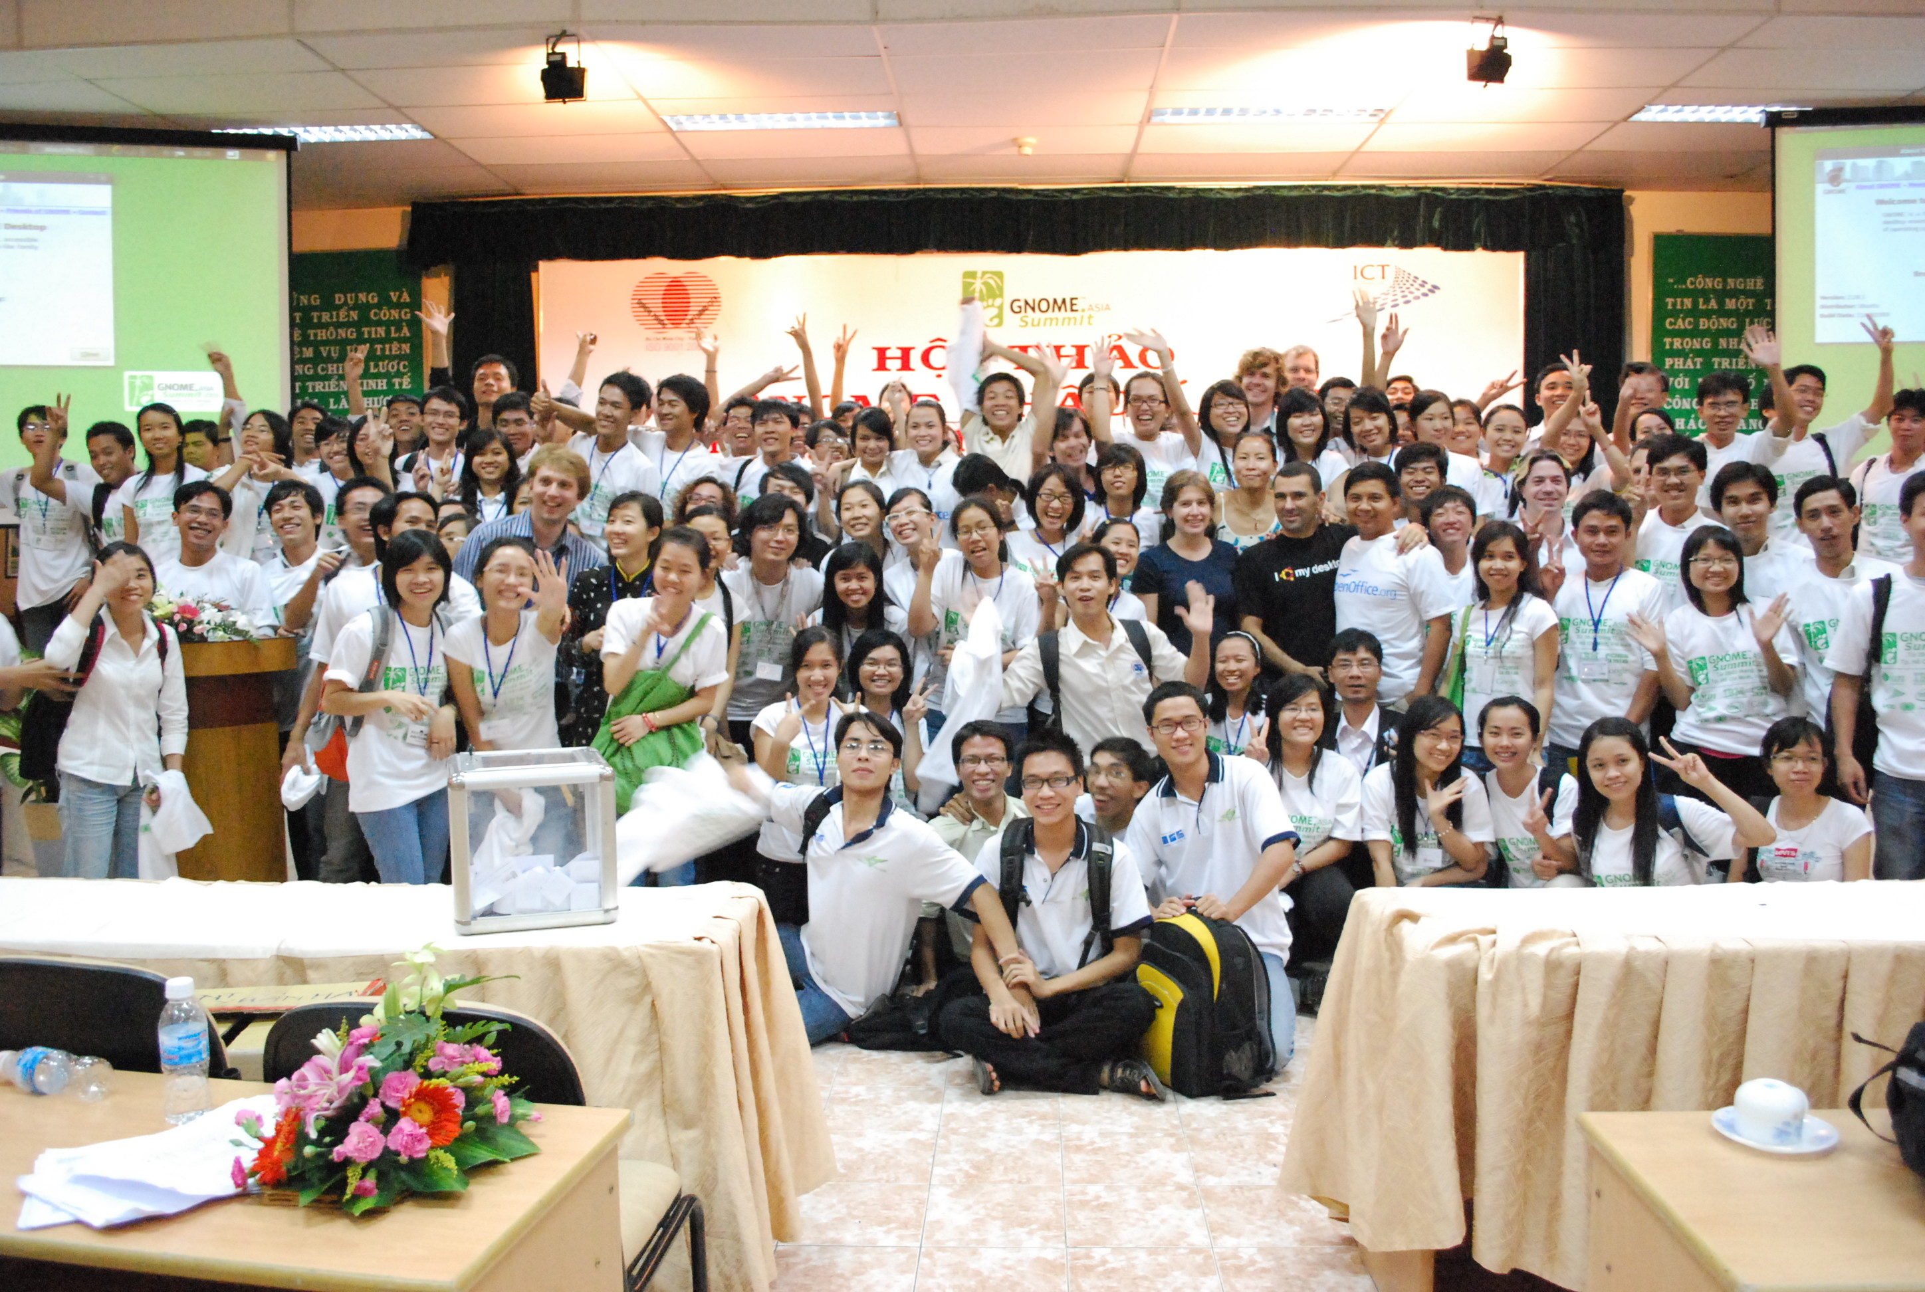

Slide 13
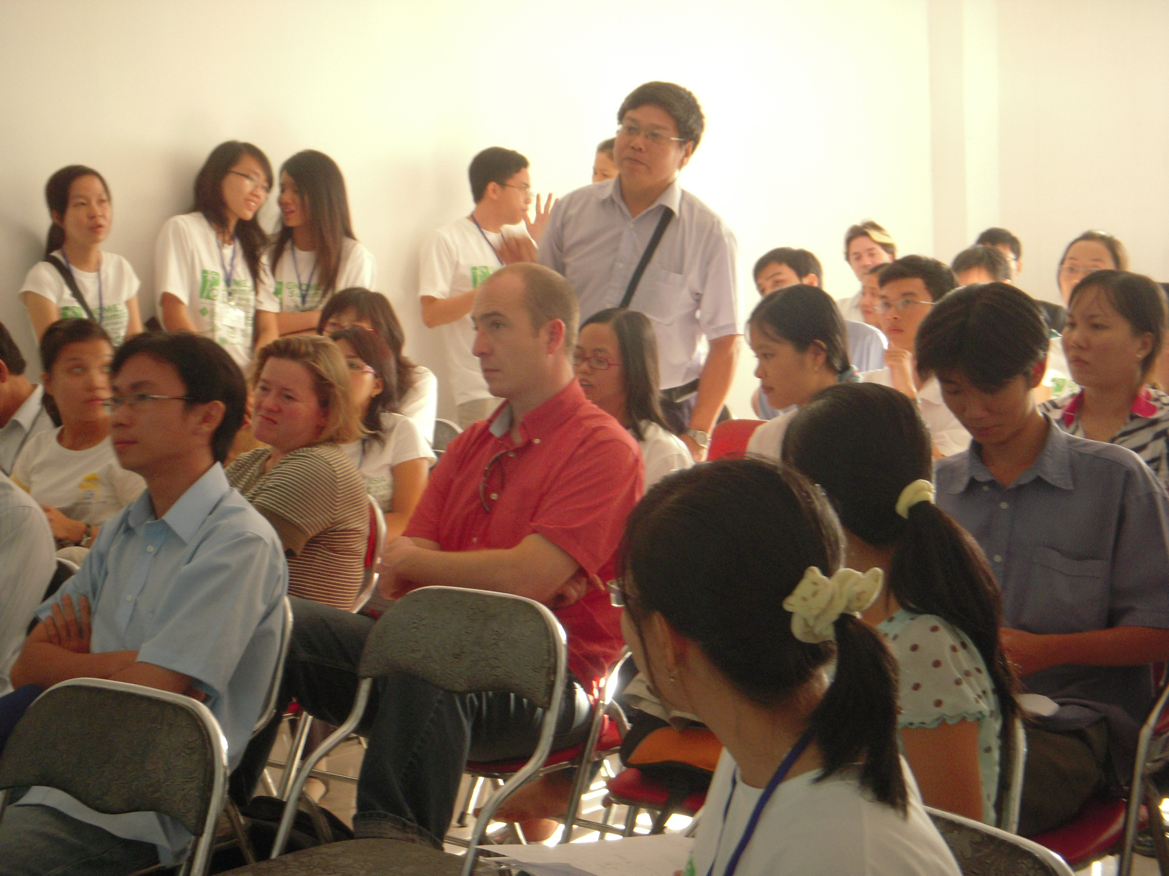
Interaction

Slide 14
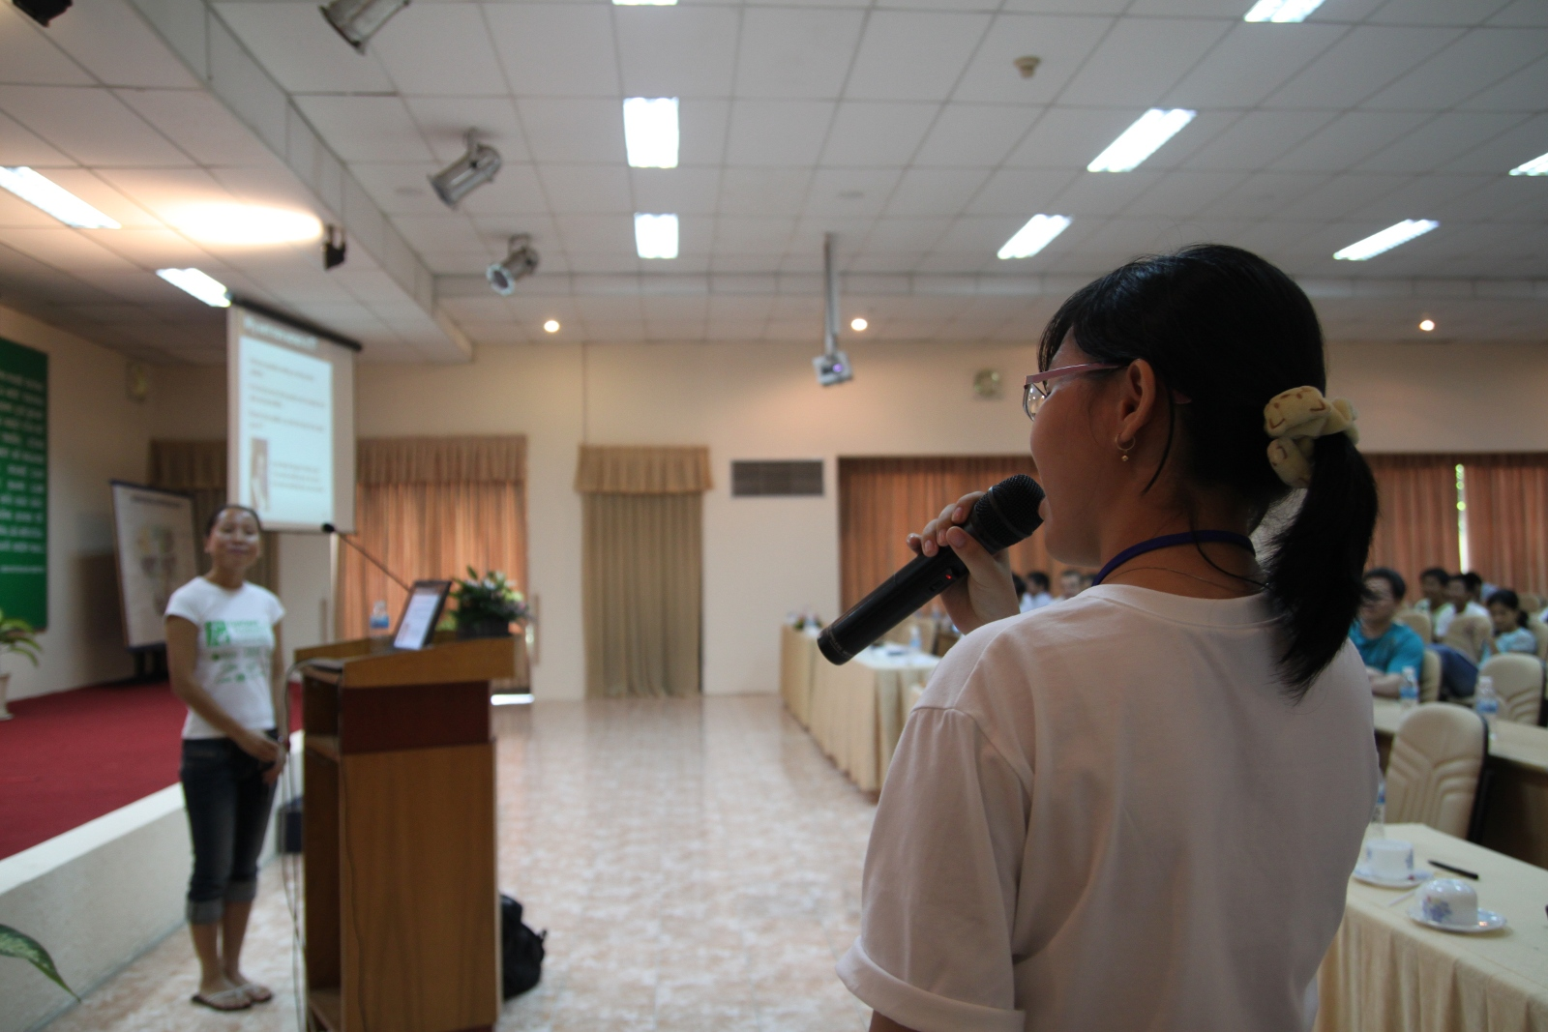
Translation

Slide 15


Slide 16
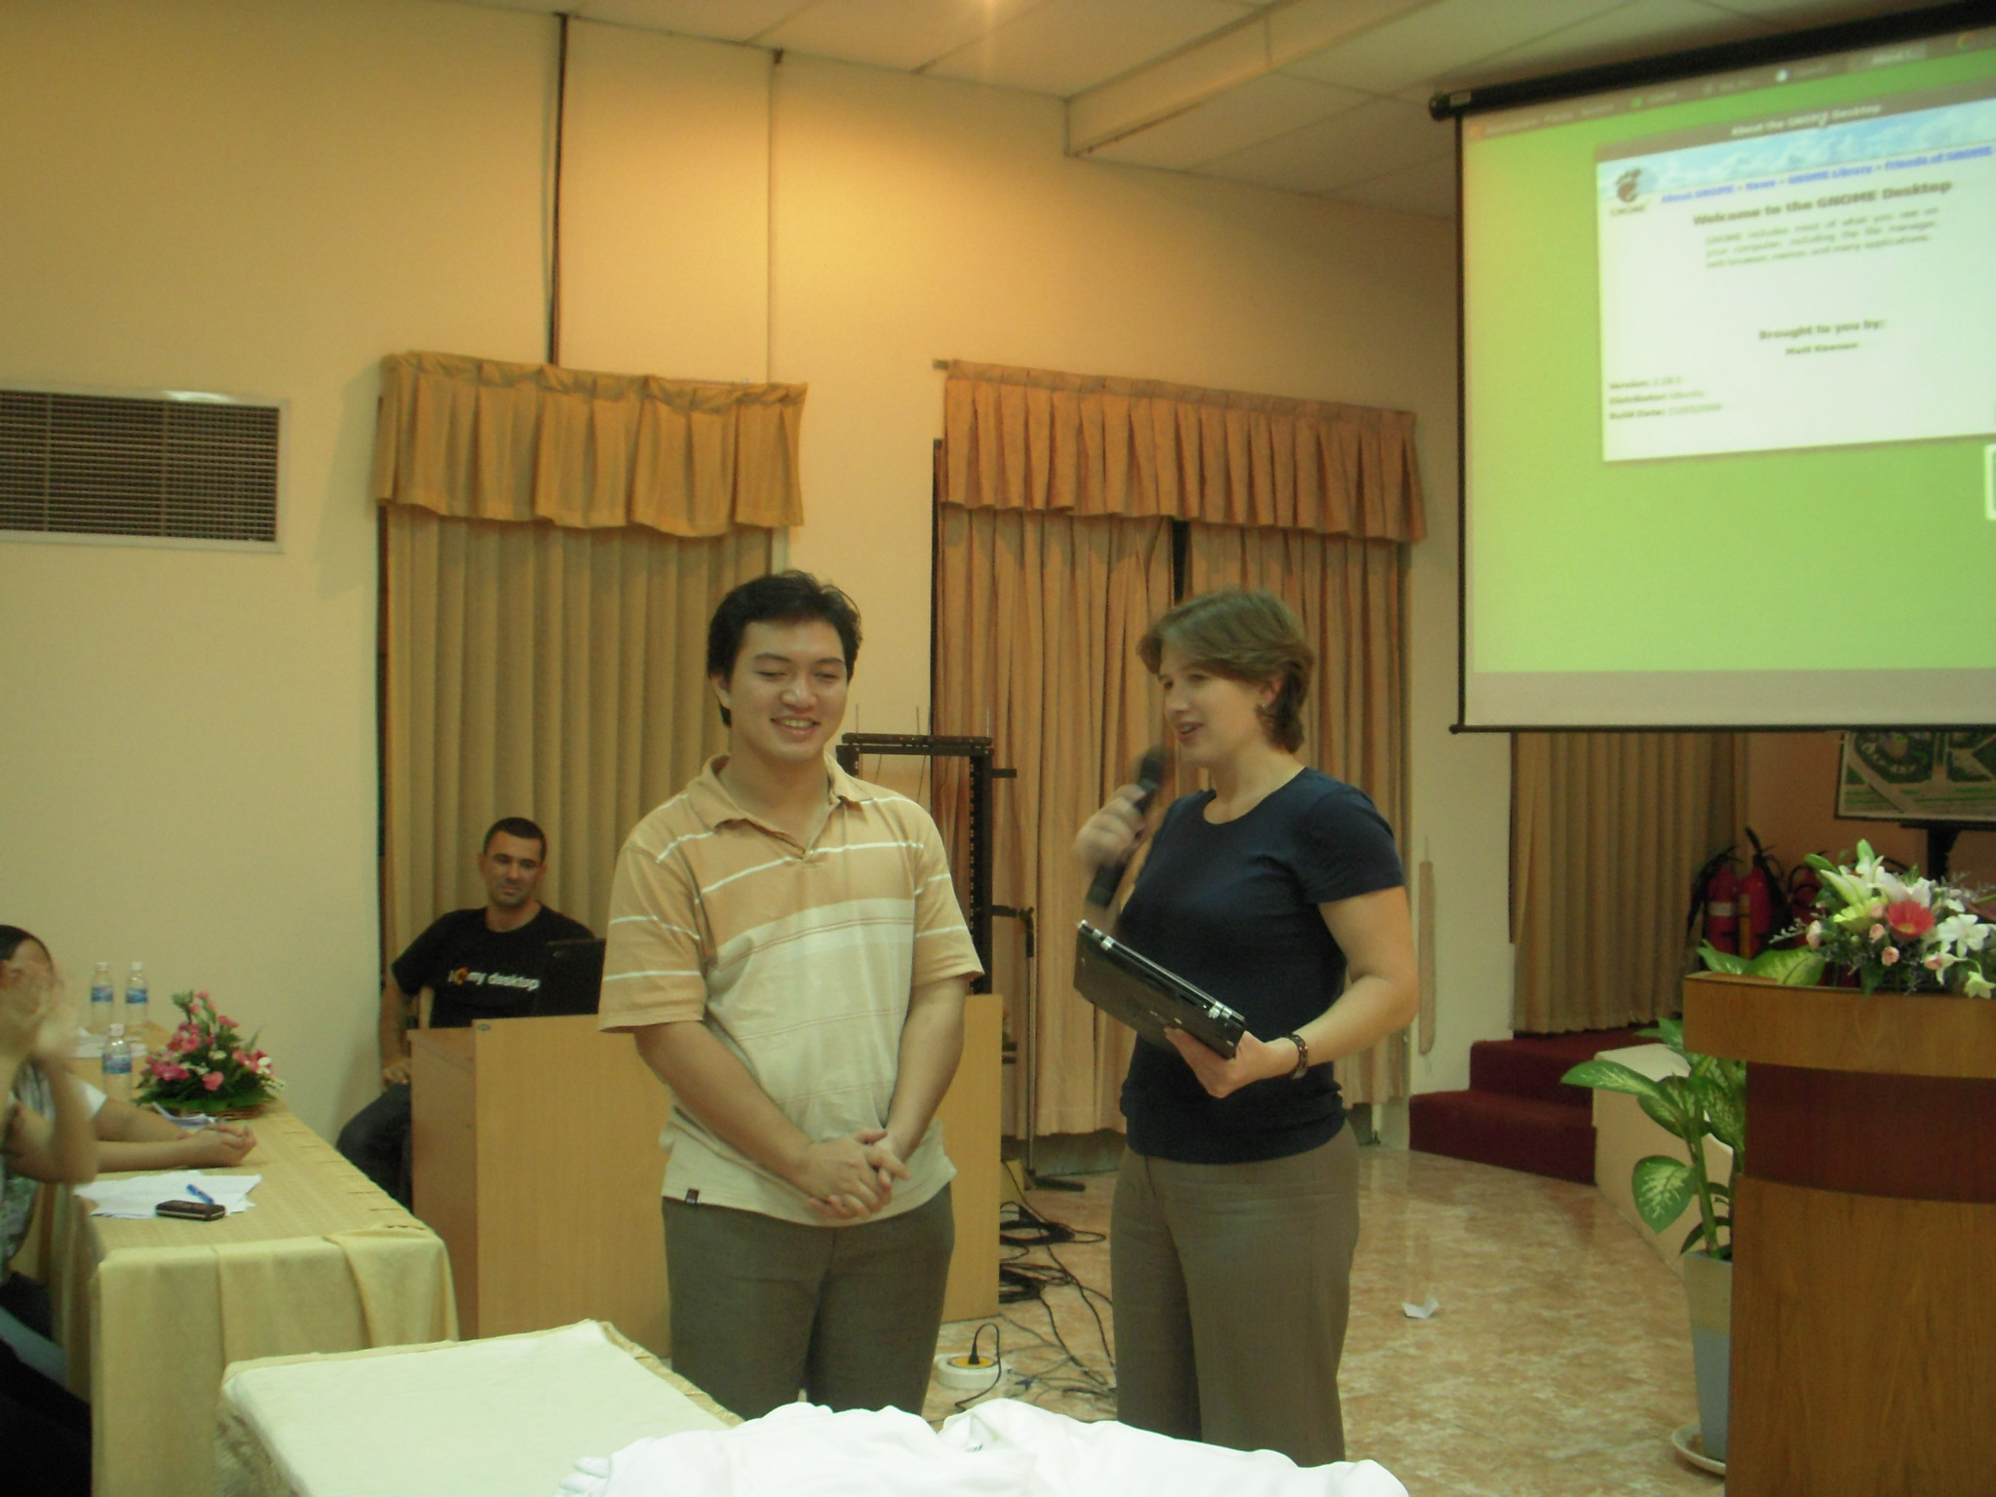
Luckydraw

Slide 17
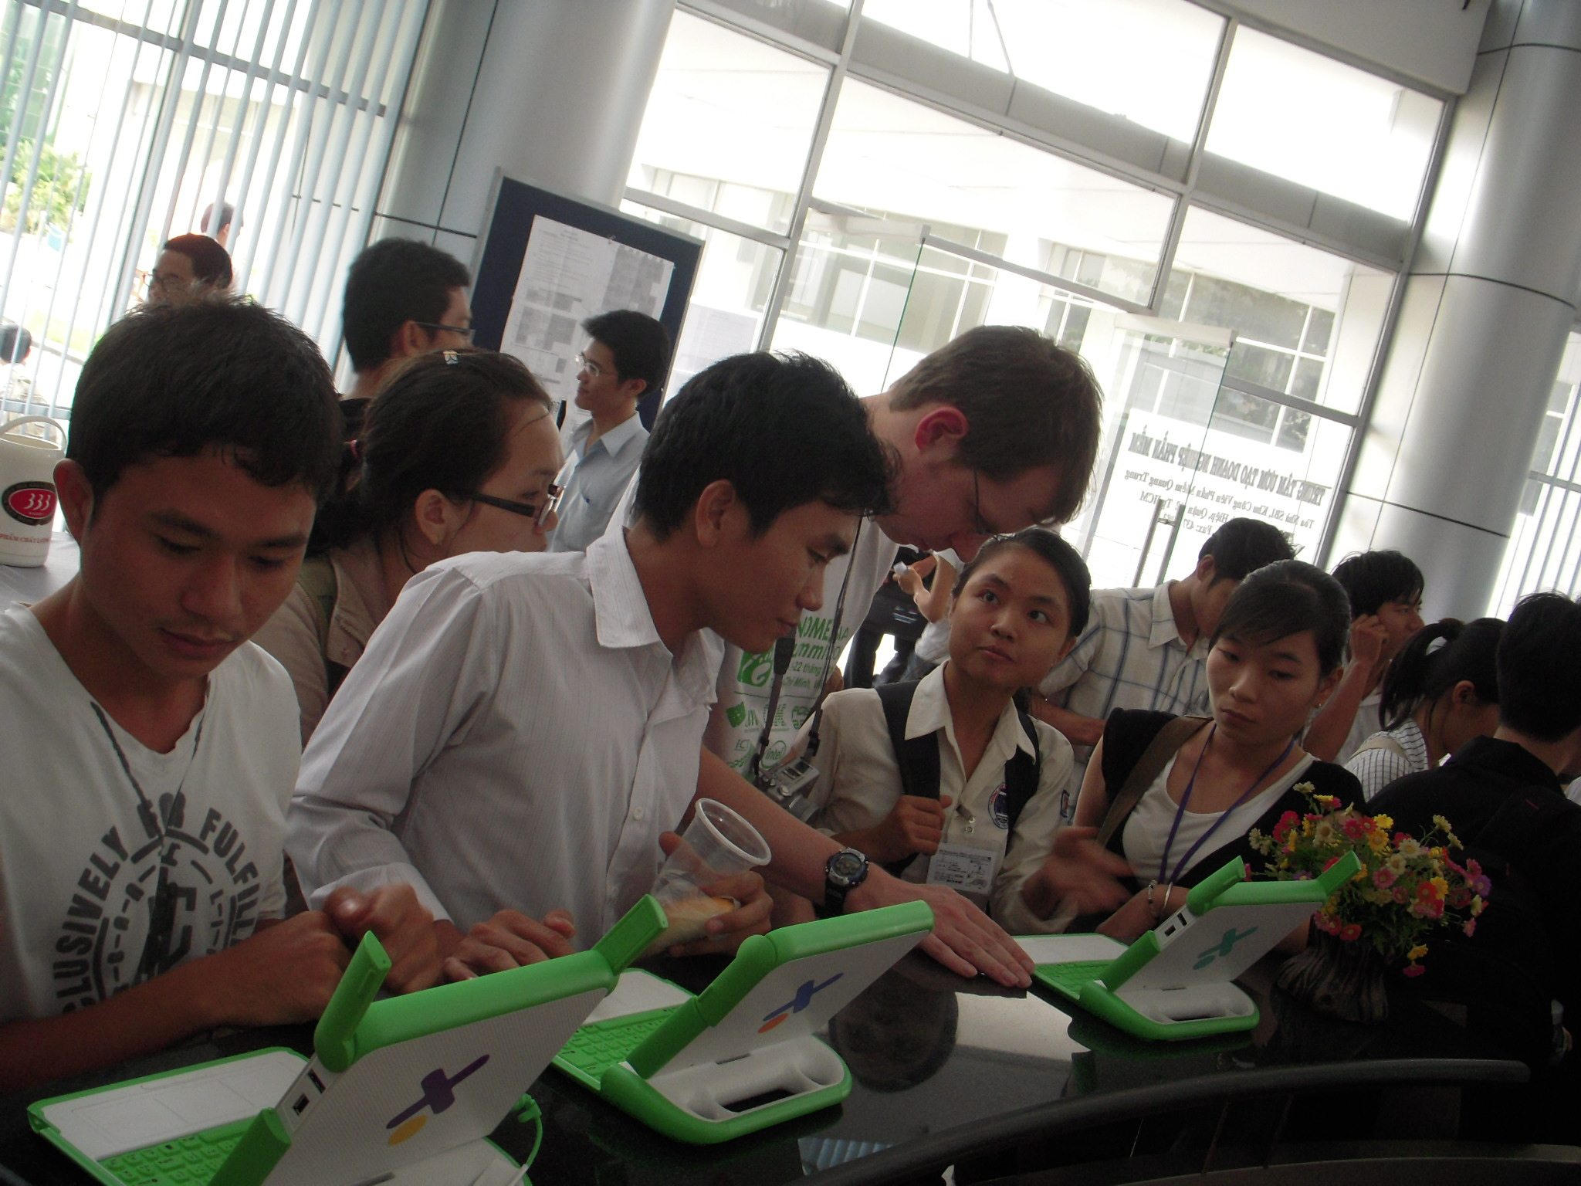
Exhibitions

Slide 18


Slide 19

August 14 - 15, 2010
Taiwan

Slide 20
Agenda
GNOME.Asia Summit
Beijing GNOME Users Group
Future Plan
Notes:
Build 72 announced available on Sept. 10, 2007 on OpenSolaris-announce forum

Slide 21
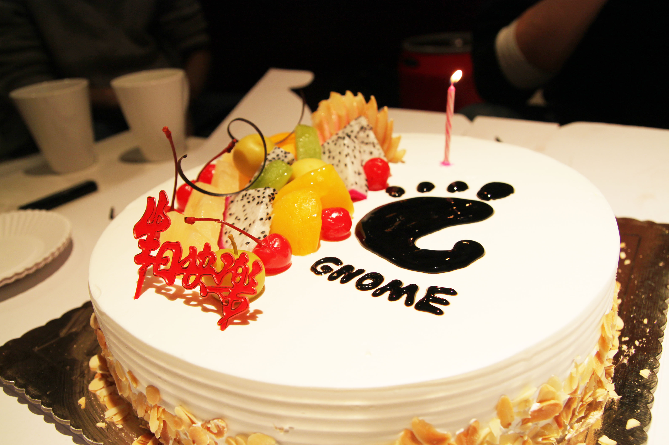

Slide 22

Summary – Starting a User Group
Lean How to Start and Maintain a Successful User Group in Your Community.
Tips from Leaders, Hosts, and User Group Members around Silicon Valley
Have a Mission and Vision
Great Location
Starting a Group is Very Satisfying
Promote Events and Group
Use Members to Get Speakers
Tap into existing Networks
Jug Mailing List

Slide 23
Role In Users Group
Lean How to Start and Maintain a Successful User Group in Your Community.
Tifrom Leaders, Hosts, and User Group Members around Silicon Valley
Organizor – annoucement, venue 2
Photographer – 2 people
Website – Design, Development, Art 2
Marketing – Website, Event 3
Speakers – Get good speakers 4
More ...

Slide 24
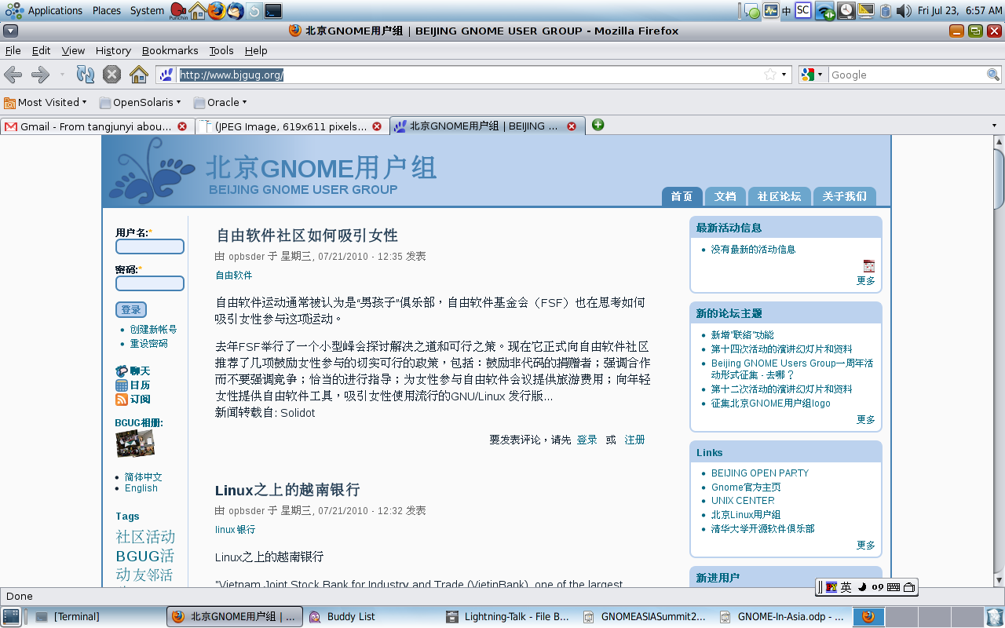
Website - http://www.bjgug.org/

Slide 25
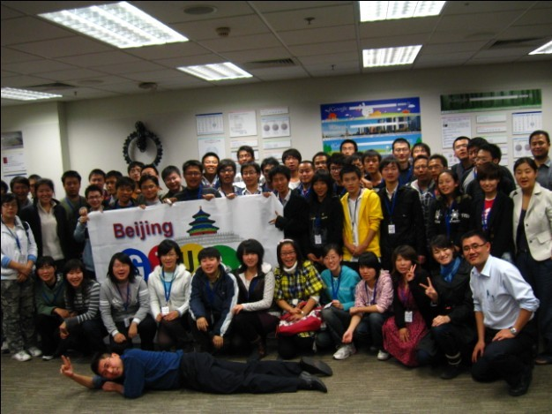
Joint Meeting
Google, Sun, Mozilla, Novell, Intel, CS2C
Beijing OpenSolaris Users Group, Beijing Linux Users Group, Univeristies, Government

Slide 26
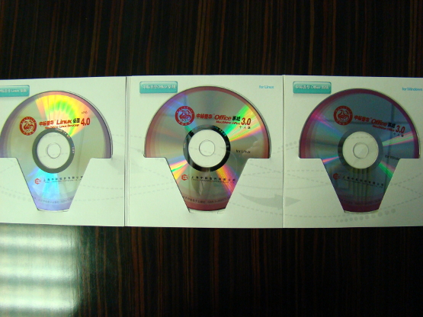
GNOME Install - Fest

Slide 27
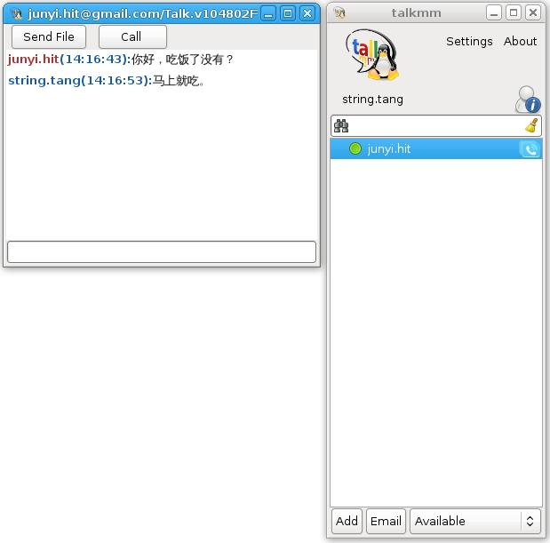
Our Projects
This is an open source project aims at constructing a gtalk client for linux based on libjingle. The project joined the 2009 Google development Day meeting’s show.

Slide 28
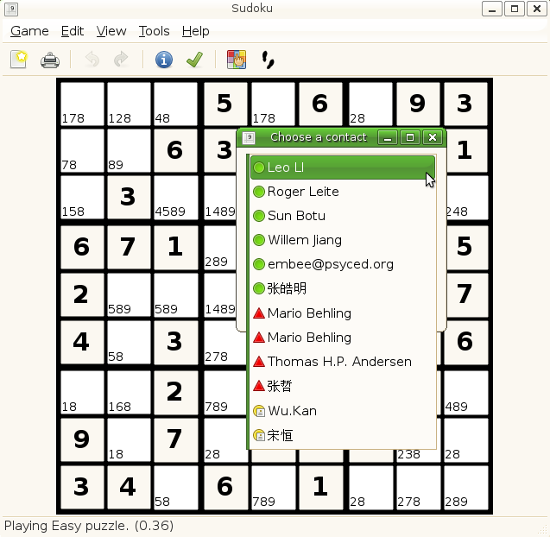
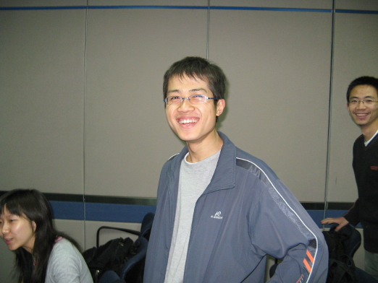
Google Summer of Code

Slide 29
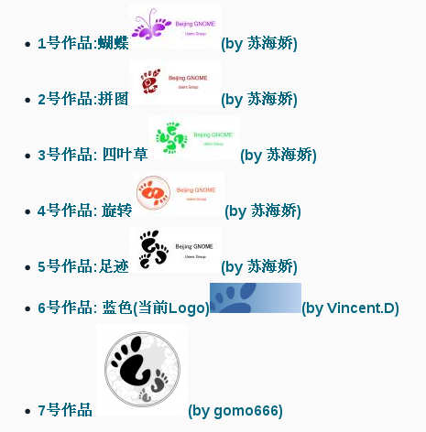
Log Contest

Slide 30
Agenda
GNOME.Asia Summit
Beijing GNOME Users Group
Future Plan
Notes:
Build 72 announced available on Sept. 10, 2007 on OpenSolaris-announce forum

Slide 31

GNOME Store

Slide 32

Friend of GNOME
Translation
Paypal ?

Slide 33
More Plan
University
More foundation members
Projects (Gsoc, Women program, etc)
Other ideas?

Slide 34
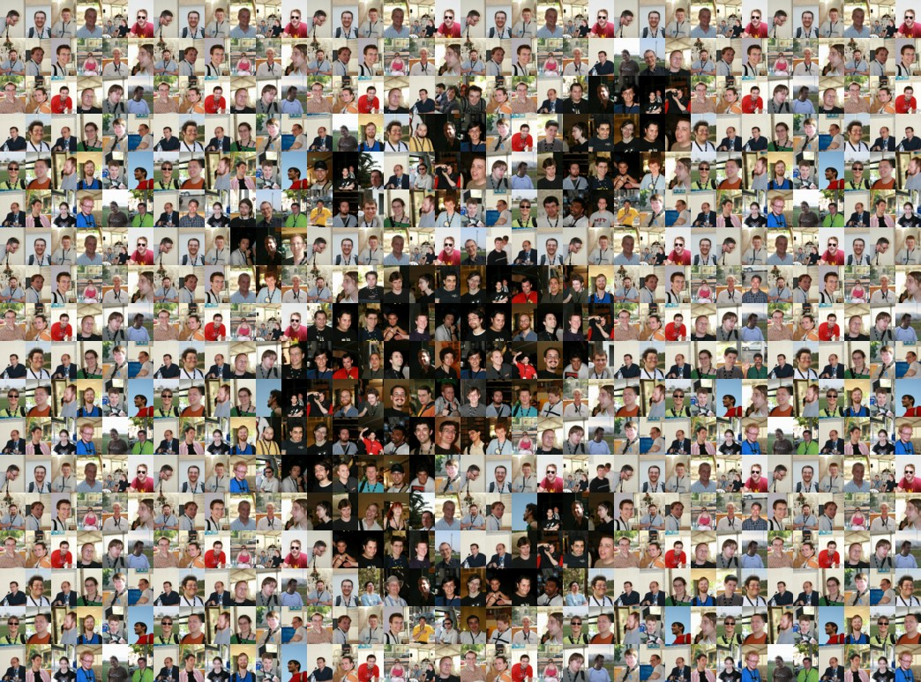

Slide 35

Beijing – 2008
Ho Chi Minh – 2009
Taipei – 2010
...
It is just a beginning !
Join Us !!!

Slide 36
Thank you!
emilychen522@gmail.com
“open” artwork and icons by chandan:
http://blogs.sun.com/chandan

