Slide 1
Hosting GNOME.Asia is FUN!
Pockey Lam, GNOME.Asia Committee Member
pockey@beijinglug.org
August 15th 2010

Slide 2
Contents
Why is it FUN?
Why is it useful?
What does it take to host the GNOME.Asia?
What's the process?
How do we communicate?
What's next?

Slide 3
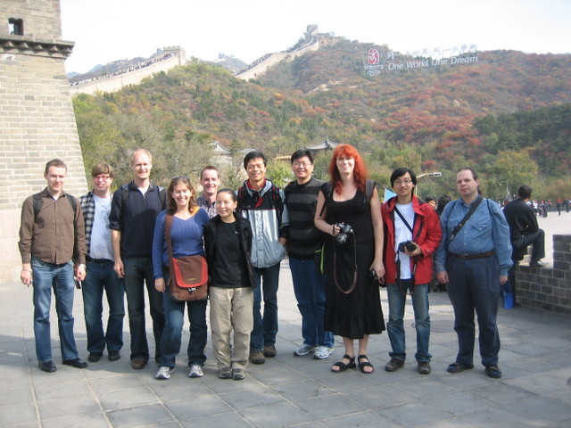
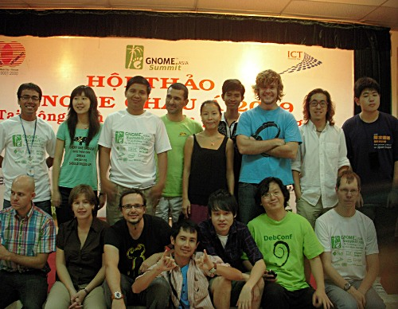
Why is it FUN?
Meet passionate people from all over the world
Make contact with communities across Asia
Share ideas and knowledge
Notes:
- GNU/Linux User Group, Open Institute, OpenFoundry
- China, Taiwan, Cambodia, Vietnam, Philippines, Indonesia
- There is educational projects, accessibility, application for desktop, for devices, there are a lot of people contributing to the GNOME project

Slide 4
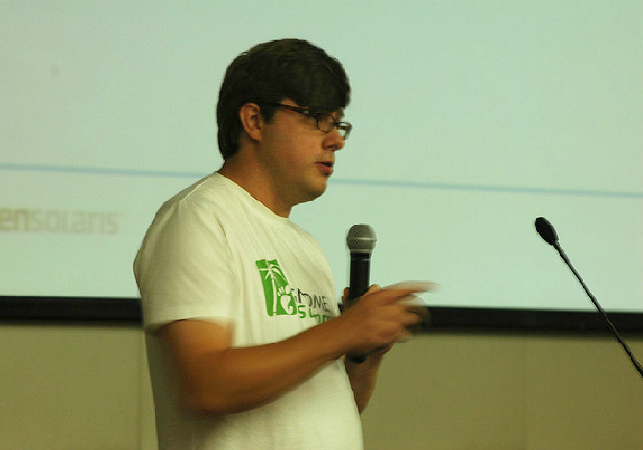
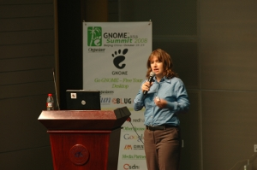
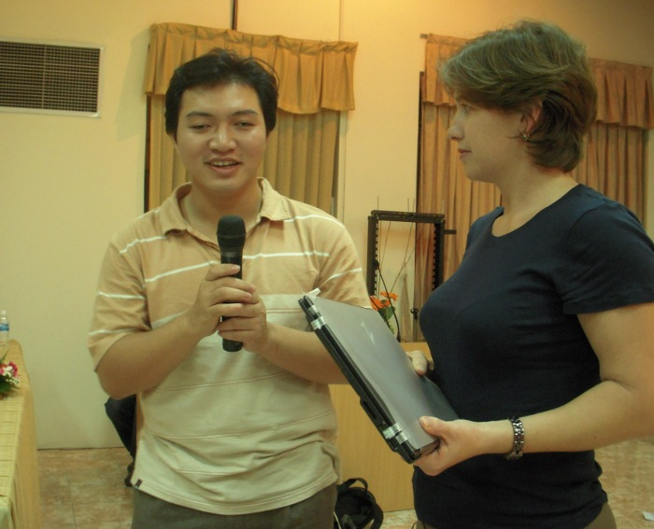
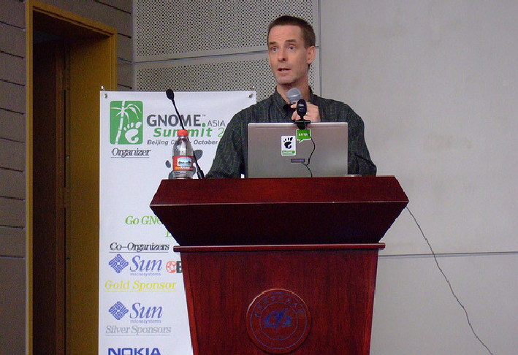
Why is it FUN?
Discover new GNOME technology
Access to cool gadgets and even get one
Achieve something as big as hosting GNOME.Asia
Notes:
desktop, mobile devices, accessibility,

Slide 5
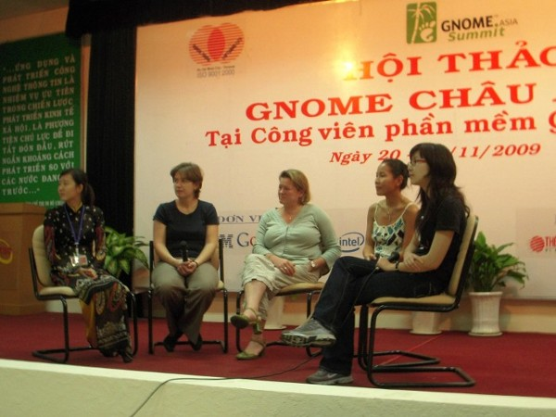
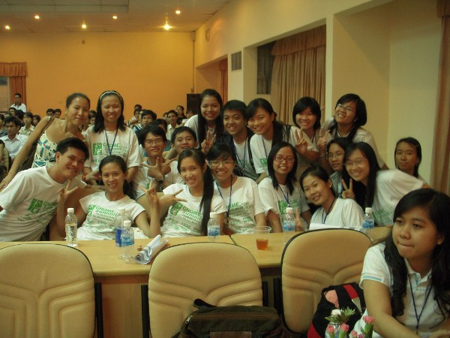
Why is it FUN?
Get to meet women geeks and volunteers :)

Slide 6
Why is it useful?
Contribute to your community
Promote Free Software in your local area
Get the experience of hosting an international event
Kick start new user groups or projects to address issues around you
To build a bridge to communicate with the international GNOME community
Notes:
Bring speakers and knowledge to your local area
Do something for the people around you

Slide 7
What does it take to host
GNOME.Asia?
Share the same goals with GNOME.Asia
In Asia
A small team of GNOME or FOSS advocates
Existing / potential GNOME hackers / users
Infrastructure in place
Local companies / universities / communities / Government support
PASSION!
Notes:
Help GNOME to reach further, more people, more companies, even the governments

Slide 8
Ready to host GNOME.Asia?

Slide 9
Early stage
Call for host
Finalize date, venue and theme
    Go GNOME- Free Your Desktop - 2008
    Get Freedom with GNOME - 2009
    Open Web and Mobile Technology - 2010
Develop / localize website content
    Info: venue, date, VISA, hotels, etc
Estimated Budget
Call for sponsors
Call for papers

Slide 10
1 month before the summit
Confirmed MC
Confirmed sponsors
Confirmed speaker list and bios
Confirmed full schedule
Confirmed actual budget
Call for participants / Registration
Confirmed printing materials for production
Event organization...

Slide 11
On-site Management
Signs – directions / tag
Final schedule
Equipments
Electricity
Reception / registration
Rooms
Crisis
Translation
Photos, Audio, Video
Lunch arrangement announcement / notice
Opinion board

Slide 12
Right after the event
Update website
Press release
Upload all the presentations
Upload event pictures
Email sponsors of the report
Remind speakers / participants to blog / tag
Put down important notes to:
    http://gnome.asia/en/p/about/checklist/
    http://gnome.asia/en/p/about/howto/

Slide 13
Key communication channels
IRC
    #asia-summit channel @ irc.gnome.org
Mailing list
    asia-summit-list@gnome.org
Local organizer face to face meeting
Website
    http://gnome.asia

Slide 14






What's next?
Talk to the GNOME.Asia committee
  Pockey Lam
  Emily Chen
  Frederic Muller
  Brian Cameron
Read
  http://gnome.asia/en/p/about/checklist/
  http://gnome.asia/en/p/about/howto/
Submit your proposal, or
spread the word,
and?

Slide 15
See you next year!
pockey@beijinglug.org

