Slide 1
GO!
Ready?
Lightning Show
閃電秀
THE REAL

Slide 2
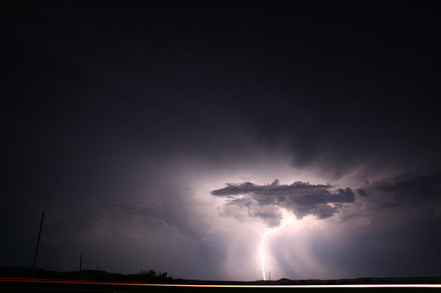
Lightning Show
CC By http://www.flickr.com/photos/jeffk/

Slide 3
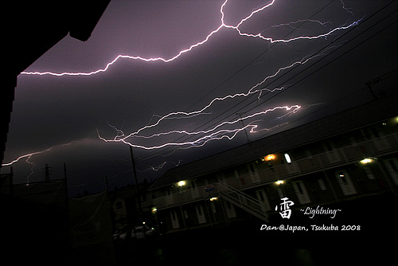
Lightning Show
CC by http://www.flickr.com/photos/minicooper_dan/

Slide 4
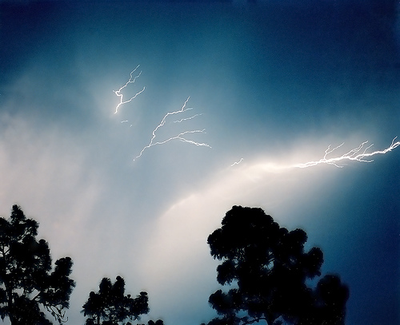
Lightning Show
CC BY http://www.flickr.com/photos/kylemay/

Slide 5
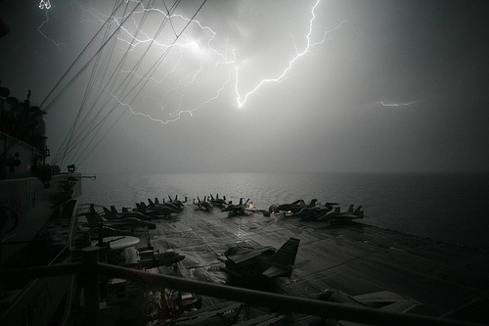
Lightning Show
CC BY http://www.flickr.com/photos/pingnews/

Slide 6
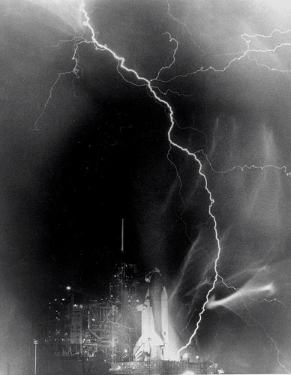
Lightning Show
CC BY http://www.flickr.com/photos/pingnews/

Slide 7
Thank you for your attention
BYE BYE

Slide 8
NO，Just kidding

Slide 9







2010/9/18
軟體自由日

Slide 10
Introduction
全球性的自由軟體和開源軟體慶祝活動
Worldwide celebration of Free and
Open Source Software (FOSS)

Slide 11
Introduction
目的在於告訴大眾使用高品質的 FOSS對於
生活、教育、生意上面的益處
to educate the worldwide public about of
the benefits of using high quality FOSS
in education, in government, at home,
and in business

Slide 12
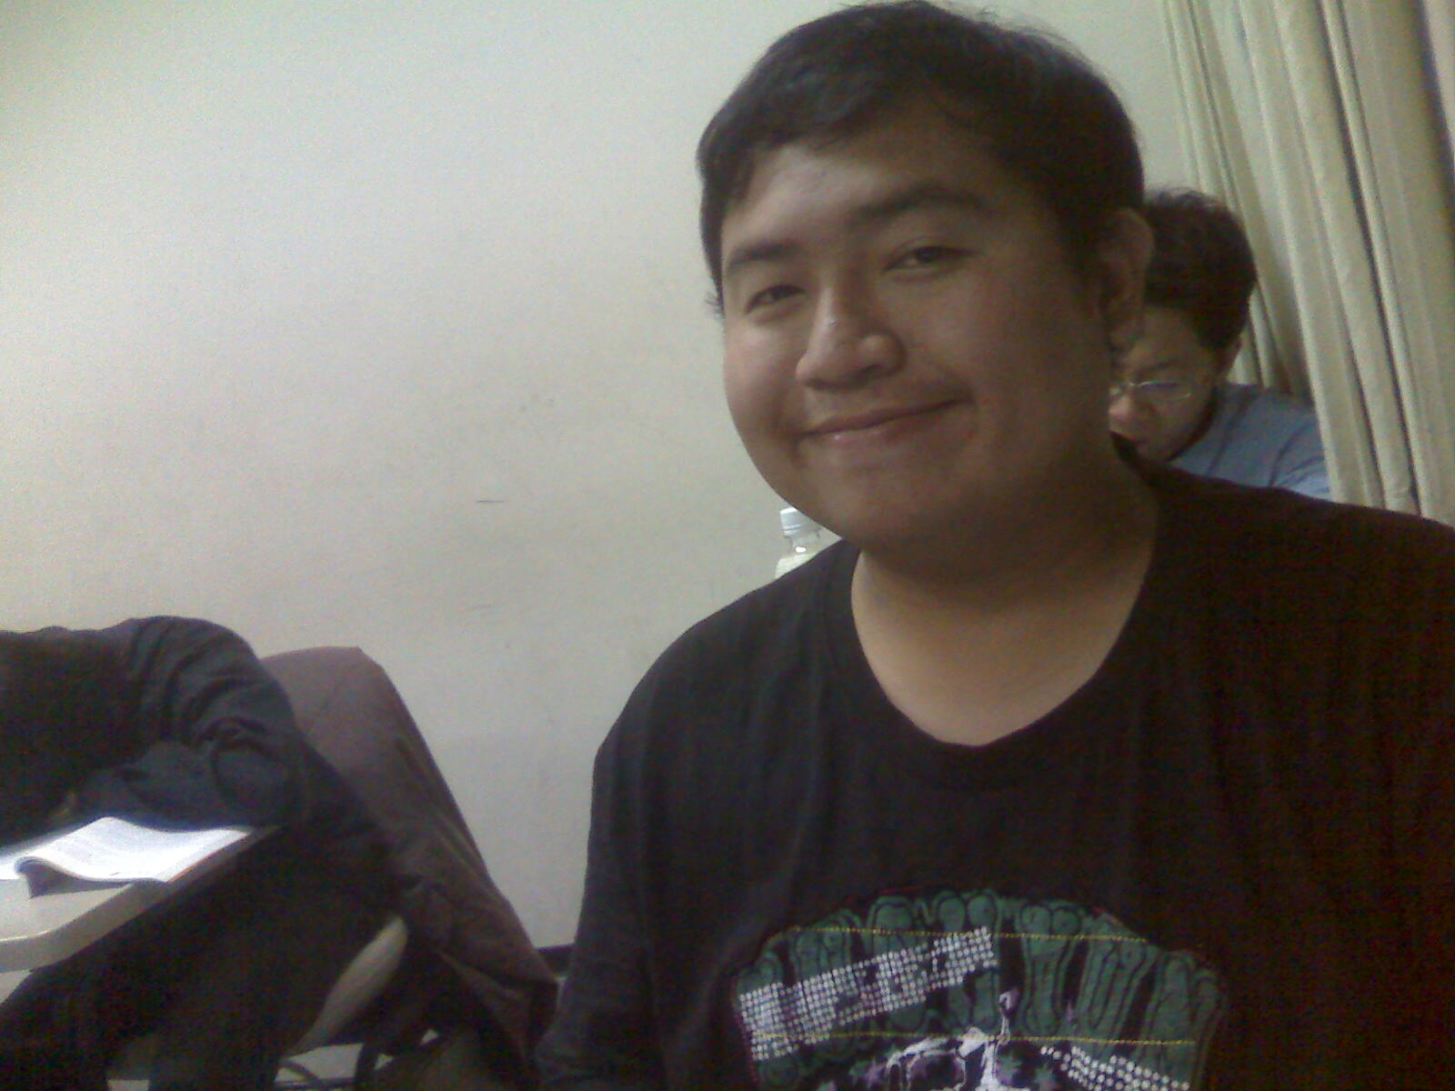
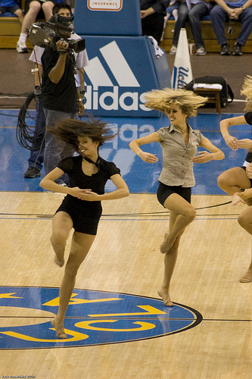
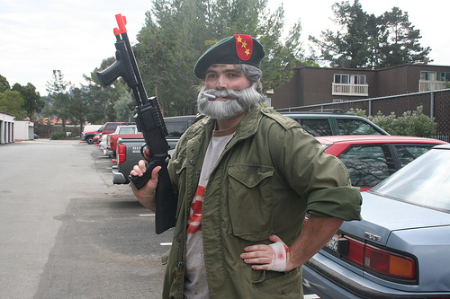
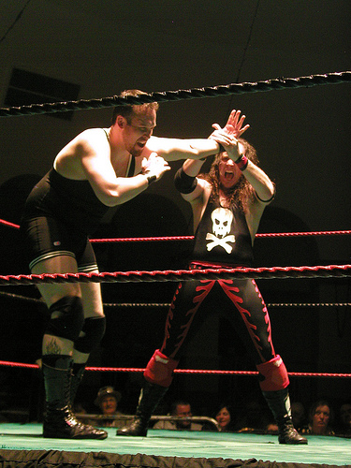
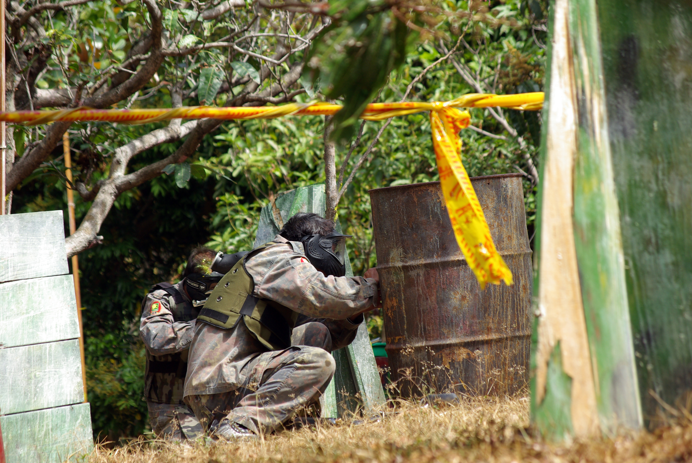
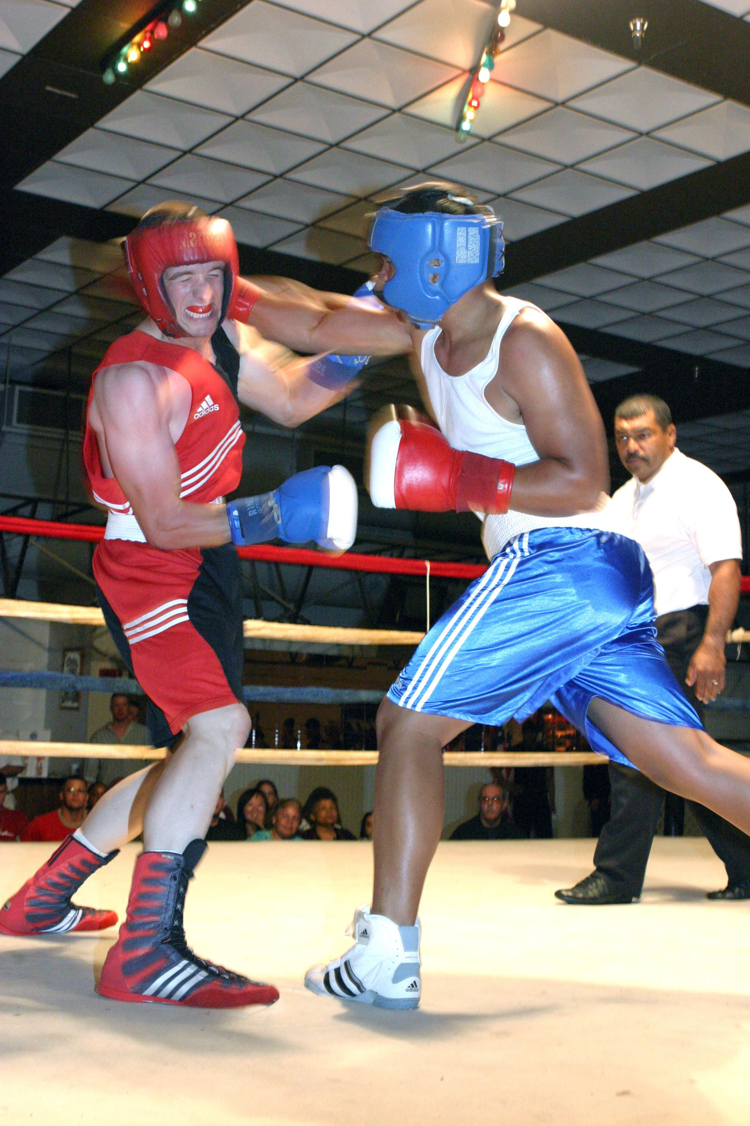
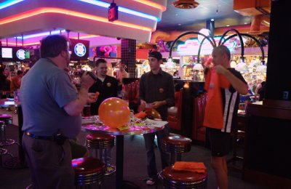
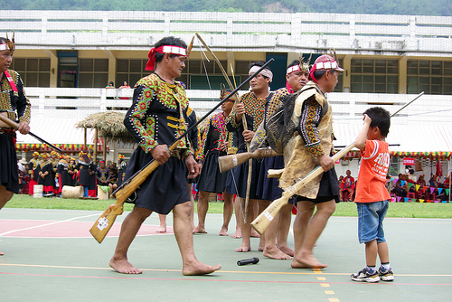
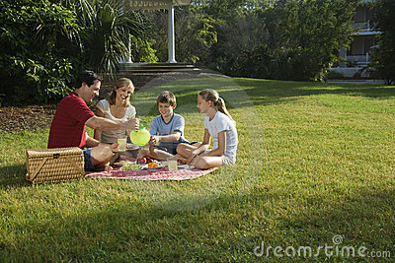
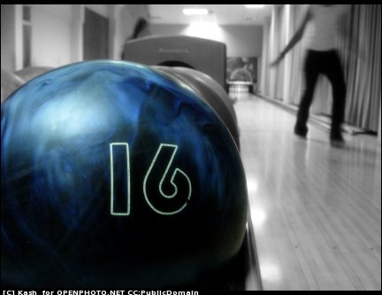
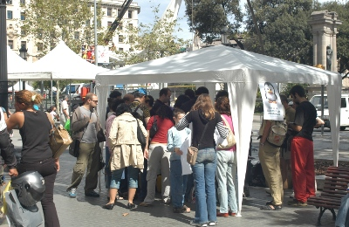
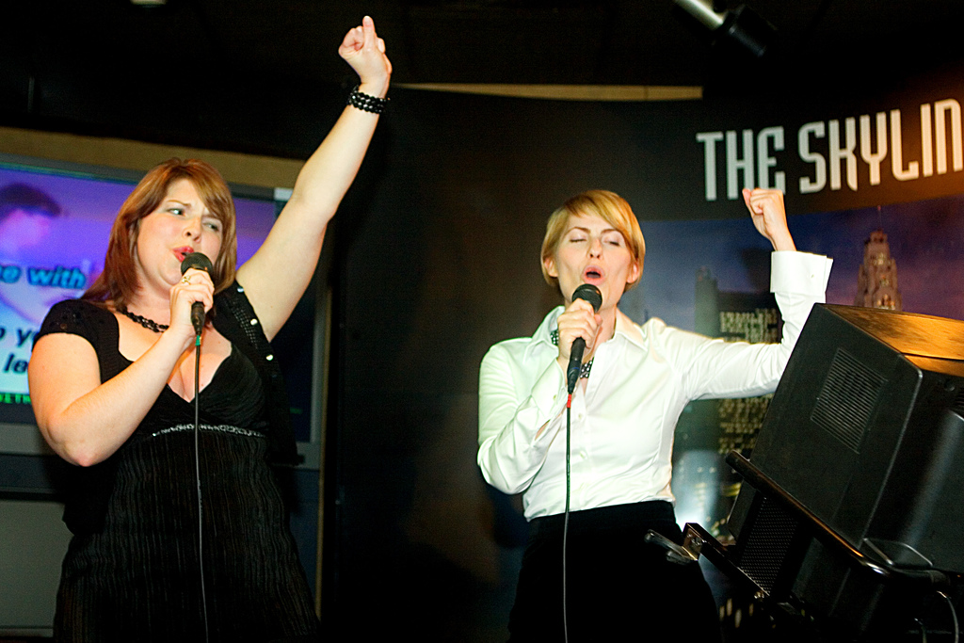
What should you do?
Be Creative
Cc by http://www.flickr.com/photos/agius/
Cc by http://www.flickr.com/photos/travelmate2021/
CC by http://www.flickr.com/photos/jmrosenfeld/
Cc by http://www.flickr.com/photos/travelmate2021/
Cc by http://www.flickr.com/photos/wapster/
CC BY http://www.flickr.com/photos/fensterbme/

Slide 13
How to Begin
1.Find a partner
2.do the following steps
Adding mailling list
Create region page
Register your team
write team page
Report Event
Create team page

Slide 14
NO!WAIT!

Slide 15

I'll do those for you!
台灣人我才這麼做喔！
Only for Taiwan

Slide 16
How to Begin
1.Find a partner
2.do the following steps
Prepare the event
Adding mailling list
Create region page
Register your team
Contact me
write team page
Report Event
Create team page

Slide 17
How to Contact me
Email: aa33002@gmail.com
Plurk: aa33002
Blog:上鎖者

Slide 18
Thank you for your attention
BYE BYE
Now It's Real

