Slide 1
Results update 20-04

Slide 2

Analytical Discrete Flow
Transition matrix: T_{ji} = 1/k_{i} transition probability from i to j. (k_{i} degree of i)
Net flow in edge ij in step r: e_{ij} = $\sum_{s}{\text{T}\text{is}\text{r}}∗Tji −$ $\sum_{s}{\text{T}\text{js}\text{r}}∗Tij$
For a given amount of steps Dt, the total edge flow is:
E_{ij} = $\sum_{r= 0}^{Dt}{eij}$(r)

Slide 3
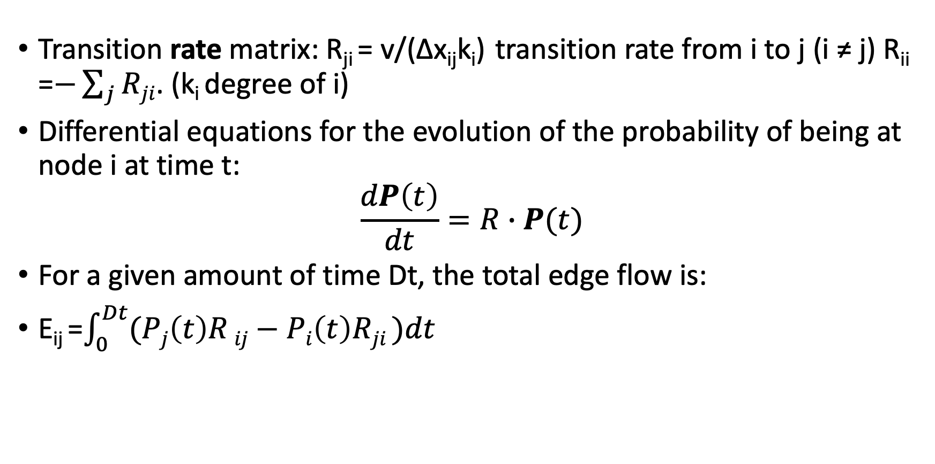
Analytical Continuous Flow
Transition rate matrix: R_{ji} = v/(∆x_{ij}k_{i}) transition rate from i to j (i ≠ j) R_{ii} =$−\sum_{j}{Rji}$. (k_{i} degree of i)
Differential equations for the evolution of the probability of being at node i at time t:
$$\frac{dP\left(t\right)}{dt}=R∙P(t)$$
For a given amount of time Dt, the total edge flow is:
E_{ij} =$\int_{0}^{Dt}{(Pj\left(t\right)R}ij−Pi\left(t\right)Rji )dt$

Slide 4
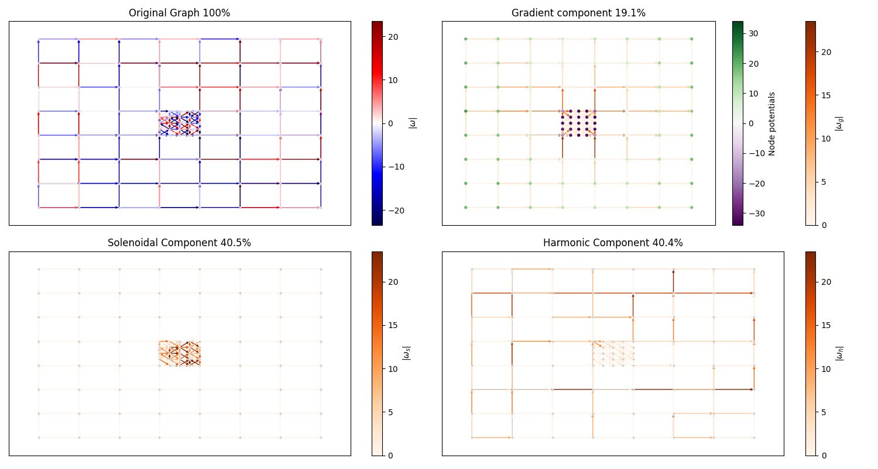
CTRW simulation (t = 20, v = 1)
Interconnected regions are repulsive

Slide 5
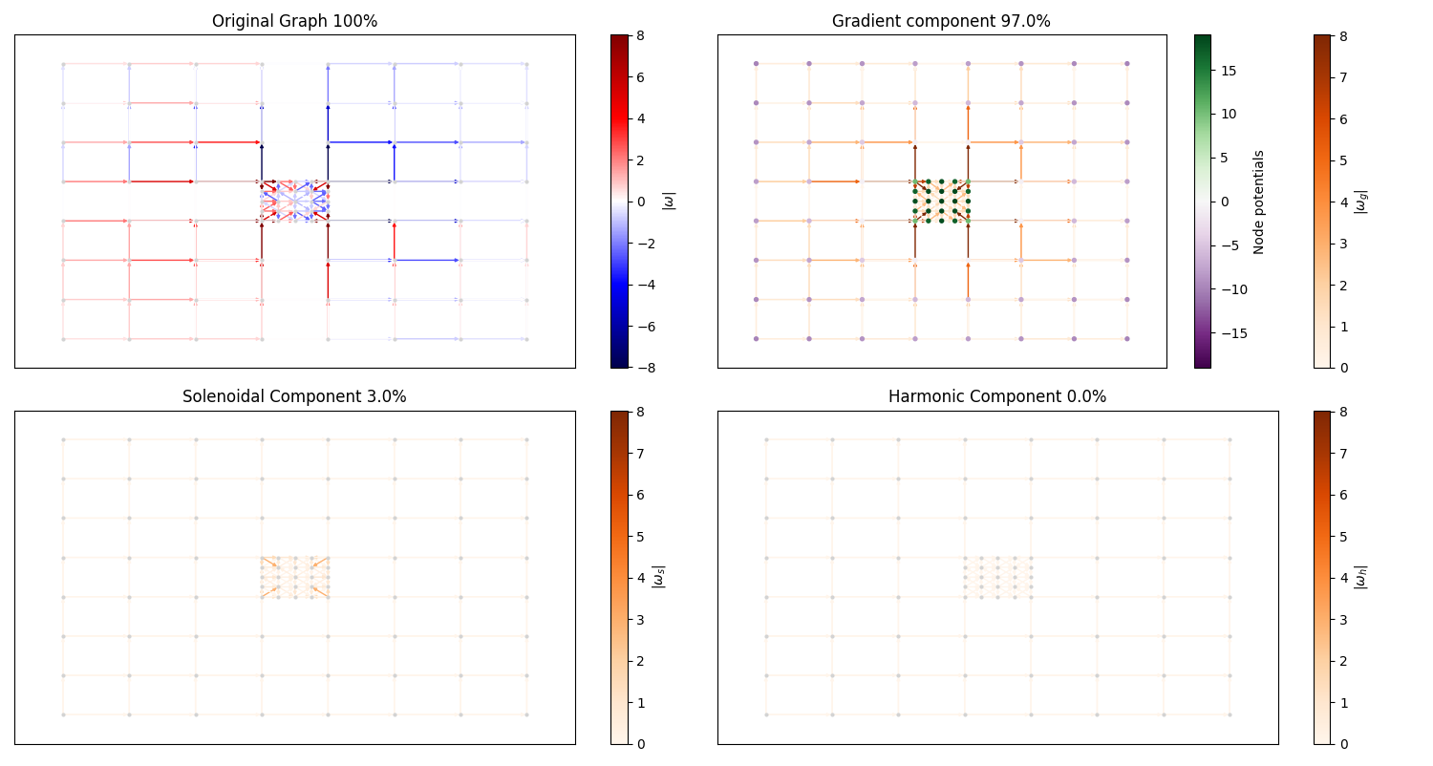
CTRW theoretical (t = 20, v=1)
Interconnected regions are attractive

Slide 6
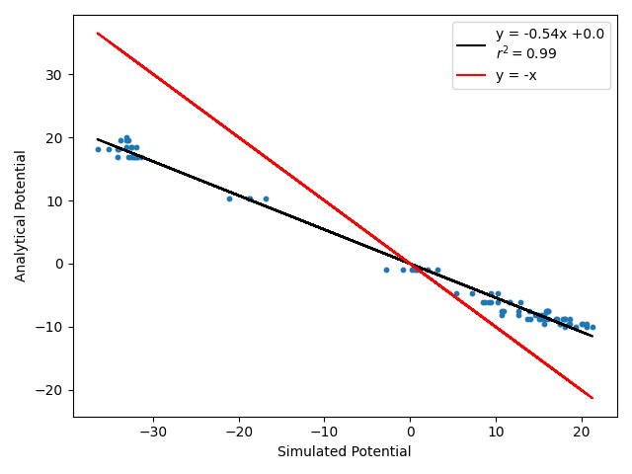
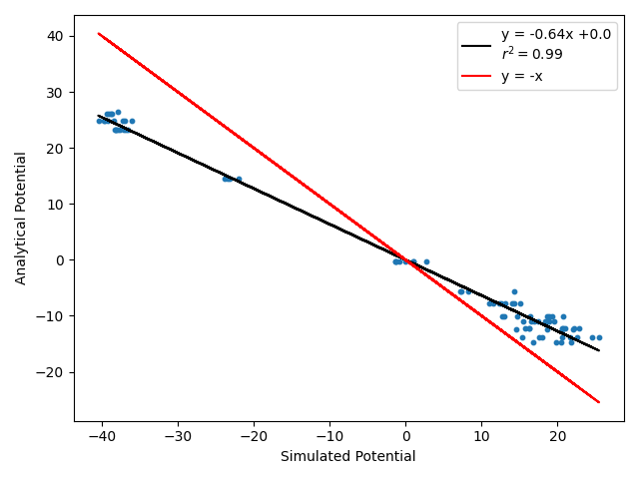
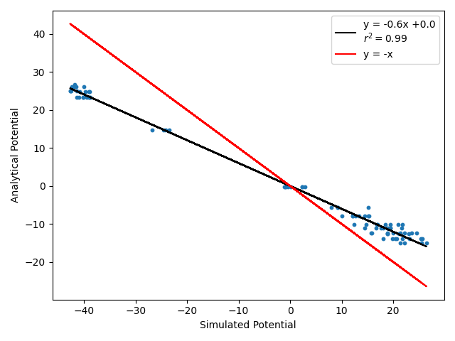
Comparison of the potentials
t = 20
t = 80
t = 200
Simulated vs analytical potential for each node of the PBC modified lattice

Slide 7
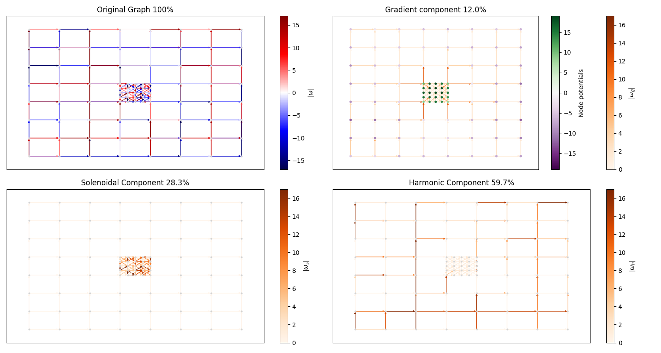
Discrete RW simulation (20 steps)
Interconnected regions are attractive

Slide 8
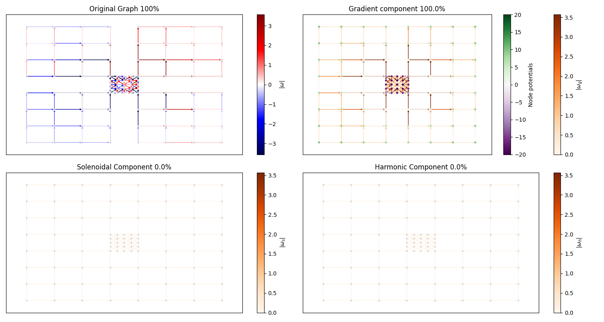
Discrete RW theoretical (20 steps)
Interconnected regions are repulsive

Slide 9
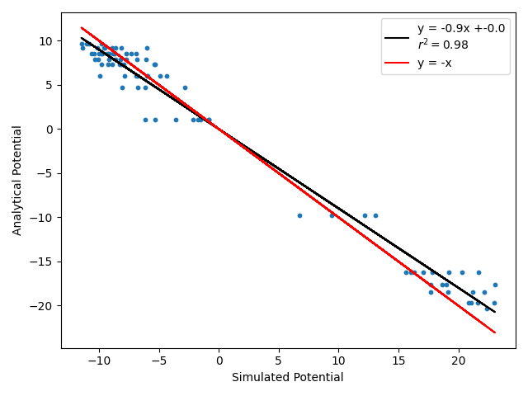
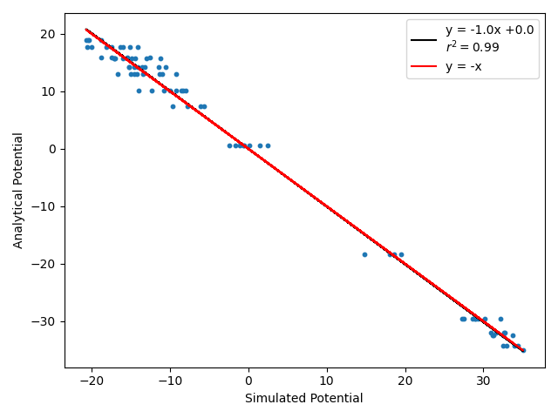
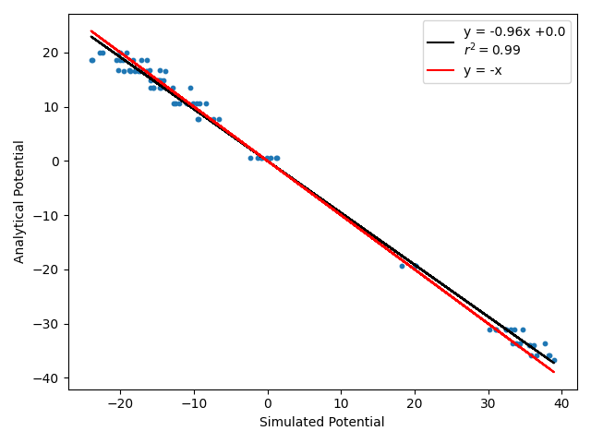
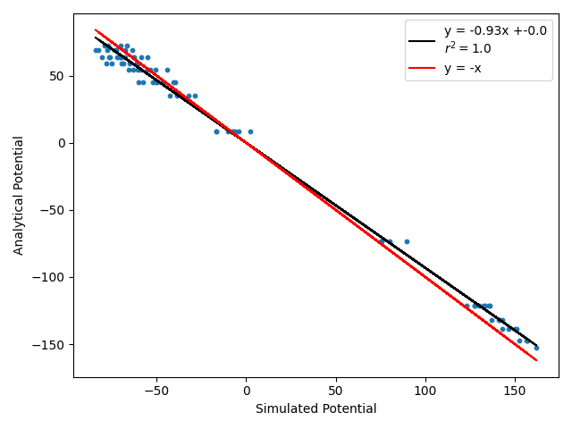
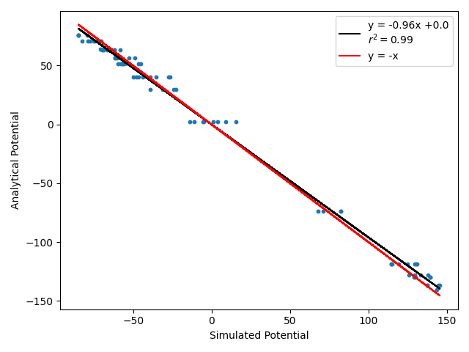
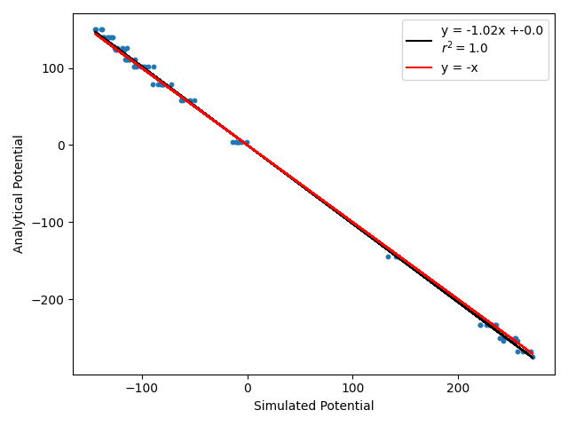
Comparison of the potentials
20 reps
steps = 20
20 reps
steps = 80
20 reps
steps = 200
150 reps
steps = 20
80 reps
steps = 80
150 reps
steps = 150
Simulated vs analytical potential for each node of the PBC modified lattice

