Slide 1

HODGE DECOMPOSITION
Robert Benassai Dalmau

Slide 2
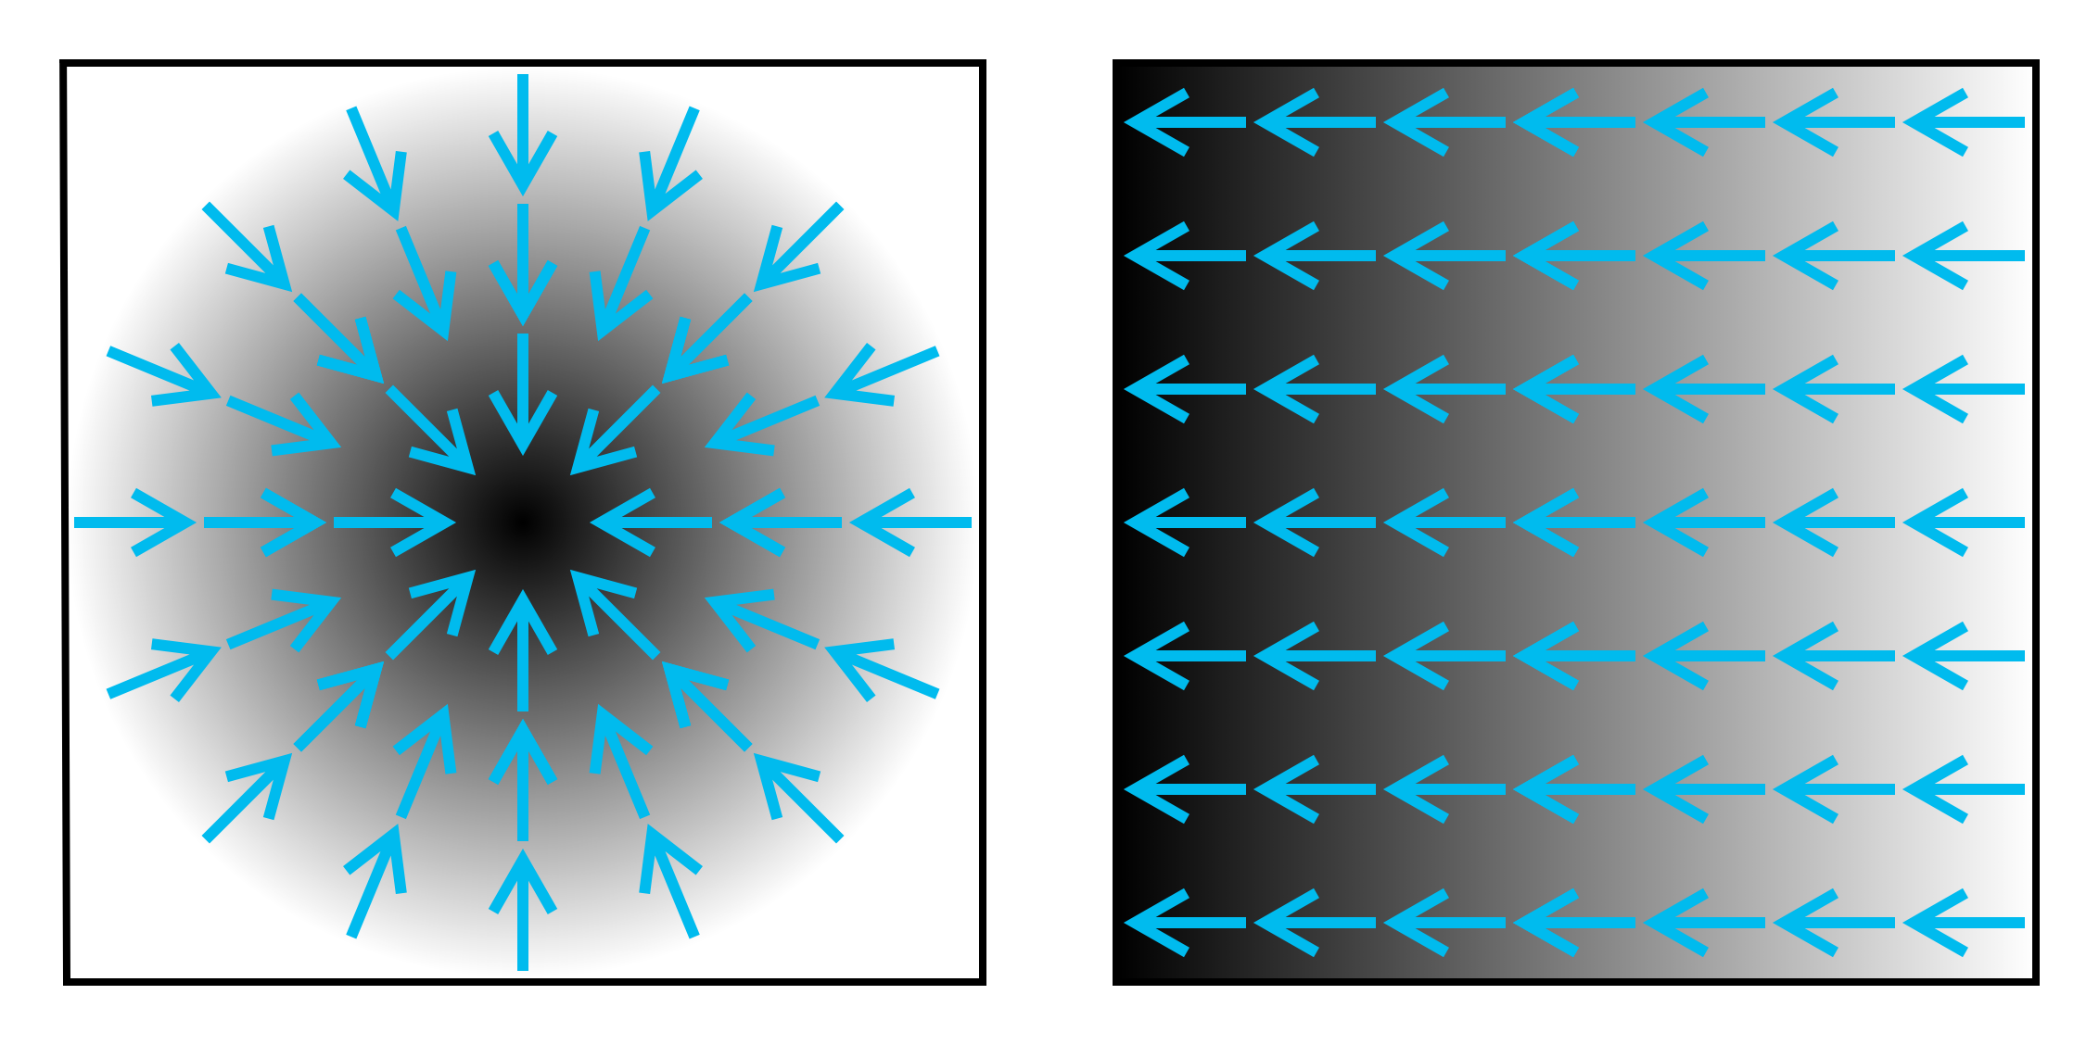
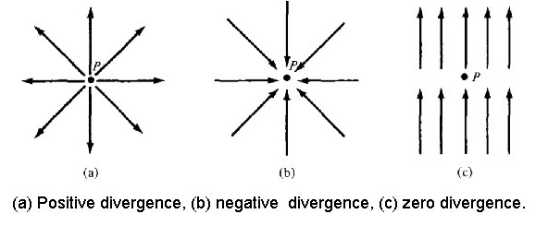
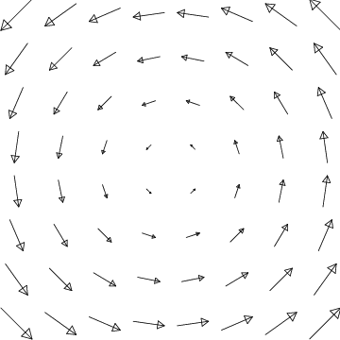
Vector and scalar fields: basic concepts
Divergence:
Gradient: (for a scalar field)
Curl:
Laplacian: divegence of a gradient
(for scalar fields)

Slide 3
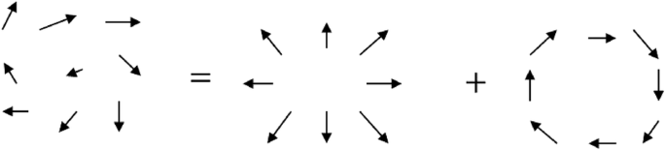

Continuous vector fields: Helmholtz decomposition
Helmholtz decomposition:
Vector field:
(well behaved)
Irrotational vector field:
Rot( ) = 0
Solenoidal vector field
Div( ) = 0
Where:
ϕ : Scalar potential
A : Vector potential

Slide 4
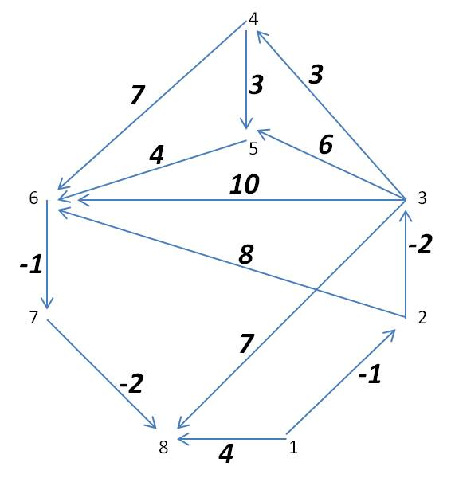
Discrete vector fields: basic concepts
In discrete vector fields (graphs) we substitute the continuous n-dimensional space by nodes and edges:
Subspaces (simplex):
Σ₀ = V vertices (0-simplex) (1), (2), (3), …
Σ₁ = E edges (1-simplex) (12), (18), (35), …
Σ₂ = triangles (2-simplex) (236), (356), (345), …
...
Each edge has a value w(ij) where i and j are the initial and final vertex indices
J. L. Johnson and T. Goldring, "Discrete Hodge Theory on Graphs: A Tutorial," in Computing in Science & Engineering, vol. 15, no. 5, pp. 42-55, Sept.-Oct. 2013, doi: 10.1109/MCSE.2012.91.

Slide 5
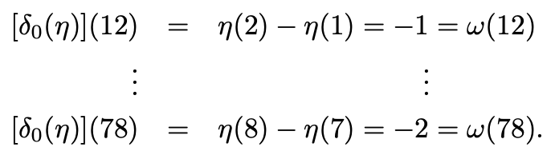
Discrete vector fields: Gradient and divergence operators
How do we define gradient and divergence in graphs?
Gradient: Acts on scalars and outputs a vector fields (continuous fields) Acts on vertices and outputs edges in discrete space
Example: Consider the following set of vertices and its weights (-potentials of each node):
Then the gradient of a given edge will be the difference of potentials between two connected nodes:
Gradient operator
J. L. Johnson and T. Goldring, "Discrete Hodge Theory on Graphs: A Tutorial," in Computing in Science & Engineering, vol. 15, no. 5, pp. 42-55, Sept.-Oct. 2013, doi: 10.1109/MCSE.2012.91.

Slide 6

Discrete vector fields: Gradient and divergence operators
How do we define gradient and divergence in graphs?
Divergence: Acts on vector fields and outputs a scalars (in continuous fields) Acts on edges and outputs vertices in discrete space.
The divergence gives a mesure of vertex importance
The divergence is simply the sum of all flows coming in or out from a vertex.
Incoming: contribute POSITIVELY
Outgoing: contribute NEGATIVELY
The divergence operator in dicrete space is:
Where w is the whole graph and i₁ is a given vertex.
Div(1) = -(-1) – 4 = -3
J. L. Johnson and T. Goldring, "Discrete Hodge Theory on Graphs: A Tutorial," in Computing in Science & Engineering, vol. 15, no. 5, pp. 42-55, Sept.-Oct. 2013, doi: 10.1109/MCSE.2012.91.

Slide 7
Discrete vector fields: Curl operator
How do we define curl in graphs?
Curl: in Graphs acts on edges and outputs triangles. Assigns a rotational value to each triangle (smallest closed loop).
The curl operator in dicrete space is:
Which is the sum of edge weights around a given triangle
Gradient graph (w_{g}): The edge sum along any closed loop is 0.
The curl of a gradient graph is 0
J. L. Johnson and T. Goldring, "Discrete Hodge Theory on Graphs: A Tutorial," in Computing in Science & Engineering, vol. 15, no. 5, pp. 42-55, Sept.-Oct. 2013, doi: 10.1109/MCSE.2012.91.

Slide 8

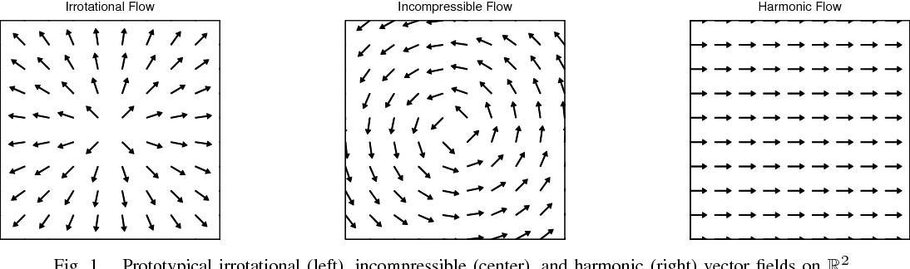
Hodge Decomposition
Analog of the Helmholtz decomposition in discrete space:
Extra term: Harmonic component due to the discreteness of the space
Gradient and solenoidal components. Present in Helmholtz decomposition

Slide 9


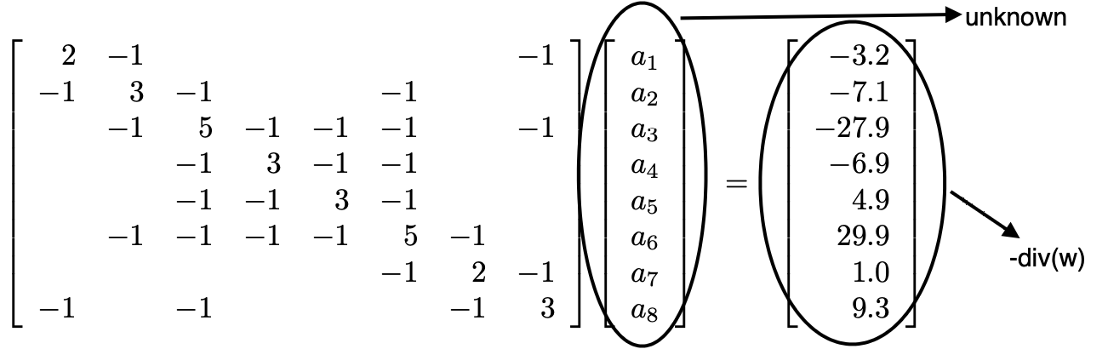

Finding the gradient component
The divergence of the total graph is just the divergence of the gradient component:
;
And a gradient graph can be obtained from computing the gradient of a set of vertices and its weights.
Considering that =
Known
Laplacian Matrix

Slide 10


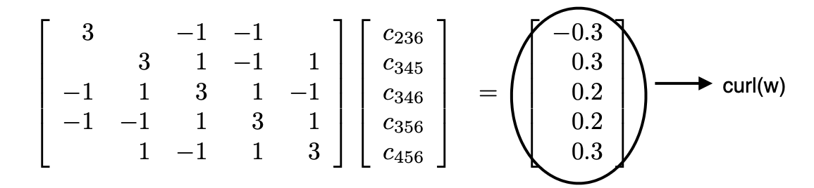

Finding the solenoidal component
The curl of the total graph is just the curl of the solenoidal component:
;
=
And a solenoidal graph can be obtained from computing the conjugate of the curl of a set of triangles and their weights
Using the matricial form of the operator:
δ₁δ*₁ operator

Slide 11

Finding the harmonic component
The solenoidal component cannot account dor all divergence-free circulations not all closed loops are triangles.
The harmonic component provides edge flows associated with bigger cyclical structures.
As the harmonic is both incompressible and irrotational it accounts for translation and it can be obtained directly knowing the other two components:

