Slide 1
Results update 24-06

Slide 2

Analytical Discrete Flow
Transition matrix: T_{ji} = 1/k_{i} transition probability from i to j. (k_{i} degree of i)
Net flow in edge ij in step r: e_{ij} = $\sum_{s}{\text{T}\text{is}\text{r}}∗Tji −$ $\sum_{s}{\text{T}\text{js}\text{r}}∗Tij$
For a given amount of steps Dt, the total edge flow is:
E_{ij} = $\sum_{r= 0}^{Dt}{eij}$(r)

Slide 3
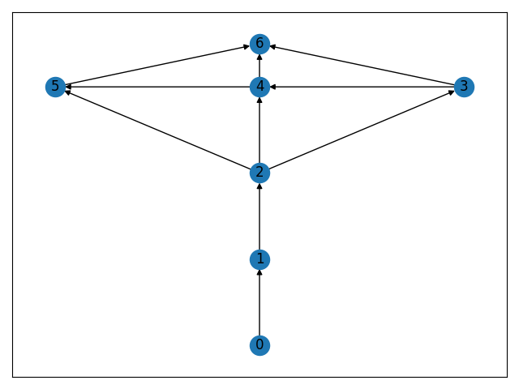
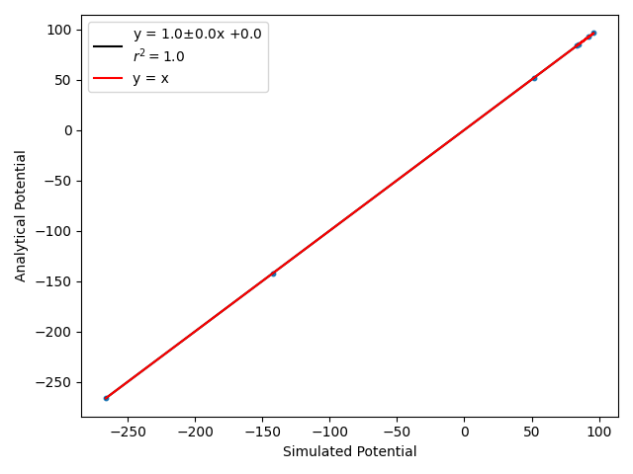
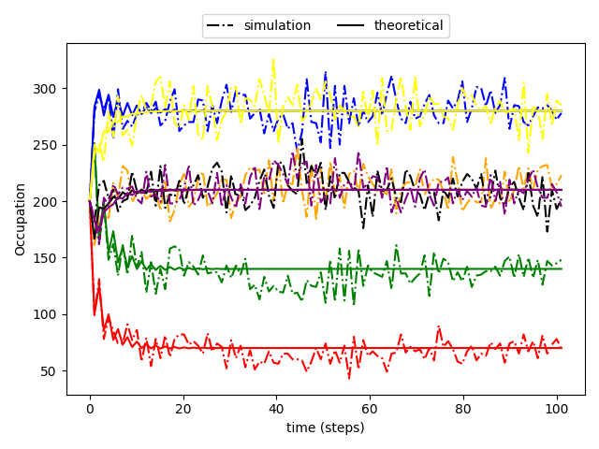
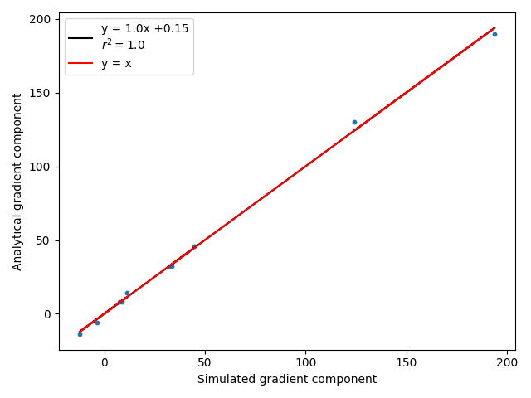
Results DTRW

Slide 4

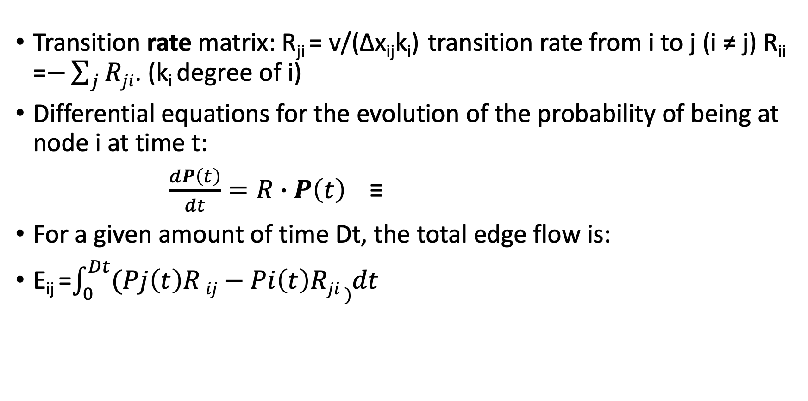
Analytical Continuous Flow
Transition rate matrix: R_{ji} = v/(∆x_{ij}k_{i}) transition rate from i to j (i ≠ j) R_{ii} =$−\sum_{j}{Rji}$. (k_{i} degree of i)
Differential equations for the evolution of the probability of being at node i at time t:
$\frac{dP\left(t\right)}{dt}=R∙P\left(t\right)$≡
For a given amount of time Dt, the total edge flow is:
E_{ij} =$\int_{0}^{Dt}{(Pj\left(t\right)R}ij−Pi\left(t\right)Rji )dt$

Slide 5
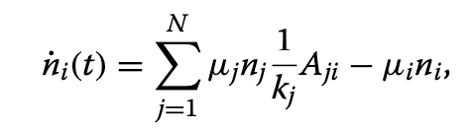
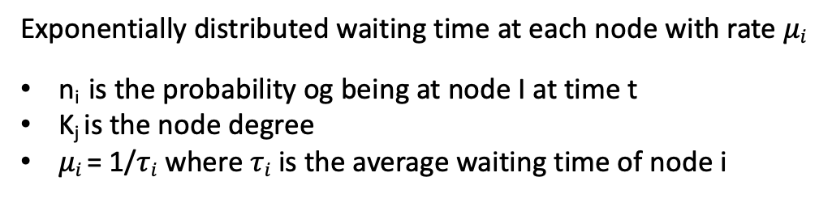
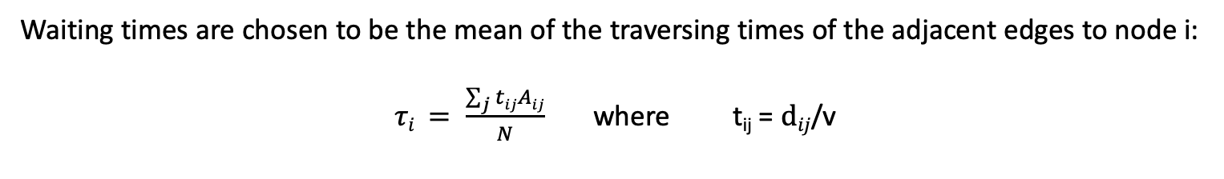
Active node centric CTRW
MASTER EQUATION FOR A NODE-CENTRIC CTRW
Exponentially distributed waiting time at each node with rate $μi$
n_{i} is the probability og being at node I at time t
K_{j} is the node degree
$μi$ = 1/$τi$ where $τi$ is the average waiting time of node i
Waiting times are chosen to be the mean of the traversing times of the adjacent edges to node i:
$τi = \frac{\sum_{j}{tij}Aij}{N}$ where t_{ij} = $dij$/v

Slide 6
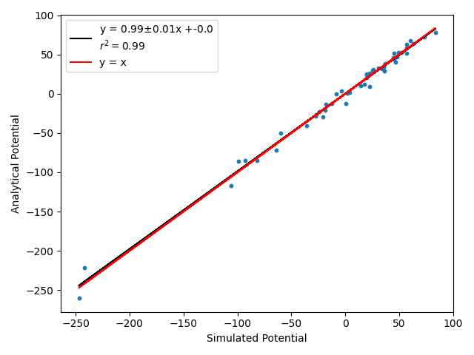
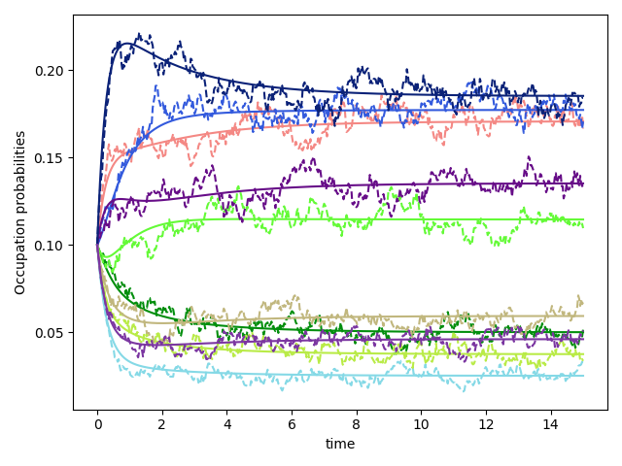
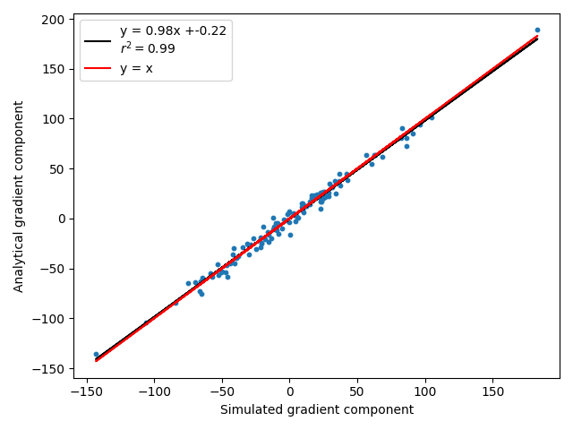
Results Node-Centric CTRW
Results for Erdös-Rényi graphs

Slide 7
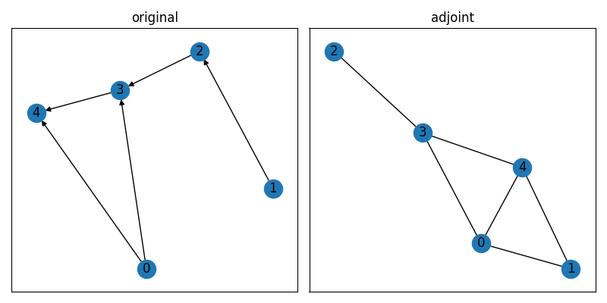
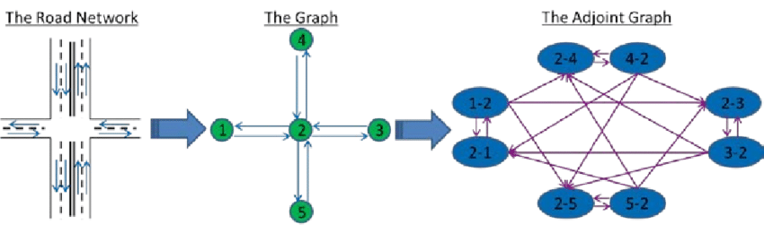
Next step: adjoint graph approach
In order to have an edge-dependent transition rate we can build the adjoint graph (exchange vertex for edges and vice-versa)
such that the walk is performed on the edges and not on the nodes.

Slide 8
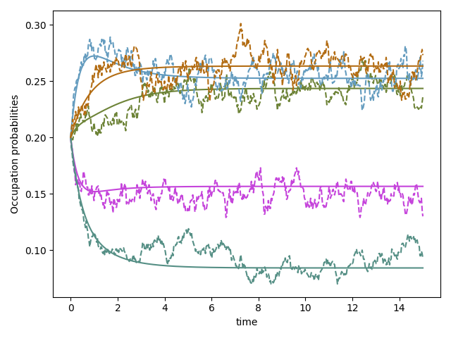
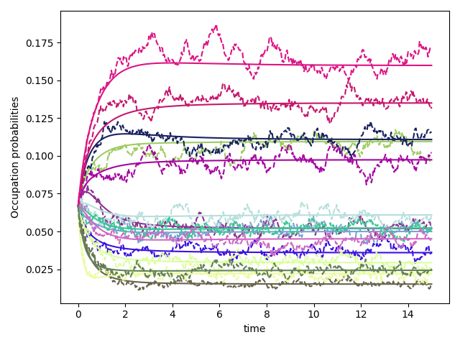
Results of adjoint graph approach
Edge occupation probabilities in ER graphs:
ER 5 nodes
ER 10 nodes

Slide 9
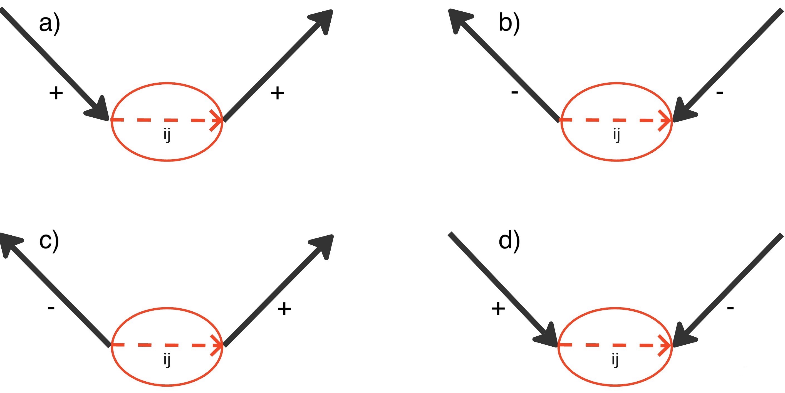
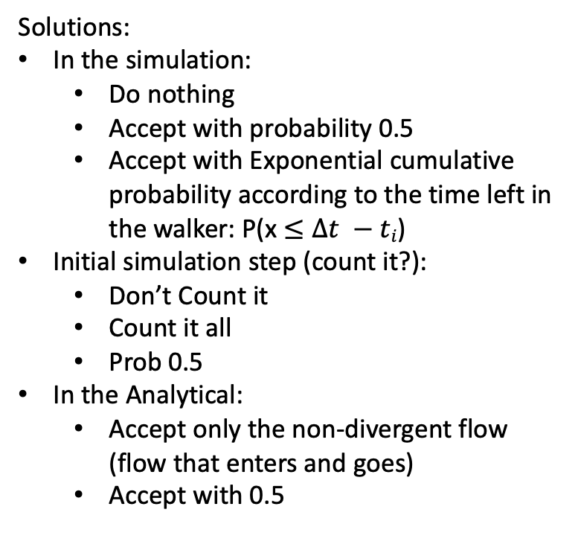
Retrieving edge flow from ”Edge-centric” CTRW
Problems with divergent terms
Solutions:
In the simulation:
Do nothing
Accept with probability 0.5
Accept with Exponential cumulative probability according to the time left in the walker: P(x $≤Δt −ti$)
Initial simulation step (count it?):
Don’t Count it
Count it all
Prob 0.5
In the Analytical:
Accept only the non-divergent flow (flow that enters and goes)
Accept with 0.5

Slide 10
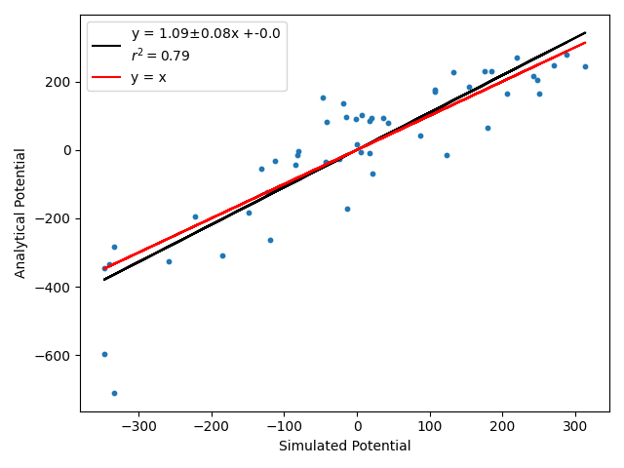
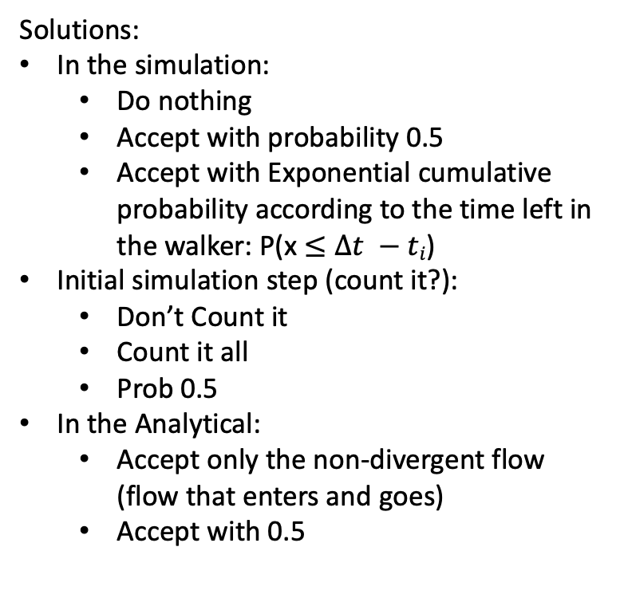
Retrieving edge flow from ”Edge-centric” CTRW
Do nothing and accept non-div flow
Solutions:
In the simulation:
Do nothing
Accept with probability 0.5
Accept with Exponential cumulative probability according to the time left in the walker: P(x $≤Δt −ti$)
Initial simulation step (count it?):
Don’t Count it
Count it all
Prob 0.5
In the Analytical:
Accept only the non-divergent flow (flow that enters and goes)
Accept with 0.5

Slide 11
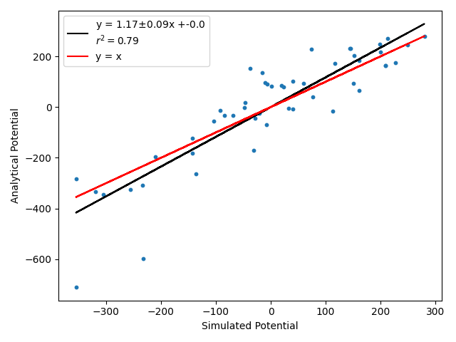
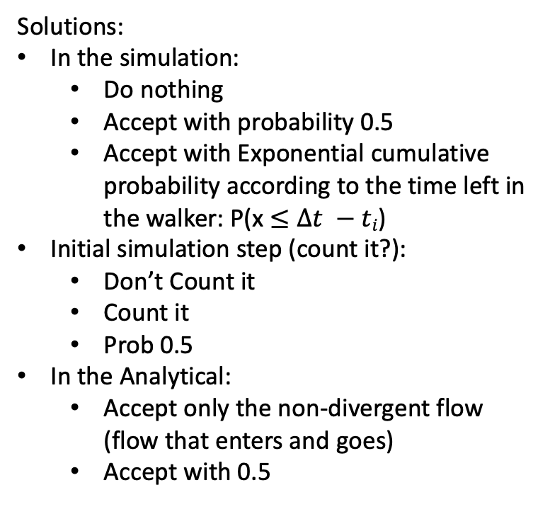
Retrieving edge flow from ”Edge-centric” CTRW
Exp and accept non-div flow
Solutions:
In the simulation:
Do nothing
Accept with probability 0.5
Accept with Exponential cumulative probability according to the time left in the walker: P(x $≤Δt −ti$)
Initial simulation step (count it?):
Don’t Count it
Count it
Prob 0.5
In the Analytical:
Accept only the non-divergent flow (flow that enters and goes)
Accept with 0.5

Slide 12
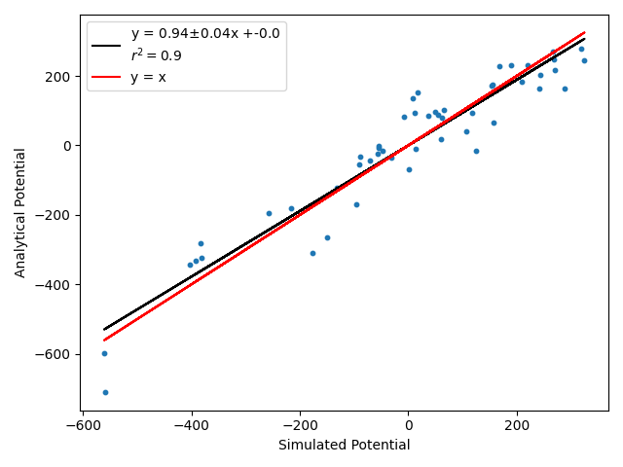
Retrieving edge flow from ”Edge-centric” CTRW
Exp and accept non-div flow
Solutions:
In the simulation:
Do nothing
Accept with probability 0.5
Accept with Exponential cumulative probability according to the time left in the walker: P(x $≤Δt −ti$)
Initial simulation step (count it?):
Don’t Count it
Count it all
Prob 0.5
In the Analytical:
Accept only the non-divergent flow (flow that enters and goes)
Accept with 0.5

Slide 13
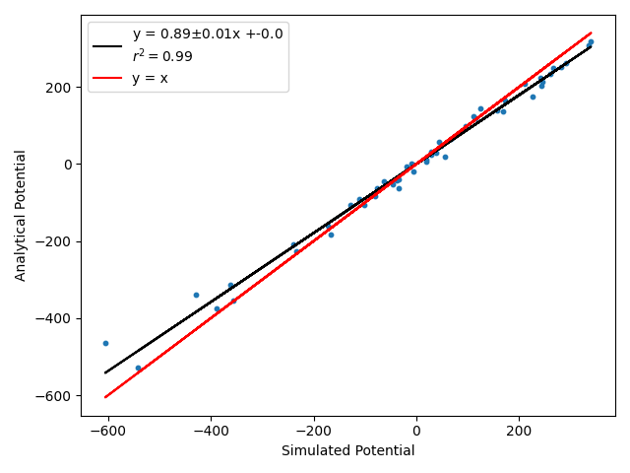
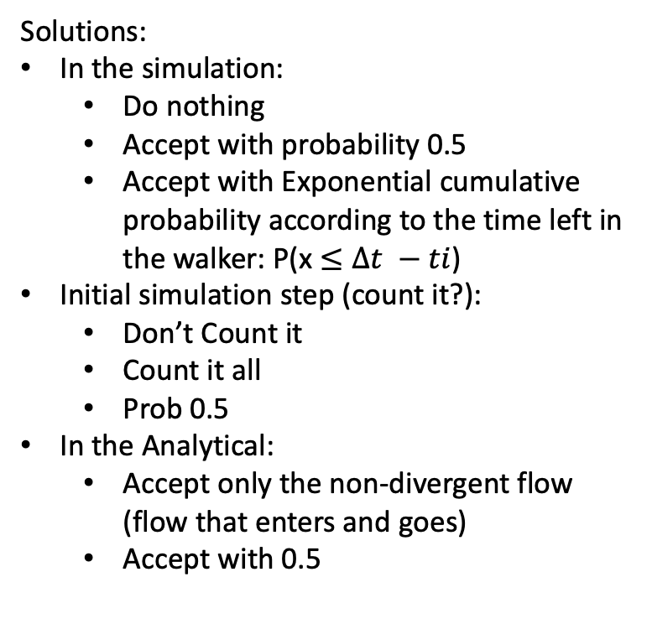
Retrieving edge flow from ”Edge-centric” CTRW
Exp and accept 0.5 flow
Solutions:
In the simulation:
Do nothing
Accept with probability 0.5
Accept with Exponential cumulative probability according to the time left in the walker: P(x $≤Δt −ti$)
Initial simulation step (count it?):
Don’t Count it
Count it all
Prob 0.5
In the Analytical:
Accept only the non-divergent flow (flow that enters and goes)
Accept with 0.5

Slide 14
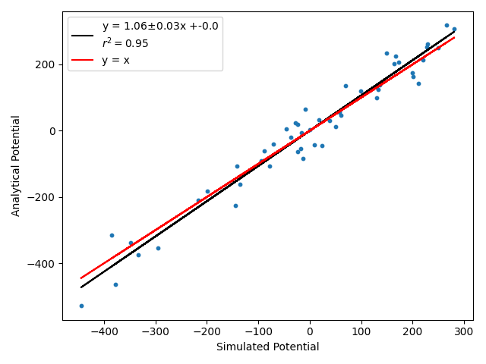
Retrieving edge flow from ”Edge-centric” CTRW
0.5 sim and 0.5 flow
Solutions:
In the simulation:
Do nothing
Accept with probability 0.5
Accept with Exponential cumulative probability according to the time left in the walker: P(x $≤Δt −ti$)
Initial simulation step (count it?):
Don’t Count it
Count it all
Prob 0.5
In the Analytical:
Accept only the non-divergent flow (flow that enters and goes)
Accept with 0.5

Slide 15
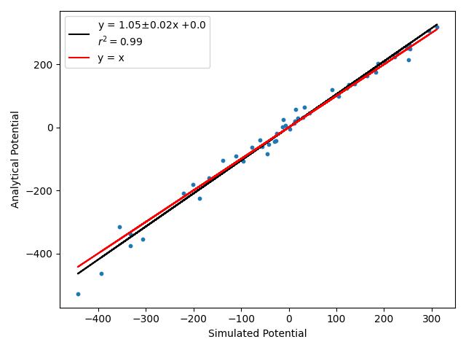
Retrieving edge flow from ”Edge-centric” CTRW
Exp sim and initial 0.5 with 0.5 flow
Solutions:
In the simulation:
Do nothing
Accept with probability 0.5
Accept with Exponential cumulative probability according to the time left in the walker: P(x $≤Δt −ti$)
Initial simulation step (count it?):
Don’t Count it
Count it all
Prob 0.5
In the Analytical:
Accept only the non-divergent flow (flow that enters and goes)
Accept with 0.5

Slide 16
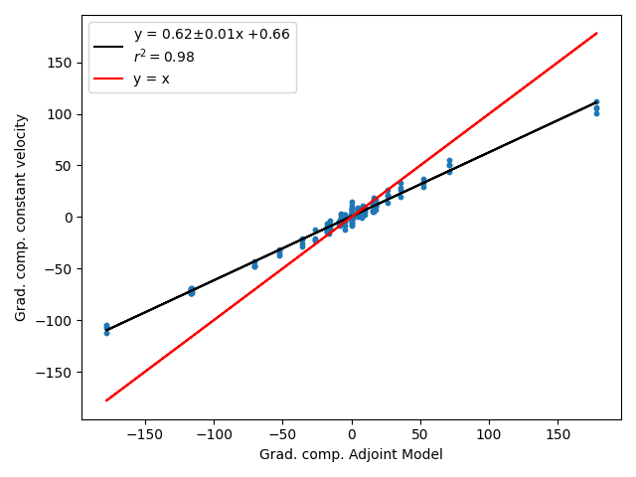
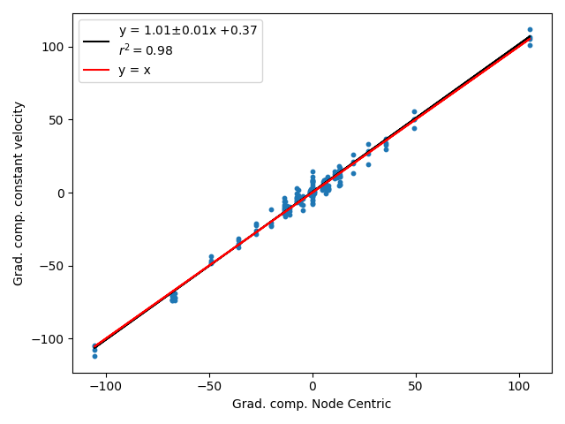
Comparisons to constant velocity
PBC Lattice:
Edge centric (adjoint)
Node centric (average rates)

Slide 17
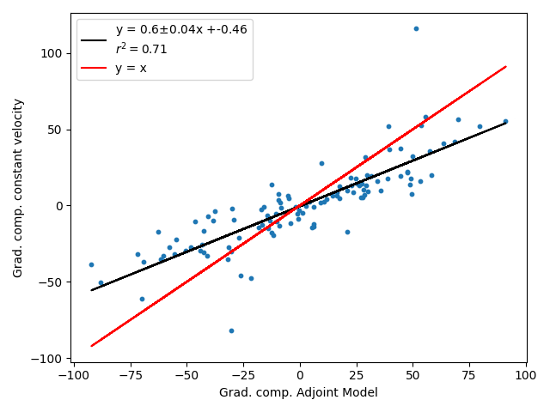
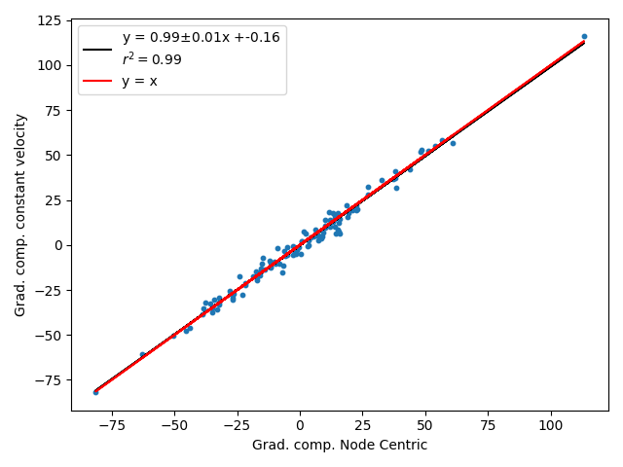
Comparisons to constant velocity
ER 50 nodes p: 0.1
Edge centric (adjoint)
Node centric (average rates)

Slide 18
Results 30-05
Why centre repulsive? Effect of degree and edge distance
Origin of harmonic+solenoidal (cyclic) component?
Evolution of cyclic component.

Slide 19
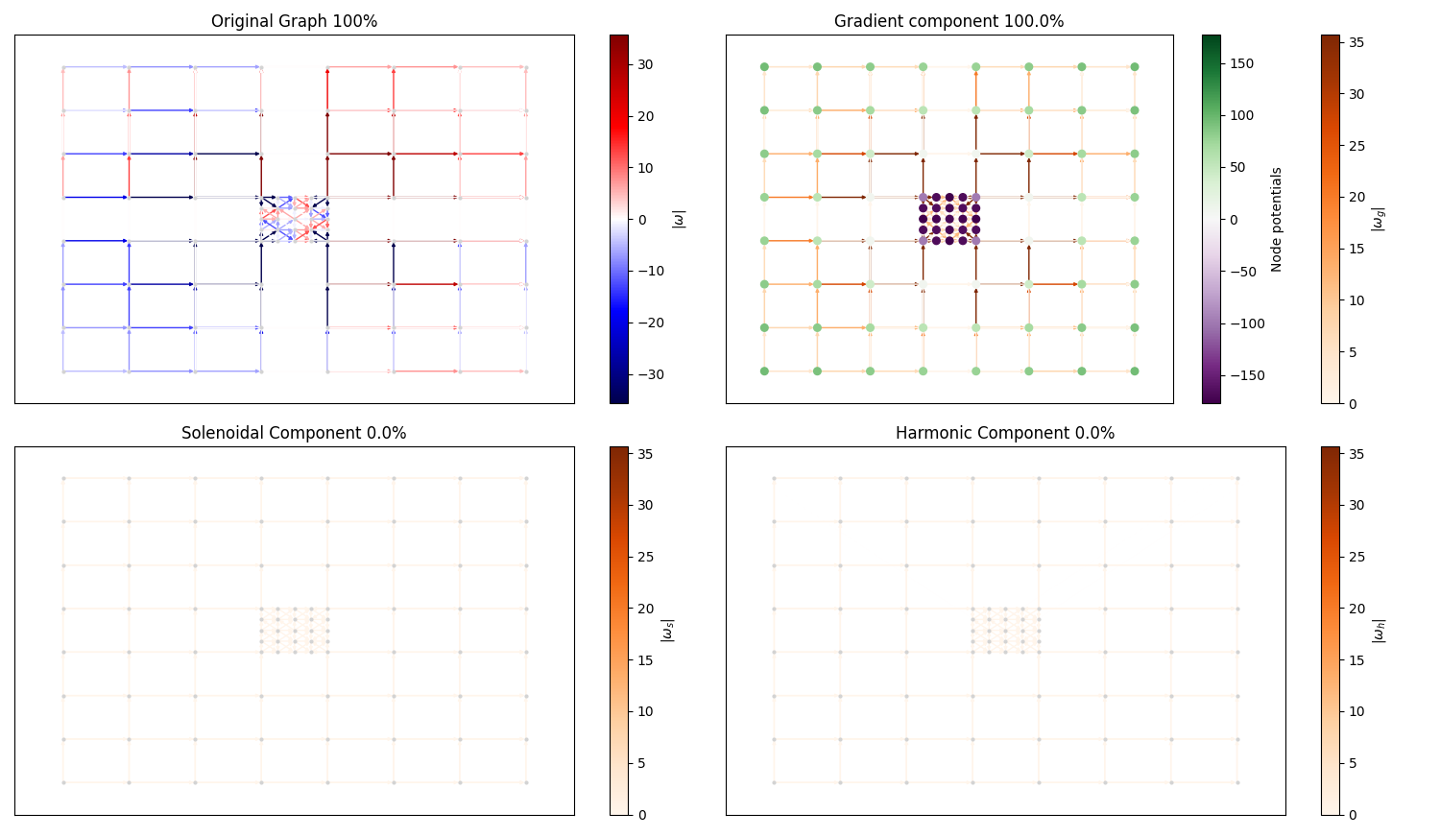
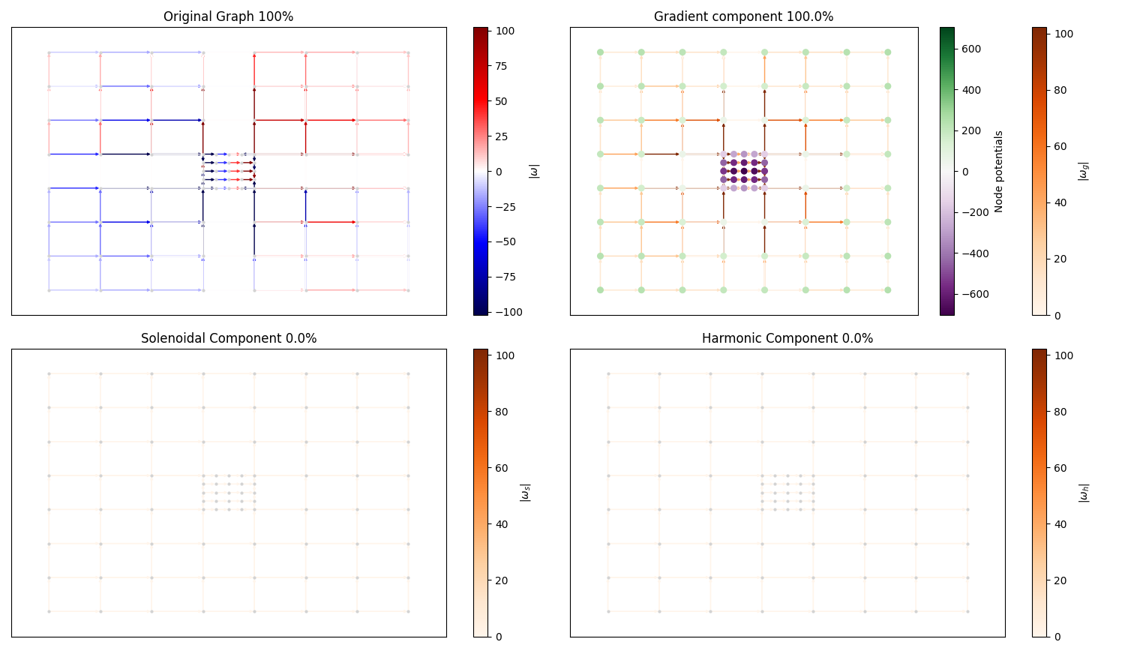
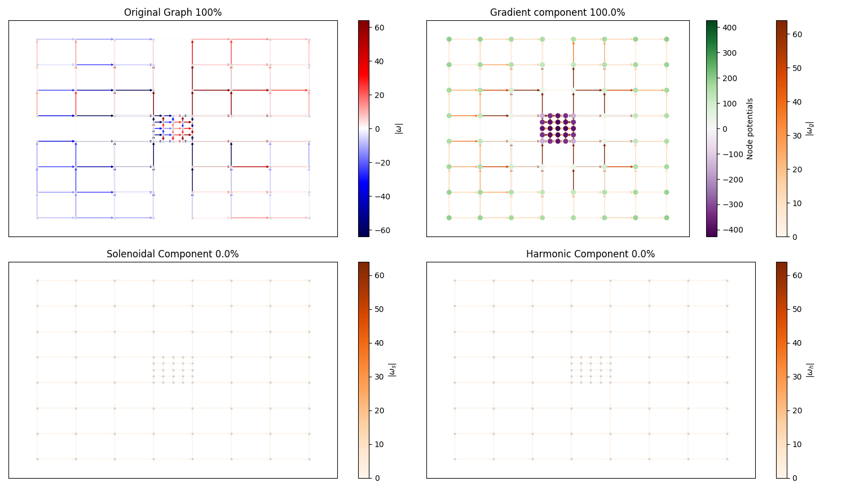
Effect of degree and edge distance in PBC lattice
More degree
Less degree
Same degree

Slide 20
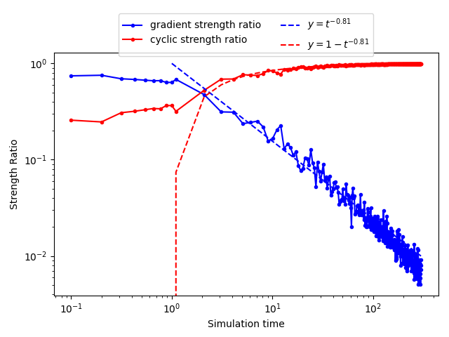
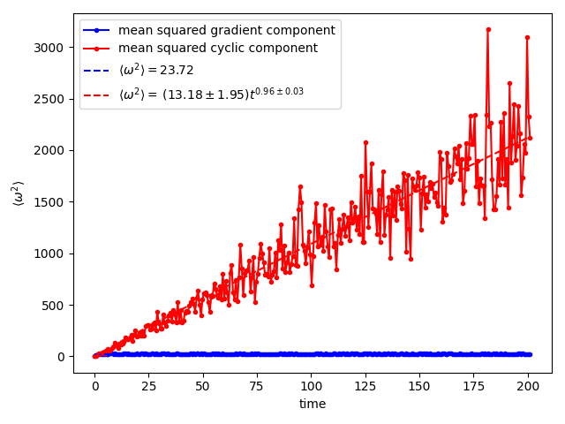
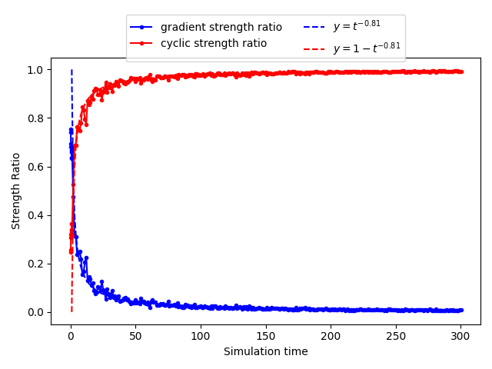
Evolution of cyclic ratio and component
Erdös-Renyi
Ratios (loglog)
Mean squared flow
Evolves linearly with t like <x^2> in random walks. Diffusion?
Ratios (linear)

Slide 21
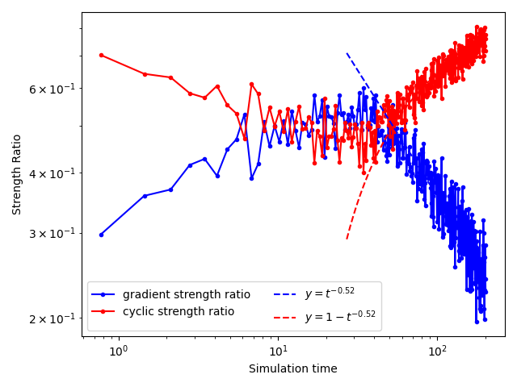
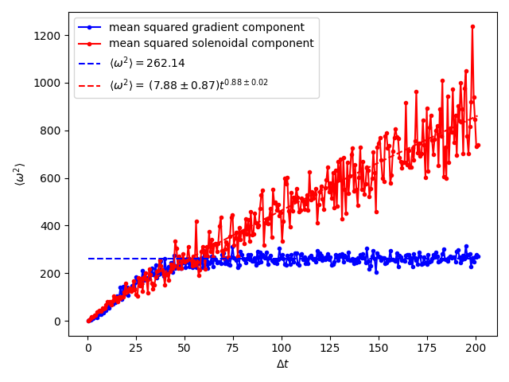
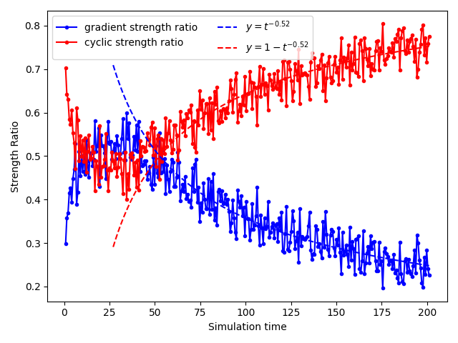
Evolution of cyclic ratio and component
PBC-lattice
Ratios (loglog)
Mean squared flow
Cyclic not entirely linear
Ratios (linear)

Slide 22
Correction of edge-centric
Erdös-Rényi
Random geometric

Slide 23
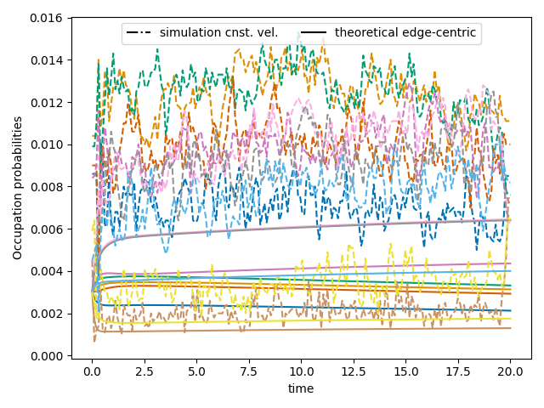
Edge probabilities
RG
ER

Slide 24
3x3 regular lattice no PBC

Slide 25
PBC lattice node probabilities
Cnst. V
DTRW
Edge-centr. th
Node centr.
Edge-centr. th + edge probs
Edge-centr. sim

