Slide 1
Results update 18-05

Slide 2

Analytical Discrete Flow
Transition matrix: T_{ji} = 1/k_{i} transition probability from i to j. (k_{i} degree of i)
Net flow in edge ij in step r: e_{ij} = $\sum_{s}{\text{T}\text{is}\text{r}}∗Tji −$ $\sum_{s}{\text{T}\text{js}\text{r}}∗Tij$
For a given amount of steps Dt, the total edge flow is:
E_{ij} = $\sum_{r= 0}^{Dt}{eij}$(r)

Slide 3
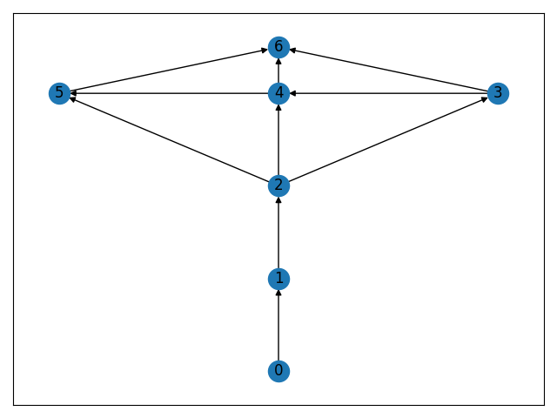
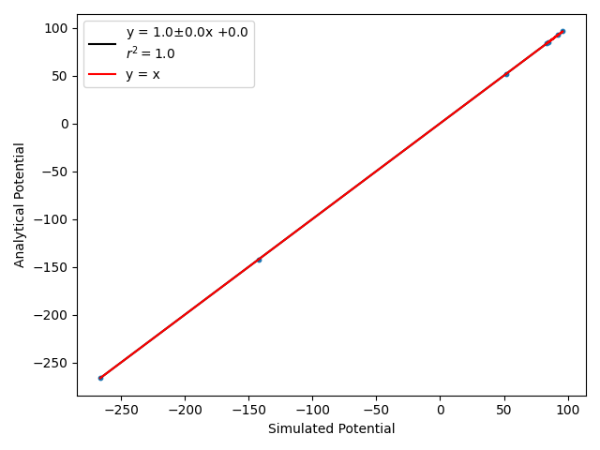
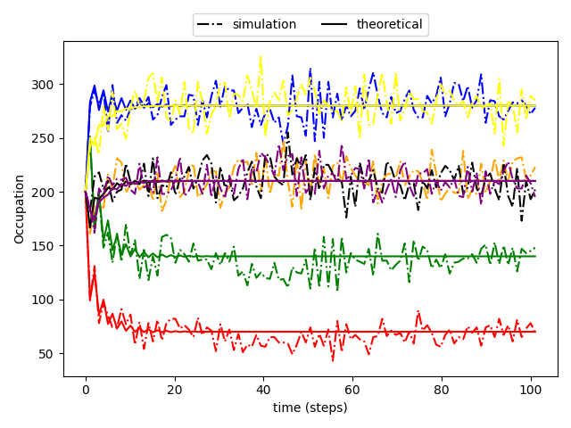
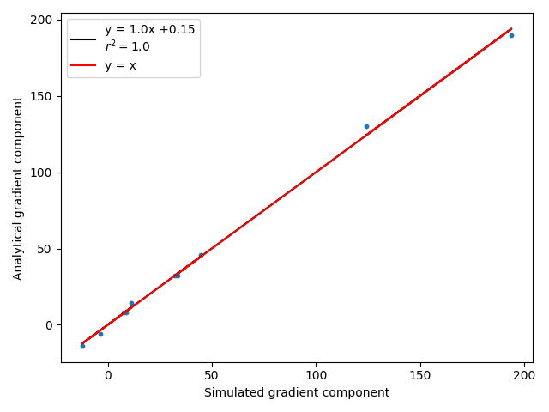
Results DTRW

Slide 4

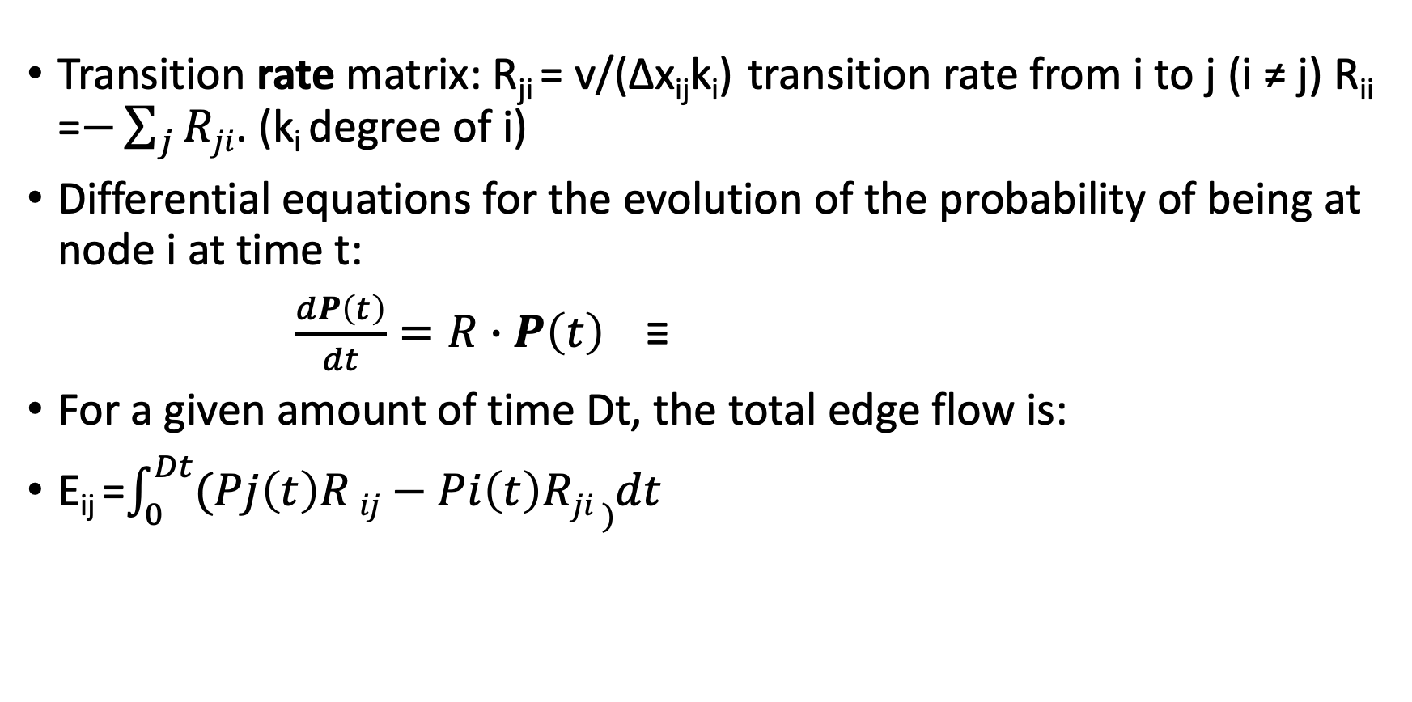
Analytical Continuous Flow
Transition rate matrix: R_{ji} = v/(∆x_{ij}k_{i}) transition rate from i to j (i ≠ j) R_{ii} =$−\sum_{j}{Rji}$. (k_{i} degree of i)
Differential equations for the evolution of the probability of being at node i at time t:
$\frac{dP\left(t\right)}{dt}=R∙P\left(t\right)$≡
For a given amount of time Dt, the total edge flow is:
E_{ij} =$\int_{0}^{Dt}{(Pj\left(t\right)R}ij−Pi\left(t\right)Rji )dt$

Slide 5
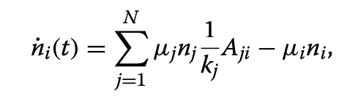
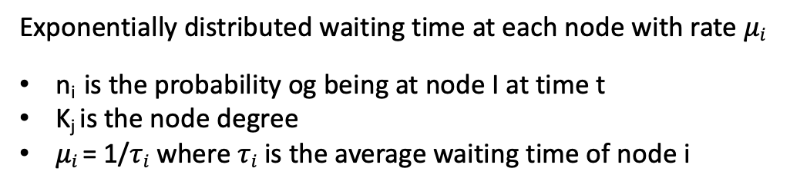
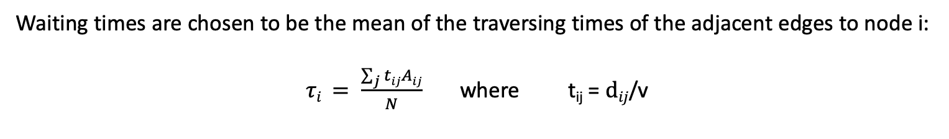
Active node centric CTRW
MASTER EQUATION FOR A NODE-CENTRIC CTRW
Exponentially distributed waiting time at each node with rate $μi$
n_{i} is the probability og being at node I at time t
K_{j} is the node degree
$μi$ = 1/$τi$ where $τi$ is the average waiting time of node i
Waiting times are chosen to be the mean of the traversing times of the adjacent edges to node i:
$τi = \frac{\sum_{j}{tij}Aij}{N}$ where t_{ij} = $dij$/v

Slide 6
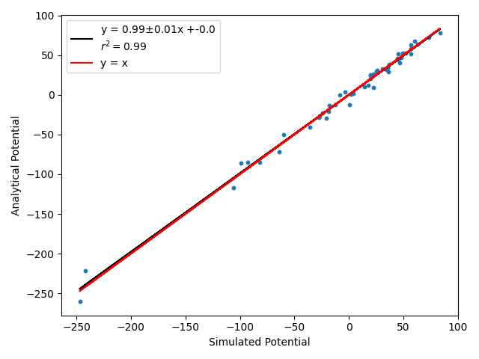
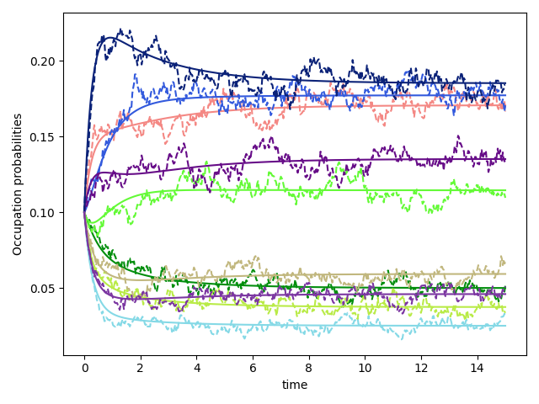
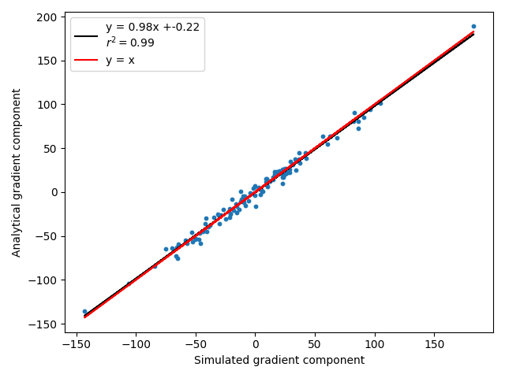
Results Node-Centric CTRW
Results for Erdös-Rényi graphs

Slide 7
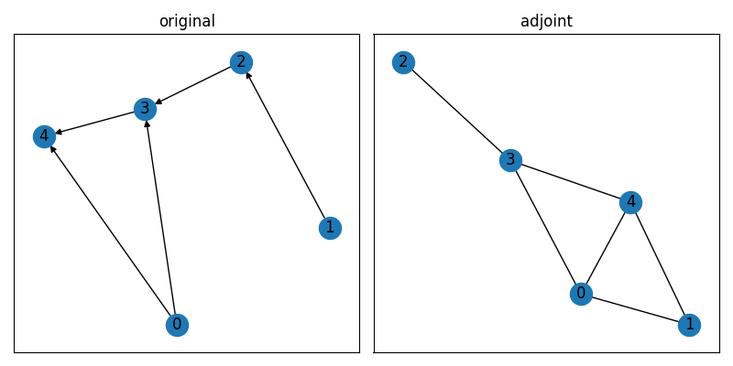
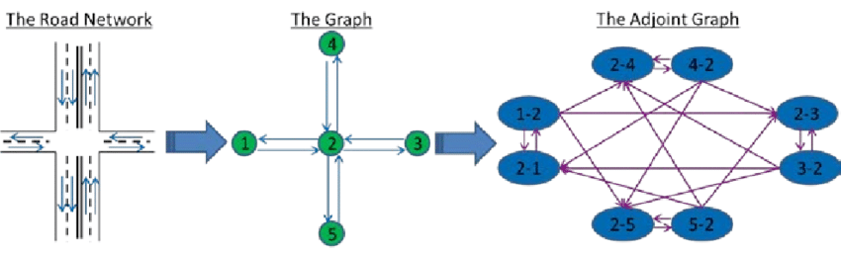
Next step: adjoint graph approach
In order to have an edge-dependent transition rate we can build the adjoint graph (exchange vertex for edges and vice-versa)
such that the walk is performed on the edges and not on the nodes.

Slide 8
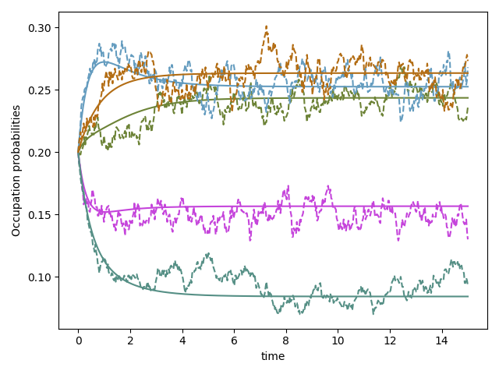
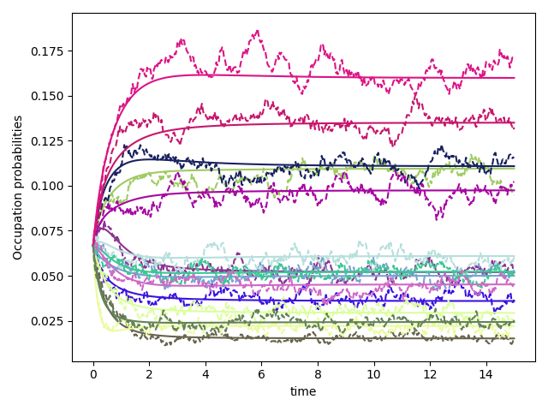
Results of adjoint graph approach
Edge occupation probabilities in ER graphs:
ER 5 nodes
ER 10 nodes

Slide 9
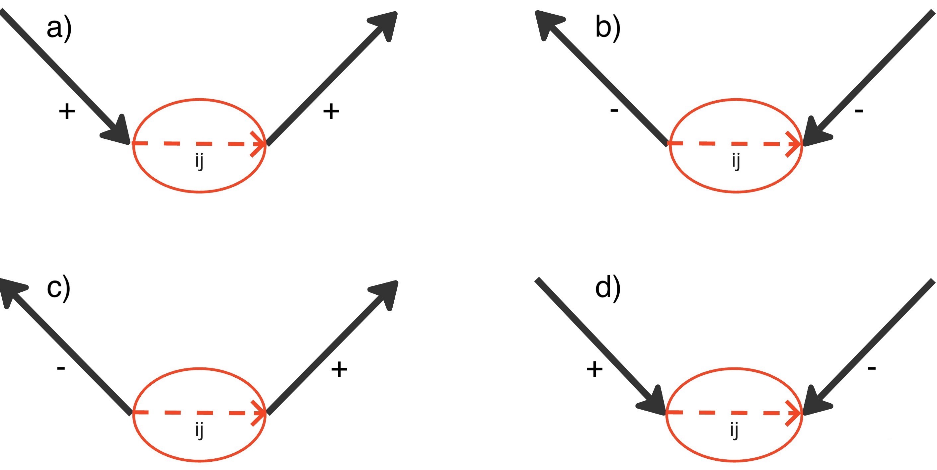
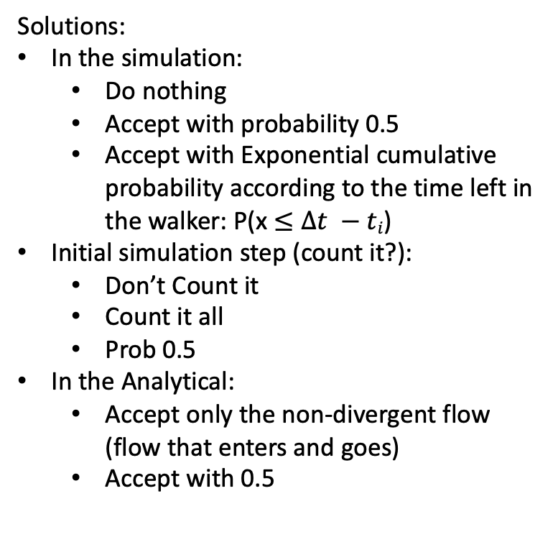
Retrieving edge flow from ”Edge-centric” CTRW
Problems with divergent terms
Solutions:
In the simulation:
Do nothing
Accept with probability 0.5
Accept with Exponential cumulative probability according to the time left in the walker: P(x $≤Δt −ti$)
Initial simulation step (count it?):
Don’t Count it
Count it all
Prob 0.5
In the Analytical:
Accept only the non-divergent flow (flow that enters and goes)
Accept with 0.5

Slide 10
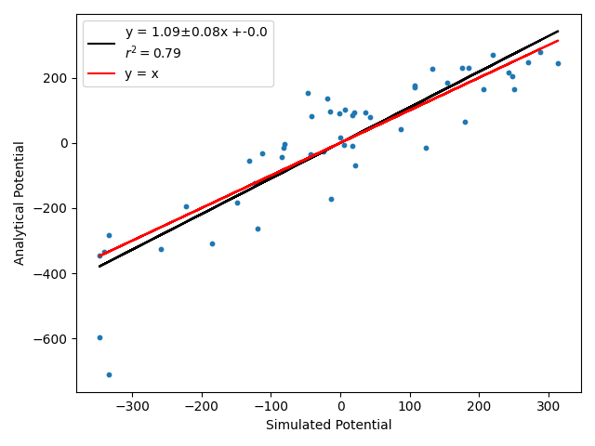
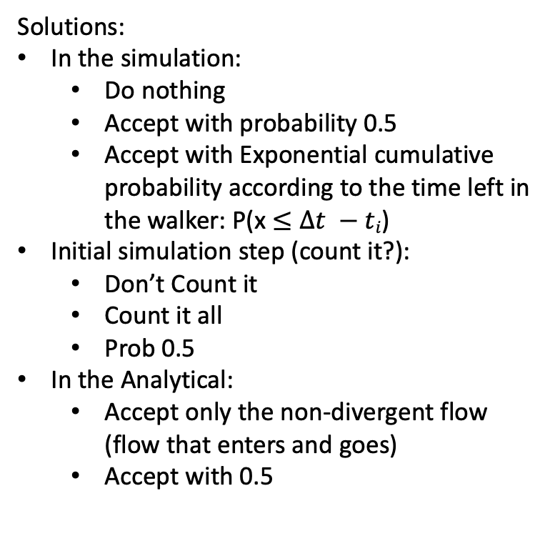
Retrieving edge flow from ”Edge-centric” CTRW
Do nothing and accept non-div flow
Solutions:
In the simulation:
Do nothing
Accept with probability 0.5
Accept with Exponential cumulative probability according to the time left in the walker: P(x $≤Δt −ti$)
Initial simulation step (count it?):
Don’t Count it
Count it all
Prob 0.5
In the Analytical:
Accept only the non-divergent flow (flow that enters and goes)
Accept with 0.5

Slide 11
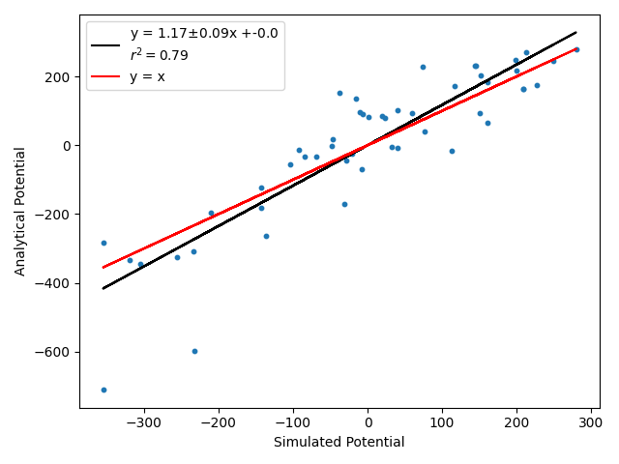
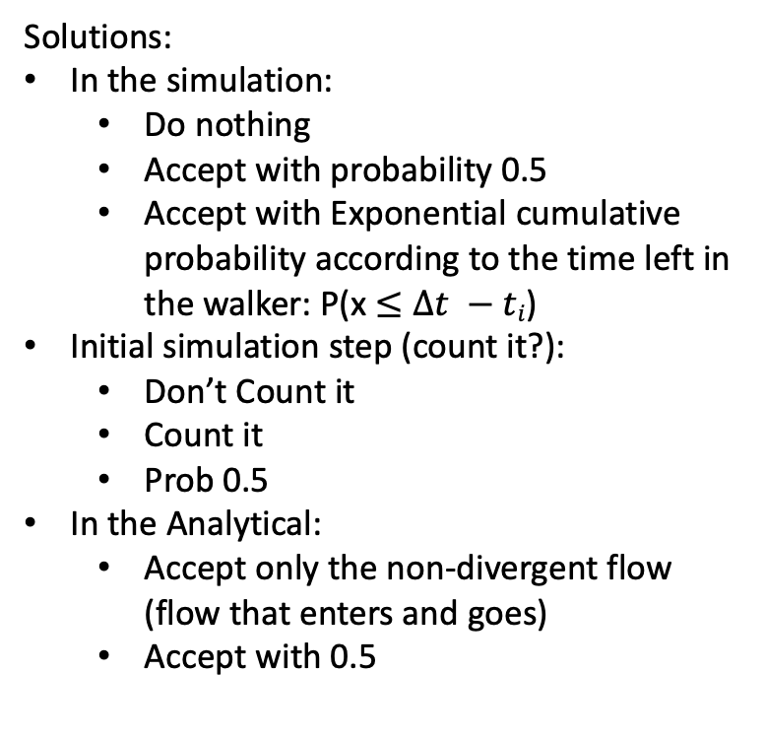
Retrieving edge flow from ”Edge-centric” CTRW
Exp and accept non-div flow
Solutions:
In the simulation:
Do nothing
Accept with probability 0.5
Accept with Exponential cumulative probability according to the time left in the walker: P(x $≤Δt −ti$)
Initial simulation step (count it?):
Don’t Count it
Count it
Prob 0.5
In the Analytical:
Accept only the non-divergent flow (flow that enters and goes)
Accept with 0.5

Slide 12
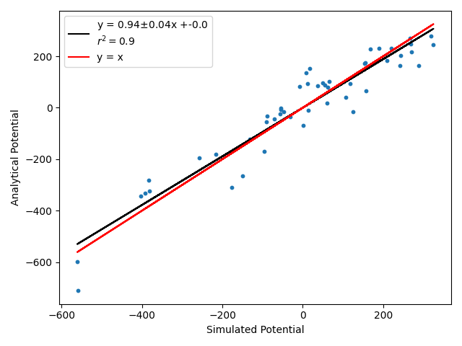
Retrieving edge flow from ”Edge-centric” CTRW
Exp and accept non-div flow
Solutions:
In the simulation:
Do nothing
Accept with probability 0.5
Accept with Exponential cumulative probability according to the time left in the walker: P(x $≤Δt −ti$)
Initial simulation step (count it?):
Don’t Count it
Count it all
Prob 0.5
In the Analytical:
Accept only the non-divergent flow (flow that enters and goes)
Accept with 0.5

Slide 13
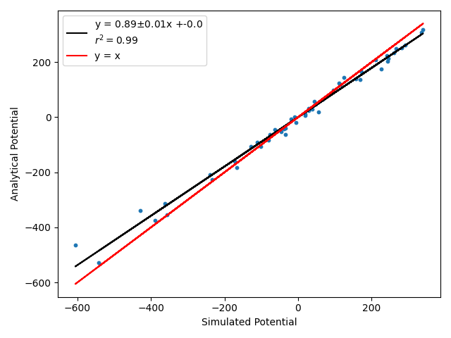
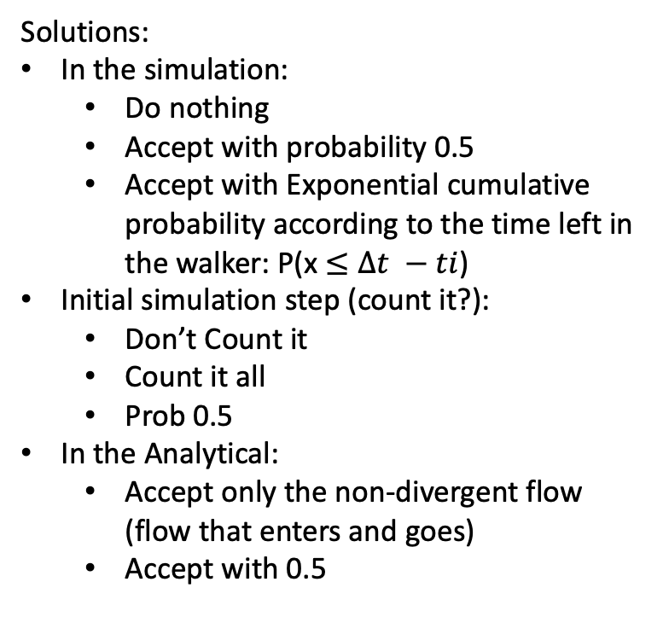
Retrieving edge flow from ”Edge-centric” CTRW
Exp and accept 0.5 flow
Solutions:
In the simulation:
Do nothing
Accept with probability 0.5
Accept with Exponential cumulative probability according to the time left in the walker: P(x $≤Δt −ti$)
Initial simulation step (count it?):
Don’t Count it
Count it all
Prob 0.5
In the Analytical:
Accept only the non-divergent flow (flow that enters and goes)
Accept with 0.5

Slide 14
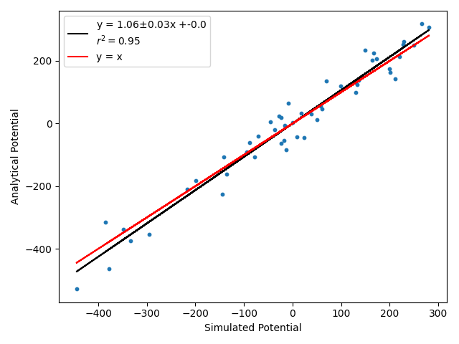
Retrieving edge flow from ”Edge-centric” CTRW
0.5 sim and 0.5 flow
Solutions:
In the simulation:
Do nothing
Accept with probability 0.5
Accept with Exponential cumulative probability according to the time left in the walker: P(x $≤Δt −ti$)
Initial simulation step (count it?):
Don’t Count it
Count it all
Prob 0.5
In the Analytical:
Accept only the non-divergent flow (flow that enters and goes)
Accept with 0.5

Slide 15
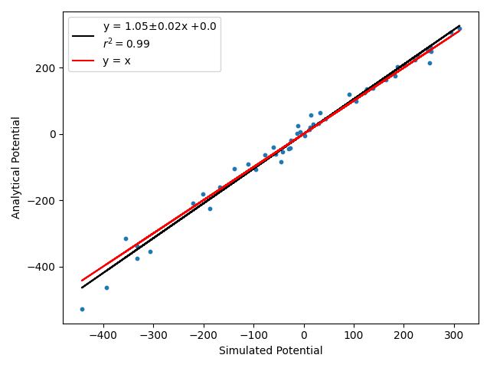
Retrieving edge flow from ”Edge-centric” CTRW
Exp sim and initial 0.5 with 0.5 flow
Solutions:
In the simulation:
Do nothing
Accept with probability 0.5
Accept with Exponential cumulative probability according to the time left in the walker: P(x $≤Δt −ti$)
Initial simulation step (count it?):
Don’t Count it
Count it all
Prob 0.5
In the Analytical:
Accept only the non-divergent flow (flow that enters and goes)
Accept with 0.5

Slide 16
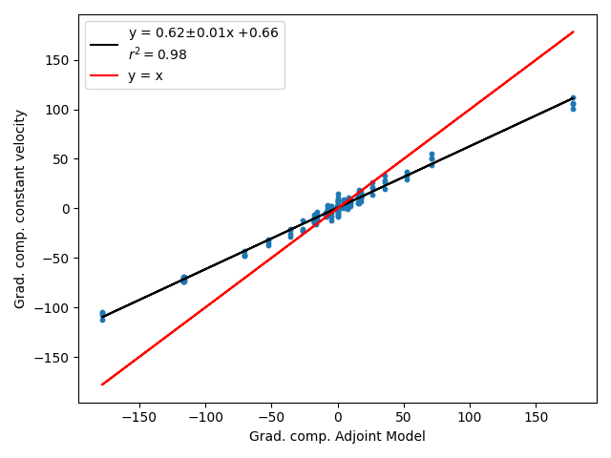
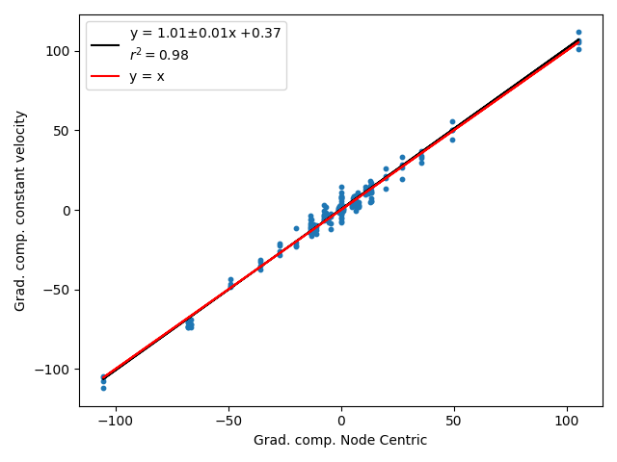
Comparisons to constant velocity
PBC Lattice:
Edge centric (adjoint)
Node centric (average rates)

Slide 17
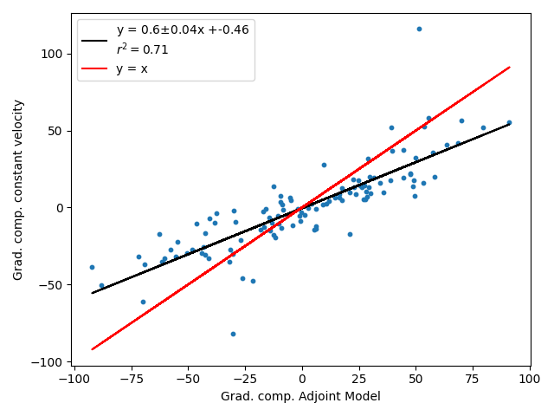
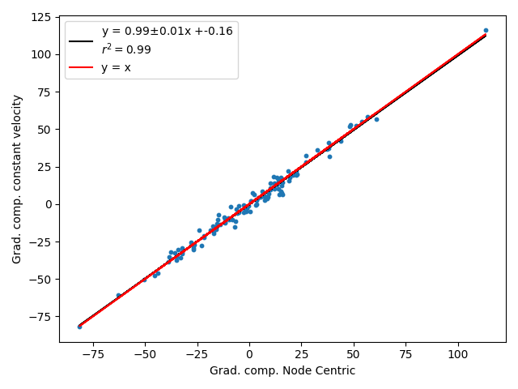
Comparisons to constant velocity
ER 50 nodes p: 0.1
Edge centric (adjoint)
Node centric (average rates)

