Slide 1
Sales Dashboard
Power BI Project for Business Insights
Created on 25-Apr-2025

Slide 2
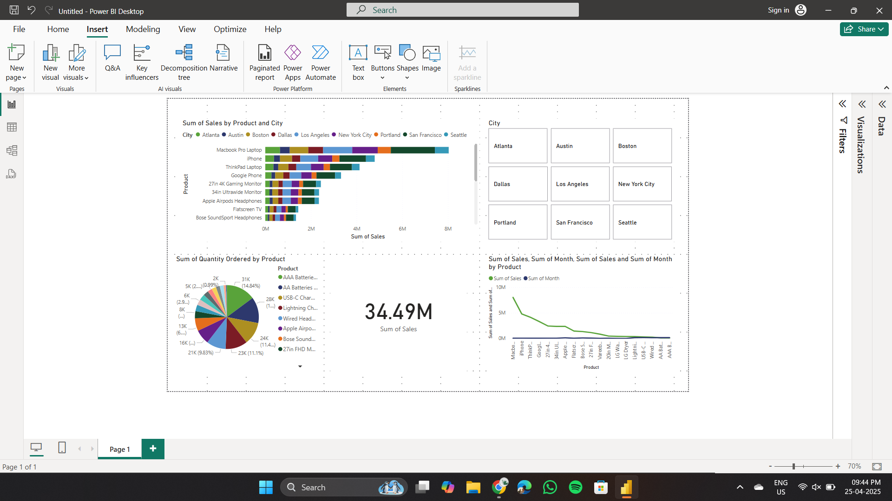
Dashboard Overview
Interactive dashboard showing key product and regional sales trends

Slide 3
Key Insights
Macbook Pro is the highest-selling product
New York City has the most diverse sales mix
AAA Batteries are top in quantity ordered
Total sales recorded: $34.49M

Slide 4
Business Recommendations
Focus marketing on top-selling products
Improve supply chain in high-performing cities
Consider bundling low-performing products
Use insights for targeted promotions

Slide 5
Conclusion & Next Steps
Dashboard provides actionable insights for decision-making
Maintain dashboard regularly with updated data
Explore deeper drilldowns for specific cities and timeframes

