Slide 1


COSMOS Cultivate Resilient Smart Objects for Sustainable City Applications
Privelets Functional Component
Achilleas Marinakis (ICCS/NTUA)

Slide 2
Overview
Applies on two different models of communication; push and pull
Push is applied when a Thing consistently feeds its data towards the communication services of COSMOS (such as the Message Bus) or towards the ingestion in the Cloud storage at the COSMOS platform side
Pull is applied through the IoT Service concept, that enables an entity to query a Thing for getting a specific data field at an arbitrary time point
Implemented as a Service
Lightweight implementation to be able to run inside the Things
Run the Service by executing java –jar PriveletsService-Y3.jar
Acts as a privacy filter
Enables the end-user to define which data can be shared and which not
Private data are entirely cut-off
Public data are available as they are

Slide 3
Fuzzification Functionality
Data can also be tagged as fuzzy
In many occasions (e.g. actual location) people are unwilling to share their real data but (slightly) different ones
Compromise between Privacy and Accuracy
Low, Medium and High Privacy correspond respectively to small, medium or large (absolute) difference between the real value and the fuzzy one
Range
The fuzzy value is randomly calculated within a range (percentage) defined from the application developer
e.g. for utm coordinates; suitable range must be selected for the fuzzy location to still belong to the same town, neighborhood etc, according to the specific application

Slide 4
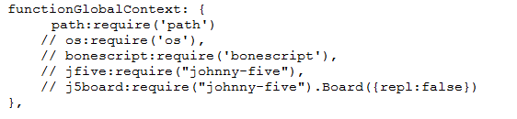
Configuration (1/2)
Configure Privelets component through Node-Red
Locate confPrivelets.js and confPrivelets.html files to your nodes directory in your user directory (e.g \AppData\Roaming\npm\node_modules\node-red\nodes for windows), to be able to use confPrivelets node, exclusively created for this purpose
Modify the settings.js file of the Node-Red folder in your user directory (e.g. \.node-red for windows), like the image below:

Slide 5
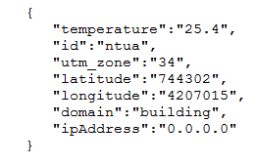
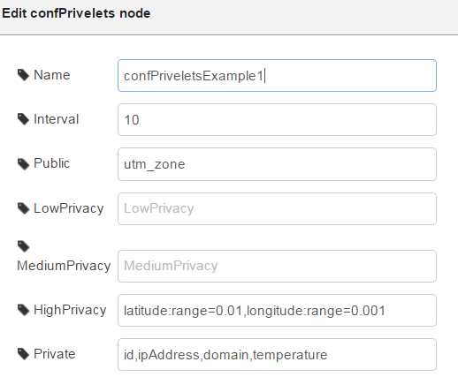
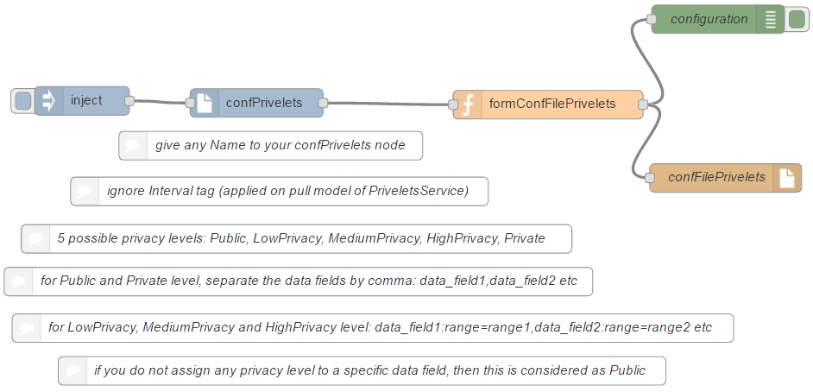
Configuration (2/2)
Fill in the confPrivelets node according to your privacy preferences, following the instructions below:

Slide 6
Input / Output
Input
json object with only string:string name/value pairs
If your json data are not in the above format, a special Node-Red function is needed to convert them to the right one
Output
json object with only string:string name/value pairs
Private data are cut-off
Public data are returned as they are
Low, Medium and High Privacy data are fuzzified

Slide 7

Thank you!
Achilleas Marinakis (ICCS/NTUA) achmarin@mail.ntua.gr
www.iot-cosmos.eu
The research leading to these results has received funding from the EC Seventh Framework Programme FP7/2007-2011 under Grant Agreement n° 609043

