Slide 1


COSMOS Cultivate Resilient Smart Objects for Sustainable City Applications
Privelets Functional Component
NTUA Hackathon, May 23rd
Athens
Achilleas Marinakis (ICCS/NTUA)

Slide 2
Overview
Applies on two different models of communication; push and pull
Push model applicable for Hackathon Scenario B (e.g. consistently feeding your personal data to a database, cloud storage etc)
Implemented as a Service
Lightweight implementation to be able to run inside the Things
Run the Service by executing java –jar PriveletsService-Y3.jar (available in GitHub)
Acts as a privacy filter
Enables the end-user to define which data can be shared and which not
Private data are entirely cut-off
Public data are available as they are

Slide 3
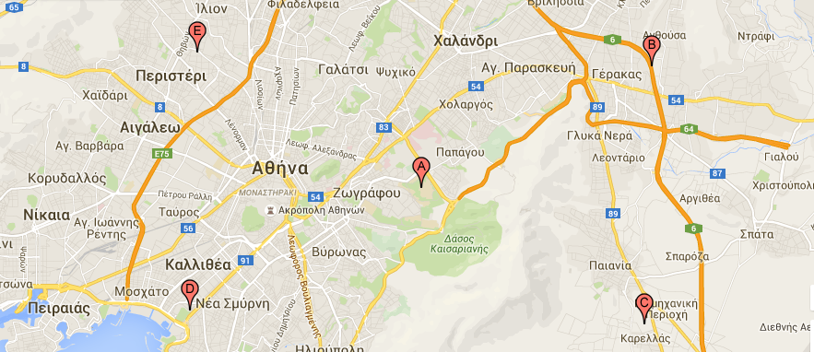
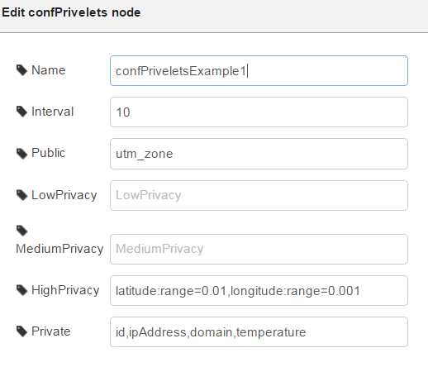
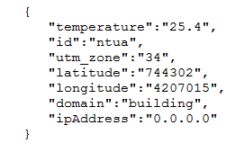
Fuzzification Functionality
Data can also be tagged as fuzzy
In many occasions (e.g. actual location) people are unwilling to share their real data but (slightly) different ones
Compromise between Privacy and Accuracy
Low, Medium and High Privacy correspond respectively to small, medium or large (absolute) difference between the real value and the fuzzy one
Range
The fuzzy value is randomly calculated within a range (percentage) defined from the app developer
e.g. for utm coordinates; suitable range must be selected for the fuzzy location to still belong to the same town, neighborhood etc, according to the specific app

Slide 4
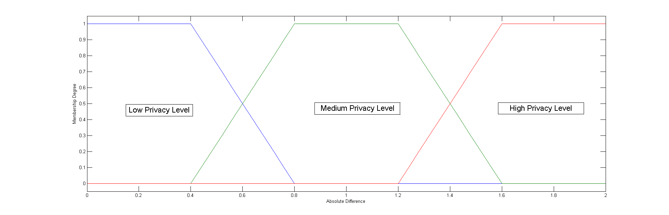
Fuzzy Value Calculation
Exploit some aspects of the fuzzy logic theory
Why fuzzy logic?
Some times people are unable to quantify their privacy preferences
Instead they are willing to describe them using linguistic variables such as “low”, “medium” or “high”
Membership Function
Symmetric trapezoidal membership function
Simple to implement
Easy for end-users to understand

Slide 5
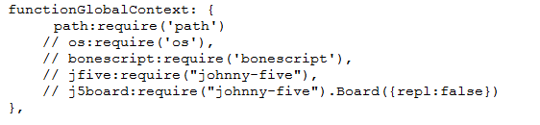
Configuration (1/2)
Configure Privelets component through Node-Red
Locate confPrivelets.js and confPrivelets.html files to your nodes directory in your user directory (e.g \AppData\Roaming\npm\node_modules\node-red\nodes for windows)
To be able to use confPrivelets node, exclusively created for this purpose
Modify the settings.js file of the Node-Red folder in your user directory (e.g. \.node-red for windows)
All the three files are available in GitHub

Slide 6
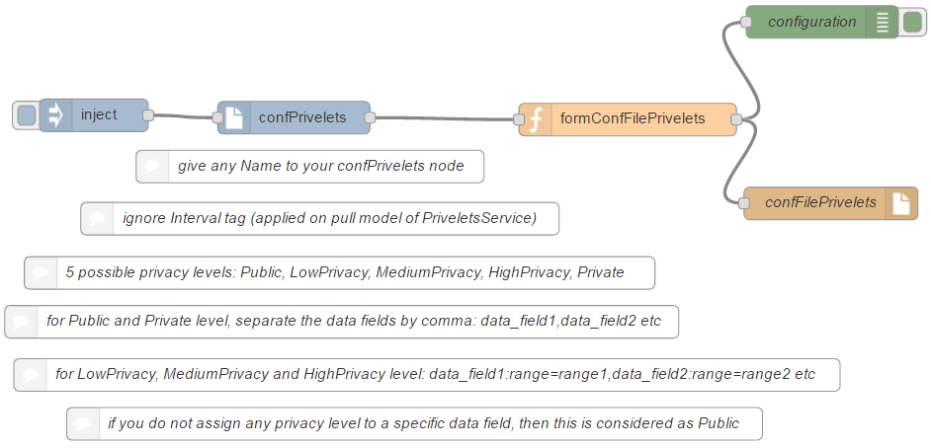
Configuration (2/2)
Fill in the confPrivelets node according to your privacy preferences:

Slide 7
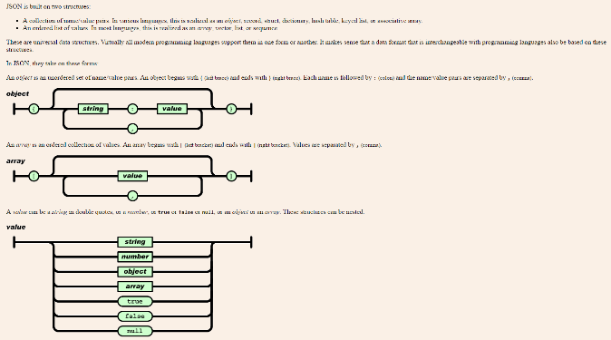
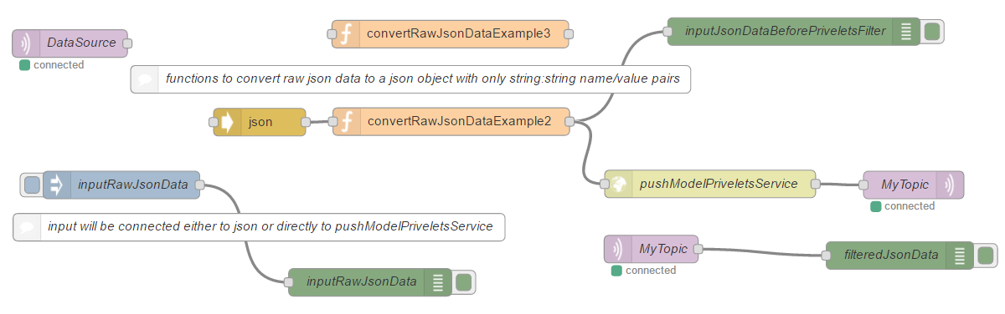
Input / Output
Input
json object with only string:string name/value pairs
If your json data are not in the above format, a special Node-Red function is needed to convert them to the right one
Output
json object with only string:string name/value pairs
Private data are cut-off
Public data are returned as they are
Low, Medium and High Privacy data are fuzzified

Slide 8
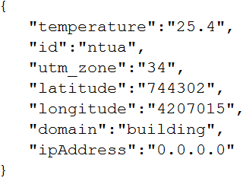
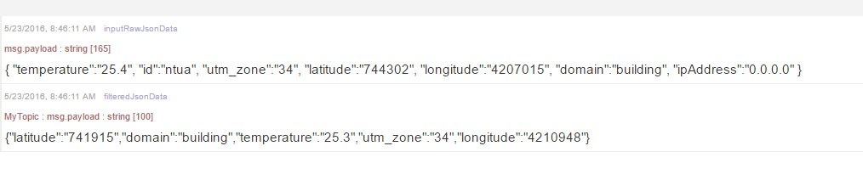
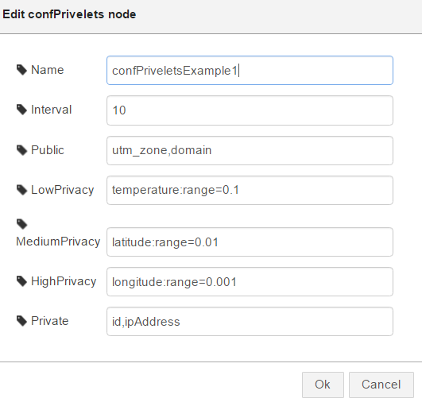
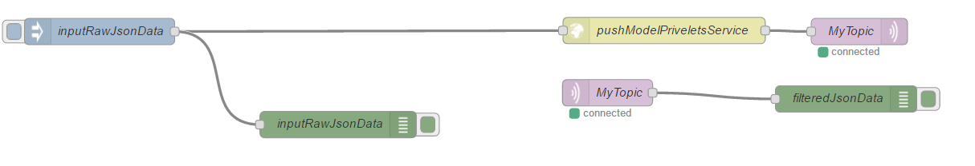
Examples (1/3)
Assuming that the Service is up and running and that the component has been configured
The data are in the right json format

Slide 9
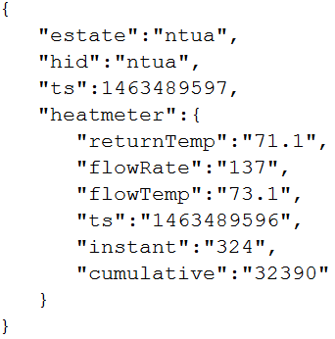
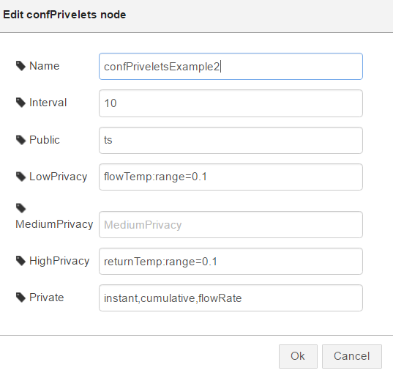
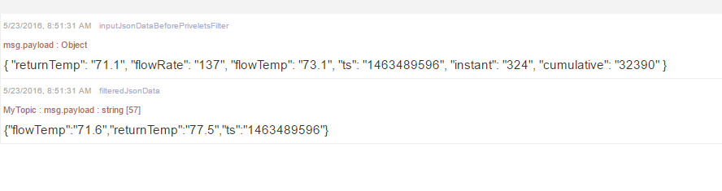
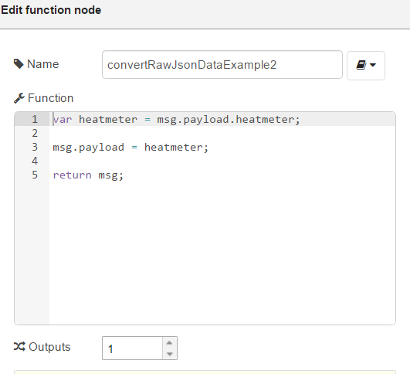
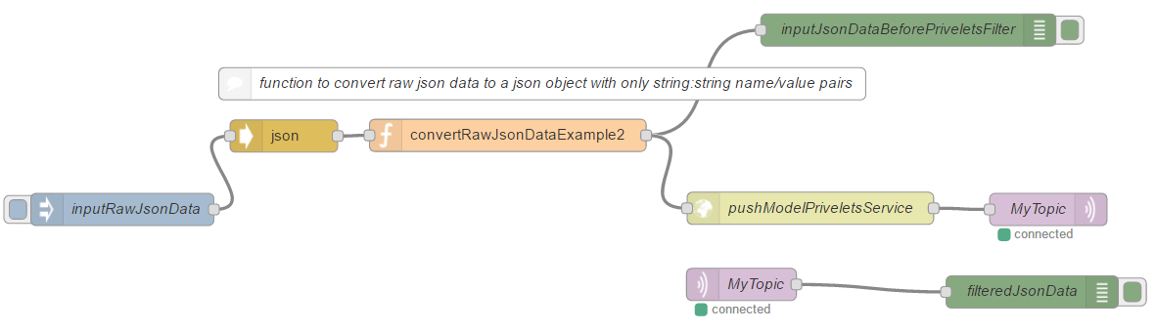
Examples (2/3)
Data are in a nested json object

Slide 10
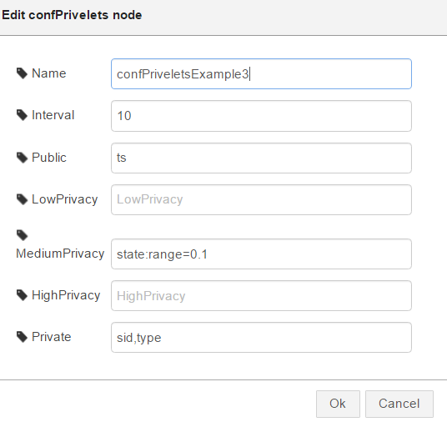
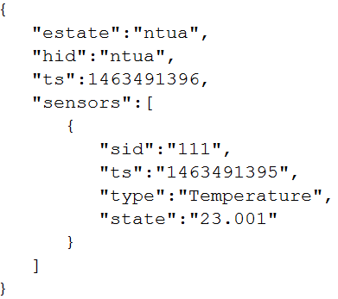
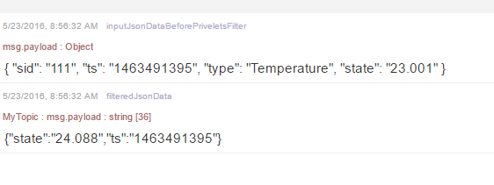
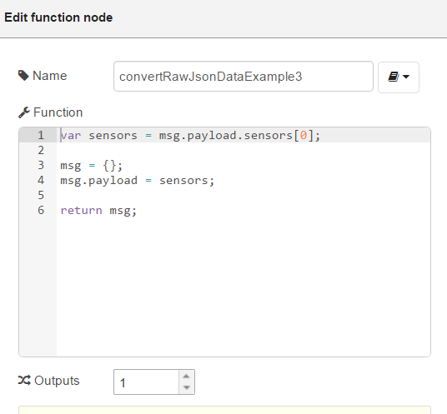
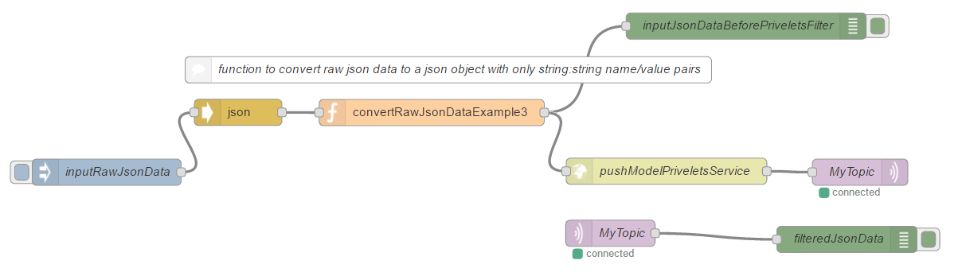
Examples (3/3)
Data are in a nested json array

Slide 11

Thank you! Any questions?
Achilleas Marinakis (ICCS/NTUA)
www.iot-cosmos.eu
The research leading to these results has received funding from the EC Seventh Framework Programme FP7/2007-2011 under Grant Agreement n° 609043

Slide 12
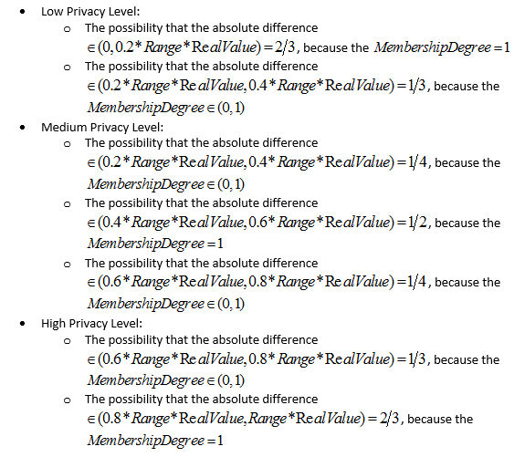
Backup
Fuzzy Value Calculation

