Slide 1

COSSE Coin
We feel confident that there won’t be burdens according to
ideal exchange rate through time delay and current time
differences in international trades.
Whitepaper (English)

Slide 2
Contents
Abstract.......................................................................................................................... 1-4
1. Introduction ............................................................................................................. 5
1.1. Vision .................................................................................................................................... 5
1.2. Background .......................................................................................................................... 5
2. ICON Overview ........................................................................................................ 8
2.1. Hyperconnect the World .................................................................................................. 8
2.2 COSSE Coin Algorithm ................................................................................................................... 9
2.3 AlPha Contracts ................................................................................ 10
2.4 VP(Virtual Person : Absolute Authority) ...................................................... 11
3. CCP(COSSE Coin Platform) ............................................................................................................... 12
3.1 CCP Environment ................................................................................................................ 12
3.2 CCP(COSSE Coin Platform) Utilization .................................................................................... 13
3.3 CCP Application Program GAM ................................................................................................14
3.4 APPS, DAPPS, GAPP Model Comparison ................................................................................ 15
4. Car Jeonse Age ........................................................................................................... 16
4.1. M.Car................................................................................................................................. 16
4.2 Car Charter Point at Issue ................................................................................... 17
4.3 M Car – Manufactured by COSSE ...................................................................... 18
4.4 M.Car Overview ....................................................................................... 19

Slide 3
Contents
5. RoadMap ............................................................................................................. 21
6. GAPP Programming .......................................................................................................................... 24
6.1. Complexchain .......................................................................................................................... 24
6.2. Features Consensus ........................................................................................................ 24
ACORE(Alpha Contract On Reliable Environment) .................................................................... 25
Multi-channel .................................................................................................................... 25
Tiered System .......................................................................................................... 25
CFT(Complex Fault Tolerance) ......................................................................................................... 26
6.4. ACORE(Alpha Contract on Reliable Environment) ........................................................... 27
6.5. BSI (Blockchain Signature Infrastructure) ...................................................................... 28
7. COSSE Coin ...................................................................................... 29
7.1 COSSE Coin Distribution ................................................................................................30
7.2 COSSE Coin fund-raising scheme .............................................................................. 31
8. References ........................................................................................................... 32

Slide 4
Abstract
John is making business in New York, if we assume that he requests household appliances from China’s Pay Chiming and make commercialization and production;
From John’s Stance
  1. After completing sampling research, is it possible to make final decided sampling rightly?
  2. Can it be completed until due date?
  3. Is it possible to reduce defection rate?
  4. Can quantity, performance and cost will be accomplished well?
  5. Can security be taken care of well?
  6. Can A/S be accomplished sincerely?
From Pay Chiming’s Stance
  Can advance payment, first round installment, second round installment, remainder be paid without any problem?
  Can contract be maintained until due date without a hitch?
  Is second round contract possible later?
Can we use car by Charter either?
  1. We overcome depreciation by future value so opened Car Charter Age.
  2. Drive a new car freely without any burden by just “0won”!!

Slide 5




1.1 Vision
1. Introduction
We define community with a new way to realize decentralized world, connect defined community and create a new world through connected community. COSSE defines by defined existing economic system in a new way by relating economical relations to the community that just exist with social and political meanings, connects defined every each of community more intimately than before. In addition, COSSE connects to not just real world, crypto world either so makes possible infinite scalability. COSSE is decentralized network that various independent communities which consisted by blockchain are connected. In the COSSE World, whoever it is can create a new blockchain project, other projects connect to new created blockchain project so can create another world. COSSE is the ecosystem, an organism lives and breaths own its own. In the COSSE World when we cross country’s border, we can connect community to whole world’s finance, medical service, public services etc. either. Due to this, remit becomes more faster from Korea to America and Indian investors become able to invest Apple, Google, Samsung stocks more conveniently. As well, while insurance companies and hospitals become able to share information more faster for their clients in community, universities become able to access diverse datas for research. We say let’s realize a world that we can take money to my Wallet under favor of my medical history data which used as research purpose at American hospital. We got entered inside of a new world that get defined in a new way, get connected in a new way through COSSE.

Slide 6
1.2 BackGround
Satoshi Nakamoto aroused considerable forward looking interest with Bitcoin which issued without central issue agency or control agency, due to this disquiets government and financial world. Even now, lots of people make an effort and challenge to make Altcoin.
We write ‘Smart Contracts’ through Ethereum and by extension, while be based on Decentralized Autonomous Organizations(DAOs), Colored Coins, Alan Turing on the basis of blockchain, Ethereum with introduced “Turing-Complete” basis shows that changes condition differently through coding rules either.
Recently, at third quartile of 2018 “It is emphasized that even USA Security and Exchange Commission did not approve Bitcoin ETF, opposition about ETF is not meaning stances of commission about crypto currency or blockchain, it means absence of trustful price formation to develop ETF.” As is seen here, how to verify not disappearing crypto currency value flaw is a problem to remedy in the future. Therefore we gain recognition reality’s value through COSSE Coin Platform and when construct more comfortable network, prevent risk of decentralization.
Even it is expressed diverse ways which used blockchain technique, couldn’t put off transaction’s integrity until now. So far possible transaction method is one-dimensional send and receive. Here, we started with feeling that there will be need to write “Smart Contracts” due to VP which decides through having more diverse criteria values and artificial program which has 2 neural network called as policy network and value network, have belief to CCP(COSSE Coin Platform) that embarks VP will be qualified.

Slide 7
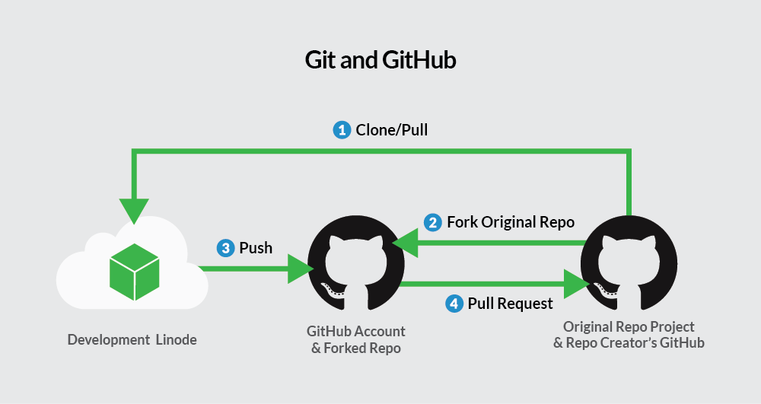
2.1 COSSE(Coin + SSE)
2. COSSE OverView
COSSE is Coin + SSE(Social Software Event), where one of the coin's various values must go forward and focused on the sociality that it should be responsible for. Also, this sort of COSSE’s policy is that contribute by integrating coin’s social contribution and coin usage’s ethical value to society.
SSE researches and builds a social orientation tools to support collaboration and information sharing through GitHub. In addition, SSE is a dynamic social context in which software can operate and a software adaptation decision at runtime, investigates software adaptation ability about client and last user’s intervention. The social context includes norms, cultures, roles and responsibilities, stakeholder goals and dependencies, and final-user awareness of the quality and suitability of each software activity.
In the global IT industry which includes Korea, there is a growing demand for GitHub account /url in the application form, which is very popular in related industry because the GitHub account can take a role as a portfolio in the programmer interview. In recent years, regardless of nationality, the usage of GitHub as a portfolio / enterprise activity has been increasing more and more as start-ups and open companies.
Git is distributed revision control system for source code management such as programs. It is designed on the basis of Geometric Invariant Theory and placing emphasis on to fast execution speed is the feature. At the outset, Linus Torvalds developed it in order to use development of linux kernel yet at present it is scattered and used in another places either.
All of Git’s work folders include whole records and information which able to track every record and it is a repository with a perfect shape. Doesn’t approach to network or rely on central server.
At present, Junio Hamano supervises software management. Git is free software which is distributed under the GNU general public utilization warrant v2.

Slide 8
2.1 COSSE(Coin + SSE)
1st society software engineering and application international workshop’s (SoSEA 2008) participants suggested features as follows:
  Focus on Community: Software is produced and consumed by the community and for the community, rather than focusing on itself.
  Cooperation/Collectivity: Utilization of human's collaborative and collective abilities
  Companion Relations: Make various associations among people clearly.
  Human/Society Activities: Software is designed in order to support human activities and solve social problems consciously.
  Social Inclusion: Software should enable social inclusion and strengthen the connection and trust to the community.
Thus SSE can be defined as “process, technique and tool’s application program which enable to focusing on community’s creation, management, distribution and software utilization in online environment”. [2]
One of the main observation in the SSE field is that the concepts, principles, and techniques created for social software application program are applicable to software development itself, because software engineering itself is a social activity. SSE isn’t limited with just specific activity of software development. Therefore, the tool which supports various parts of SSE such as social system design or social requirements engineering was suggested. Therefore, it is being used at decision making process that can make profit in society construction element such as vertical market software yet, helps with software development tools, engineering tools, marketing tools, or software this sort of perpendicular social software strongly differentiate traditional social software such as Yammer with user base.

Slide 9
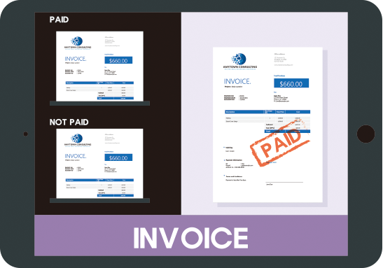
2.2 COSSE Coin Algorithm
COSSE Coin organizes by base of invoice, isn't influenced by exchange rate at the time of trading and prioritize senior trading.
At the time of trading, in the event of Betting trading isn’t accomplished and remains undecided, it does not affect Wallet, acknowledges normal trade only for concluded case.
At the time of preorders, on payment stage which achieved with down payment, intermediate payment, balance etc. acknowledges as normal trade that down payment must be paid and when back-burner installment, balance etc. will be organize by 2nd round payday and payment amount 3rd payday and payment amount, make organization of expenses possible by reserved transaction.
Also, betting is the structure which diverse price rises at the time of auction and if we look at current auction methods whereas each price is concluded, final winner “B” who betted best price is being selected while it is progressing in concept of 1+1 which is not rising structure. As well, in the event of this auction, if “A” who have right to make final decision (owner if not decision maker) becomes key member which makes a judgment if ever you clarify input value to “A”, there is no problem in making decision. By extension, in case concept of bringing third party person (referee) in, “F” who is third party person (judge) acquires right from “A” that able to make decision on behalf of “A”. But in case of “A” enforces referee, able to prevent double decision that can’t do own management by limiting about right to decide.

Slide 10
2.3 AlPha Contracts
Alpha Contract is a contract creation platform with condition values that goes beyond the limits of Smart Contract, allowing various reimbursement conditions to be entered at the time of contract, allowing safe transaction with mutual trust.
Also, Alpha Contract enable to write virtual trade like actual trade.
After completing the contract, you can see if the contract is proceeding properly and you can obtain the results according to the contracted conditions as the contract is completed step by step.
At the time of international trade business, the existing transaction methods (Refer to the Korea International Trade Association) are choosing payment method done by bank intermediation but there is high commission and onerousness of conformation procedure. Therefore, Alpha Contract can be reliably used by DAPP's Gateway Account Membership Decentralized Application (GAPP), which provides easy-to-use platforms for anyone with simple procedures, and it is possible to keep past data securely. Furthermore, future contracts are also available in Alpha contracts.
 | The type of payment forms
Advanced Payment | T/T, M/T, CWO, Red Clause L/C
Co current Payment | COD, CAD, At Sight L/C, D/P
Deferred Payment | USANCE L/C, D/P
 |  | The type of payment forms
No Credit Method | Remittance | T/T, M/T
 | Collection | D/A, D/P
Letter of Credit Method |  | At Sight L/C, USANCE L/C

Slide 11
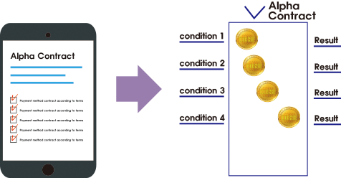
2.4 VP(Virtual Person : Absolute Authority)
VP
Virtual Person (VP)
; Person → Group → Company → Corporate Body → Association
; VP – Connote nationless, decentralized character and necessary to be able to produce the results that absolutely give maximum satisfaction to criteria value of A and B.
To do that the scope of authority in one transaction should be the same level as all if not equivalent, but the risk is high. Then "Should VP's authority be controllable?" answer is “NO”. If it becomes a structure that anybody can get involved, can be raised a problem to trust of VP. If so “Indeed how should we do to be able to get guarantee absolutely about VP’s decision making power?”, answer is “Able to replace all of the effects by typing number of different cases that gives order of priority at the time of contract.”

Slide 12
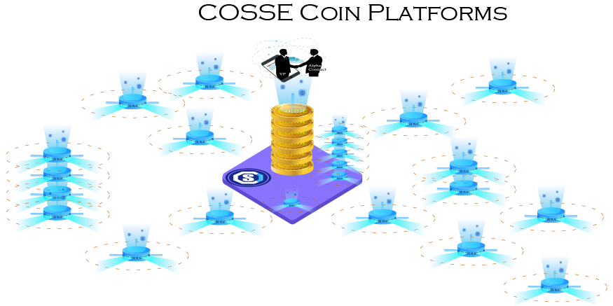
3. CCP(COSSE Coin Platform)
3.1 CCP Environment
COSSE Coin Platform (CCP) ) Infrastructure
Consignment management (Offline - Property Management Companies, Judicial Scriveners, Lawyer…) is available, if we insist to say – a person isn’t like offline, can create A Virtual Person (VP).Trade safety transaction, auction, real estate brokerage… etc. diverse value of activities can be established. This can make it possible to preserve, continuation, maintain and operate the value by making the contractual owner exist, not the existing virtual currency based on the payment method.
The COSSE coin platform (CCP) is also configured using Blockchain and reconstructed into a different system than the Bitcoin. The purpose of the transaction as a general virtual currency will be the same, and the provision of a virtual decision maker VP is absolutely necessary to enable the use of the CCP.

Slide 13
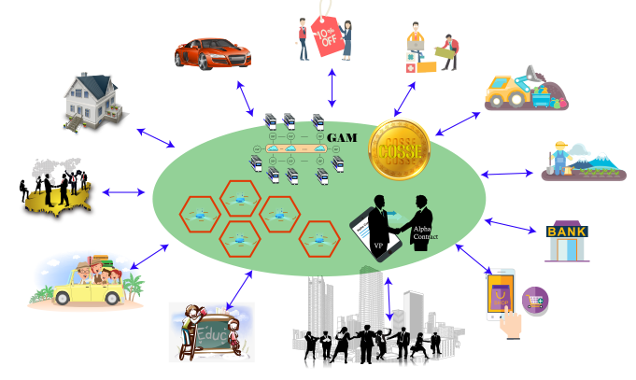
3.2 CCP(COSSE Coin Platform)
COSSE Coin Platform (CCP)
Auto Trade
Merchandise trade
Employment Contracts
Building/Construction
Real Estate Transaction
Production Activity
International Business
Financial Trading Activities
Travel/ Leisure
Online Activities
Education
Diverse Trade of Daily Life
COSSE Coin Platform (CCP) Infrastructure
We can redefine all the contractual relationships that have been using up to now. It is possible to give the value of time and future value that existed but not used until now. For example “What is the value of 1 million won in the 1980s in 2018 after 38 years?” It was very difficult for anyone to answer up to now because have many risks to accept but we value for this kind of situations. However, by creating an Alpha Contract which mounts VP, we will be able to determine and contract future time and values at the present time.
The VP has reached the end of its value by completing the Alpha contract conditional expressions step by step.If the results are satisfactory, the first consideration to be paid will be paid safely and in case of failure, the result will be a mutually agreed upon result.

Slide 14

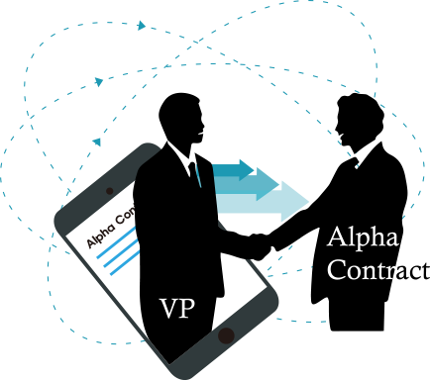

3.3 CCP Application Program GAM
(Gateway Account Membership Decentralized Application )
GAM on the basis of CCP
Thus, the planar blocks of the virtual currency in the past will now show a three-dimensional structure in which the various conditions are combined. This is due to the existence of the virtual money market that has spread by decentralization, and it will bring convenience and economic value to our life in more various ways.
Clear and accurate Alpha Contracts can provide users with a variety of examples through GAPP and will be able to create new or various contracts based on algorithms. In order to obtain satisfactory results for the purpose of the user, the VP will determine the Alpha Contract as an absolute person with monitoring, management and supervisory functions.
It is important to make the conditional expression subdivided. The more accurate the classification, the lower the probability of failure and can have an economic value or a satisfactory result value.

Slide 15
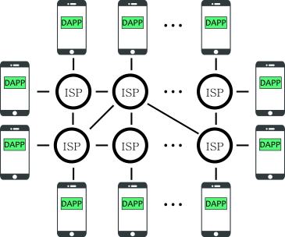
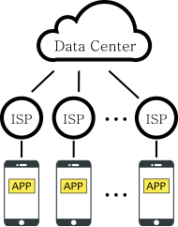
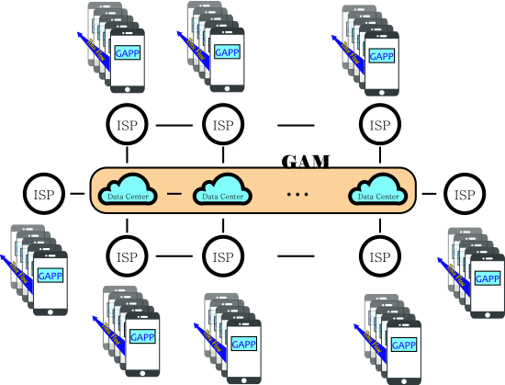
3.4 APPS, DAPPS, GAPP Model Comparison
APPS
DPPS
GPPS

Slide 16


4. Car Charter Age
4.1 M.Car
Lets start My Car with Charter

Slide 17


4.2 Car Charter Point at Issue
The reason that there couldn't be Car Charter??
“
mm… Over time, because loss of car depreciation is big,
no one was able to make Charter.”
”
SELF PURCHASE
MONTHLY RENT
Charter
Purchase house in person
: Rising asset value
Monthly Rent House
: Deposit+ Monthly Rent
Charter House
: Full Refund of Charter Deposit at the end of the Contract
Purchase vehicle in person: Decreasing in asset value
Long term Rent Car Usage
:Deposit+ Monthly Rent
Contract Car Usage
: Full Refund of Contract Deposit at the end of the Contract

Slide 18
4.3 M Car – Manufactured by COSSE
At the time of Contract
♠ Benefits:
Taking over a New Car
100% security deposit setting
♠ Charges:
Coin Purchase 100%
  50% Deposit
  50% Self-Storage
During the Contract Period
♠ Benefits:
1.No Monthly Expenses
In the case of Accident, Charges belong to Customer
Ensure Safe of Assets.
Possible to Change Car Model (But, there is a fee)
End
♠ Benefits:
Refund 100% of Deposit
Advantages whenRejoining

Slide 19
COST SAVINGS
““You can freely ride without hesitation.”
CUSTOMER’S CHARGE:
$0
New car installment |  | M Car – Guarantee Type
Initial cost | GENESS G80 3.3 LUXURY / $4.880
① Acquisition Tax + Premium | ② $976 | ③ $2,440 $2,440(Self-Storage)
④ Acquisition Tax + Premium | $551 | No
⑤ Monthly Payment (48 Months) | $896,947 X 48 =$42,545,942 | No
⑥ Expiration Time | ⑦ Deposit $24.400.000 Refund (\10,500,000) | ⑧ After Secondhand Car Returns Deposit $24.400.000 Refund
⑨ Total Cost ①+④+⑤-⑥ = ⑨ | ⑩ $47,315,942 | ⑪ $ 0 Revenue: $2,440COS
② 20% of Vehicle Price = Cost of Pre-Financing (Differentiate according to customer's credibility)
③ 50% of Vehicle Price = Deposit (Expiration Time Refund)
Possible to sell COSSE which in retention in case of gaining revenue!!!!
④ Acquisition Tax = 7% of Vehicle Price, Premium $1.500.000
⑤ Contract Period = 4 Years
⑦ 4 Years 80.000 Km Secondhand Car Quotation (Can be differentiate according to model of car, situation)
⑧ Ride without hesitation and at the end of contract if you return secondhand MCar, 100% of your deposit will be refund.
※ Standard of comparing vehicles is written in basis of M Car Program.
It can be differentiate according to model of car, situation etc.

Slide 20
4.3 M.Car OverView
“
mm …. Over time, because loss of car depreciation is big,
No one was able to make Charter.
”
We made this difficult thing real.
Q
I want to buy a car, however as time goes
by I am worried about depreciation.
Because COSSE is based on CCP, it converts the present value to the future value, making it possible to purchase new car without burdening the customer.
If you are concerned about depreciation when purchasing a new car, looking for a long-term rental car or lease, it will be difficult to find a relieving answer. However, if client chooses themselves the car that they want, they can use M Car long term rent car when pay the deposit for 4 years by making a contract with us, at the end of contract period we will reimburse full amount of the Charter deposit that have been paid in the first place without any cost or deduction. Also when it comes to deposit, we will set up collateral that correspond to 100% of deposit.
Anymore, no longer without decreasing car value concern, without rent car fee which is thrown away every month, you can use vehicle in a rational way. In addition, automobile installments are subject to principal and high interest rate. On the other hand, using M Car's Charter Car can save you money by having a new car with convenient and beneficial benefits.
Q
Can I change my car during the contract period?
Yes. We can do it at Mcar.
After one year of mandatory period, it is possible to change freely by calculating the difference between the remaining months, the vehicle's model and the condition of the vehicle.
If the desired car is higher than the existing car, you must raise the deposit. Of course, if the price of the vehicle is low, it is natural to get off. You can also refer to the Residual Valuation Table calculated by the Mcar program according to the number of remaining months.

Slide 21
5. RoadMap
The COSSE we want to create is not in the world. Once completed, everyone can make very convenient and secure trust transactions.
Concept
2015. Q4 - 2017. Q1
Concept Generation
Team Assemble
Research
2017. Q2
Proving the concept can work
Strategic Plan
White paper conpletion
Design
2018. Q2
Platform design and technical demonstration
Building the MVP : CCP
Pre-Sale
2018. Q3
Public financing & Seed funding raised
Beginning Building the GAM
Building GETOBox ICO
Design
2018. Q2
Platform design and technical demonstration
Building the MVP : CCP

Slide 22
5. RoadMap
The COSSE we want to create is not in the world. Once completed, everyone can make very convenient and secure trust transactions.
CCP Test
2018. Q4
Prototype published and linked to Ethereum blockchain
with real-time scanning
In-house testing of functional
COSSE Token Sale
GETOBox Open
2017. Q2
Proving the concept can work
Strategic Plan
White paper conpletion
App Beta Test
2019. Q2
Private closed GAM Beta
Open beta launched to public and improvement the app
GAM Alpha Contracts
2019. Q3
Crowdfunding Integration
GAM Smart contracts support creators
Ethereum tokens support
Design
2018. Q2
Platform design and technical demonstration
Building the MVP : CCP

Slide 23
5. RoadMap
The COSSE we want to create is not in the world. Once completed, everyone can make very convenient and secure trust transactions.
Community Benefits
2019. Q4 ~
Establishing global user base
US start retailer selection
Joint development through storage
API disclosure
Hardware things
Integration of third party controllers
Marketplace cooperative module
More Operational
Integration with Private Chains, More Coin in Wallet
New services offered by members or business
Activation in international trade transactions
Limited to 100 charter cars
Design
2018. Q2
Platform design and technical demonstration
Building the MVP : CCP

Slide 24
6. GAPP Programming
(Gateway Account Membership Decentralized Application )
COSSE's core is Complexchain and is a high-performance block chain that can support real-time trading based on efficient alpha contracts.
6.1. Complexchain
The bit coin 20, which is often referred to as a synonym for virtual currency, demonstrates the reliability of block chain technology as a distributed branch. Although the initial block chain technology has focused on virtual money such as bit coin, various virtual currencies have appeared, but they are not widely used in financial institutions and are used as investment means through private exchanges. In the meantime, as Etherium provides a runtime environment called smart contract based on block chain technology, the block chain technology has received explosive interest in the system. The block chain technology, which has remained at the level of a simple transaction ledger, has been extended to the application platform by enabling intermediary-free transactions through smart contracts.
There have been various attempts to realize intermediary-free transactions based on a public block chain platform such as Etherium in the financial sector, but the number of transactions per second is only 7 to 15, and transaction details are disclosed to all nodes There is a limit to apply to areas where regulations such as finance are needed. In order to overcome the limitation of public block chain, enterprise block chain technology which participates only in certified node centered on financial sector has emerged.
Hyperledger Fabric24, R3 Corda25, etc. are being introduced in various fields such as finance, public, and supply chain management. However, these also only represent one-off transactions. Complxchain can enhance security by stabilizing the node through Alpha Contract with VP.
6.2. Features Consensus
Complxchain supports fast branch-less consensus through Loft Fault Tolerance (LFT), which supports Byzantine Fault Tolerance (BFT26). In addition, it is possible to establish a consensus by combining a plurality of nodes having a trust relationship based on the LFT with one node, and by performing the node disassembly again, a quick agreement can be achieved and the number of votes can be freely set for these groups and nodes.

Slide 25
6. GAPP Programming
(Gateway Account Membership Decentralized Application )
ACORE(Alpha Contract On Reliable Environment)
ACORE refers to the Alpha contract supported by Complxchain, which is a high performance alpha contract support function that is directly executed in the Node operating environment due to the existence of a separate VP (Virtual Person). ACORE is a highly productive alpha contract that is easy to create and supports a variety of tasks while working as a separate process from the block chain process.
Multi-channel
Multi-channel is a function that can perform transaction request, agreement, and smart contract for each channel by constructing a virtual network called a channel in each independent block chain network. Since a variety of channels are connected to only one business node in each node, integrity and assurance are ensured for each channel, and the transaction data can be handled by the actual transaction parties, thereby coping with various regulations.
Tiered System
In addition to authentication for participation in the block-chain network, transactions are verified and secured through PKI-based authentication for each transaction. It also supports the ability to assign a specific node the ability to perform audit on transaction details as needed, without participating in transactions.
6.3. Consensus
Background
The first block chain implementation service, Bit Coin, has agreed on a transaction record for all bit coin nodes in the Global Scale network using a proof of work algorithm. However, the proof-of-work algorithm used in the bit coin was not available in an environment that required efficiency and immediate payment completion because of the low speed, inefficient use of energy, the problem of partial network branching. In order to solve the problem of the conventional block chain algorithm, the algorithm of the Byzantine Fault Tolerance (BFT) series which is used for the traditional distributed state machine replication has begun to be utilized. The BFT sequence summing algorithm represented by PBFT29 (Practical Byzantine Fault Tolerance) performs an agreement by voting and voting the validity of data for data agreement. Tendermint30 introduced a block-chain-summing algorithm in which the PBFT algorithm is modified into DPOS (Delegated Proof Of Stake). In addition, IBM Fabric, an enterprise private block-chain project, adopted PBFT as a consensus algorithm in version 0.6, and in version 1.0, it is using SBFT (Simple Byzantine Fault Tolerance), a consensus algorithm that simplifies PBFT as an agreement algorithm for orderer services.

Slide 26
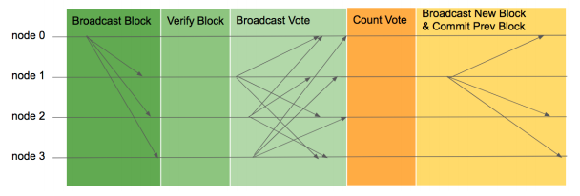
6. GAPP Programming
(Gateway Account Membership Decentralized Application )
CFT(Complex Fault Tolerance)
CFT is a conventional BFT type agreement algorithm that can protect the Raft algorithm, which is one of the state machine replication 31 algorithms used in Fault Tolerance method in existing distributed environment, against Byzantine Node attack (Byzantine Fault Tolerance) It is an agreement algorithm that is optimized to be optimized for block-chain network characteristics.
An object constituting a block-chain network is called a Node. These Nodes are responsible for block creation, verification, and retention, and each Node can create a signature that identifies its own message. For most networks that use the BFT sequence sum algorithm, there are two types of nodes: a reader node and a verification node. In the case of a leader node, it plays a role of generating and propagating a block. In the case of a verification node, it performs a role of verifying the validity of the block by verifying the contents of the block generated by the leader. The LFT is also a BFT series summing algorithm consisting of a reader node and a verification node. The CFT is free to merge nodes and nodes here.
The way in which LFT operates is as follows. When the network is started, the verification nodes transmit the transaction to the leader node. The leader node generates a block using the collected transaction and sends it to all other verification nodes along with its signature. When each validation node receives a block, it verifies that 1) the current reader has generated a block, 2) checks whether the block height and previous block hashes are correct, and 3) verifies that the block's data is correct. Verification Node generates Vote data if 1 ~ 3 times are correct and propagates to all nodes of the network. It is very important to propagate Vote data to the entire Node. If the leader node is Byzantine, it can attempt to separate specific nodes from the network by propagating the blocks only to the nodes over the quorum. To prevent this problem, spread Vote data to all peers. A node that has not received a block can get information about whether a block has been created and can request a block from another node.

Slide 27
6. GAPP Programming
(Gateway Account Membership Decentralized Application )
The reader receives Vote data from a quorum node to generate a block. The leader is new
Create a block containing the Vote data in the block to be created and propagate it to all peers. This ensures that a quorum of peers, like PBFT, has the same vote, eliminating the need to send all the data once again and allowing the block to be confirmed with the new block's Vote confirmation. If the propagated block is not the first block, the verification node performs a vote data verification of quorum or more at the same time when verifying the block. At this time, all nodes finally commit the previous block.
The block chain is a technique for constructing a trust network by gathering nodes with insufficient trust and agreeing on data distribution. Not all state machines guarantee a response like an existing state machine replication system, but each node provides a service and creates a transaction. A leader node can reject a transaction of a specific node when generating a block. To minimize this problem, Spinning33 technique was used to replace the reader every time the block was generated, reducing the number of service disruptions that could be caused by the Byzantine reader. In addition, we have developed a method to directly tolerate a fault handler by avoiding complicated reader fault recovery algorithm used in existing algorithms such as Tangaroa34.
LFT is a distributed sum algorithm for permutated block chains.
The existing BFT algorithm was improved to fit the block chain and the block data was used to simplify the process. More information on the settlement process can be found in LFT white paper35.
6.4. ACORE(Alpha Contract on Reliable Environment)
ACORE is a highly productive alpha contract implementation environment that runs in Complexchain. The basic block-chain process works well even if it is run at runtime directly by a separate VP (virtual person) and can implement high-performance alpha contracts and runs in a separate container-based runtime and in a separate container-based runtime, causing problems with alpha contracts.
ACORE is characterized by supporting versioning based on Repository. Generally, if you need to change the alpha contract, you need to create a new alpha contract and manage all the states of the existing smart contract. However, if you use Versioning, Version of State can be accessed to update Alpha Contracts easily and quickly without any additional state migration. You can distribute and update the alpha contract conveniently by providing a basic repository for ACORE distribution and using a remote repository called ACORE Store.

Slide 28
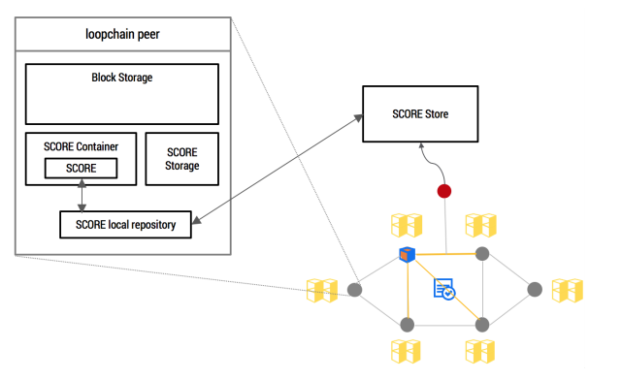
6. GAPP Programming
(Gateway Account Membership Decentralized Application )
6.5. BSI (Blockchain Signature Infrastructure)
BSI is based on the block-chain smart contract, which enables to construct an electronic signature infrastructure such as PKI. In the existing PKI, a separate Trusted Third Party (TTP) is required regardless of the transaction that manages the certificate issuance key and issues and manages the certificate according to the policy.
BSI generates digital signature information based on the information that can perform the proof of existence based on the Merkle tree, and issues an X.509 format certificate, eliminating the need for separate certificate issuance key management. In loopchain, a BSI-based certificate is issued to a node participating in Light Client36 in addition to a general node participating in verification and agreement, and is used for digital signature of the authentication and transaction of the corresponding node when joining the loopchain network.
Component
§ User: generates a PKI-based key pair and manages the issued certificate
§ RA (Registration Authority): confirms the user and requests certificate issuance
§ CA (Certificate Authority) SCORE: Providing services related to certificate issuance in smart contract on loopchain, not separate agency

Slide 29
7. COSSE Coin
5. COSSE Token
5.1. Token Sale Term Summary
§ Target Amount offered: 150,000 ETH
§ Currency accepted: ETH Only
§ Fixed Price: 0.005 ETH per 1 COSSE ( 6,000 COSSE per 1ETH )
§ Offering Summary
Topic | Description
COSSE Coin | COSSE is a loopchain-based smart contract digital protocol that facilitates, verifies, and enacts a negotiated agreement between consenting parties within COSSE The Issuer
The Issuer | COSSE Foundation, a Swiss nonprofit organization
Rights | • ICX represents limited license to validate the ICON and DEX • No voting or membership rights • No sharing of revenue, dividends, equity, etc.
Refunds | • None
Redemption | Buyback option in open market (treasury) • Regulatory redemption
Listing | • DEX (immediate with ETH) • Exchange partners

Slide 30
COSSE Coin has 30% Fundraiser, 15% Foundation, 25% Pre-Sale,
10% are Community Group & Strategy Partner,
10% will be distributed to Team, Advisors & Early Donors.

Slide 31
COSS Coin, Tech Company, Reserve, Operation Exp, Marketing Exp, Bussiness
We will enforce funds in Development, Stategy Parther.

Slide 32
Resources
1 https://github.com/ethereum/wiki/wiki/White-Paper
2 https://about.bancor.network/static/bancor_protocol_whitepaper_en.pdf
3 https://github.com/EOSIO/Documentation/blob/master/TechnicalWhitePaper.md
4 http://www.coindesk.com/tokenized-dollars-singapores-central-bank-details-new-blockchain-trial
5 product development and distribution, pricing and underwriting, payment and collections, claims, policy & administration and back offices, risk capital and investment management
6 Seven out of 10 nationally designated hospitals participate in this consortium
7 https://www.ohdsi.org
8 https://www.swift.com
9 https://www.cryptocompare.com/exchanges/guides/what-is-a-decentralized-exchange
10 https://www.wired.com/2014/03/bitcoin-exchange
11 https://bitsquare.io
12 https://bitshares.org
13 https://about.bancor.network/static/bancor_protocol_whitepaper_en.pdf
14 https://goo.gl/HXQBUr
15 https://en.wikipedia.org/wiki/Byzantine_fault_tolerance
16 https://davincilabs.ai
17 http://www.coindesk.com/information/what-is-a-decentralized-application-dapp
18 https://en.wikipedia.org/wiki/Representation_(politics)
19 https://en.bitcoin.it/wiki/Off-Chain_Transactions
20 https://bitcoin.org/bitcoin.pdf

Slide 33
Resources
21 https://github.com/ethereum/wiki/wiki/White-Paper
22 https://en.wikipedia.org/wiki/Smart_contract
23 https://github.com/ethereum/wiki/wiki/Sharding-FA
24 https://www.hyperledger.org/projects/fabric
25 https://www.corda.net
26 https://en.wikipedia.org/wiki/Byzantine_fault_tolerance
27 A.4. loopchain Multi-channel
28 https://bitcoin.org/bitcoin.pdf
29 http://pmg.csail.mit.edu/papers/osdi99.pdf
30 https://tendermint.com/static/docs/tendermint.pdf
31 https://en.wikipedia.org/wiki/State_machine_replication
32 https://raft.github.io/raft.pdf
33 http://ieeexplore.ieee.org/document/5283369
34 http://www.scs.stanford.edu/14au-cs244b/labs/projects/copeland_zhong.pdf
35 https://loopchain.files.wordpress.com/2017/07/lft-e18487e185a2e186a8e18489e185a5.pdf
36 https://github.com/ethereum/wiki/wiki/Light-client-protocol

Slide 34
Thank you.

