Slide 1
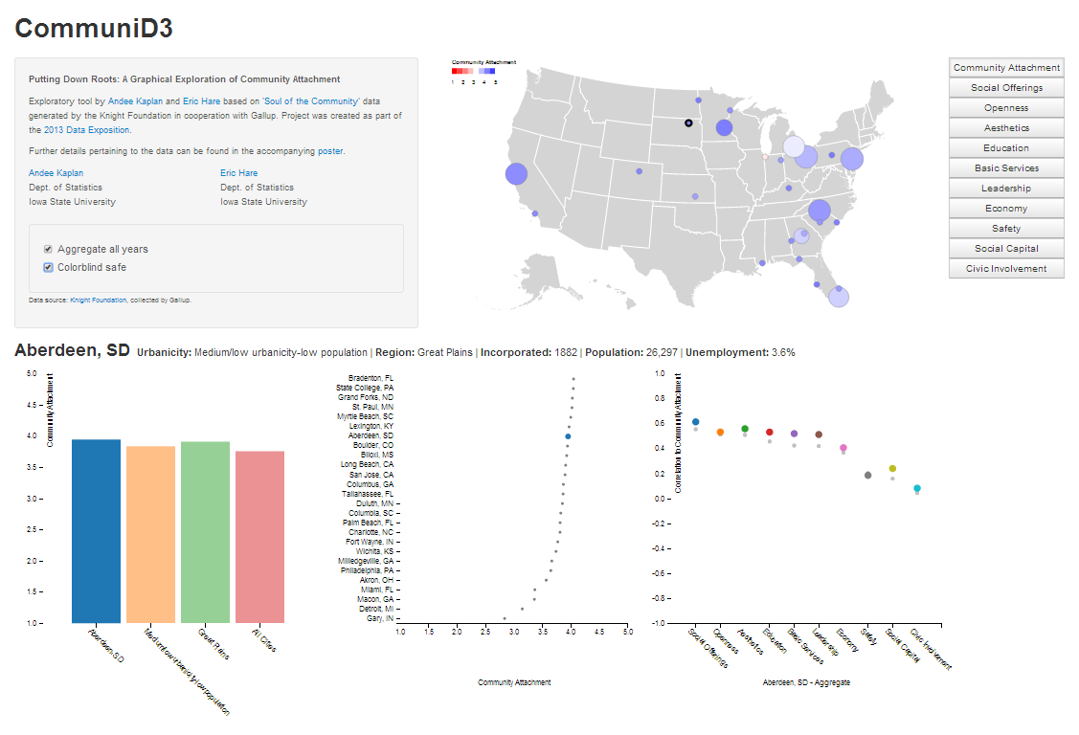
1
2
3

Slide 2
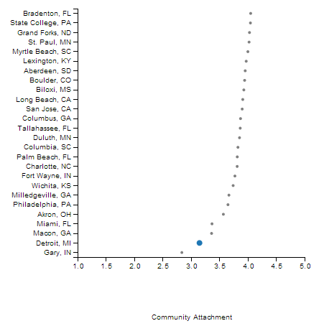
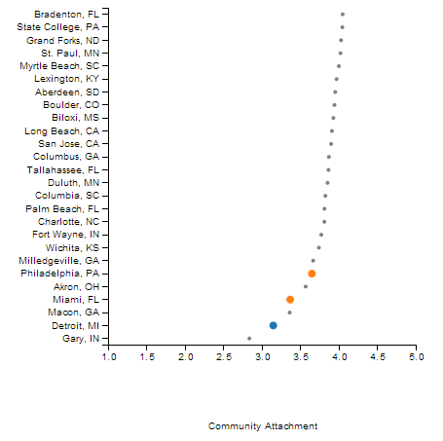
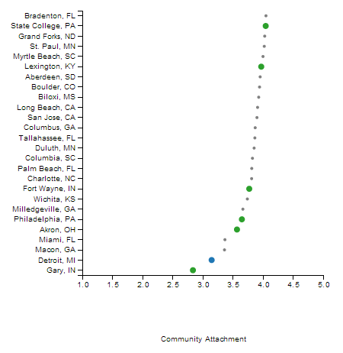
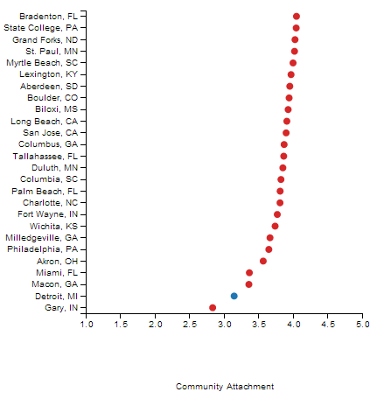
1
Community Selection
2
Urbanicity Selection
3
Region Selection
4
All Community Selection

Slide 3

Server Side
Client Side
Interactive Tool
User Controls
D3
javascript
(general)
Shiny
Binding
Binding
Shiny
plyr, reshape2
rjson
Data formatting

Slide 4
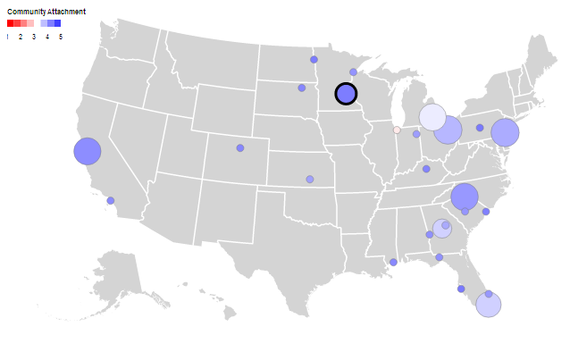
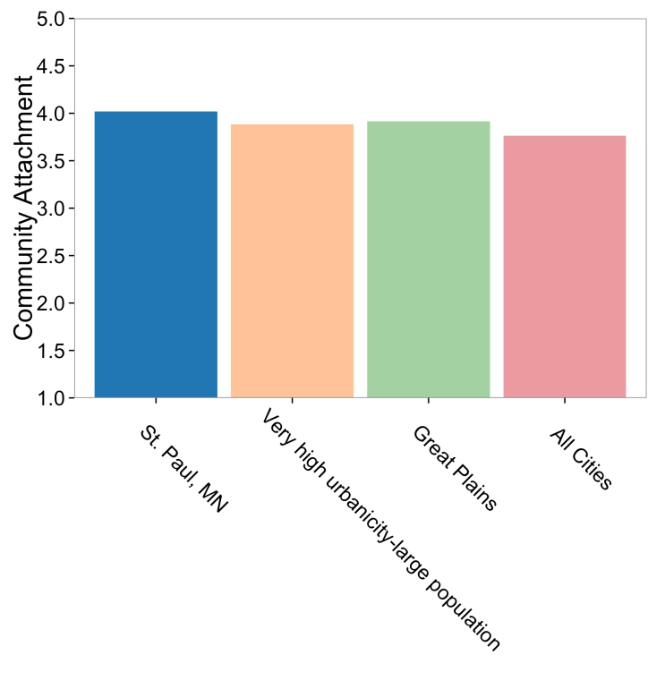





1
2
Grand Forks
Aberdeen
Duluth
St. Paul
Wichita

Slide 5
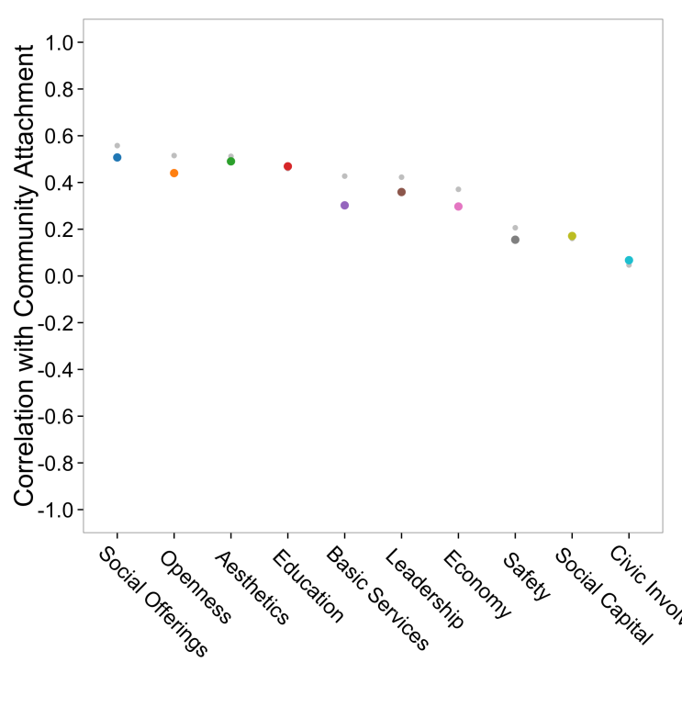
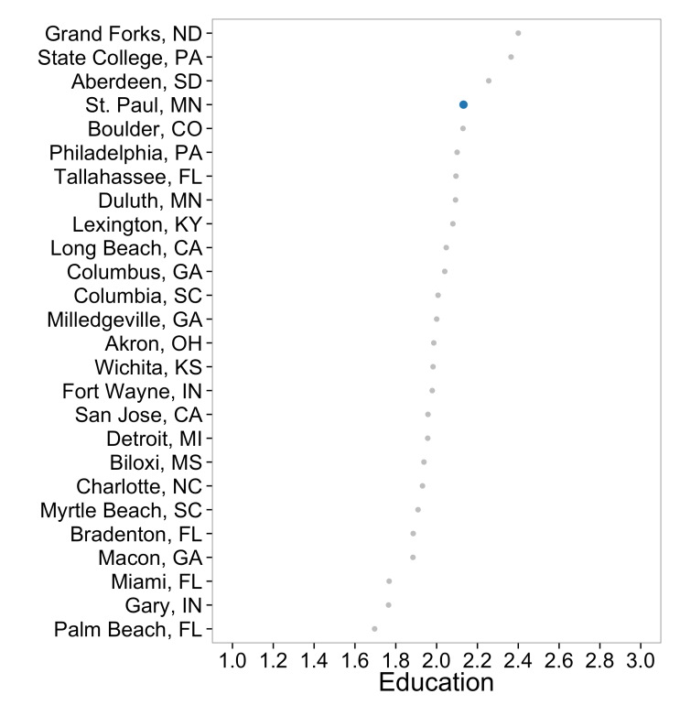
3
4
Education

Slide 6
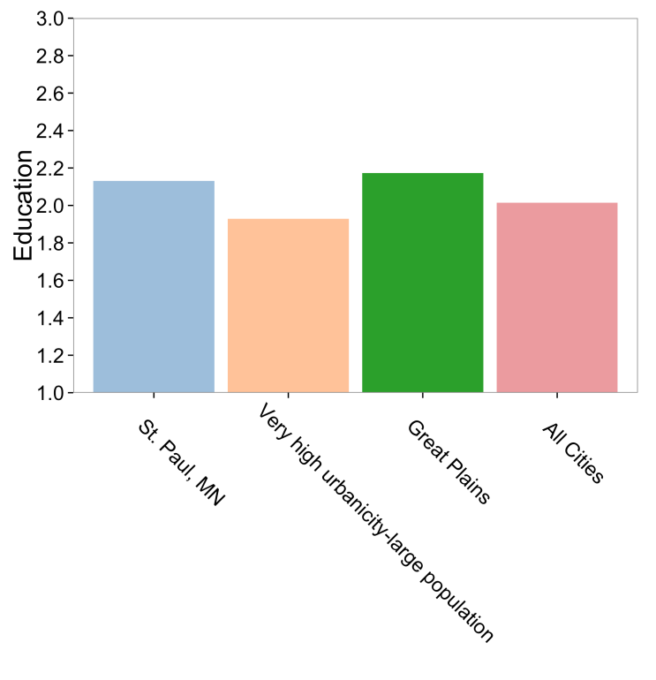
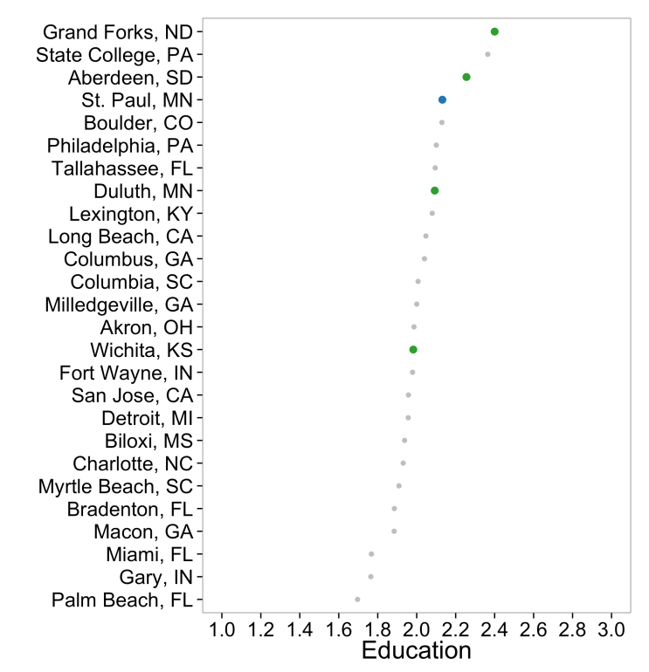
5
6
Great Plains

