Slide 1
displayHTS: An R package for displaying data and results from high-throughput screening experiments
Xiaohua Douglas Zhang
Head, Early Development Statistics – Asian Pacific
BARDS
Merck Research Laboratories
May 18, 2013

Slide 2
Outline
Background knowledge for the R package
Basic drug discovery & development process
High-throughput screening
Brief description of our R-package “displayHTS”
Main functions in the package
plateWellSeries.fn
image.design.fn
image.intensity.fn
dualFlashlight.fn
An Example
Summary

Slide 3
Drug Discovery & Development Process
Target
Discovery
(e.g.,受体)
Drug
Discovery
(e.g.,作用体)
Introduction
Pre-clinical
(safety &
drug metabolism)
Phase I / II
Phase III
Phase IV
(Registration &
Pharmacovigilance)
FDA Approval

Slide 4
Drug Discovery Using High-Throughput Biotechnologies
High-throughput biotechnologies
High-throughput screening (HTS)
A book having already been published for HTS
A book “Statistical Omics” to be under contract

Slide 5
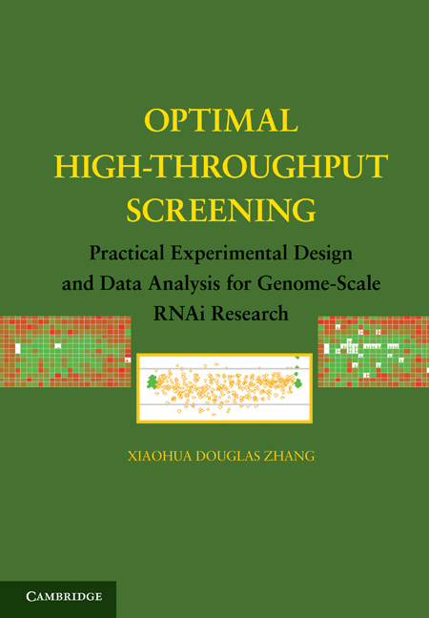

Slide 6
Library
Cell of Interest
Transfection
High
Throughput
Screen
Treatment
Scanning
Numeric Data
Statistical Analysis
Genes Identification
Or Therapeutic Target

Slide 7
HTS Project and Data
An HTS project may contain
one primary screen with millions of compounds with no replicate
one confirmatory screen with replicates
The measured response is usually the intensity emitted by labeled particles such as fluorescent dyes.
Need to display data and results
R package “displayHTS” to serve the need

Slide 8
R Package: displayHTS
freely available from CRAN: http://cran.r-project.org/mirrors.html
displayHTS has four main functions:
plateWellSeries.fn
image.design.fn
image.intensity.fn
dualFlashlight.fn

Slide 9
plateWellSeries.fn()
library(displayHTS)
data(HTSdataSort)
wells = as.character(unique(HTSdataSort[, "WELL_USAGE"]))
colors = c("black", "pink", "grey", "blue", "skyblue", "green", "red")
orders=c(1, 3, 2, 4, 5, 7, 6)
par( mfrow=c(1,1) )
plateWellSeries.fn(data.df = HTSdataSort[1:(384*2),], intensityName="log2Intensity",
plateName="BARCODE", wellName="WELL_USAGE",
rowName="XPOS", colName="YPOS", show.wellTypes=wells,
order.wellTypes=orders, color.wells=colors, pch.wells=rep(1, 7),
ppf=6, byRow=TRUE,
yRange=NULL, cex.point=0.75,cex.legend=0.75,
main="A: Plate-well series plot")

Slide 11
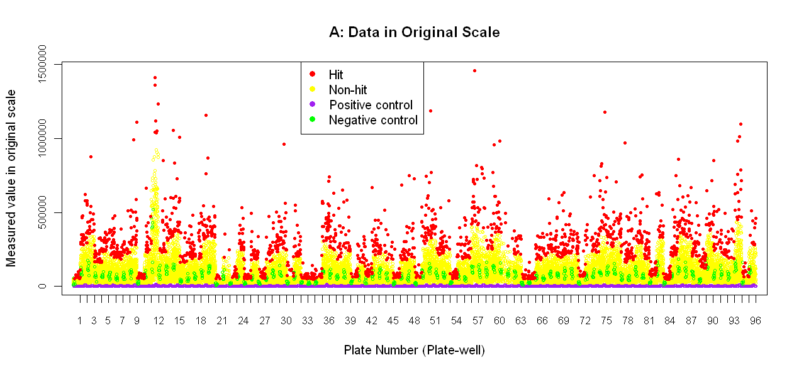
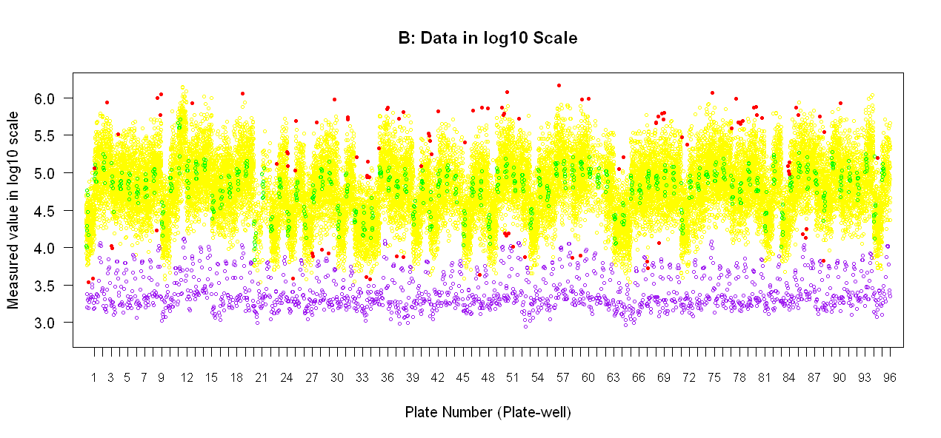
Zhang’s Book

Slide 12
imageDesign.fn()
data(HTSresults)
condtSample = HTSresults[, "WELL_USAGE"] == "Sample"
condtUp = HTSresults[,"ssmd"] >= 1 & HTSresults[,"mean"] >= log2(1.2)
condtDown = HTSresults[,"ssmd"] <= -1 & HTSresults[,"mean"] <= -log2(1.2)
sum(condtSample & (condtUp | condtDown) )/sum(condtSample)
hit.vec = as.character(HTSresults[, "WELL_USAGE"])
hit.vec[ condtSample & condtUp ] = "up-hit"
hit.vec[ condtSample & condtDown ] = "down-hit"
hit.vec[ condtSample & !condtUp & !condtDown] = "non-hit"
result.df = cbind(HTSresults, "hitResult"=hit.vec)
wells = as.character(unique(result.df[, "hitResult"])); wells
colors = c("black", "green", "white", "grey", "red", "purple1", "purple2", "pink", "purple3")
par( mfrow=c(1,1) )
imageDesign.fn(result.df[1:384,], wellName="hitResult", rowName="XPOS",
colName="YPOS", wells=wells, colors=colors,
title="B: Image of hits and controls")

Slide 14
imageIntensity.fn()
imageIntensity.fn(HTSdataSort[1:384,], intensityName="log2Intensity",
plateName="BARCODE", wellName="WELL_USAGE",
rowName="XPOS", colName="YPOS", sampleName="Sample",
sourcePlateName="SOBARCODE")

Slide 16
An ApoA1 siRNA Confirmatory Screen
J. Biomol. Screen 2008 13:378-389

Slide 17
An ApoA1 siRNA Confirmatory Screen
J. Biomol. Screen 2008 13:378-389

Slide 18
An ApoA1 siRNA Confirmatory Screen
J. Biomol. Screen 2008 13:378-389

Slide 19
dualFlashlight.fn() for Generating a Dual-Flashlight Plot
par( mfrow=c(1, 1) )
dualFlashlight.fn(HTSresults, wellName="WELL_USAGE", x.name="mean",
y.name="ssmd", sampleName="Sample", sampleColor="black",
controls = c("negCTRL", "posCTRL1", "mock1"),
controlColors = c("green", "red", "lightblue"),
xlab="Average Fold Change", ylab="SSMD",
main="C: Dual-Flashlight Plot", x.legend=0.1, y.legend= -12,
cex.point=1, cex.legend=0.8, xat=log2( c(1/4, 1/2, 1/1.2, 1,1.2,2,4) ),
xMark=c("1/4", "1/2", "1/1.2","1", "1.2", "2", "4"),
xLines=log2( c(1/4, 1/2, 1/1.2, 1, 1.2, 2, 4) ),
yLines=c(-5, -3, -2, -1, 0, 1, 2, 3, 5 ) )

Slide 21
dualFlashlight.fn() for Generating a Volcano Plot
result.df = cbind(HTSresults, "neg.log10.pval" = -log10(HTSresults[,"p.value"]))
dualFlashlight.fn(result.df, wellName="WELL_USAGE", x.name="mean",
y.name="neg.log10.pval", sampleName="Sample", sampleColor="black",
controls = c("negCTRL", "posCTRL1", "mock1"),
controlColors = c("green", "red", "lightblue"),
xlab="Average Fold Change", ylab="p-value in -log10 scale",
main="D: Volcano Plot", x.legend=NA, y.legend=-log10(0.006),
cex.point=1, cex.legend=0.8, xat=log2( c(1/4, 1/2,1/1.2,1,1.2,2, 4) ),
xMark=c("1/4", "1/2", "1/1.2","1", "1.2", "2", "4"),
xLines=log2( c(1/4, 1/2, 1/1.2, 1, 1.2, 2, 4) ),
yLines=c(-5, -3, -2, -1, 0, 1, 2, 3, 5 ) )

Slide 23
An Example in Drug Discovery
New Technology for drug discovery:
RNA interference high-throughput screening
RNAi HTS for HIV:
Zhou H, Xu M, Huang Q, Gates AT, Zhang XHD, Stec EM, Ferrer M, Hazuda DJ, Espeseth AS. 2008. Genome-scale RNAi screen for host factors required for HIV replication. Cell Host & Microbe 4(5):495-504
listed by Nature Medicine in their year end review on Notable advances in 2008

Slide 24
Summary
Knowledge about drug R&D is important
HTS is a critical biotechnology for drug R&D
“displayHTS” can display HTS data and results
plateWellSeries.fn(): display data and results plate-by plate and well-by-well
image.design.fn(): display the position of control types and result categories
image.intensity.fn(): display data and results by imaging
dualFlashlight.fn(): display calculated results such as SSMD and p-value

Slide 25
References for Data Analysis in HTS (2006 – 2007)
Zhang XHD, Yang XC, Chung N, Gates AT, Stec EM, Kunapuli P, Holder DJ, Ferrer M, Espeseth AS. 2006. Robust statistical methods for hit selection in RNA interference high throughput screening experiments. Pharmacogenomics 7 (3) 299-309
Espeseth AS, Huang Q, Gates AT, Xu M, Yu Y, Simon AJ, Shi X, Zhang XHD, Hodor PG, Stone D, Burchard J, Cavet GL, Bartz S, Linsley PS, Ray WJ, Hazuda DJ. 2006. A genome wide analysis of ubiquitin ligases in APP processing identifies a novel regulator of BACE1 mRNA levels. Molecular and Cellular Neuroscience 33(3): 227-235.
Zhang XHD, Espeseth AS, Chung N, Holder DJ, Ferrer M. 2006. The use of strictly standardized mean difference for quality control in RNA interference high throughput screening experiments. The 2006 American Statistical Association Proceedings, Alexandria, VA: American Statistical Association: 882-886
Zhang XHD, Espeseth AS, Chung N, Ferrer M. 2006. Evaluation of a novel metric for quality control in an RNA interference high throughput screening assay. BIOCOMP:385-390.
Zhang XHD. 2007. Threshold determination of strictly standardized mean difference in RNA interference high throughput screening assays. IMECS Proceeding: 261-266
Zhang XHD, Ferrer M, Espeseth AS, Marine SD, Stec EM, Crackower MA, Holder DJ, Heyse JF, Strulovici B. 2007. The use of strictly standardized mean difference for hit selection in primary RNA interference high throughput screening experiments. Journal of Biomolecular Screening 12 (4): 497-509
Zhang XHD. 2007. A new method with flexible and balanced control of false negatives and false positives for hit selection in RNA interference high throughput screening assays. Journal of Biomolecular Screening 12 (5): 645-655
Zhang XHD. 2007. A pair of new statistical parameters for quality control in RNA interference high throughput screening assays. Genomics 39: 552-561.

Slide 26
References (2008 - 2009)
Zhang XHD, Kuan PF, Ferrer M, Shu X, Liu YC, Gates AT, Kunapuli P, Stec EM, Xu M, Marine SD, Holder DJ, Stulovici B, Heyse JF, Espeseth AS. 2008. Hit selection with false discovery rate control in genome-scale RNAi screens. Nucleic Acids Research 36 (14):4667-4679.
Zhang XHD, Espeseth AS, Johnson E, Chin J, Gates A, Mitnaul L, Marine SD, Tian J, Stec EM, Kunapuli P, Holder DJ, Heyse JF, Stulovici B, Ferrer M. 2008. Integrating experimental and analytic approaches to improve data quality in genome-wide RNAi screens. Journal of Biomolecular Screening 13(5): 378-389.
Zhang XHD, 2008. Novel analytic criteria and effective plate designs for quality control in genome-wide RNAi screens. Journal of Biomolecular Screening 13(5): 363-377.
Zhang XHD. 2008. Genome-wide screens for effective siRNAs through assessing the size of siRNA effects. BMC Research Notes 1:33.
Chung K, Zhang XHD, Kreamer A, Locco L, Kuan PF, Bartz S, Linsley PS, Ferrer M, Strulovici B. 2008. Median absolute deviation to improve hit selection for genome-scale RNAi screens. Journal of Biomolecular Screening 13: 149-158.
Zhou H, Xu M, Huang Q, Gates AT, Zhang XHD, Stec EM, Ferrer M, Hazuda DJ, Espeseth AS. 2008. Genome-scale RNAi screen for host factors required for HIV replication. Cell Host & Microbe 4(5):495-504.
Zhang XHD, Shane SD, Ferrer M. 2009. Error rates and power in genome-scale RNAi screens Journal of Biomolecular Screening 14: 230-238.
Zhang XHD. 2009. A method effectively comparing gene effects in multiple conditions in RNAi and expression profiling research. Pharmacogenomics 10: 345-358
Zhang XHD, Heyse JF. 2009. Determination of sample size in genome-scale RNAi screens. Bioinformatics 25:841-844
Klinghoffer RA, Frazier J, Annis J, Berndt JD, Roberts BS, Arthur WT, Lacson R, Zhang XHD, Ferrer M, Moon, RT, Cleary MA. 2009. A lentivirus-mediated genetic screen identifies dihydrofolaste reductase (DHFR) as a modulator of -actenin/GSK3 signaling. PLoS ONE 4(9): e6892

Slide 27
References (2010)
Zhang XHD. 2010. Assessing the size of gene or RNAi effects in multi-factor high-throughput experiments. Pharmacogenomics 11(2): 199 - 213
Zhang XHD. 2010. Strictly standardized mean difference, standardized mean difference and classical t-test for the comparison of two groups. Statistics in Biopharmaceutical Research 2(2): 292-299
Zhang XHD. 2010. A statistical method assessing collective activity of multiple siRNAs targeting a gene in RNAi screens. The 2010 American Statistical Association Proceedings [CD-ROM], Alexandria, VA: American Statistical Association.
Zhang XHD. 2010. An effective method controlling false discoveries and false non-discoveries in genome-scale RNAi screens. Journal of Biomolecular Screening 15: 1116 – 1122 .
Zhang XHD, Lacson R, Yang R, Marine SD, McCampbell, Toolan DM, Hare TR, Kajdas J, Holder DJ, Heyse JF, Ferrer M. 2010. The use of SSMD-based false discovery and false non-discovery rates in genome-scale RNAi screens Journal of Biomolecular Screening 15: 1123 – 1131.
Zhang XHD, 2010. Contrast variable potentially providing a consistent interpretation to effect sizes. Journal of Biometrics & Biostatitics 1:108
Zhao WQ, Santini F, Breese R, Ross D, Zhang XHD, Stone DJ, Ferrer M, Townsend M, Wolfe AL, Seager MA, Kinney GG, Shughrue PJ, Ray WJ. 2010. Inhibition of calcineurin-mediated endocytosis and AMPA receptor prevent amyloid oligomer-induced synaptic disruption. Journal of Biological Chemistry 285(10): 7619-7632

Slide 28
References (2011-2013)
Zhang XHD. 2011. Illustration of SSMD, z-score, SSMD*, z*-score and t-statistic for hit selection in high-throughput screens. Journal of Biomolecular Screening 16 (7): 775 - 785 .
Zhang XHD, Santini F, Lacson R, Marine SD, Wu Q, Benetti L, Yang R, McCampbell A, Berger JP, Toolan DM, Stec EM, Holder DJ, Soper KA, Heyse JF and Ferrer M. 2011. cSSMD: Assessing collective activity of multiple siRNAs in genome-scale RNAi screens. Bioinformatics 27(20): 2775-2781.
Zhang XHD, Heyse JF. 2012. Contrast variable for comparing groups in biopharmaceutical research. Statistics in Biopharmaceutical Research 4 (3): 228 – 239.
Huang W, Zhang XHD, Yong Li, William W Wang, Keith Soper. 2012. Standardized median difference for quality control in high-throughput screening. Proceedings of 2012 International Symposium on Information Technologies in Medicine and Education (ITME): 515 – 518.
Yang R, Lacson RG, Castriota G, Zhang XHD, Liu Y, Zhao WQ, Einstein M; Camargo, Luiz CM, Qureshi S, Wong KK, Zhang BB, Ferrer M, Berger JP. 2012. A genome-wide siRNA screen to identify modulators of insulin sensitivity and gluconeogenesis. PLoS ONE 7(5): e36384.
Zhang XHD, Zhang ZZ. 2013. displayHTS: a R package for displaying data and results from high-throughput screening experiments. Bioinformatics 29 (6): 794–796.
BOOK 1: Zhang XHD. Optimal High-Throughput Screening: Practical Experimental Design and Data Analysis for Genome-scale RNAi Research. 2011. Cambridge University Press, Cambridge, UK (ISBN: 9780521734448).
BOOK 2: Zhang XHD, Heyse JF (editors). Statistics Omics. Under preparation to come out in 2014. Chapman & Hall/CRC Press, California, USA.

