Slide 1
CRR125950 confidence interval analysis
CRR125950
Jochum, Michael D. 15 Sept 2020

Slide 2
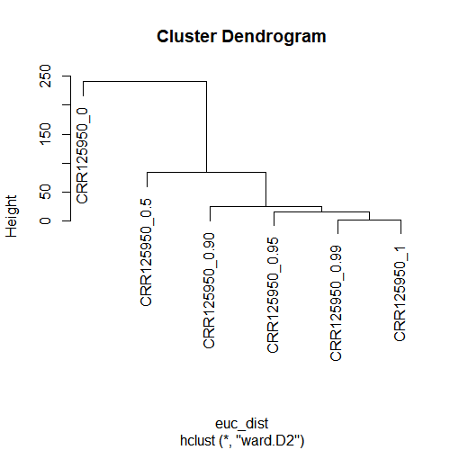
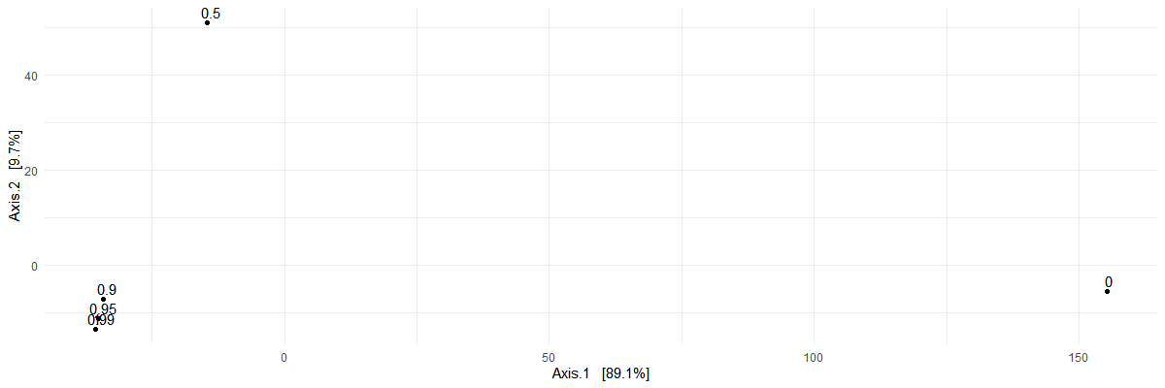

Slide 3
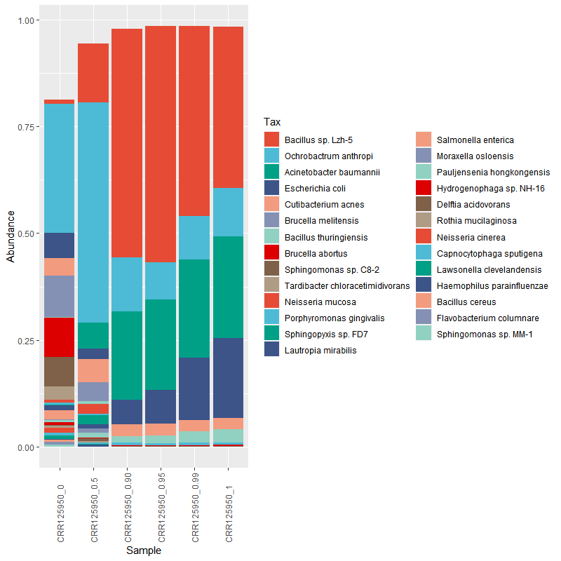
#make the phyloseq object
CRR125950<-phyloseq(otu,tax,sam)
#get rid of eukaryotic, and archeal, and viral hits
CRR125950<-subset_taxa(physeq = CRR125950, domain=="Bacteria")
#transfrom into a relative abundance
CRR125950_rel<-microbiome::transform(CRR125950, "compositional")
#subset the core mriobiota >0.5% prevalence and 0.5% detection
CRR125950_core<-core(x = CRR125950_rel, detection = 0.5/100, prevalence = 0.5/100)
#make the names the species
tax_glom(CRR125950_core,taxrank = "species", NArm = T )
taxa_names(CRR125950_core)<-get_taxa_unique(physeq = CRR125950_core, taxonomic.rank = "species")
#plot it up by confidence
plot_composition(x = CRR125950_core, sample.sort = 'confidence', otu.sort = "abundance",verbose = T)+
scale_fill_manual(values=rep( pal_npg("nrc", alpha = 1)(10),times=4))

