Slide 1
Reviewer 3
1. Could the authors examine the code used to generate Figure 3? Why are the two samples with outcome= Deceased (fourth and fifth from the right side) clustered within Column cluster 2, when their trends are entirely different from samples in Cluster2?

Slide 2
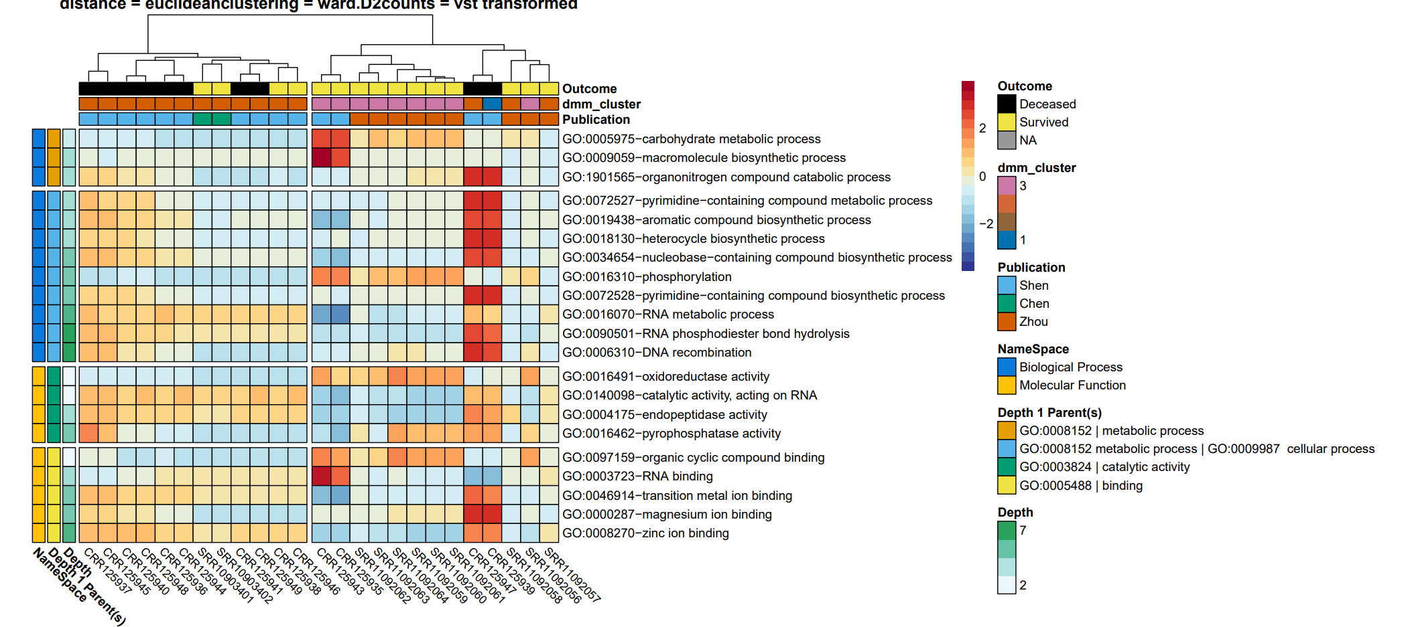
Old one
Count data = VST transformed
Distance = Euclidean
Clustering = ward.d2

Slide 3
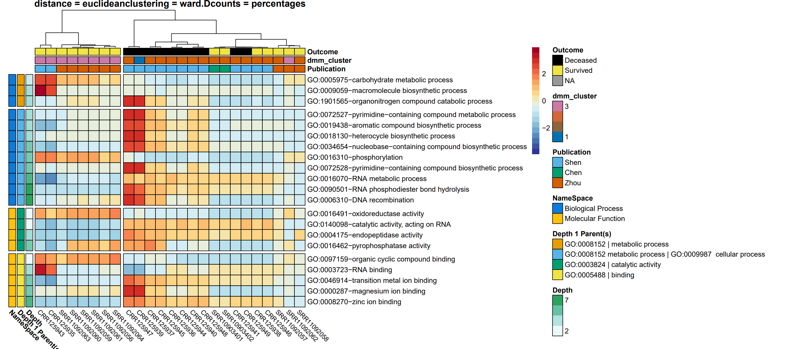
Read counts (Z-scale)
(s)

Slide 4
New one
Count data = percentages
Distance = Euclidean
Clustering = ward.d2

Slide 5
New one
Count data = percentages
Distance = Euclidean
Clustering = ward.d2

