Slide 1
COVIRT-19 microbial subgroup analysis of BALF samples update
2 Sept 2020

Slide 2
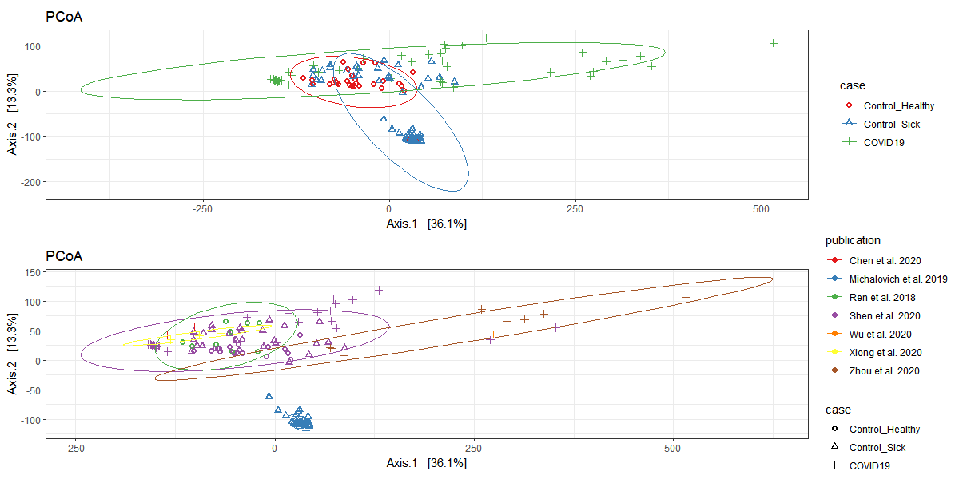
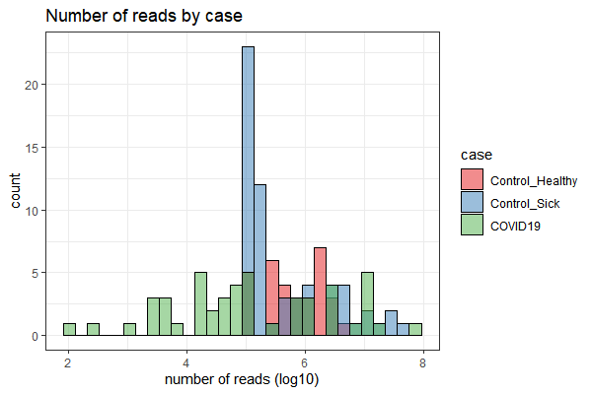
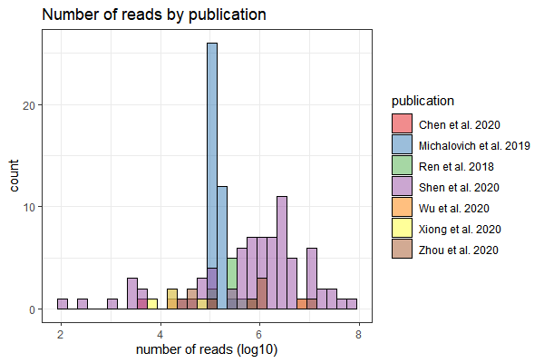
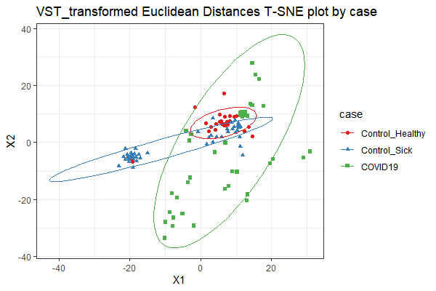
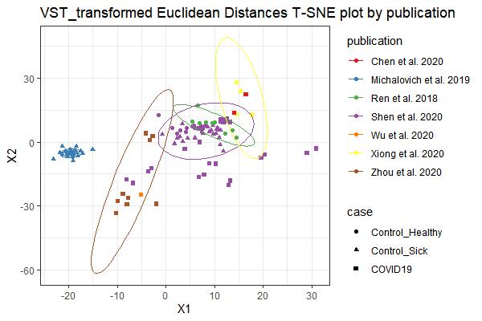

Slide 3
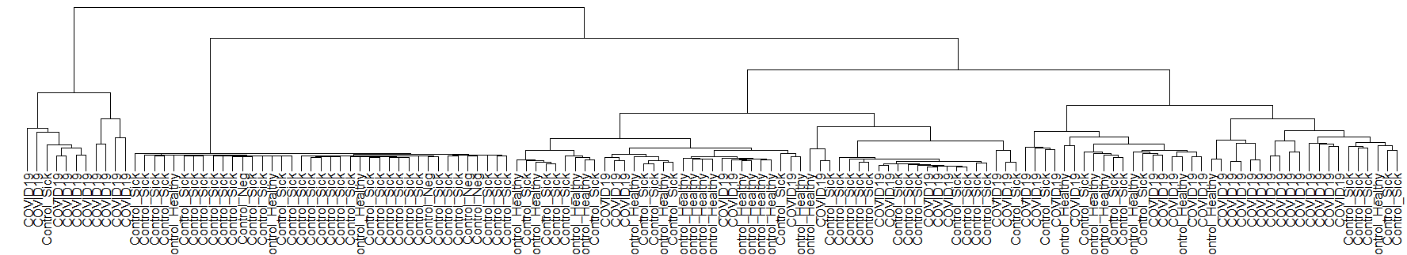
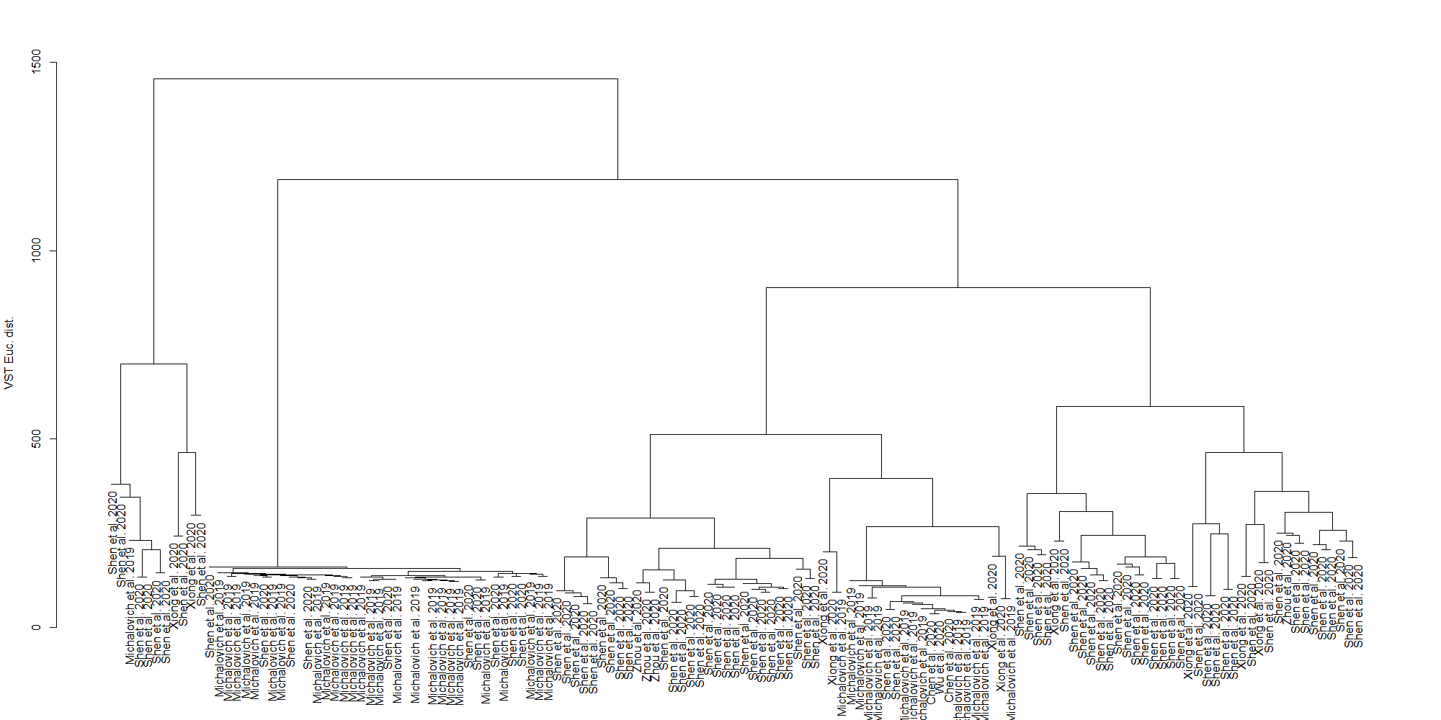

Slide 4
Community typing with Dirichlet Multinomial Mixtures

Slide 5
COVIRT-19 microbial subgroup analysis of BALF samples
1 Sept 2020

Slide 6
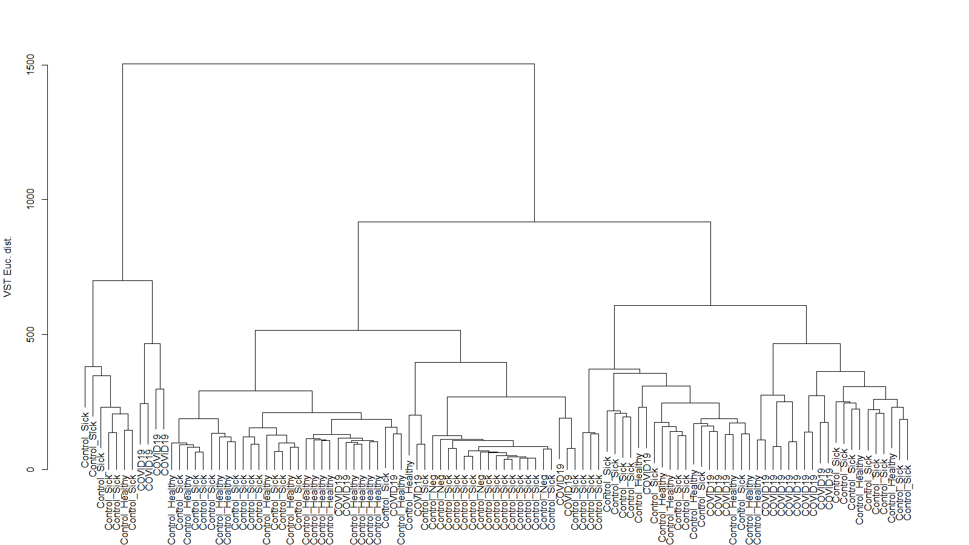
Dendrogram of Euclidean distances of VST transformed counts by case

Slide 7
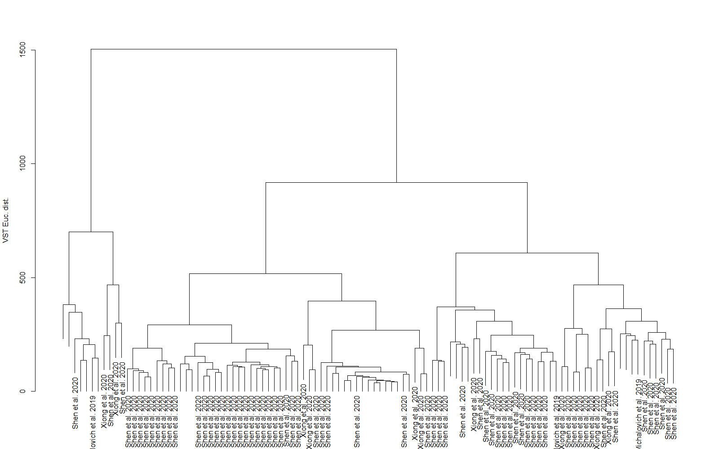
Dendrogram of Euclidean distances of VST transformed counts by publication

Slide 8
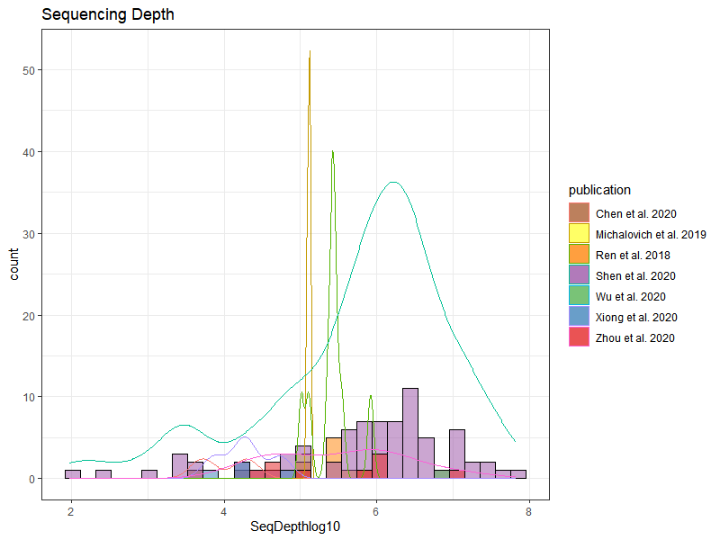
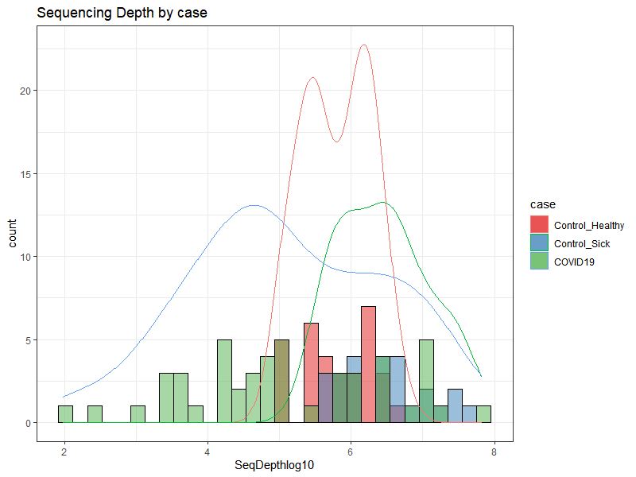
Preprocessing
Distributions of reads by publication post processing
Subset Taxa to only Bacteria
Subset Samples to only BALF tissue
Removed Huang et. al 2019 samples
large batch effect observed
status was “Control_unknown”
Pruned taxa with >0 reads counts

Slide 9
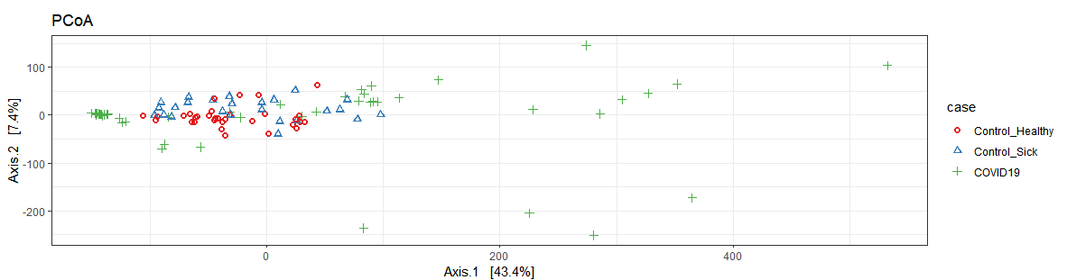
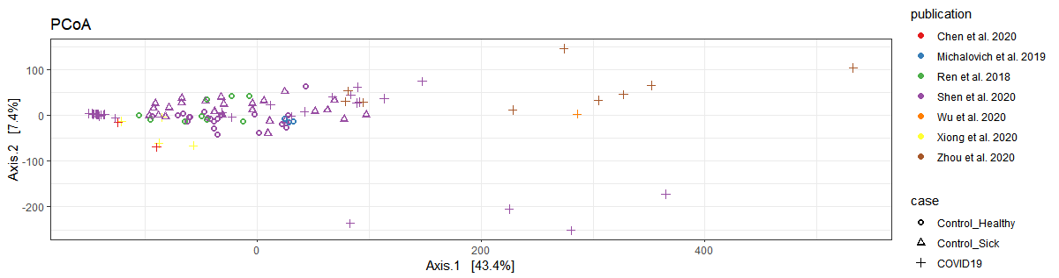
PCoA plots of Euclidean distances of VST transformed counts by case and publication

Slide 10
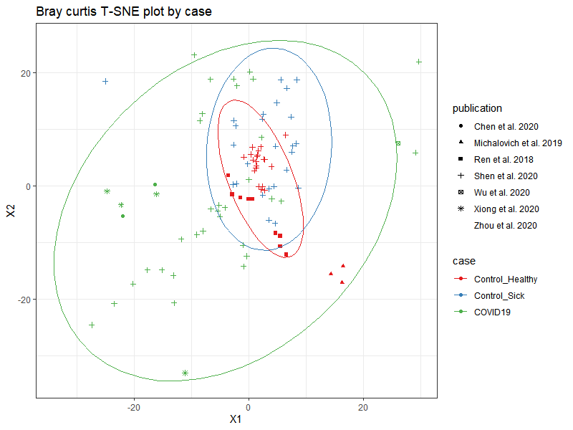
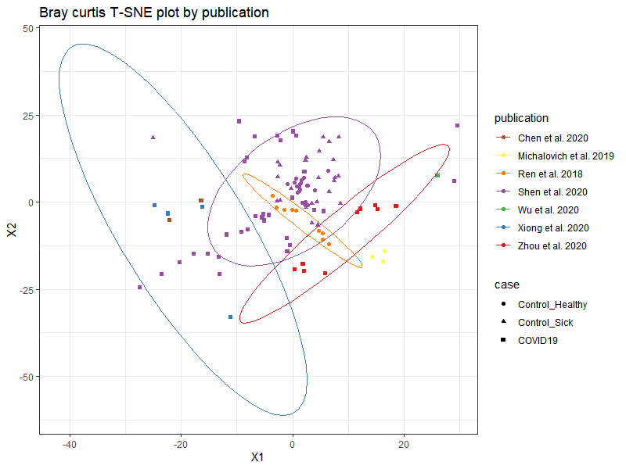
T-SNE plots of Bray Curtis dissimilarity of counts by case and publication

Slide 11
Within group betadisper Euclidean distance VST transformed counts by case
within_group_difs_anova<-anova(betadisper(euc_dist, meta(vst_physeq)$case)) # 0.002 > within_group_difs_anova
Analysis of Variance Table
Response: Distances
Df Sum Sq Mean Sq F value Pr(>F)
Groups 2 253724 126862 17.232 3.571e-07 ***
Residuals 102 750933 7362
---
Signif. codes: 0 ‘***’ 0.001 ‘**’ 0.01 ‘*’ 0.05 ‘.’ 0.1 ‘ ’ 1
within_group_difs_permutest
Permutation test for homogeneity of multivariate dispersions
Permutation: free
Number of permutations: 999
Response: Distances
Df Sum Sq Mean Sq F N.Perm Pr(>F)
Groups 2 253724 126862 17.232 999 0.001 ***
Residuals 102 750933 7362
---
Signif. codes: 0 ‘***’ 0.001 ‘**’ 0.01 ‘*’ 0.05 ‘.’ 0.1 ‘ ’ 1
TukeyHSD(betadisper(euc_dist, meta(vst_physeq)$case))
Tukey multiple comparisons of means
95% family-wise confidence level
Fit: aov(formula = distances ~ group, data = df)
$group
diff lwr upr p adj
Sick - Healthy 1.644249 -52.82854 56.11703 0.9971626
COVID19 - Healthy 99.391186 52.81794 145.96444 0.0000052
COVID19 - Control_Sick 97.746937 47.41334 148.08053 0.0000335

Slide 12
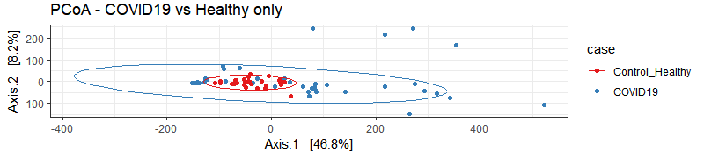
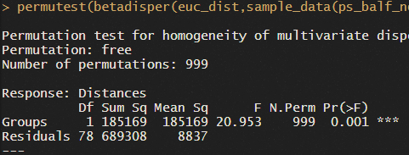
Adonis permanova Euclidean distance VST transformed counts by case, stratified by publication
Betadisper
Call: adonis(formula = euc_dist ~ sample_data(ps_balf_not_sick)$case,
permutations = 9999,
strata = sample_data(ps_balf_not_sick)$publication)
Blocks: strata
Permutation: free
Number of permutations: 9999
Terms added sequentially (first to last)
Df SumsOfSqs MeanSqs F.Model R2 Pr(>F)
case 1 157741 157741 3.8181 0.04667 0.064 .
Residuals 78 3222517 41314 0.95333
Total 79 3380257 1.00000
---
Signif. codes: 0 ‘***’ 0.001 ‘**’ 0.01 ‘*’ 0.05 ‘.’ 0.1 ‘ ’ 1

Slide 13
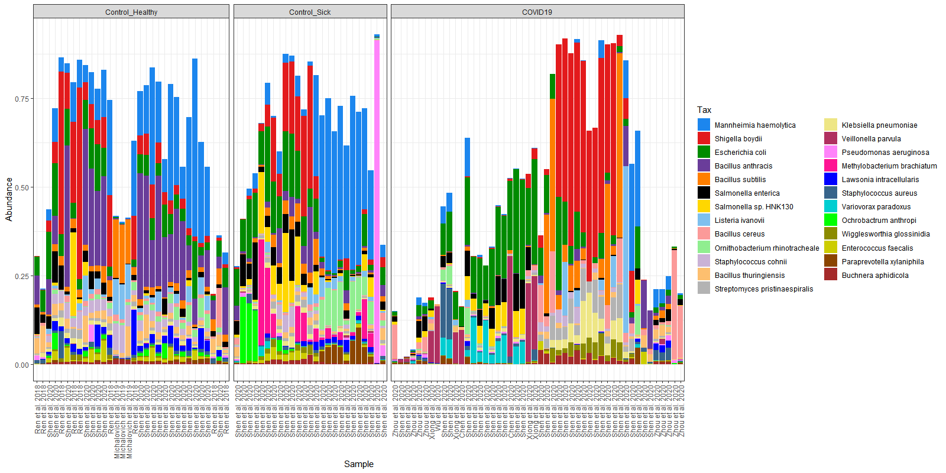
% Relative Abundance of Top25 Species

Slide 14
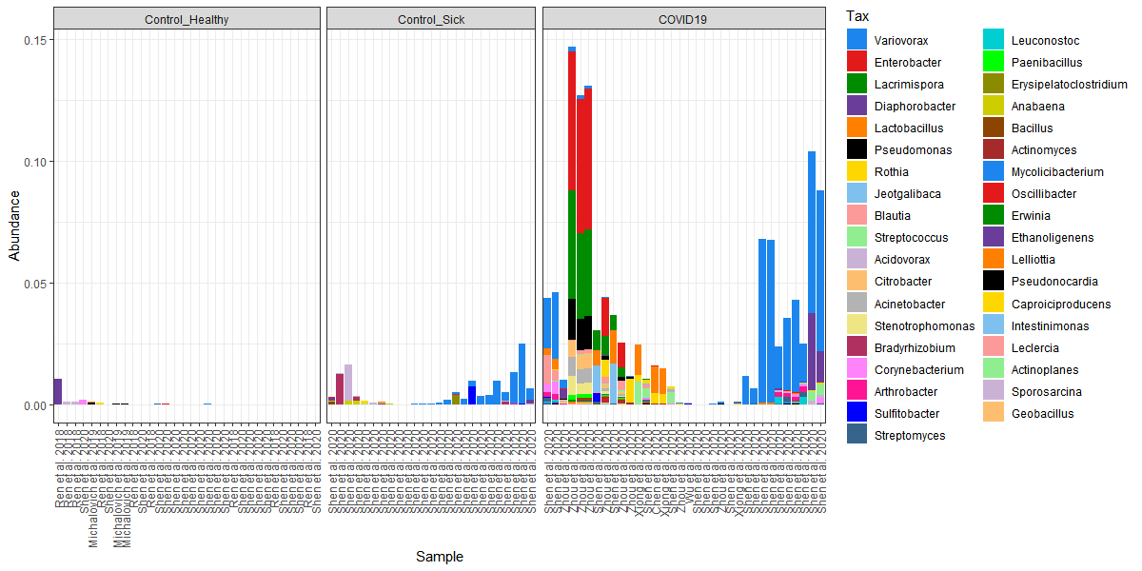
% Relative Abundance of DESeq2 Taxa

Slide 15
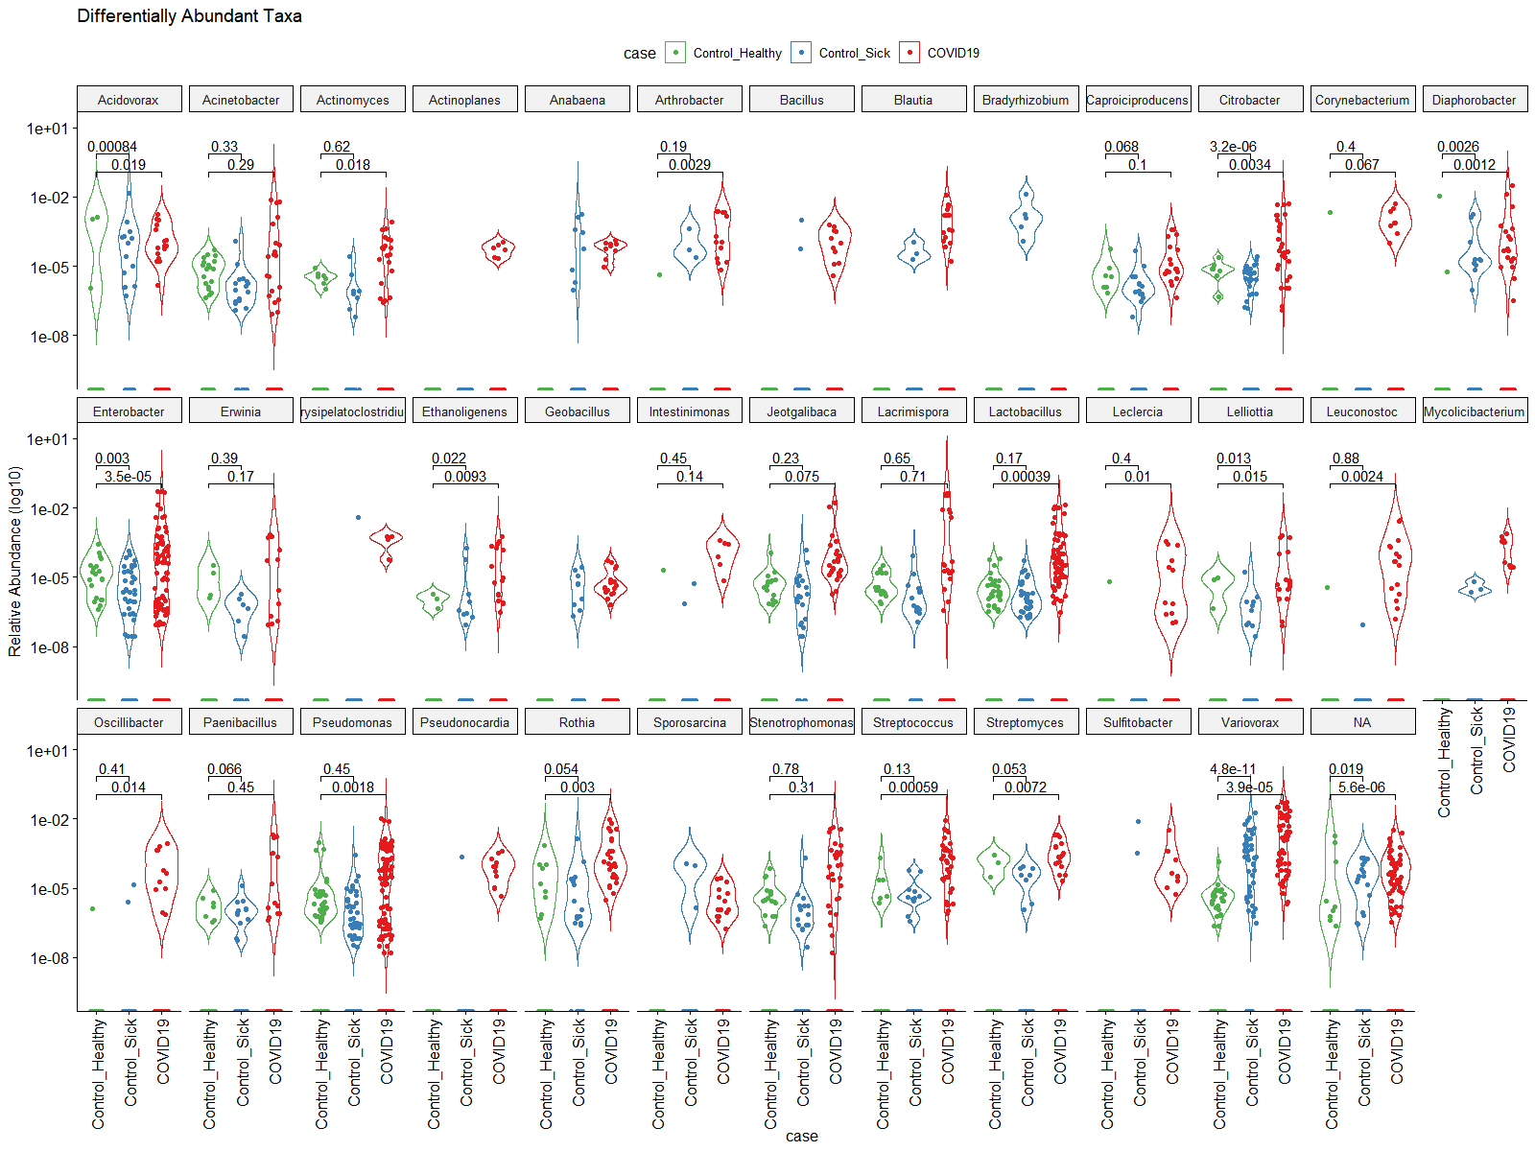
% Relative Abundance violin plot comparisons of DESeq2 Identified Genera
*p values obtained using wilcox test comparisons to Control_Healthy

Slide 16
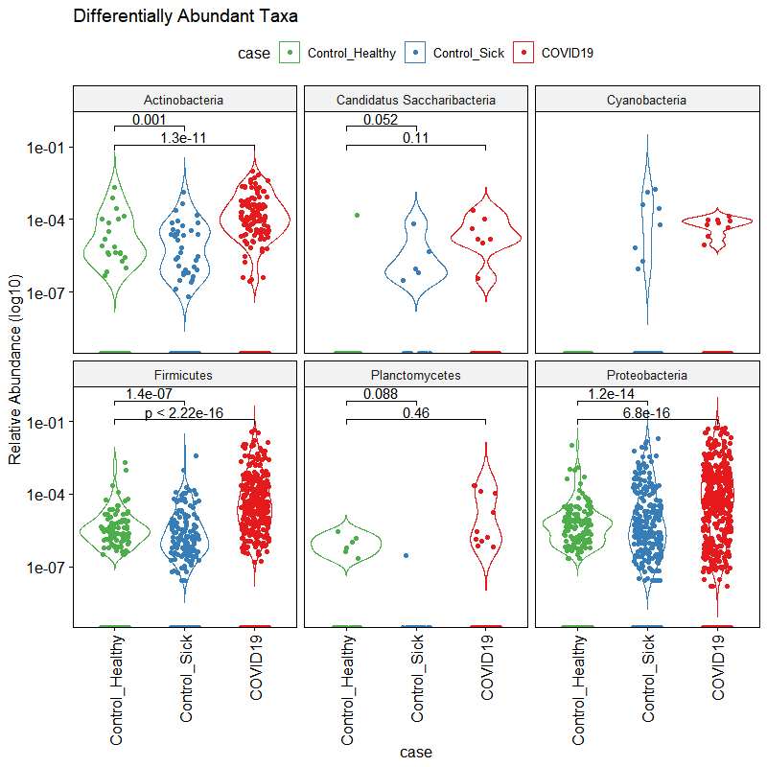
% Relative Abundance violin plot comparisons of DESeq2 Identified Phyla

