Slide 1
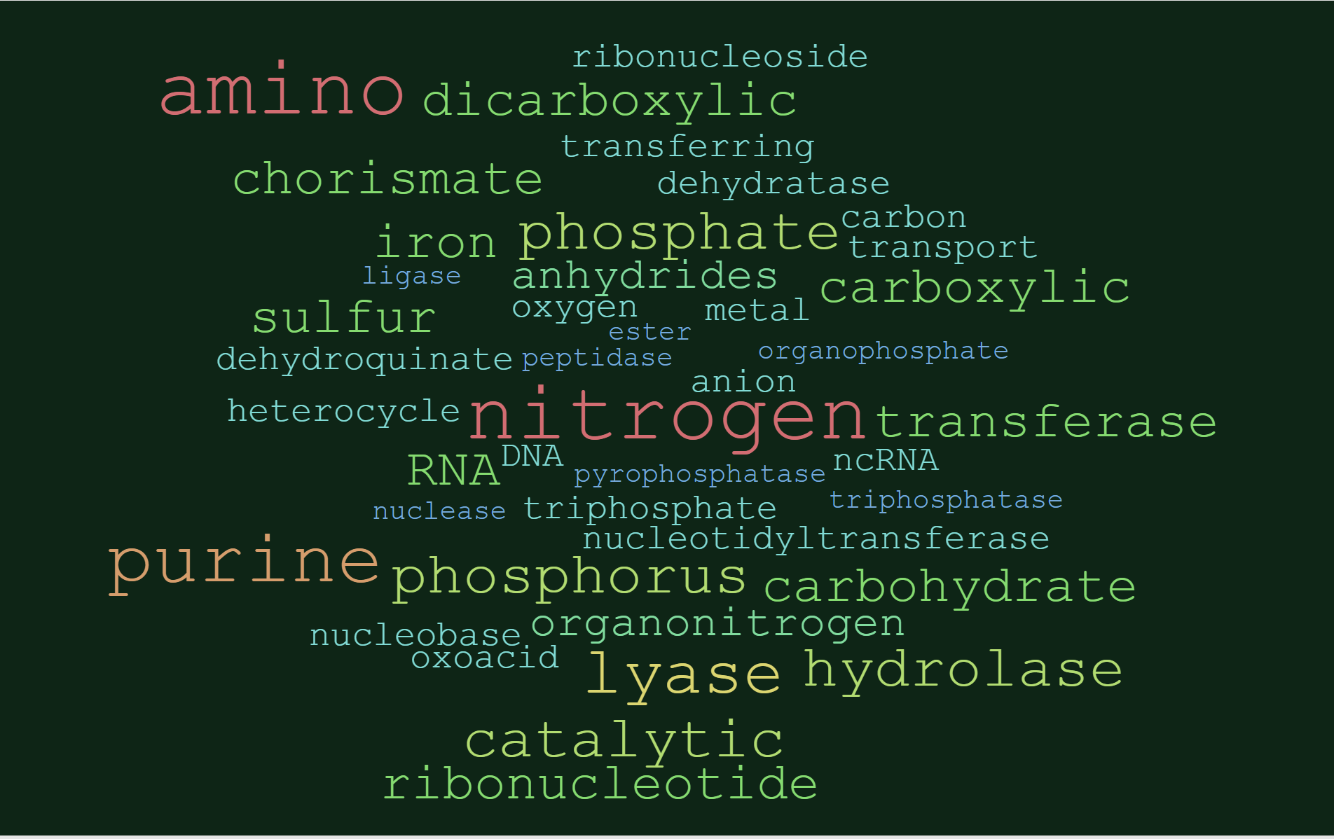
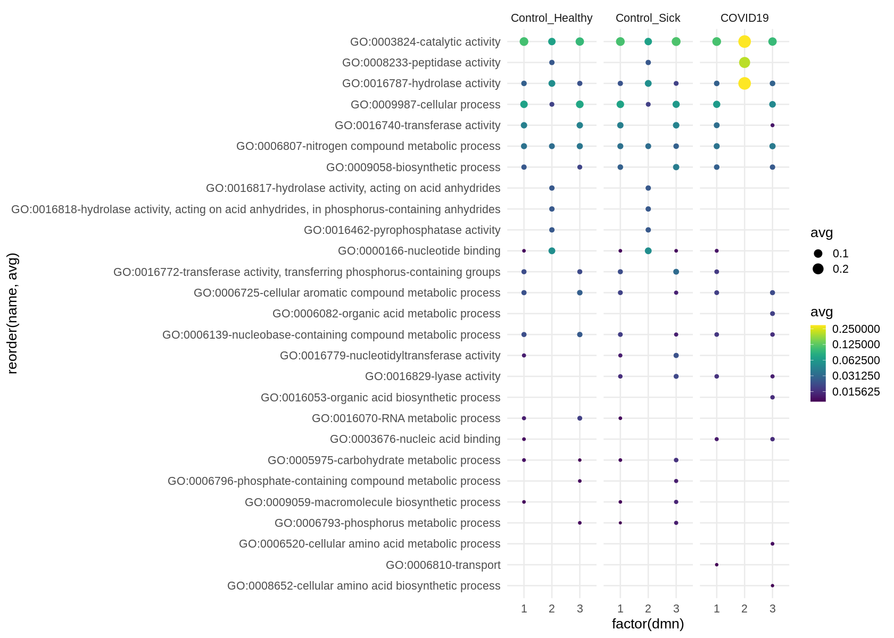

Slide 2
Tables and Figures
24 November 2020
Jochum, Michael D.

Slide 3
Table 1. Overview of Meta-analysis dataset Clinical Characteristics
Categorical, n (%) | Community acquired pneumonia | Control Healthy | Control Sick | COVID19 | p- value
case | 25 (17.7%) | 32 (22.7%) | 36 (25.5%) | 48(34%) | TBD
Sex
female | 8 (32%) | 6 (18.8%) | 24 (66.7%) | 16 (33.3%) | TBD
male | 11 (44%) | 6 (18.8%) | 12 (33.3%) | 32 (66.7%) | TBD
unspecified | 6 (24%) | 20 (62.5%) | 0 (0%) | 0 (0%) | TBD
origin | FIX THIS LATER | FIX THIS LATER | FIX THIS LATER | FIX THIS LATER | TBD
smoking status
yes | 0 (0%) | 1 (3.12%) | 13 (36.1%) | 0 (0%) | TBD
no | 0 (0%) | 3 (9.38%) | 0 (0%) | 0 (0%) | TBD
unspecified | 25 (100%) | 28 (87.5%) | 23 (63.9%) | 48 (100%) | TBD
Reads |  |  |  |  | TBD
paired | 25 (100%) | 32 (100%) | 0 (0%) | 32 (66.7%) | TBD
single | 0 (0%) | 0 (0%) | 0 (0%) | 16 (33.3%) | TBD
unspecified | 0 (0%) | 0 (0%) | 36 (100%) FIX THIS LATER | 0 (0%) | TBD
Publication
Chen | 0 (0%) | 0 (0%) | 0 (0%) | 2 (4.2%) | TBD
Michalovich | 0 (0%) | 3 (9.4%) | 36 (100%) | 0 (0%) | TBD
Ren | 0 (0%) | 9 (28.1%) | 0 (0%) | 0 (0%) | TBD
Shen | 25 (100%) | 20 (62.5%) | 0 (0%) | 32 (66.7%) | TBD
Wu | 0 (0%) | 0 (0%) | 0 (0%) | 1 (2.1%) | TBD
Xiong | 0 (0%) | 0 (0%) | 0 (0%) | 4 (8.3%) | TBD
Zhou | 0 (0%) | 0 (0%) | 0 (0%) | 9 (18.8%) | TBD
Numeric, mean ± SD (n)
Age | 51.1 ± 19.8 (n=17) | 49.8 ± 13.9 (n=12) | 43 ± 11.3 (n=36) | 47.9 ± 10.4 (n=48) | TBD
Temp. °C | 38.4 ± 0.91 (n=15) | - | - | 38.4 ± 0.715 (n=8) | TBD
days after onset | 9.07 ± 3.17 (n=14) | - | - | 12.05 ± 6.5 (n=41) | TBD
Suppl. Table 1. COVID19 Sample Characteristics
outcome | n (%) | p-value
Deceased | 20 (41.7%) | TBD
Recovered | 11 (22.9%) | TBD
Stabilized | 7 (16.7%) | TBD
Unspecified | 9 (18.8%) | TBD
Cough
aggravated | 1 (2.1%) | TBD
expectoration | 3 (6.3%) | TBD
intermittent | 2 (4.2%) | TBD
yes | 6 (12.5%) | TBD
Unspecified | 36 (75%) | TBD
days delayed hospital mean ± SD (n) | 5.27 ± 3.29 (n=11) | TBD
Suppl. Table 2. Control Sick Sample Characteristics
Sample Type | n (%) | p-value
Asthma | 7 (19.4%) | TBD
Asthma_Ex_smoker | 3 (8.3%) | TBD
Asthma_Smoker | 2 (5.6%) | TBD
Obese | 6 (16.7%) | TBD
Obese_Asthma | 9 (25%) | TBD
Obese_Asthma_Smoker | 1 (2.8%) | TBD
Obese_Smoker | 5 (13.9%) | TBD
Smoker | 3 (8.3%) | TBD

Slide 4
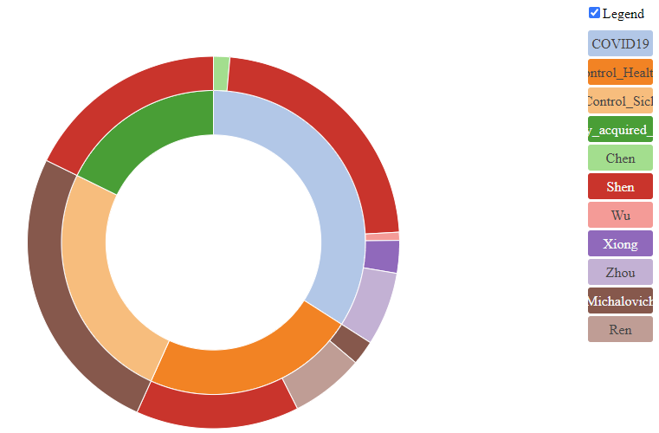
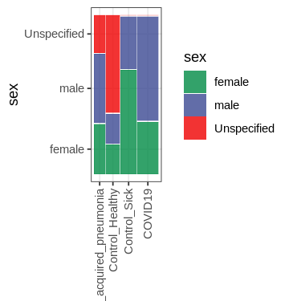
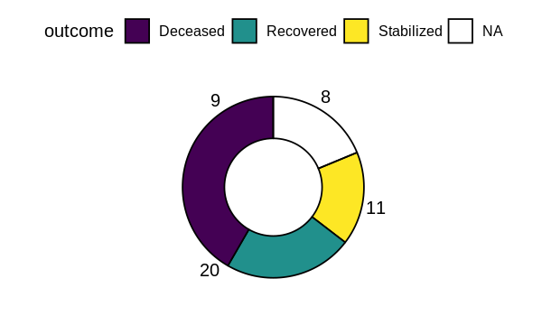
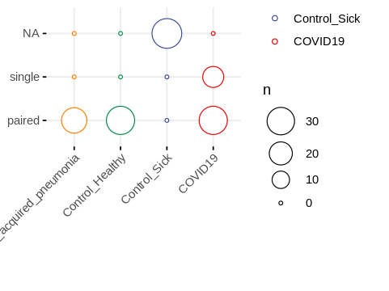
hyperlink

Slide 5
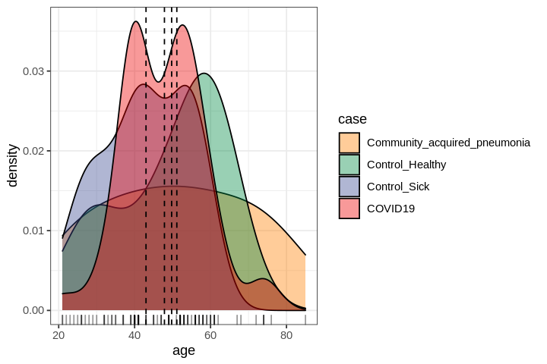
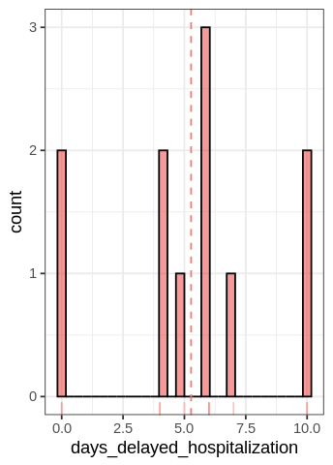
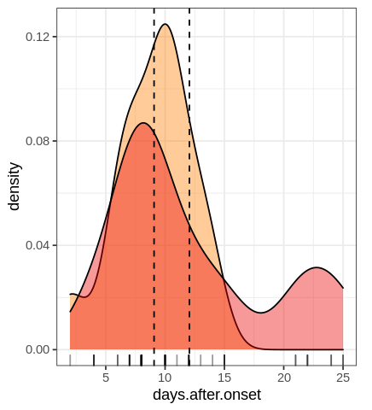
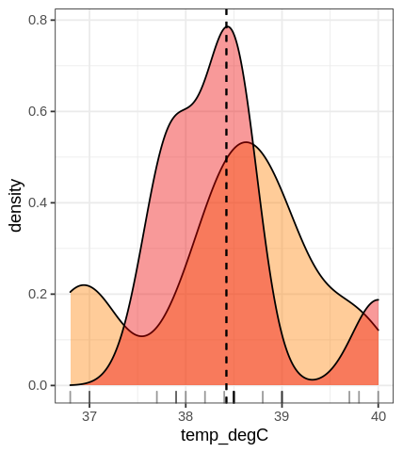

Slide 6
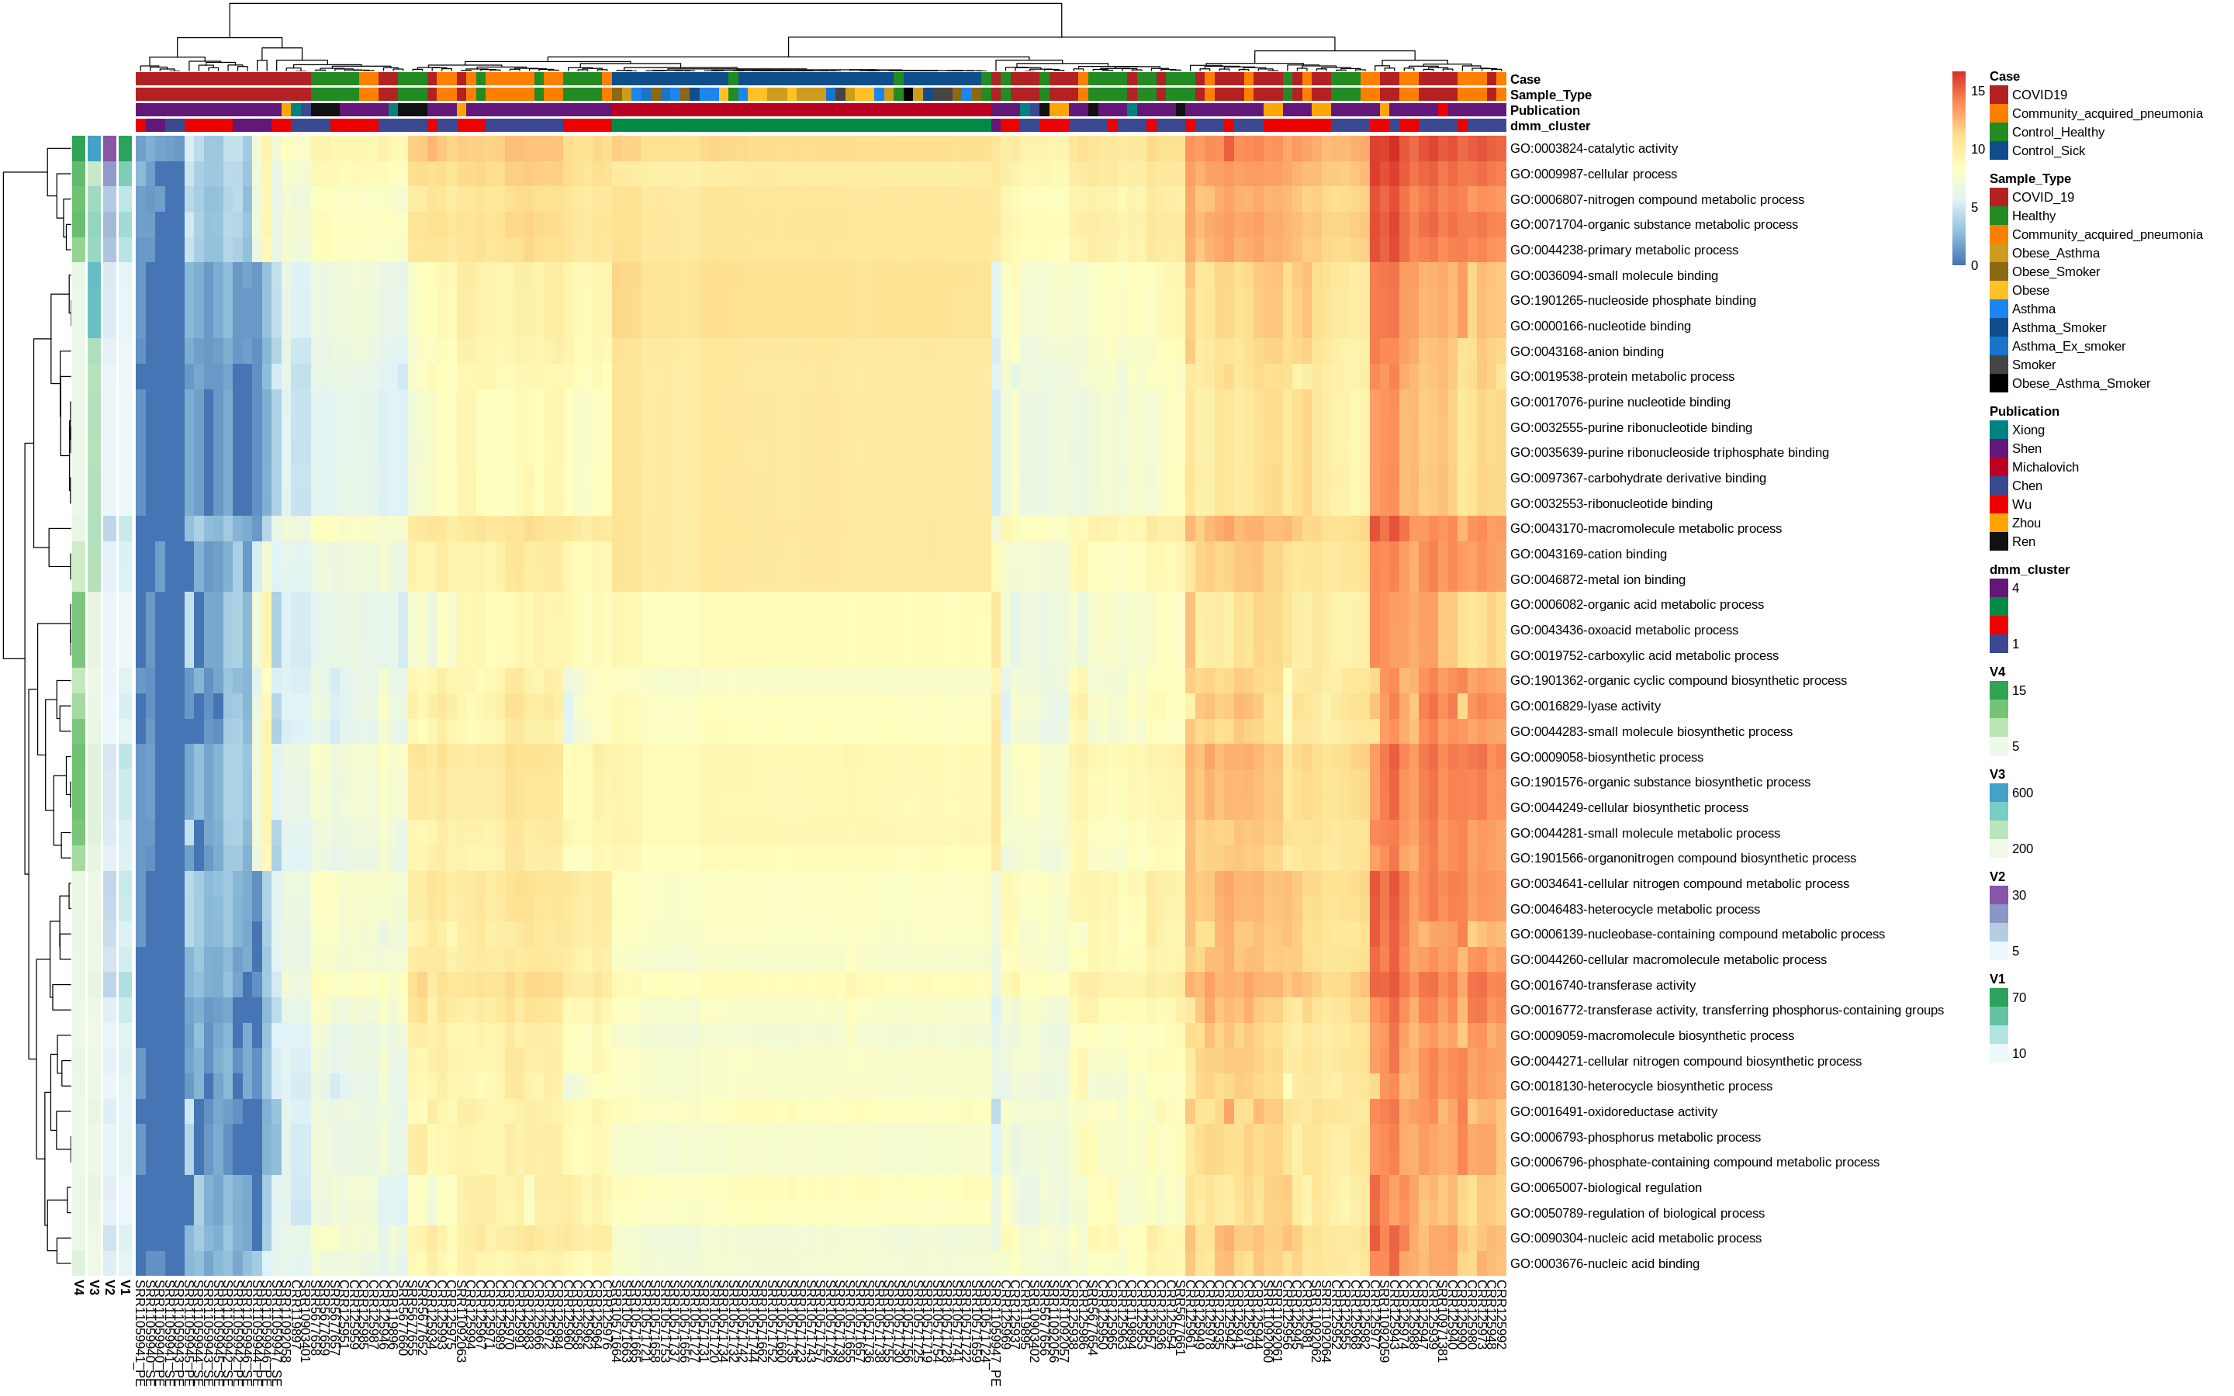

Slide 7
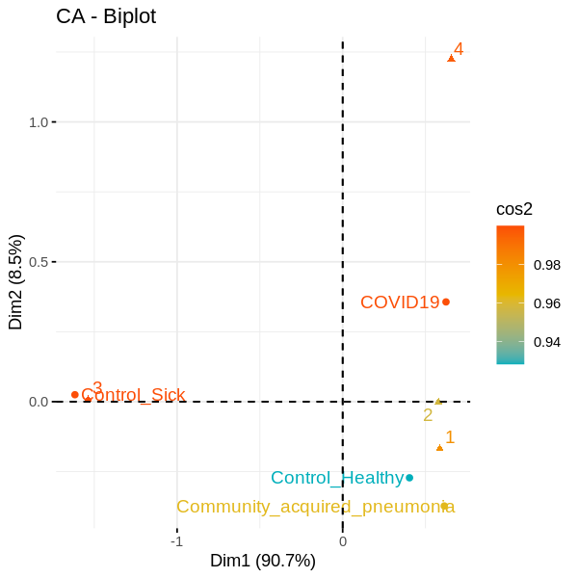

Slide 8
