Slide 1
GO TERM DMM modeling update
Jochum, Michael D.
17 November 2020

Slide 2
Recap
Last week 10 NOV 2020 objective
Mike Lee updated the go term summary file to include parent/children counts for each depth
Hypothesis
COVID19, Sick, and healthy patient BALF samples have different Gene ontologies that can be differentiated using the unsupervised machine learning algorithm Dirichlet Multinomial modeling
Objectives:
Determine if unsupervised machine learning can differentiate the COVID19, Sick, and healthy patient samples (Pearson correlation between case and dmm)
identify the GO terms that were used in making this determination
identify other latent variables associated with the dmm groups
Outcome, treatments, medications, age, etc
Updates to the algo
Use the new parent propagated counts
Using the combined biological processes and molecular function
Do not attempt to subset to depth
Do not agglomerate GO terms by name

Slide 3
Issues
(Resolved 11/3/2020) GO term names used special characters like quotations and # signs which broke the algo
Solution: Mike Lee made a script that conducted parent propagation base on depth and uploaded a new combined GO term summary sheet to OSF
(Resolved 11/3/2020) Determination of statistically significant GO Terms to include in the model / report in data visualization
Solution: I used library(matrixTests) to conduct a rowise Kuskal Wallis test on every GO Term by case and report out the Terms with p < 0.01.
(ONGOING) Batch effect issues with publication (primarily with Viktorija’s DESeq2 analysis)
Investigate post VST limma remove batch effect command
(ONGOING) Duplicate samples with different accessions and SE vs PE
Run the model with duplicate samples and confirm that they fall into the same dmm clustering group.
I tried this and I think it doesn’t work because it exacerbates batch effects from publications and adds to the uneven sample distributions
Merge the samples with duplicated sample ids and re-run the model
Mean? Cumsum?
Remove 1 of the duplicated samples (SE)
(This is the solution I decided to go with)
(ONGOING) Discuss the implications of using a kraken2 build with human: GRCh38 human genome/proteins versus transcriptome
Bring up the idea of running KrakenUniq because we are no longer trying to get relative abundances

Slide 4
Attempt #1 – 11 Nov 2020
Pre- processing steps
Fit modeling parameters
fit <- mclapply(1:8, dmn, count = t(abundances(bac_pseq_prune_deep))
DMM fit modeling started 11 Nov 2020
DMM fit modeling ended TBA
Ok so this is taking way too long…
Pre-processing Steps Taken | Go Term (n) | samples
Bac_pseq | 13846 | 167
Removed all non-bacterial GO terms, neg control, and Unknown samples | 13846 | 162
Removed Go terms and samples with summation < 50 | 8504 | 139
New idea:
Identify the statistically significant GO Terms associated with the case states (COVID19,Sick,Healthy)
Subset the Go terms input into the model using only the statistically significant terms associated with age

Slide 5
Attempt #2 – 16 Nov 2020
Text import / regex
Convert the parent propagated summary sheet into a tibble
fix little issues with samples names with some regex
Phyloseq
Convert the tibble into a phyloseq object
Subset the phyloseq for neg controls and unknown samples
Remove batch effect samples publication!="Michalovich“ #NOT RUN
filter out empty GO Terms and empty samples
DESEQ2 VST transformation
Convert the phyloseq object Dataset with design all
Remove batch effect with limma #
Convert the normalized vst physeq counts to a tibble
MatrixTests
Run Kruskalwallis test on the vst normalized counts
Run one way welch test on the vst normalized counts
Identify the statistically significant GO Terms associated with the case states (COVID19,Sick,Healthy)
Subset the Go terms in the non-normalized physeq object with only the statistically significant terms associated with age
Dirichlet Multinomial Modeling
Fit the model
Fit the group model #NOT RUN
Evaluate the model fit
Correlate the dmm clusters with the variables (case, sample_type, age, etc)
Identify GO TERM contributions to each cluster
Data Visualization
deseq_counts<-phyloseq_to_deseq2(physeq = bac_pseq_prune,design = ~ 1)
deseq_counts_vst <- estimateSizeFactors(deseq_counts, type = "poscounts")
vst_trans_count_tab <- assay(deseq_counts_vst)
vst_trans_count_tab2 <- limma::removeBatchEffect(vst_trans_count_tab, sample_info_tab$publication)
Pre-processing Steps Taken | Go Term (n) | samples
Bac_pseq | 13846 | 167
Removed all non-bacterial GO terms, neg control, and Unknown samples | 13846 | 162
Remove all duplicates samples | 13846 | 126
Remove Go terms & samples w/ <1 | 13476 | 126
Removed Go terms w/ p<0.05 (~case) | 2089 | 126
Remove GO terms & samples w/ <10 | 2077 | 126

Slide 6
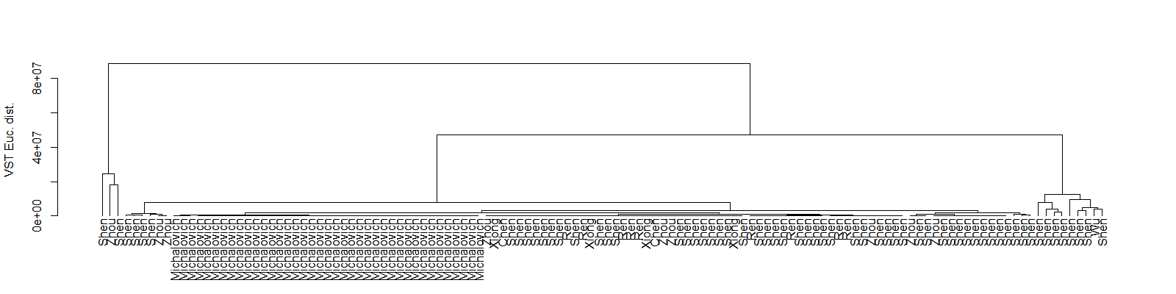
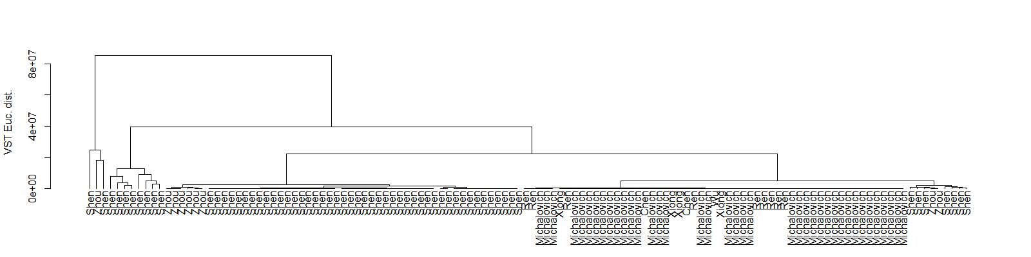
VST transformed Euclidean distance
VST transformed Euclidean distances with limma Bath effect Removal

Slide 7
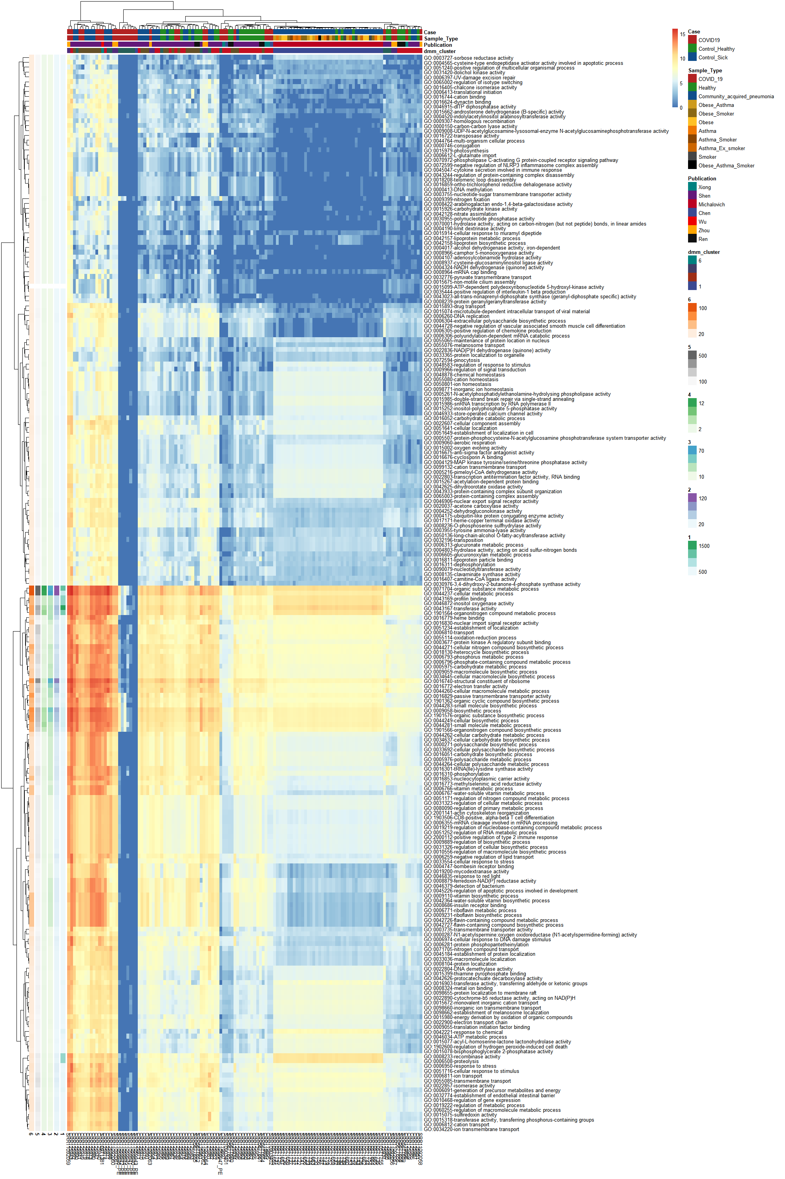
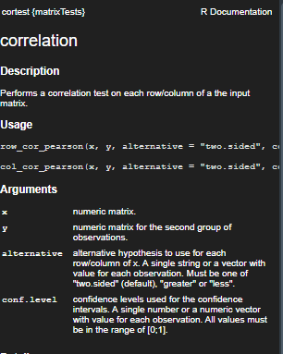
Michalovich Batch Effect Issue
Clustering Successful!
Issues
The Michalovich pub has batch effect issues
This is inappropriately weighting the dmm clustering model.
Questions
What statistical test do I perform to show that the dmm clusters are matching the case groups (and not the publication
What test can I perform that will identify associations with other latent variables
I should re-run the model with all the terms
Is there a way to minimize or agglomerate the GO Terms so the analysis doesn’t take > a week to run

Slide 8
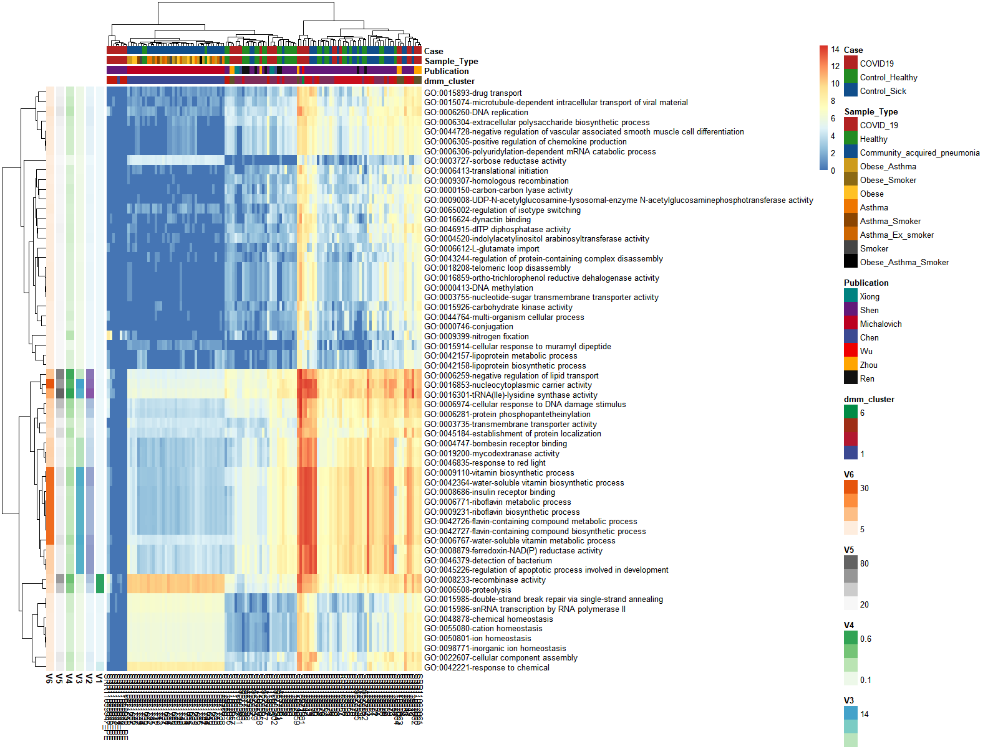
Same heatmap subset with GO Terms w/Std. deviations >2

Slide 9
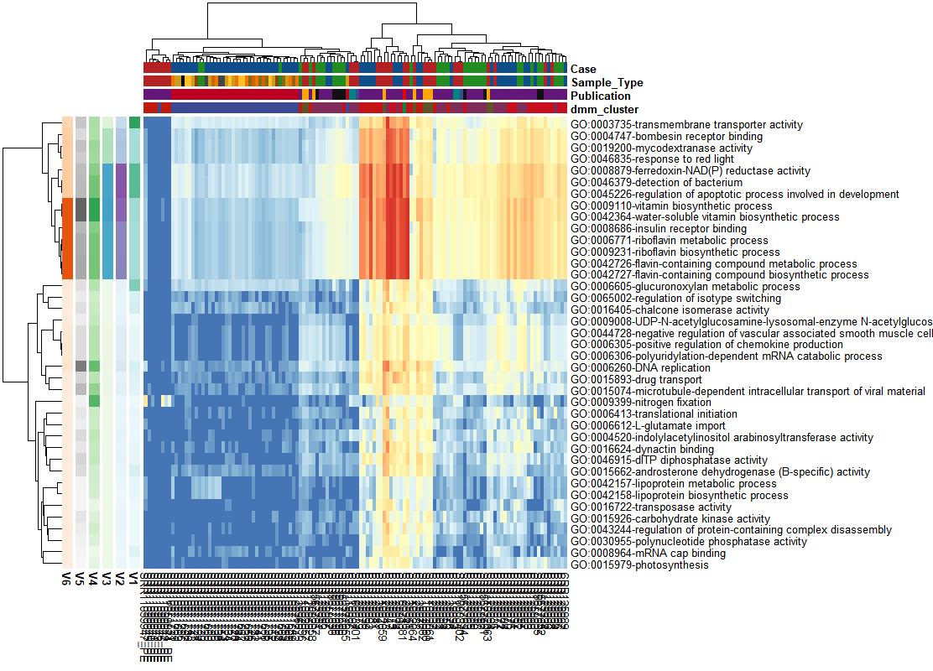
Same heatmap subset with GO Terms w/rowMadDiffs >1
Estimation of scale based on sequential-order differences, corresponding to the scale estimates provided by var, sd, mad and IQR.
select4<-select2%>%filter(rowMadDiffs(as.matrix(select2))>1)

Slide 10
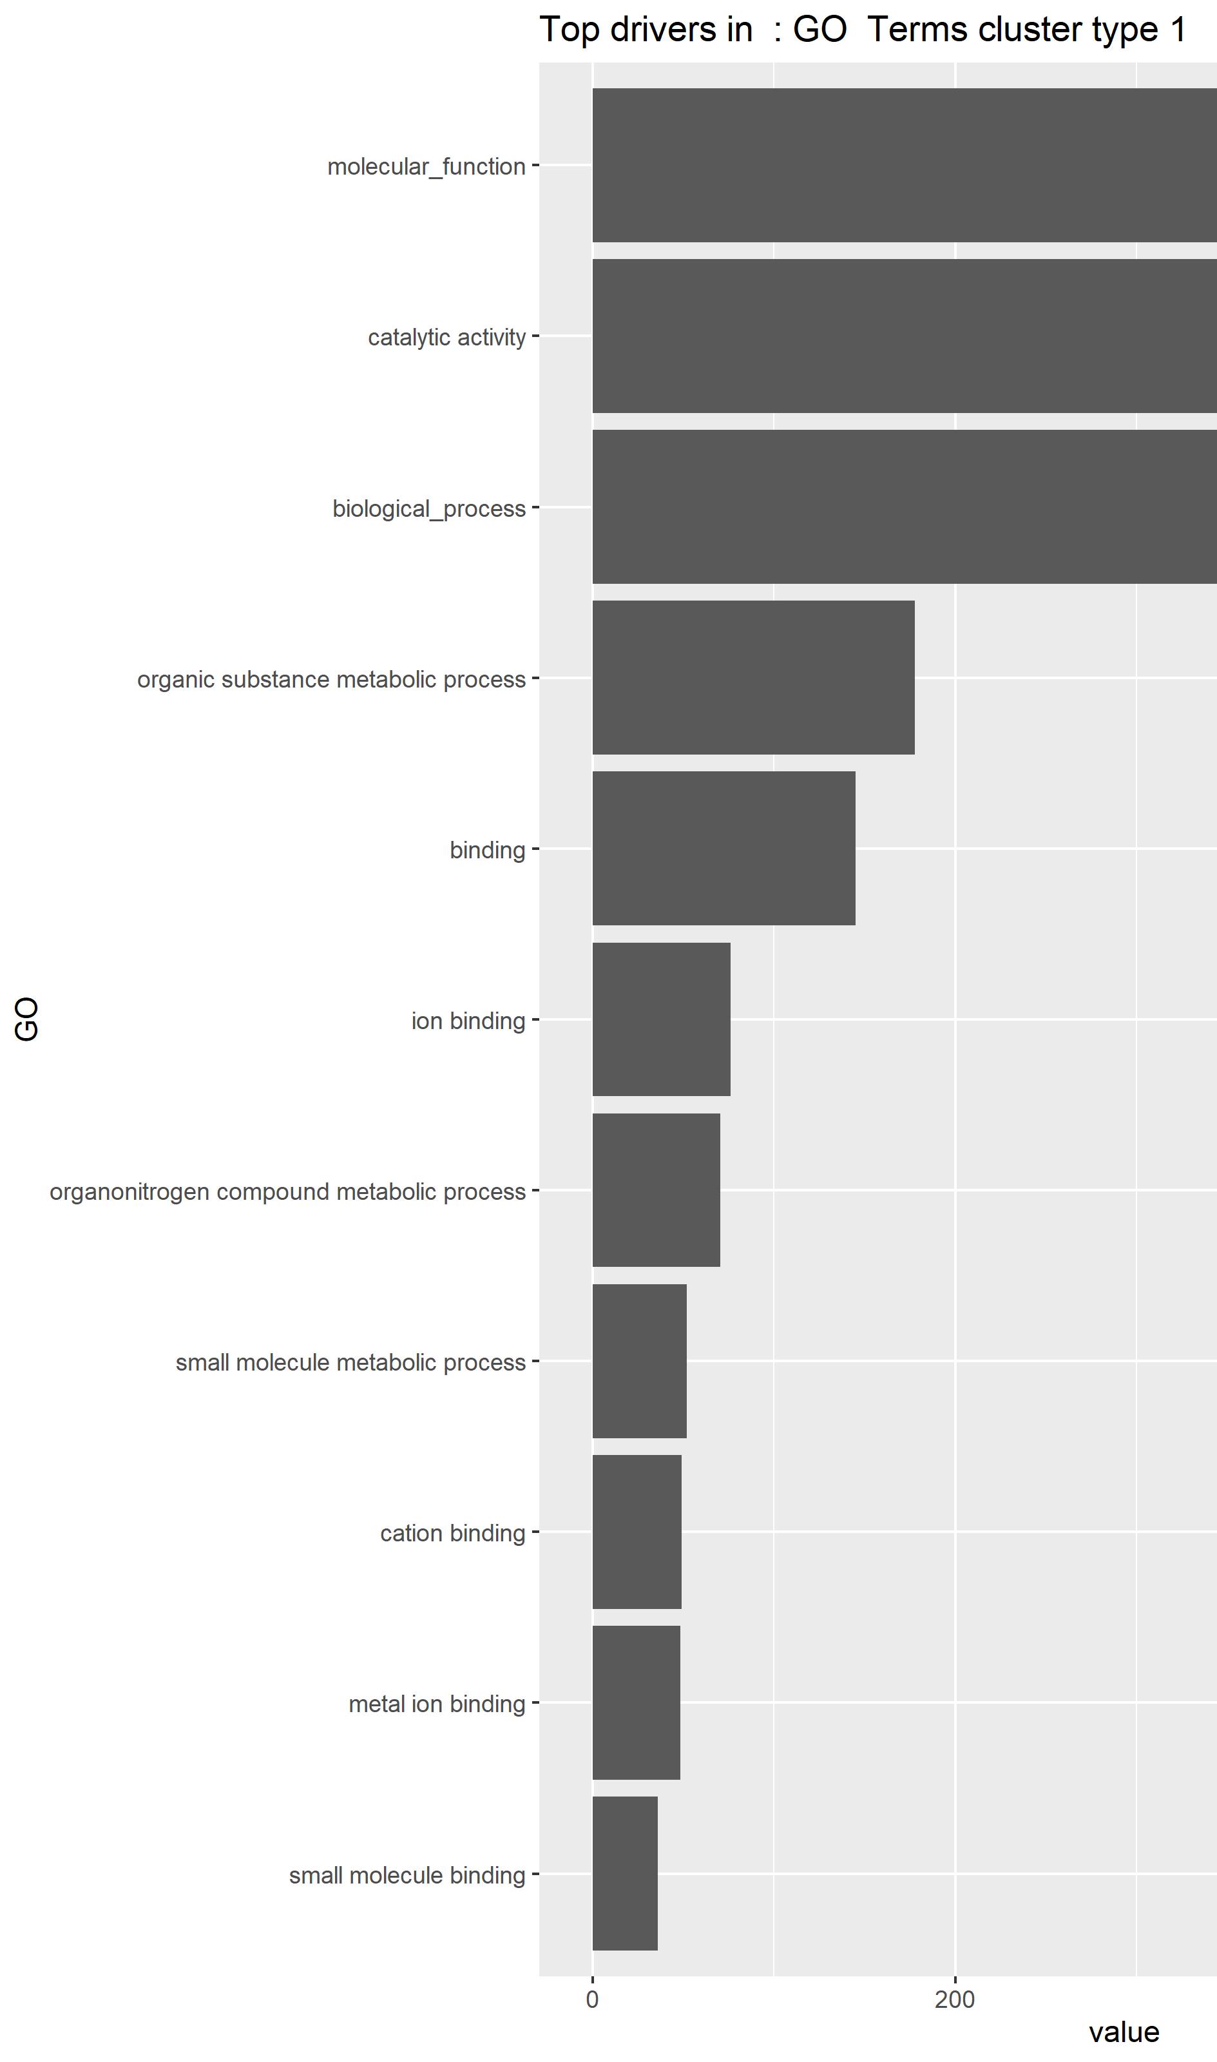
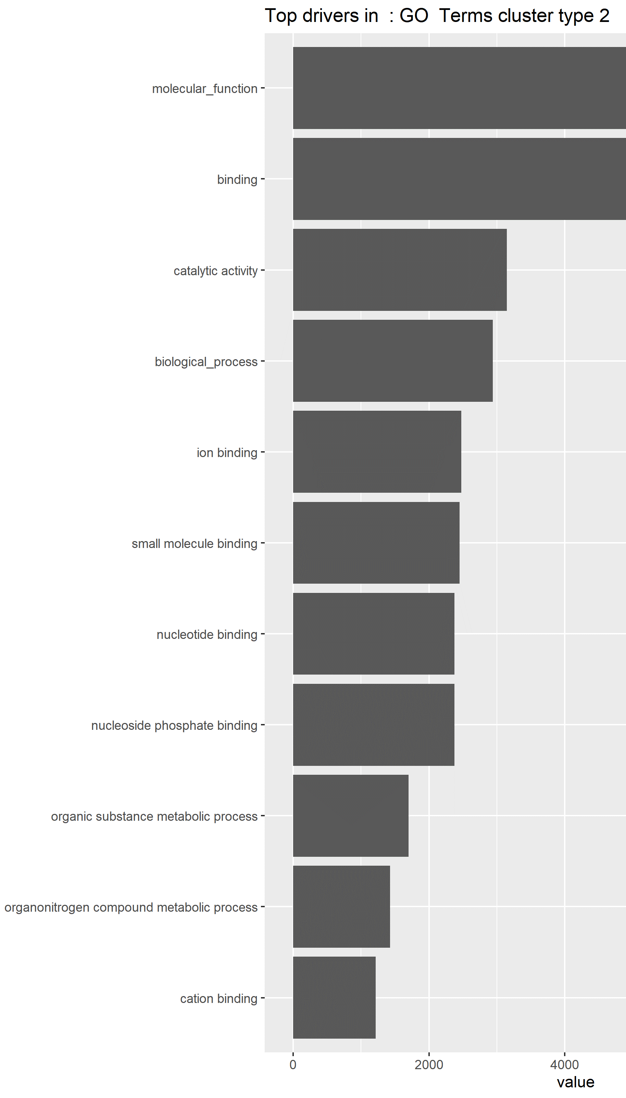
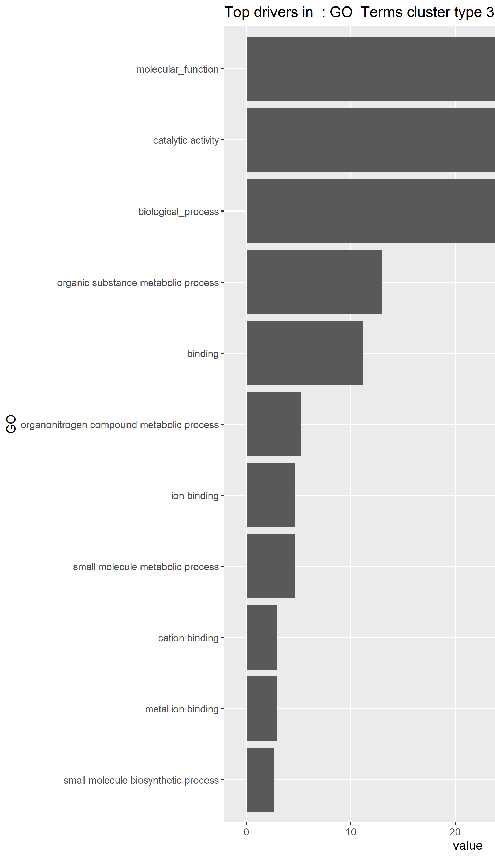

Slide 11
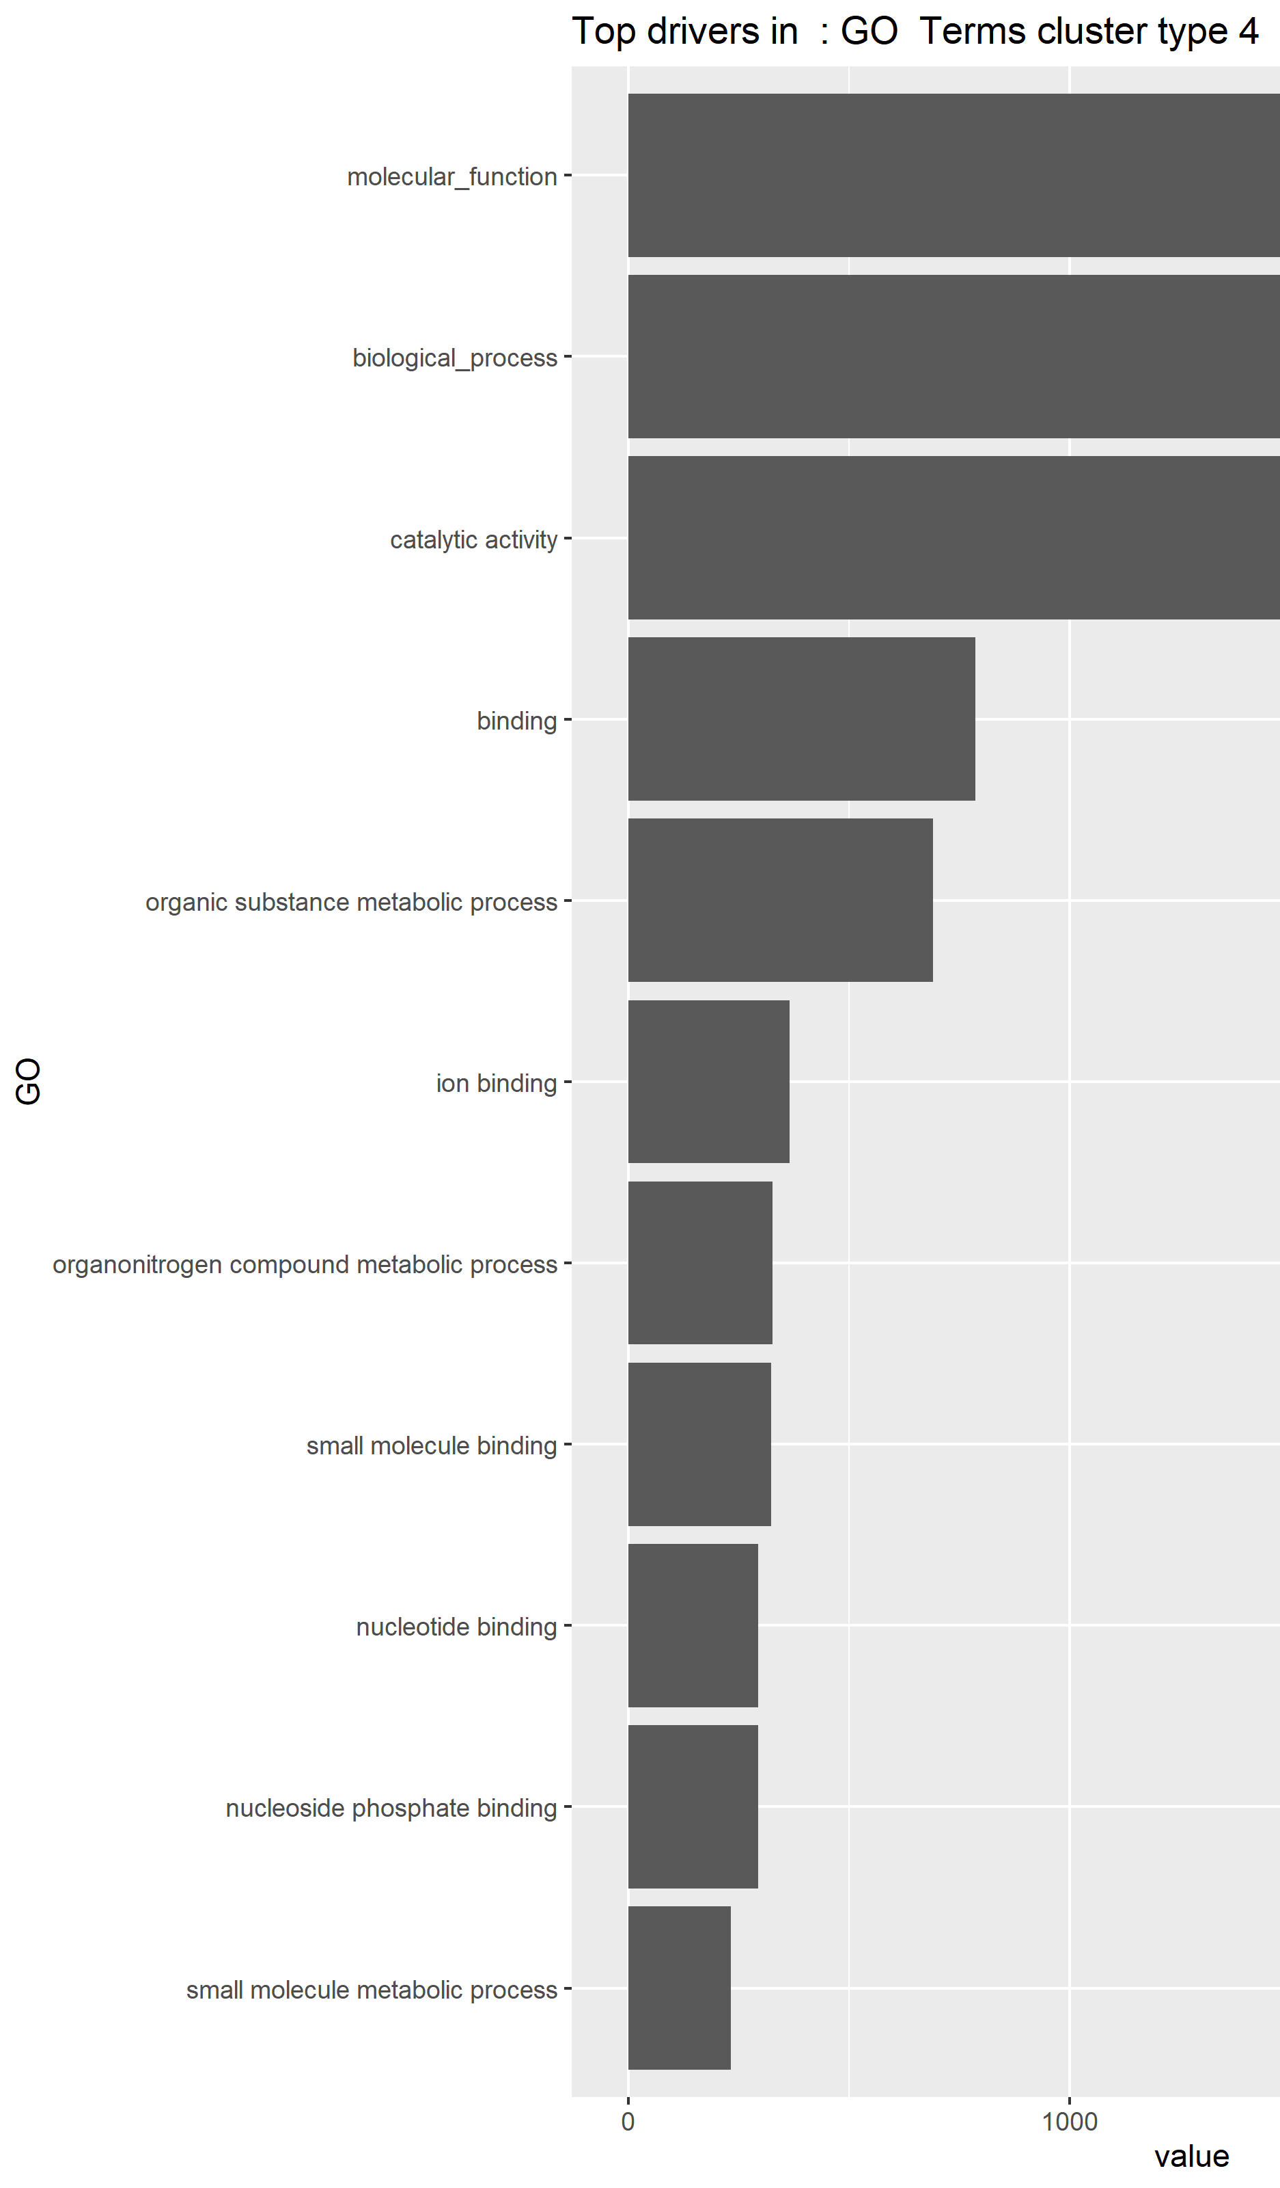
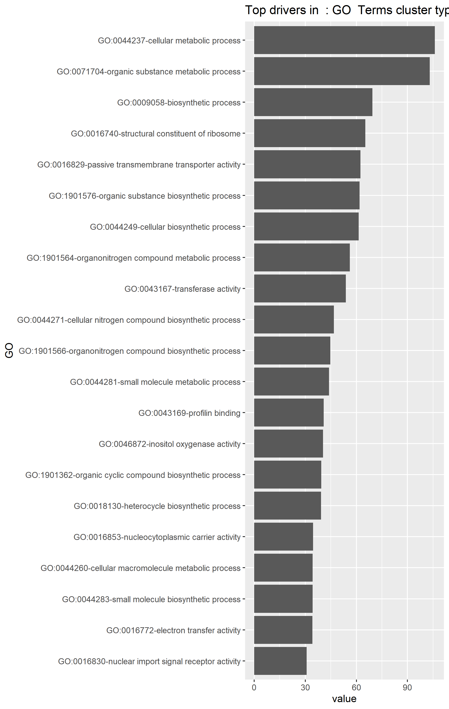
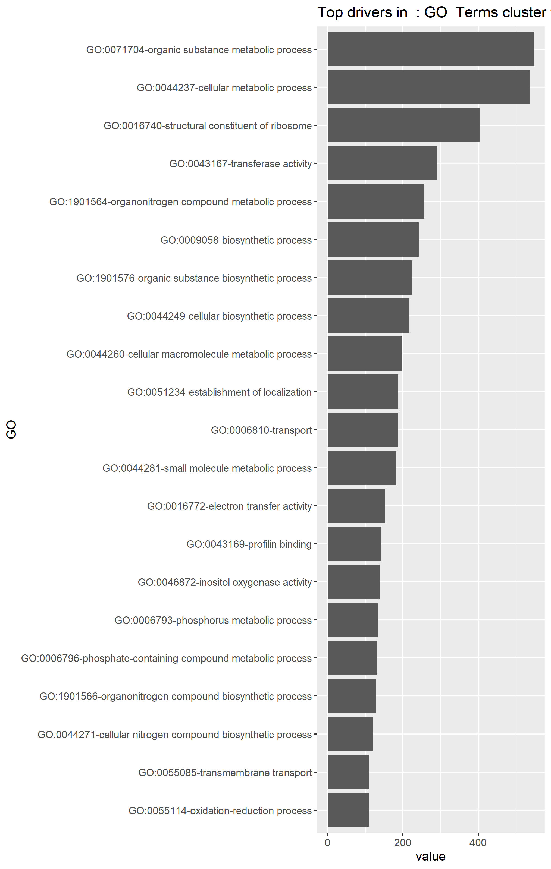

Slide 12
Bonus stuff

Slide 13
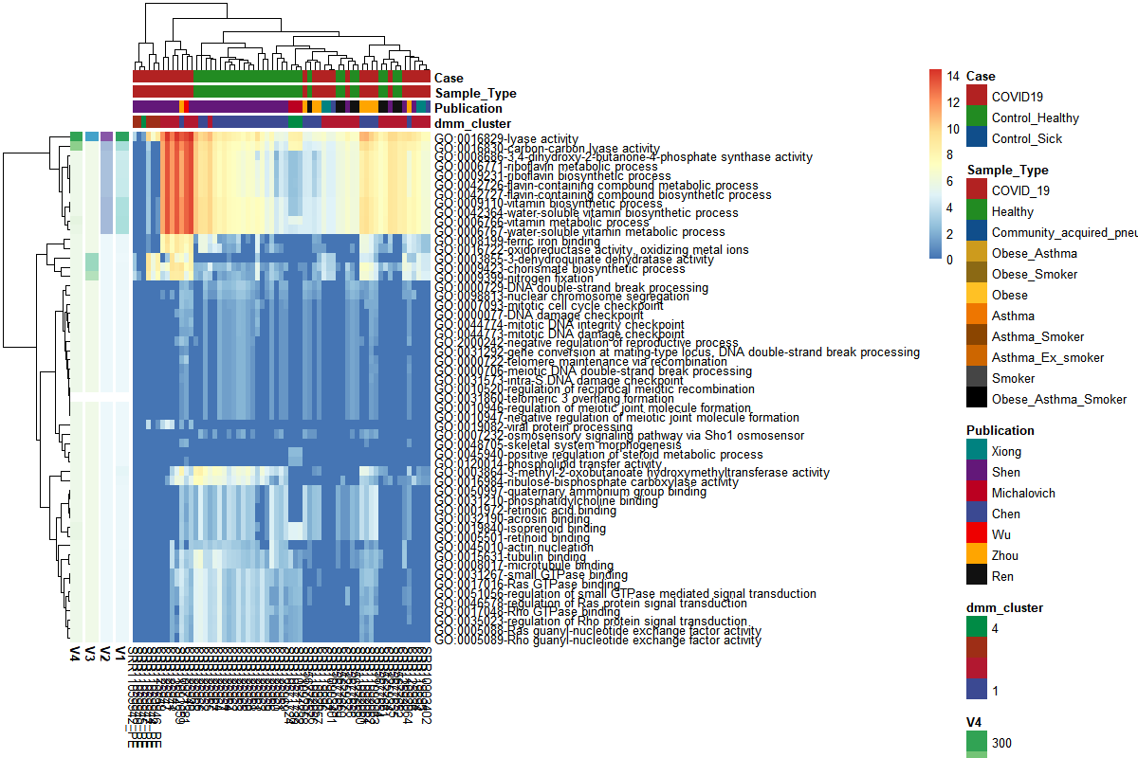
I tried running a model with only COVID19 vs Healthy (bc no Michalovich samples)

Slide 14
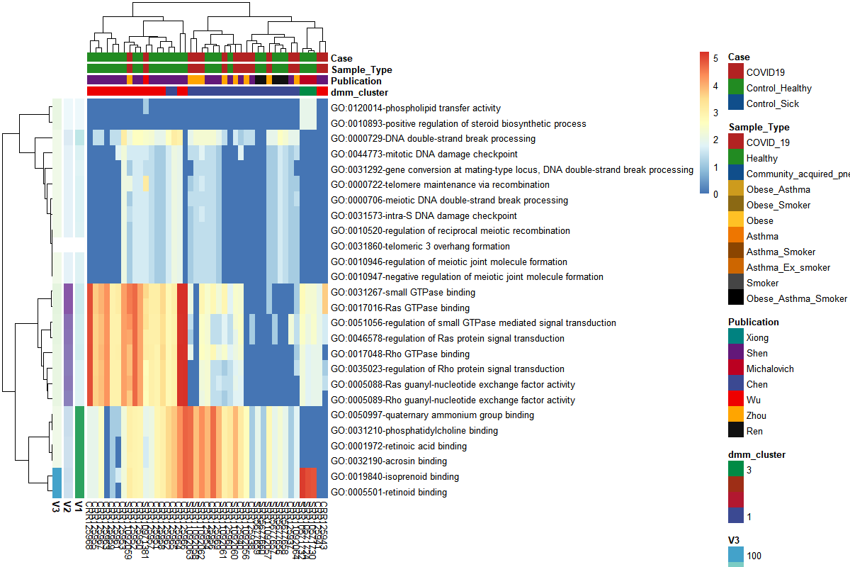
I did it again and I filtered less GO terms this time (only Kruskal-wallis significant)

Slide 15
Dmngroup modeling
 | k | samples | GO_Terms | NLE | LogDet | Laplace | BIC | AIC
Control_Healthy | 1 | 32 | 2077 | 53384.32 | -3058.99 | 49946.19 | 56983.48 | 55461.32
Control_Sick | 2 | 61 | 2077 | 101327 | -6709.36 | 94154.15 | 109867.4 | 105482
COVID19 | 2 | 33 | 2077 | 77762.51 | -1898.72 | 72994.96 | 85026.5 | 81917.51
Control_Healthy | Control_Sick | COVID19 | Control_Sick+COVID19
49946.19 | 94154.15 | 72994.96 | 217095.3
Single
203389.8
2 group class: DMNGroup summary:
k samples taxa NLE LogDet Laplace BIC AIC
Control_Healthy 1 32 2077 53384.32 -3058.9868 49946.19 56983.48 55461.32
COVID19 2 33 2077 77343.17 210.8834 73630.42 84607.16 81498.17

Slide 16
Dmngroup modeling
 | k | samples | GO_Terms | NLE | LogDet | Laplace | BIC | AIC
Control_Healthy | 1 | 32 | 2077 | 53384.32 | -3058.99 | 49946.19 | 56983.48 | 55461.32
Control_Sick | 2 | 61 | 2077 | 101327 | -6709.36 | 94154.15 | 109867.4 | 105482
COVID19 | 2 | 33 | 2077 | 77762.51 | -1898.72 | 72994.96 | 85026.5 | 81917.51
Control_Healthy | Control_Sick | COVID19 | Control_Sick+COVID19
49946.19 | 94154.15 | 72994.96 | 217095.3
Single
203389.8
2 group class: DMNGroup summary:
k samples taxa NLE LogDet Laplace BIC AIC
Control_Healthy 1 32 2077 53384.32 -3058.9868 49946.19 56983.48 55461.32
COVID19 2 33 2077 77343.17 210.8834 73630.42 84607.16 81498.17

