Slide 1
COVIRT-19 microbial subgroup analysis of BALF samples update
2 Sept 2020

Slide 2
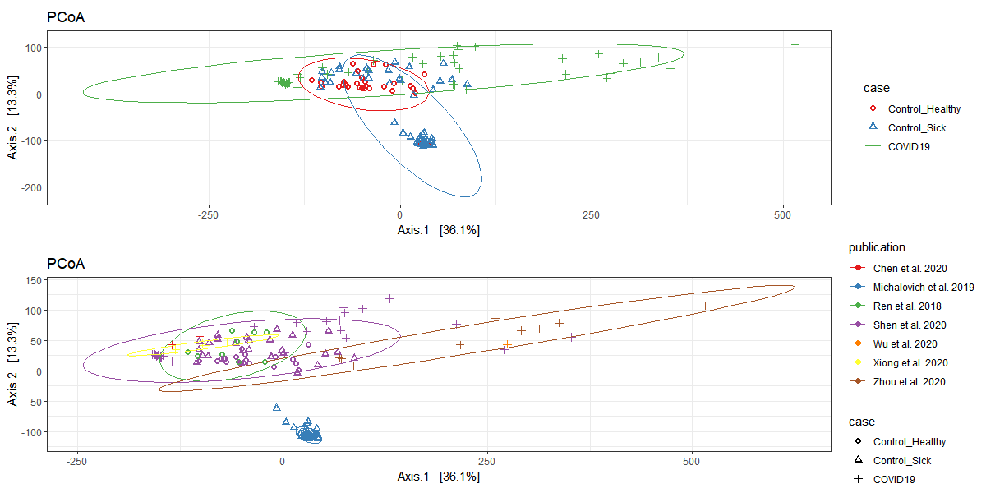
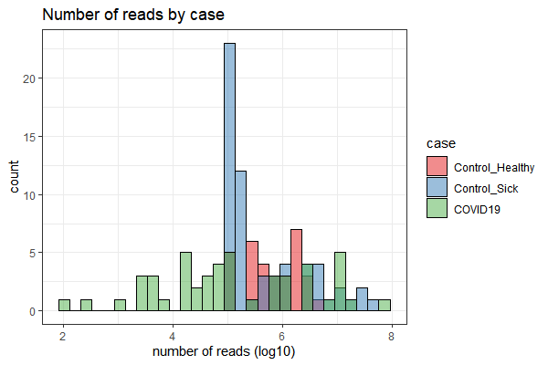
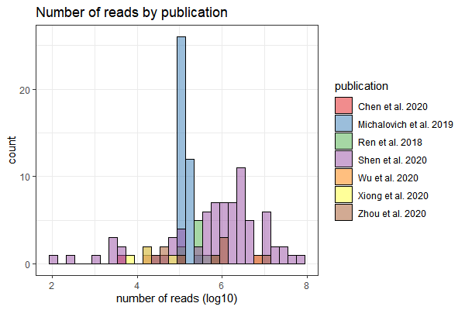
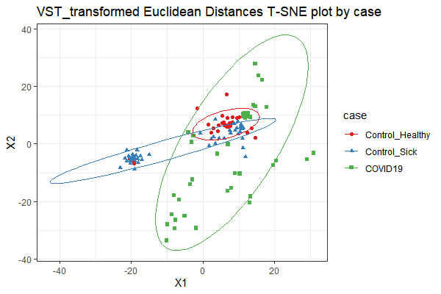
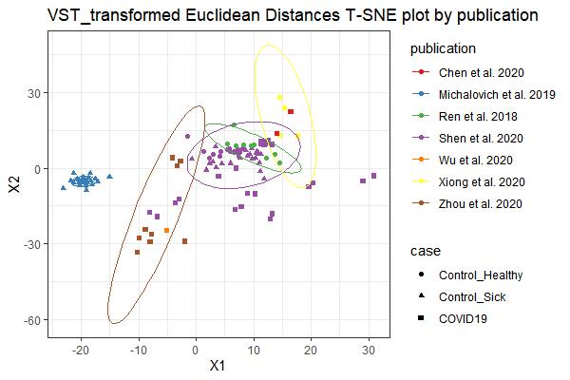

Slide 3
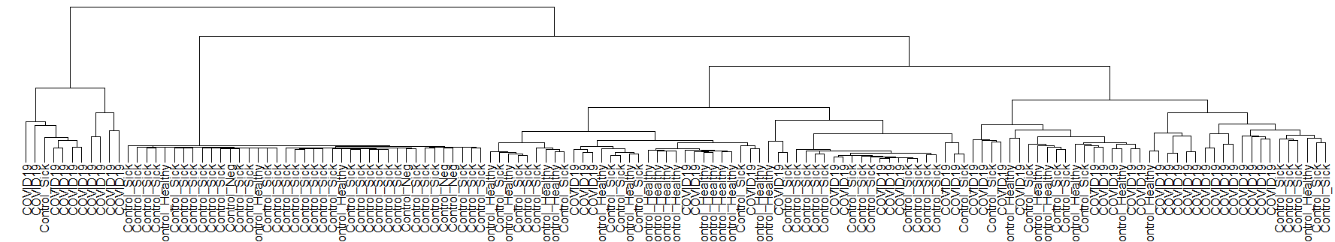
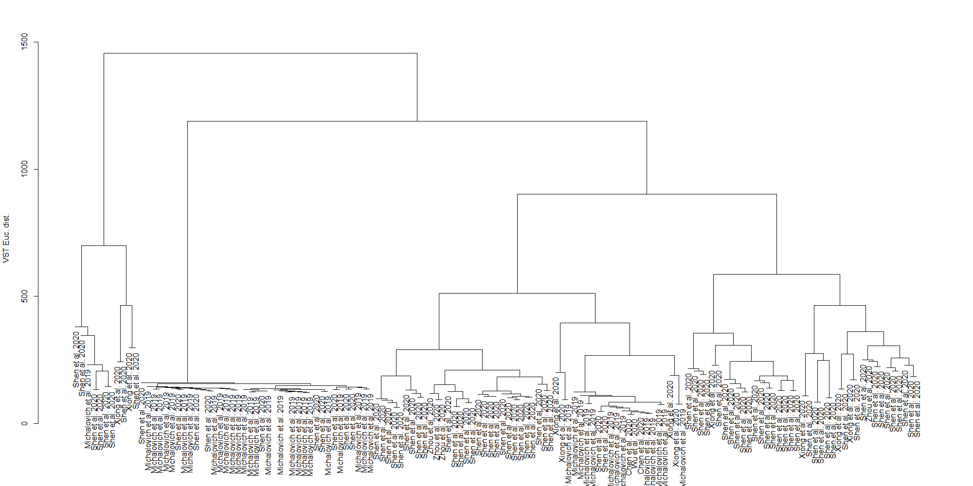

Slide 4
COVIRT-19 microbial subgroup analysis of BALF samples
1 Sept 2020

Slide 5
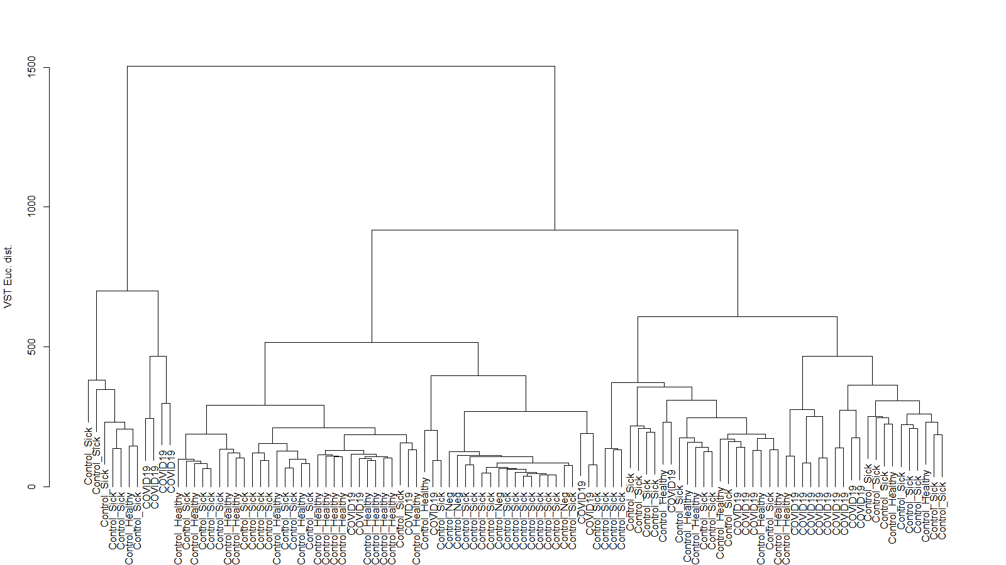
Dendrogram of Euclidean distances of VST transformed counts by case

Slide 6
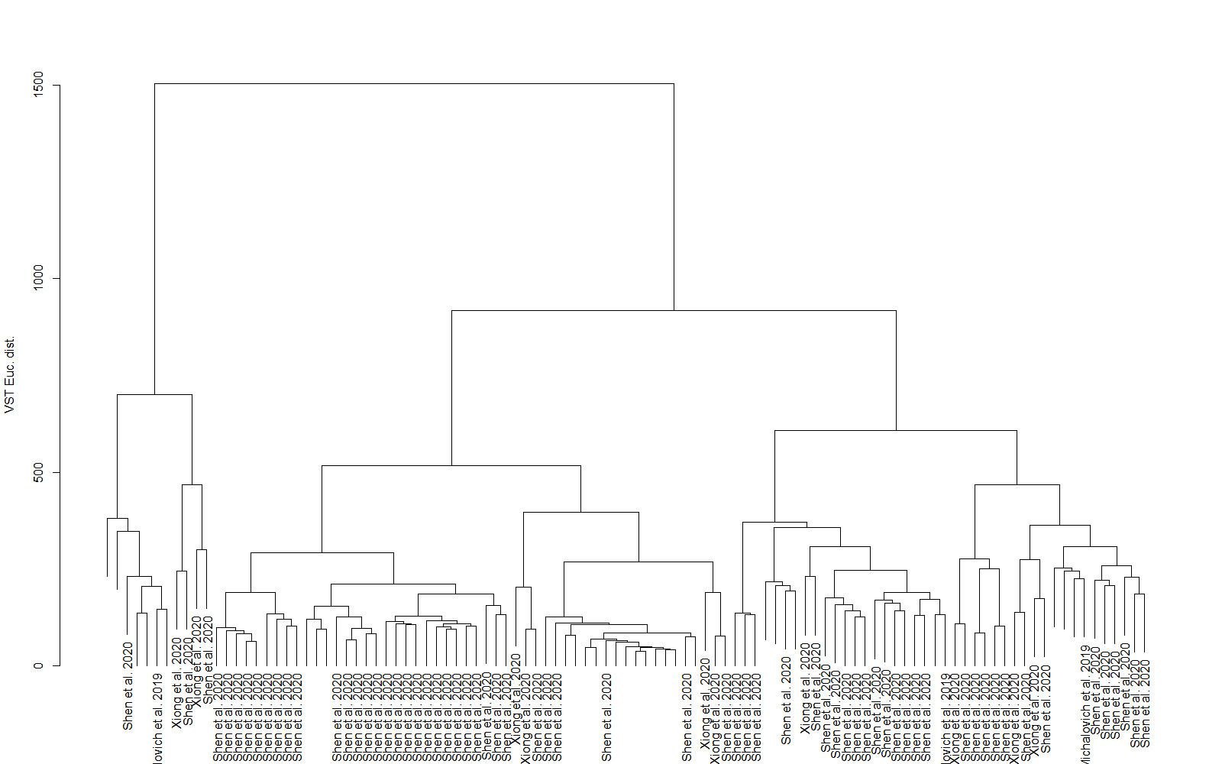
Dendrogram of Euclidean distances of VST transformed counts by publication

Slide 7
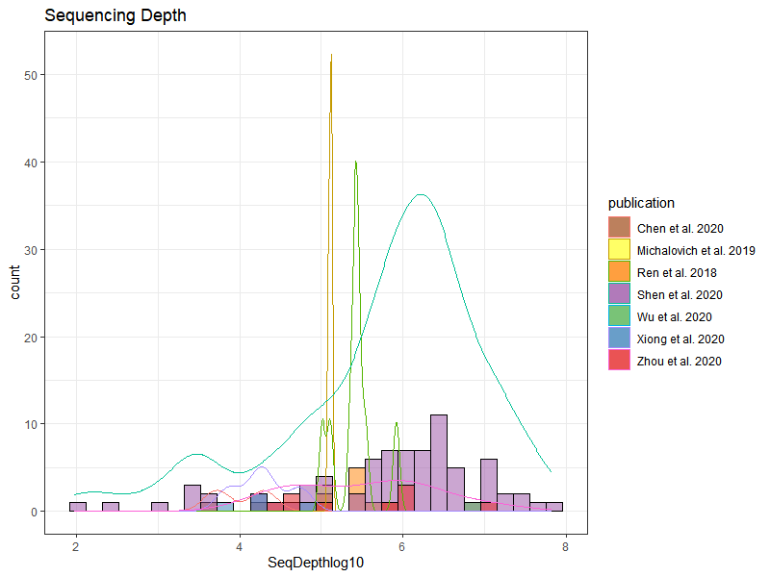
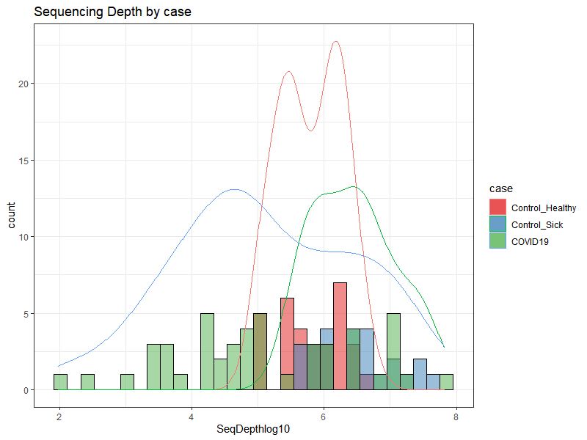
Preprocessing
Distributions of reads by publication post processing
Subset Taxa to only Bacteria
Subset Samples to only BALF tissue
Removed Huang et. al 2019 samples
large batch effect observed
status was “Control_unknown”
Pruned taxa with >0 reads counts

Slide 8
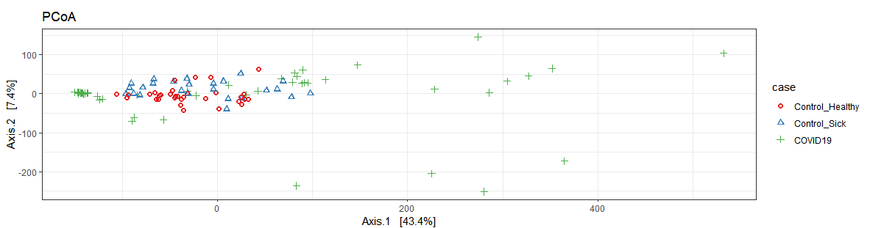
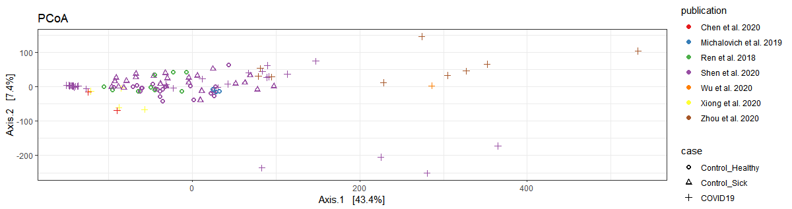
PCoA plots of Euclidean distances of VST transformed counts by case and publication

Slide 9
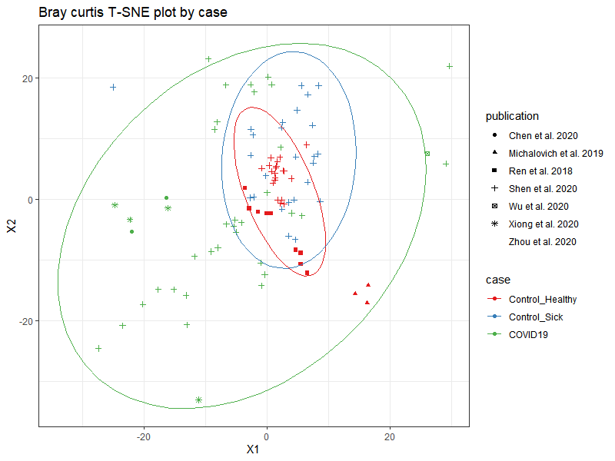
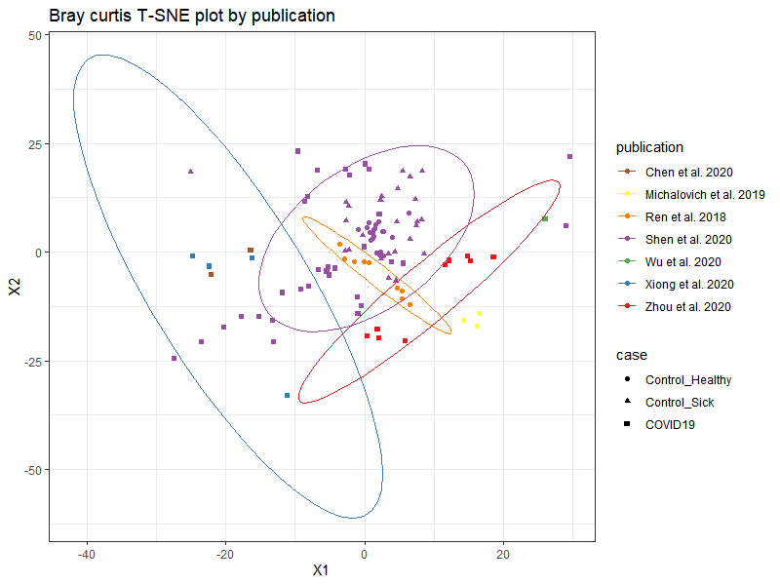
T-SNE plots of Bray Curtis dissimilarity of counts by case and publication

Slide 10
Within group betadisper Euclidean distance VST transformed counts by case
within_group_difs_anova<-anova(betadisper(euc_dist, meta(vst_physeq)$case)) # 0.002 > within_group_difs_anova
Analysis of Variance Table
Response: Distances
Df Sum Sq Mean Sq F value Pr(>F)
Groups 2 253724 126862 17.232 3.571e-07 ***
Residuals 102 750933 7362
---
Signif. codes: 0 ‘***’ 0.001 ‘**’ 0.01 ‘*’ 0.05 ‘.’ 0.1 ‘ ’ 1
within_group_difs_permutest
Permutation test for homogeneity of multivariate dispersions
Permutation: free
Number of permutations: 999
Response: Distances
Df Sum Sq Mean Sq F N.Perm Pr(>F)
Groups 2 253724 126862 17.232 999 0.001 ***
Residuals 102 750933 7362
---
Signif. codes: 0 ‘***’ 0.001 ‘**’ 0.01 ‘*’ 0.05 ‘.’ 0.1 ‘ ’ 1
TukeyHSD(betadisper(euc_dist, meta(vst_physeq)$case))
Tukey multiple comparisons of means
95% family-wise confidence level
Fit: aov(formula = distances ~ group, data = df)
$group
diff lwr upr p adj
Sick - Healthy 1.644249 -52.82854 56.11703 0.9971626
COVID19 - Healthy 99.391186 52.81794 145.96444 0.0000052
COVID19 - Control_Sick 97.746937 47.41334 148.08053 0.0000335

Slide 11
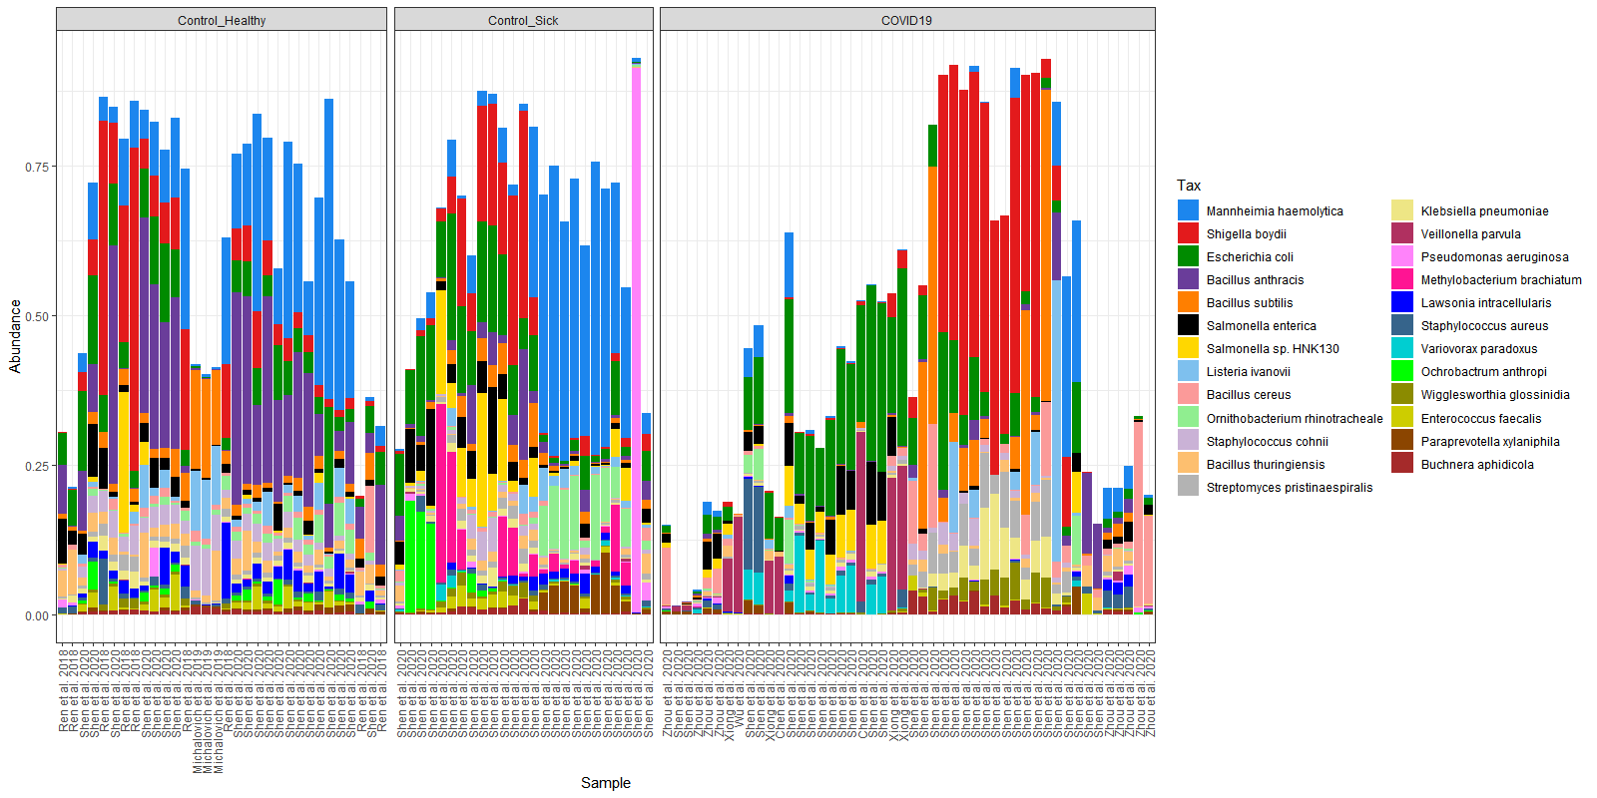
% Relative Abundance of Top25 Species
Low complexity region issue from bracken re-estimations

Slide 12
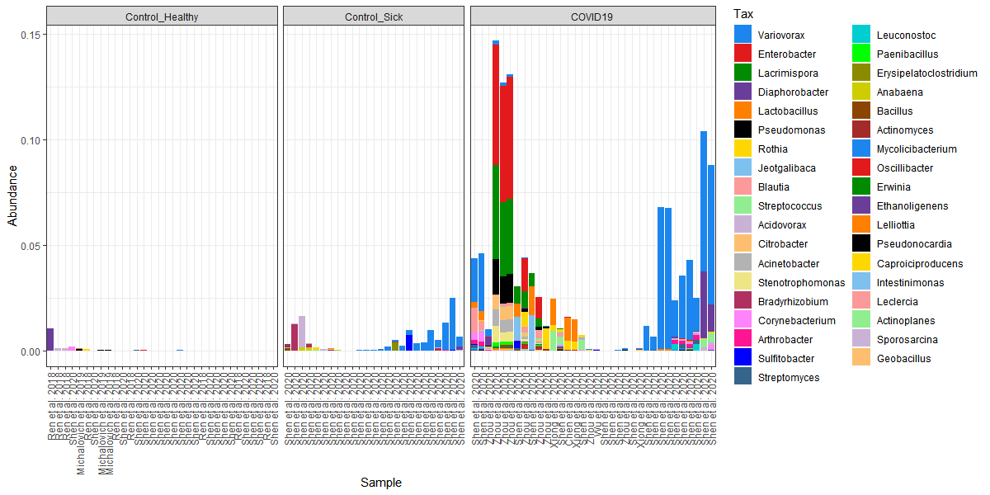
% Relative Abundance of DESeq2 Taxa

Slide 13
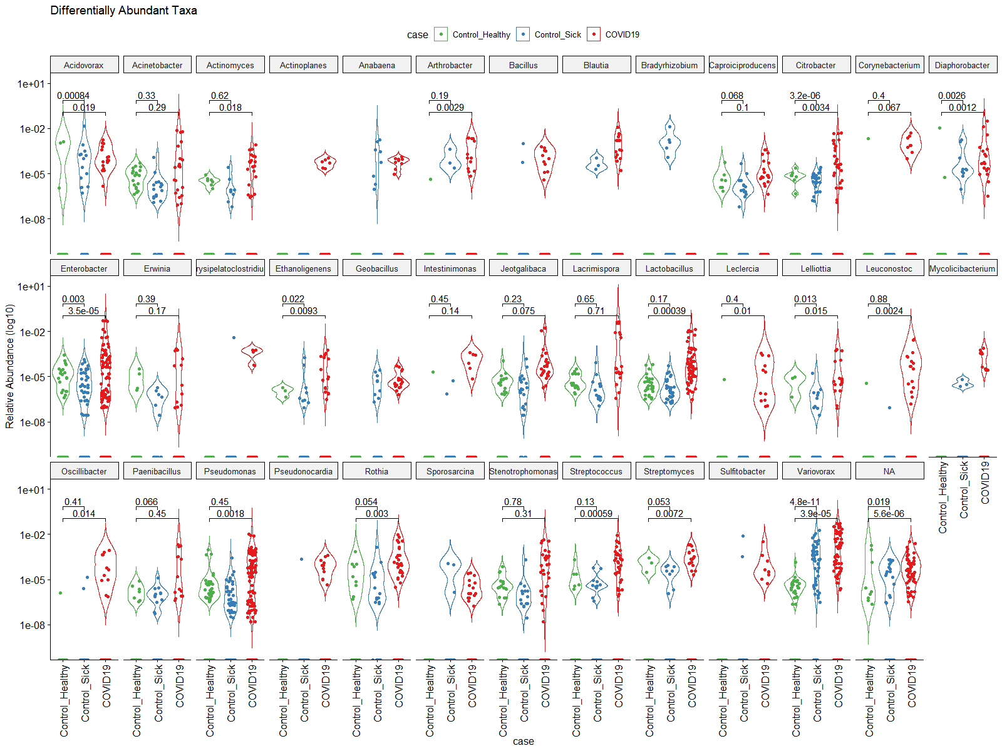
% Relative Abundance violin plot comparisons of DESeq2 Identified Genera
*p values obtained using wilcox test comparisons to Control_Healthy

Slide 14
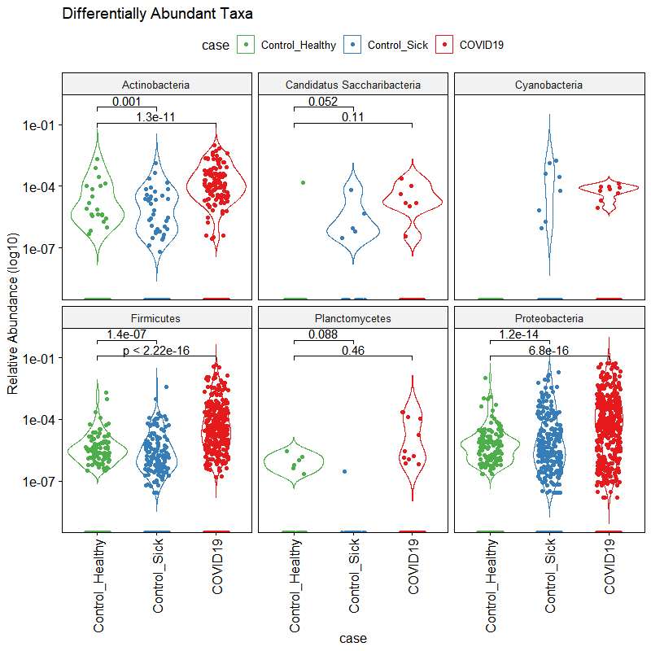
% Relative Abundance violin plot comparisons of DESeq2 Identified Phyla

Slide 15
CRR125950 confidence interval analysis
CRR125950
15 Sept 2020
Objective: determine if filtering out the low complexity regions from the dataset prior to Kraken2 fixed the issue with Bracken incorrectly over estimations of false taxa

Slide 16
Issue: there are homopolymers (26nt AAAAAA) reads that passed filtering, and being classified as Firmicutes by Kraken2, followed by Bracken re-estimation into Bacillus anthracis
Objective: Determine if filtering out the low complexity regions from the dataset prior to Kraken2 fixed the issue with Bracken incorrectly over estimations of false taxa
Secondary Objective: Identify the effects of utilizing varying confidence interval stringencies in the Kraken2 classification step.

Slide 17
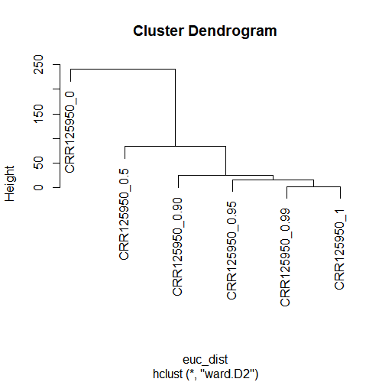
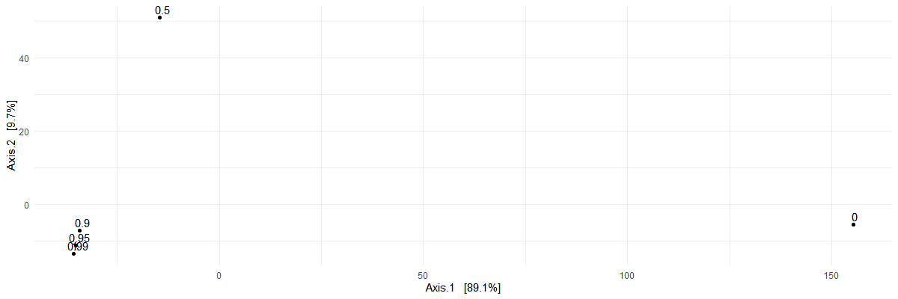

Slide 18
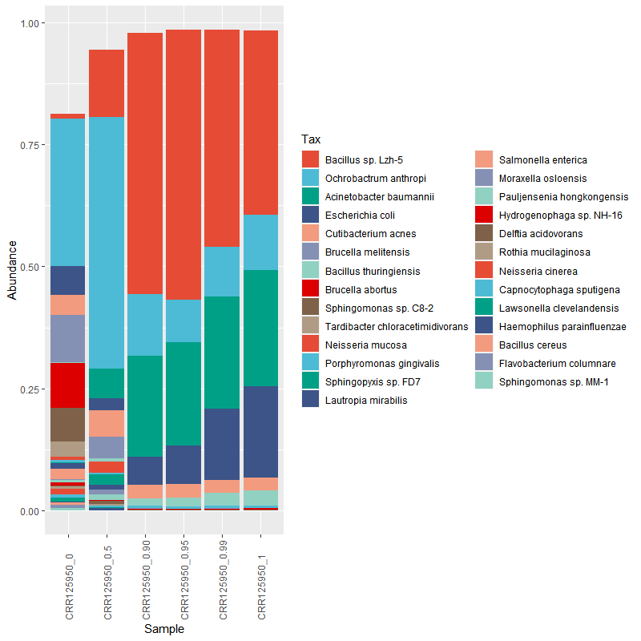
#make the phyloseq object
CRR125950<-phyloseq(otu,tax,sam)
#get rid of eukaryotic, and archeal, and viral hits
CRR125950<-subset_taxa(physeq = CRR125950, domain=="Bacteria")
#transfrom into a relative abundance
CRR125950_rel<-microbiome::transform(CRR125950, "compositional")
#subset the core mriobiota >0.5% prevalence and 0.5% detection
CRR125950_core<-core(x = CRR125950_rel, detection = 0.5/100, prevalence = 0.5/100)
#make the names the species
tax_glom(CRR125950_core,taxrank = "species", NArm = T )
taxa_names(CRR125950_core)<-get_taxa_unique(physeq = CRR125950_core, taxonomic.rank = "species")
#plot it up by confidence
plot_composition(x = CRR125950_core, sample.sort = 'confidence', otu.sort = "abundance",verbose = T)+
scale_fill_manual(values=rep( pal_npg("nrc", alpha = 1)(10),times=4))

