Slide 1
BP1 = GO:0044419 – Biological process involved in interspecies interaction between organisms Definition: Any process evolved to enable an interaction with an organism of a different species.

Slide 2
Terminal Term in Results? | GO Term Number | GO Term Name | Ontology | Depth | COVID vs. Other | COVID Survived vs. Deceased P-Value
No | GO:0044419 | Biological process involved in interspecies interaction between organisms | Biological Process | 1 | Yes | None
No | GO:0035821 | Modulation of process of other organism | Biological Process | 2 | Yes | None
No | GO:0044403 | Biological process involved in symbiotic interaction | Biological Process | 2 | Yes | None
No | GO:0051701 | Biological process involved in interaction with host | Biological Process | 3 | Yes | None
No | GO:0051817 | Modulation of process of other organism involved in symbiotic interaction | Biological Process | 3 | Yes | None
No | GO:0016032 | Viral process | Biological Process | 3 | Yes | None
No | GO:0044003 | Modulation by symbiont of host process | Biological Process | 4 | Yes | None
No | GO:0044068 | Modulation by symbiont of host cellular process | Biological Process | 5 | Yes | None
No | GO:0019048 | Modulation by virus of host process | Biological Process | 5 | Yes | None
Yes | GO:0019054 | Modulation by virus of host cellular process | Biological Process | 6 | Yes | None

Slide 3
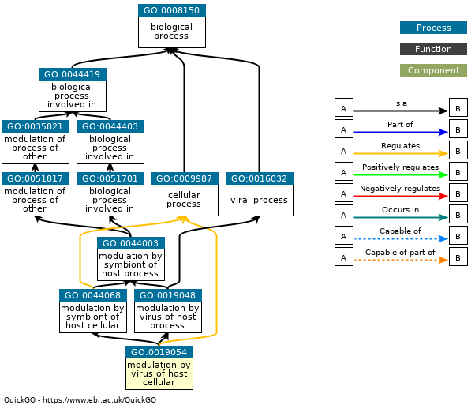
BP1 = GO:0044419 - Biological process involved in interspecies interaction between organisms
BP6 = GO:0019054 - Modulation by virus of host cellular process
Definition: The process in which a virus effects a change in the processes and activities of its host organism.

Slide 4
MF1 = GO:0005215 - Transporter activity Definition: Enables the directed movement of substances (such as macromolecules, small molecules, ions) into, out of or within a cell, or between cells.

Slide 5
Terminal Term in Results? | GO Term Number | GO Term Name | Ontology | Depth | COVID vs. Other | COVID Survived vs. Deceased P-Value
No | GO:0005215 | Transporter activity | Molecular Function | 1 | No | 0.021
Yes | GO:0022857 | Transmembrane transporter activity | Molecular Function | 2 | No | 0.021

Slide 6
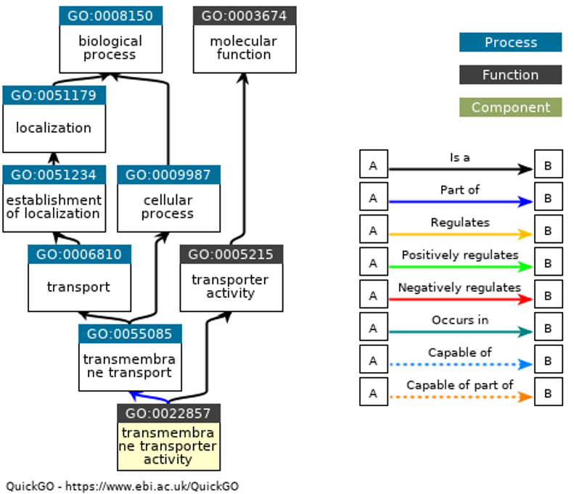
MF1 = GO:0005215 - Transporter activity
MF2 = GO:0022857 - Transmembrane transporter activity
Definition: Enables the transfer of a substance, usually a specific substance or a group of related substances, from one side of a membrane to the other.

Slide 7
BP1 = GO:0051179 - Localization Definition: Any process in which a cell, a substance, or a cellular entity, such as a protein complex or organelle, is transported, tethered to or otherwise maintained in a specific location. In the case of substances, localization may also be achieved via selective degradation.

Slide 8
Terminal Term in Results? | GO Term Number | GO Term Name | Ontology | Depth | COVID vs. Other | COVID Survived vs. Deceased P-Value
No | GO:0051179 | Localization | Biological Process | 1 | No | 0.006
No | GO:0051234 | Establishment of Localization | Biological Process | 2 | No | 0.006
No | GO:0006810 | Transport | Biological Process | 3 | No | 0.006
No | GO:0006811 | Ion Transport | Biological Process | 4 | No | 0.034
Yes | GO:0071705 | Nitrogen Compound Transport | Biological Process | 4 | No | 0.006
Yes | GO:0055085 | Transmembrane Transport | Biological Process | 4 | No | 0.011
Yes | GO:0071702 | Organic Substance Transport | Biological Process | 6 | No | 0.030

Slide 9
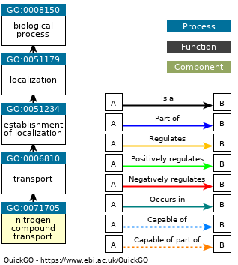
BP1 = GO:0051179 - Localization
BP4 = GO:0071705 - Nitrogen compound transport
Definition: The directed movement of nitrogen-containing compounds into, out of or within a cell, or between cells, by means of some agent such as a transporter or pore.

Slide 10
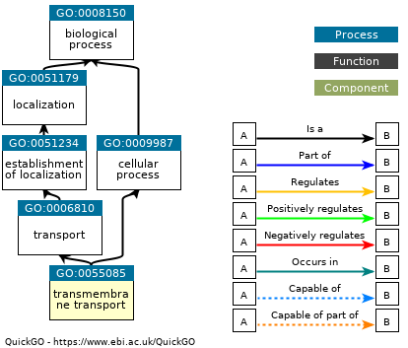
BP1 = GO:0051179 - Localization
BP4 = GO:0055085 – Transmembrane transport
Definition: The process in which a solute is transported across a lipid bilayer, from one side of a membrane to the other.

Slide 11

BP1 = GO:0051179 - Localization
BP6 = GO:0071702 - Organic substance transport
Definition: The directed movement of organic substances into, out of or within a cell, or between cells, or within a multicellular organism by means of some agent such as a transporter or pore. An organic substance is a molecular entity that contains carbon.

Slide 12
BP1 = GO:0008152 - Metabolic process Definition: The chemical reactions and pathways, including anabolism and catabolism, by which living organisms transform chemical substances. Metabolic processes typically transform small molecules, but also include macromolecular processes such as DNA repair and replication, and protein synthesis and degradation.

Slide 13
Terminal Term in Results? | GO Term Number | GO Term Name | Ontology | Depth | COVID vs. Other | COVID Survived vs. Deceased P-Value
No | GO:0008152 | Metabolic process | Biological Process | 1 | Yes | None
No | GO:0009058 | Biosynthetic process | Biological Process | 2 | Yes | None
No | GO:0044237 | Cellular metabolic process | Biological Process | 2 | Yes | None
No | GO:0006807 | Nitrogen compound metabolic process | Biological Process | 2 | Yes | None
No | GO:0071704 | Organic substance metabolic process | Biological Process | 2 | Yes | None
No | GO:0055114 | Oxidation-reduction process | Biological Process | 2 | No | 0.004
No | GO:0044238 | Primary metabolic process | Biological Process | 2 | Yes | None
No | GO:0005975 | Carbohydrate metabolic process | Biological Process | 3 | No | 0.002
No | GO:0044249 | Cellular biosynthetic process | Biological Process | 3 | Yes | None
No | GO:0034641 | Cellular nitrogen compound metabolic process | Biological Process | 3 | Yes | None
No | GO:0046483 | Heterocycle metabolic process | Biological Process | 3 | Yes | None
No | GO:0043170 | Macromolecule metabolic process | Biological Process | 3 | Yes | None
No | GO:1901360 | Organic cyclic compound metabolic process | Biological Process | 3 | Yes | None
No | GO:1901576 | Organic substance biosynthetic process | Biological Process | 3 | Yes | None

Slide 14
Terminal Term in Results? | GO Term Number | GO Term Name | Ontology | Depth | COVID vs. Other | COVID Survived vs. Deceased P-Value
No | GO:1901564 | Organonitrogen compound metabolic process | Biological Process | 3 | Yes | None
No | GO:0019438 | Aromatic compound biosynthetic process | Biological Process | 4 | No | 0.000
No | GO:0016051 | Carbohydrate biosynthetic process | Biological Process | 4 | No | 0.019
No | GO:0044262 | Cellular carbohydrate metabolic process | Biological Process | 4 | No | 0.010
No | GO:0044260 | Cellular macromolecule metabolic process | Biological Process | 4 | Yes | None
No | GO:0018130 | Heterocycle biosynthetic process | Biological Process | 4 | No | 0.000
No | GO:0009059 | Macromolecule biosynthetic process | Biological Process | 4 | No | 0.000
No | GO:1901565 | Organonitrogen compound catabolic process | Biological Process | 4 | No | 0.001
No | GO:0005976 | Polysaccharide metabolic process | Biological Process | 4 | No | 0.009
No | GO:0072527 | Pyrimidine-containing compound metabolic process | Biological Process | 4 | No | 0.000
No | GO:0034637 | Cellular carbohydrate biosynthetic process | Biological Process | 5 | No | 0.025
No | GO:0044264 | Cellular polysaccharide metabolic process | Biological Process | 5 | No | 0.013
No | GO:0016310 | Phosphorylation | Biological Process | 5 | No | 0.001
No | GO:0000271 | Polysaccharide biosynthetic process | Biological Process | 5 | No | 0.023

Slide 15
Terminal Term in Results? | GO Term Number | GO Term Name | Ontology | Depth | COVID vs. Other | COVID Survived vs. Deceased P-Value
No | GO:0033692 | Cellular polysaccharide biosynthetic process | Biological Process | 6 | No | 0.029
No | GO:0046379 | Extracellular polysaccharide metabolic process | Biological Process | 6 | No | 0.028
No | GO:0006753 | Nucleoside phosphate metabolic process | Biological Process | 6 | No | 0.008
No | GO:0016070 | RNA metabolic process | Biological Process | 6 | No | 0.000
No | GO:0090501 | RNA phosphodiester bond hydrolysis | Biological Process | 7 | No | 0.000
Yes | GO:0043412 | Macromolecule modification | Biological Process | 4 | No | 0.003
Yes | GO:0016053 | Organic acid biosynthetic process | Biological Process | 4 | No | 0.046
Yes | GO:0019538 | Protein metabolic process | Biological Process | 4 | No | 0.039
Yes | GO:0034654 | Nucleobase-containing compound biosynthetic process | Biological Process | 5 | No | 0.000
Yes | GO:0072528 | Pyrimidine-containing compound biosynthetic process | Biological Process | 5 | No | 0.001
Yes | GO:0046835 | Carbohydrate phosphorylation | Biological Process | 6 | No | 0.036
Yes | GO:0006520 | Cellular amino acid metabolic process | Biological Process | 6 | No | 0.028
Yes | GO:0006310 | DNA recombination | Biological Process | 7 | No | 0.001

Slide 16
Terminal Term in Results? | GO Term Number | GO Term Name | Ontology | Depth | COVID vs. Other | COVID Survived vs. Deceased P-Value
Yes | GO:0045226 | Extracellular polysaccharide biosynthetic process | Biological Process | 7 | No | 0.028
Yes | GO:0009117 | Nucleotide metabolic process | Biological Process | 7 | No | 0.007
Yes | GO:0090503 | RNA phosphodiester bond hydrolysis exonucleolytic | Biological Process | 8 | No | 0.019

Slide 17
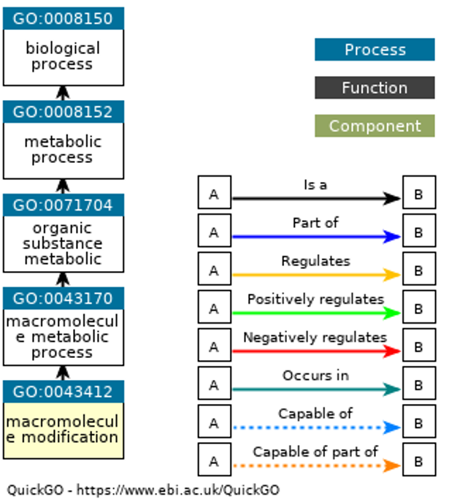
BP1 = GO:0008152 - Metabolic process
BP4 = GO:0043412 - Macromolecule modification
Definition: The covalent alteration of one or more monomeric units in a polypeptide, polynucleotide, polysaccharide, or other biological macromolecule, resulting in a change in its properties.

Slide 18
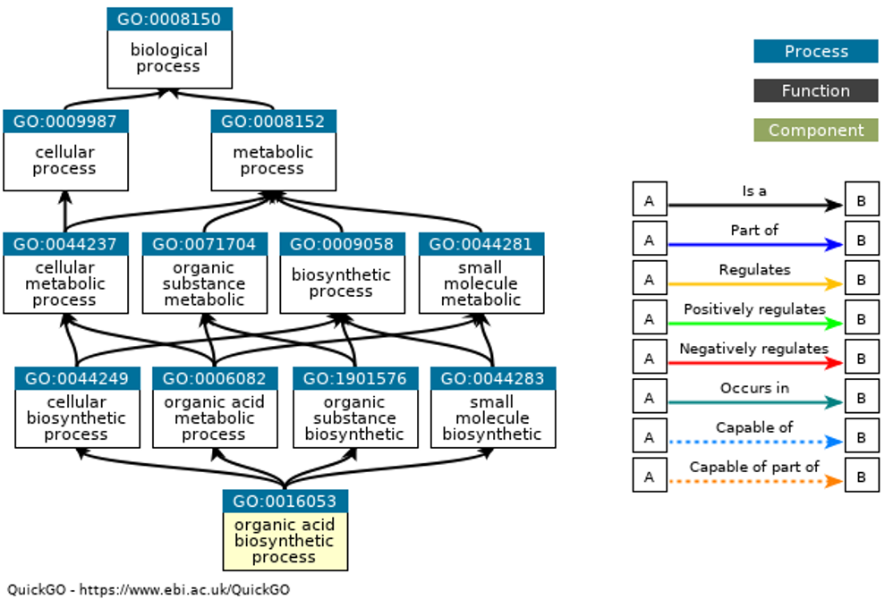
BP1 = GO:0008152 - Metabolic process
BP4 = GO:0016053 - Organic acid biosynthetic process
Definition: The chemical reactions and pathways resulting in the formation of organic acids, any acidic compound containing carbon in covalent linkage.

Slide 19
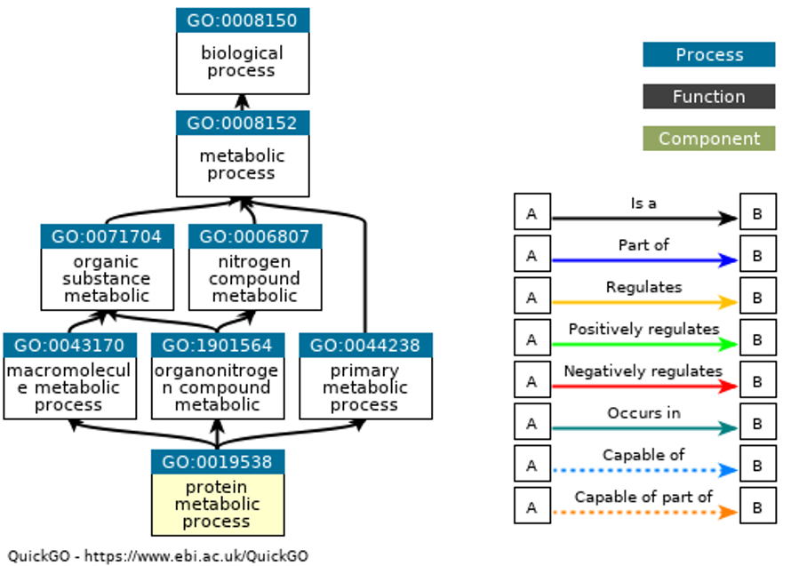
BP1 = GO:0008152 - Metabolic process
BP4 = GO:0019538 - Protein metabolic process
Definition: The chemical reactions and pathways involving a protein. Includes protein modification.

Slide 20
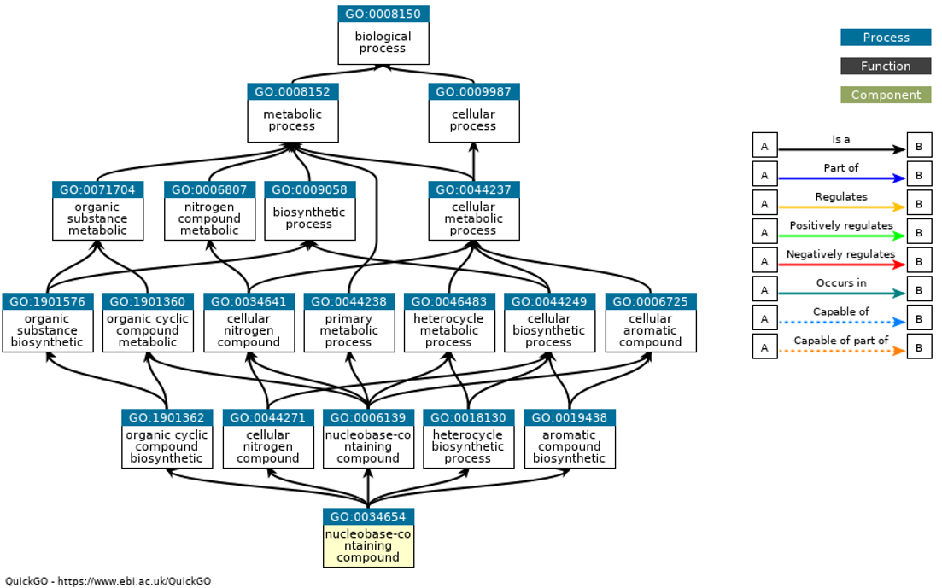
BP1 = GO:0008152 - Metabolic process
BP5 = GO:0034654 - Nucleobase-containing compound biosynthetic process
Definition: The chemical reactions and pathways resulting in the formation of nucleobases, nucleosides, nucleotides and nucleic acids.

Slide 21
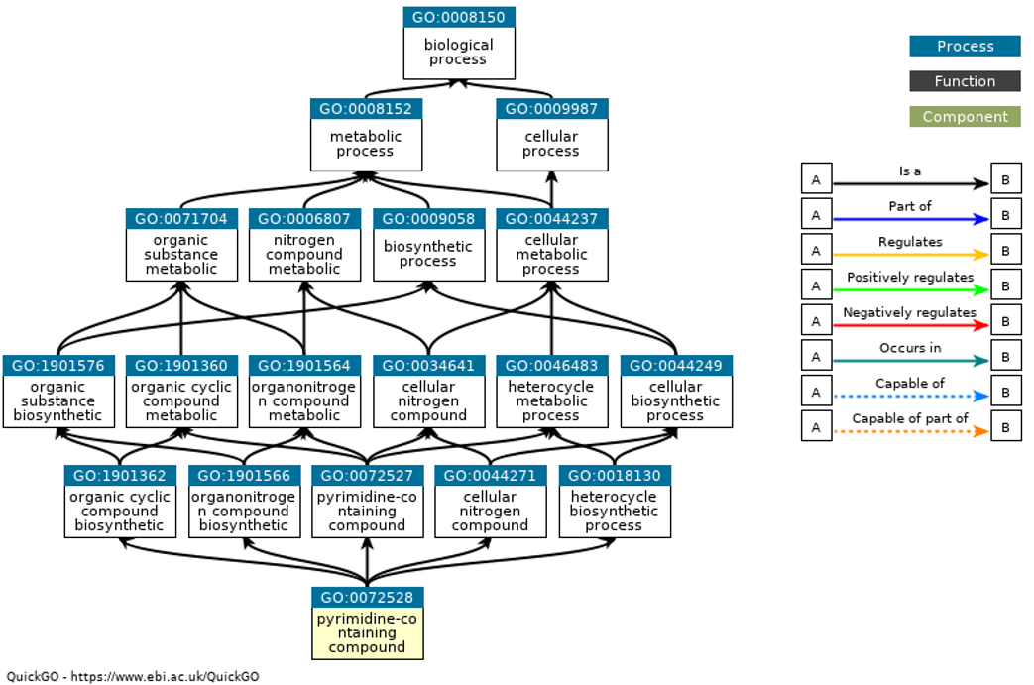
BP1 = GO:0008152 - Metabolic process
BP5 = GO:0072528 - Pyrimidine-containing compound biosynthetic process
Definition: The chemical reactions and pathways resulting in the formation of a pyrimidine-containing compound, i.e. any compound that contains pyrimidine or a formal derivative thereof.

Slide 22
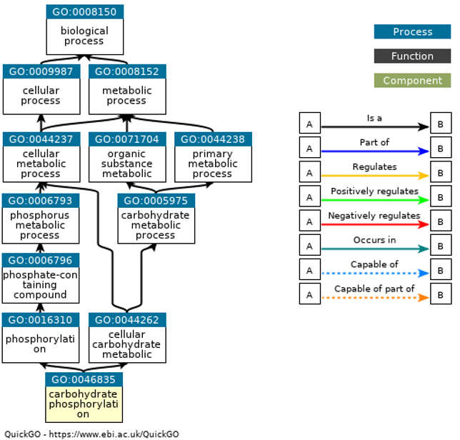
BP1 = GO:0008152 - Metabolic process
BP6 = GO:0046835 - Carbohydrate phosphorylation
Definition: The process of introducing a phosphate group into a carbohydrate, any organic compound based on the general formula Cx(H2O)y.

Slide 23
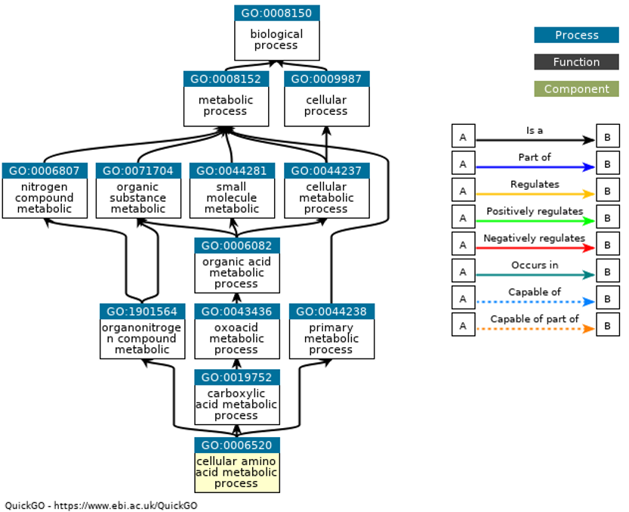
BP1 = GO:0008152 - Metabolic process
BP6 = GO:0006520 - Cellular amino acid metabolic process
Definition: The chemical reactions and pathways involving amino acids, carboxylic acids containing one or more amino groups, as carried out by individual cells.

Slide 24
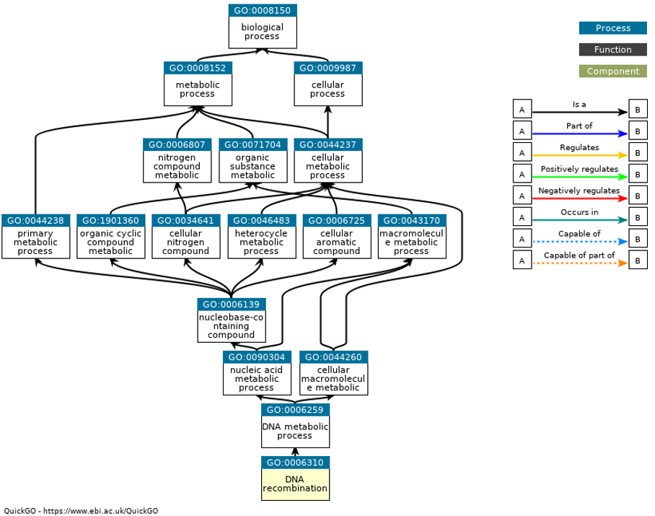
BP1 = GO:0008152 - Metabolic process
BP7 = GO:0006310 - DNA recombination
Definition: Any process in which a new genotype is formed by reassortment of genes resulting in gene combinations different from those that were present in the parents. In eukaryotes genetic recombination can occur by chromosome assortment, intrachromosomal recombination, or nonreciprocal interchromosomal recombination. Interchromosomal recombination occurs by crossing over. In bacteria it may occur by genetic transformation, conjugation, transduction, or F-duction.

Slide 25
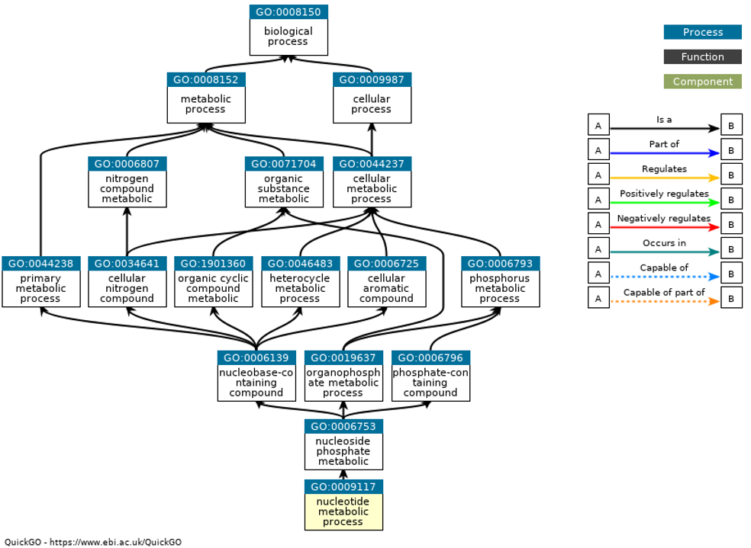
BP1 = GO:0008152- Metabolic process
BP7 = GO:0009117 - Nucleotide metabolic process
Definition: The chemical reactions and pathways involving a nucleotide, a nucleoside that is esterified with (ortho)phosphate or an oligophosphate at any hydroxyl group on the glycose moiety; may be mono-, di- or triphosphate; this definition includes cyclic nucleotides (nucleoside cyclic phosphates).

Slide 26
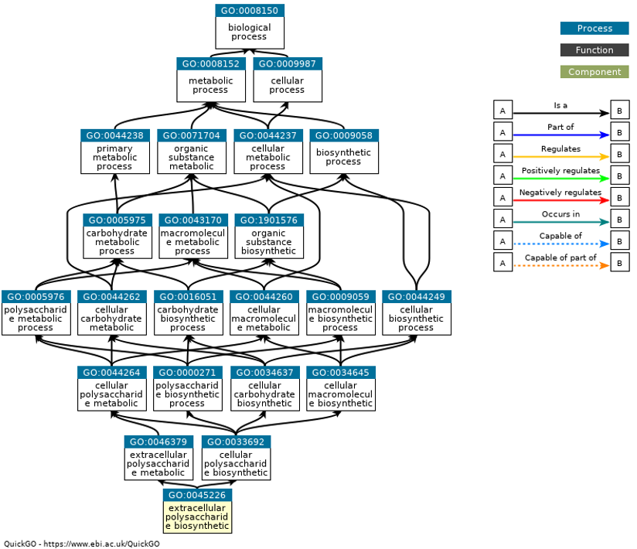
BP1 = GO:0008152 - Metabolic process
BP7 = GO:0045226 - Extracellular polysaccharide biosynthetic process
Definition: The chemical reactions and pathways resulting in the formation of polysaccharides used in extracellular structures.

Slide 27
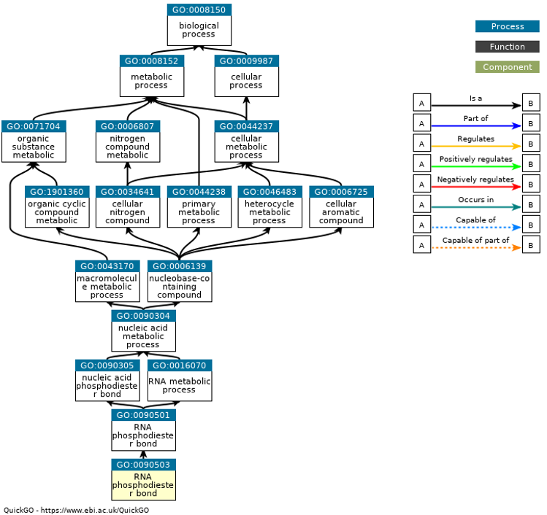
BP1 = GO:0008152 - Metabolic process
BP8 = GO:0090503 - RNA phosphodiester bond hydrolysis exonucleolytic

Slide 28
BP1 = GO:0009987 - Cellular process Definition: Any process that is carried out at the cellular level, but not necessarily restricted to a single cell. For example, cell communication occurs among more than one cell, but occurs at the cellular level.

Slide 29
Terminal Term in Results? | GO Term Number | GO Term Name | Ontology | Depth | COVID vs. Other | COVID Survived vs. Deceased P-Value
No | GO:0009987 | Cellular process | Biological Process | 1 | Yes | None
No | GO:0071840 | Cellular component organization or biogenesis | Biological Process | 2 | No | 0.004
Yes | GO:0016043 | Cellular component organization | Biological Process | 3 | No | 0.021

Slide 30
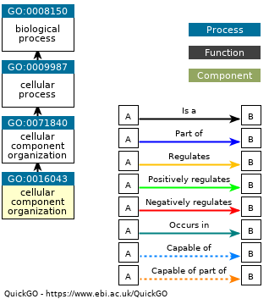
BP1 = GO:0009987 - Cellular process
BP3 = GO:0016043 - Cellular component organization

Slide 31
MF1 = GO:0003824 – Catalytic activity Definition: Catalysis of a biochemical reaction at physiological temperatures. In biologically catalyzed reactions, the reactants are known as substrates, and the catalysts are naturally occurring macromolecular substances known as enzymes. Enzymes possess specific binding sites for substrates, and are usually composed wholly or largely of protein, but RNA that has catalytic activity (ribozyme) is often also regarded as enzymatic.

Slide 32
Terminal Term in Results? | GO Term Number | GO Term Name | Ontology | Depth | COVID vs. Other | COVID Survived vs. Deceased P-Value
No | GO:0003824 | Catalytic activity | Molecular Function | 1 | Yes | None
No | GO:0140098 | Catalytic activity acting on RNA | Molecular Function | 2 | No | 0.002
No | GO:0016787 | Hydrolase activity | Molecular Function | 2 | Yes | None
No | GO:0016740 | Transferase activity | Molecular Function | 2 | Yes | None
No | GO:0016817 | Hydrolase activity acting on acid anhydrides | Molecular Function | 3 | No | 0.003
No | GO:0016772 | Transferase activity transferring phosphorus containing groups | Molecular Function | 3 | Yes | None
No | GO:0016779 | Nucleotidyltransferase activity | Molecular Function | 4 | Yes | None
No | GO:0016462 | Pyrophosphatase activity | Molecular Function | 5 | No | 0.002

Slide 33
Terminal Term in Results? | GO Term Number | GO Term Name | Ontology | Depth | COVID vs. Other | COVID Survived vs. Deceased P-Value
Yes | GO:0016853 | Isomerase activity | Molecular Function | 2 | No | 0.020
Yes | GO:0016491 | Oxidoreductase activity | Molecular Function | 2 | No | 0.002
Yes | GO:0004175 | Endopeptidase activity | Molecular Function | 4 | No | 0.001
Yes | GO:0016773 | Phosphotransferase activity alcohol group as acceptor | Molecular Function | 4 | No | 0.010
Yes | GO:0019200 | Carbohydrate kinase activity | Molecular Function | 5 | No | 0.035
Yes | GO:0008879 | Glucose-1-phosphate thymidylyltransferase activity | Molecular Function | 5 | No | 0.027
Yes | GO:0004540 | Ribonuclease activity | Molecular Function | 5 | No | 0.017
Yes | GO:0017111 | Nucleoside-triphosphatase activity | Molecular Function | 6 | No | 0.009
Yes | GO:0004747 | Ribokinase activity | Molecular Function | 6 | No | 0.036

Slide 34
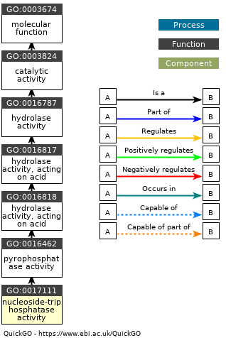
MF1 = GO:0003824 - Catalytic activity
MF6 = GO:0017111 - Nucleoside-triphosphatase activity
Definition: Catalysis of the reaction: a nucleoside triphosphate + H2O = nucleoside diphosphate + phosphate.

Slide 35
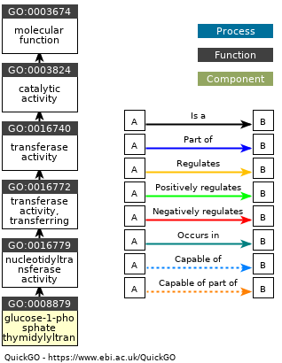
MF1 = GO:0003824 - Catalytic activity
MF5 = GO:0008879 - Glucose-1-phosphate thymidylyltransferase activity
Definition: Catalysis of the reaction: alpha-D-glucose 1-phosphate + dTTP = diphosphate + dTDP-glucose.

Slide 36
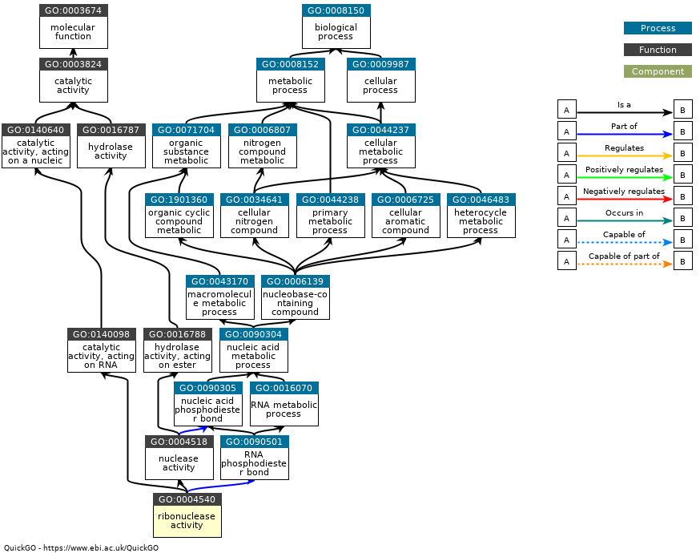
MF1 = GO:0003824 - Catalytic activity
MF5 = GO:0004540 - Ribonuclease activity
Definition: Catalysis of the hydrolysis of phosphodiester bonds in chains of RNA.

Slide 37
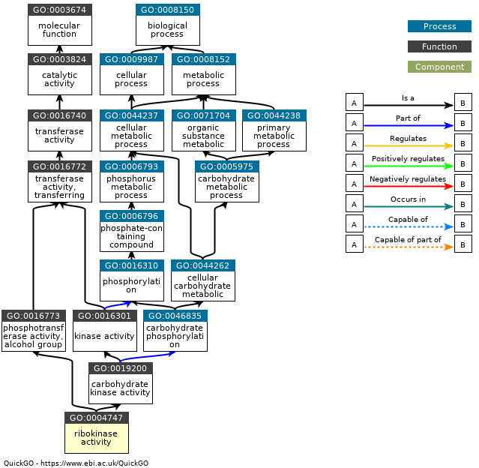
MF1 = GO:0003824 - Catalytic activity
MF6 = GO:0004747 - Ribokinase activity
Definition: Catalysis of the reaction: ATP + D-ribose = ADP + D-ribose 5-phosphate.

Slide 38
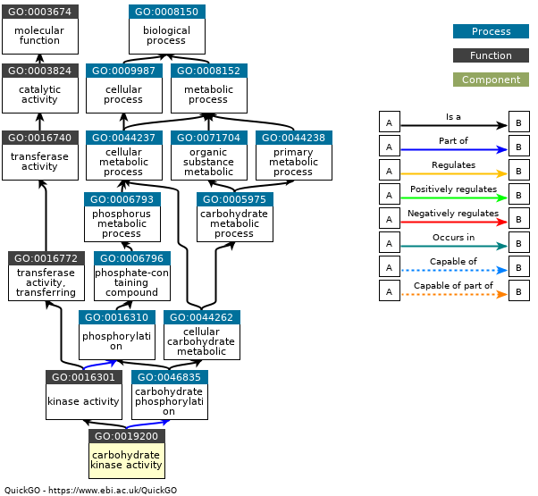
MF1 = GO:0003824 - Catalytic activity
MF5 = GO:0019200 - Carbohydrate kinase activity
Definition: Catalysis of the transfer of a phosphate group, usually from ATP, to a carbohydrate substrate molecule

Slide 39
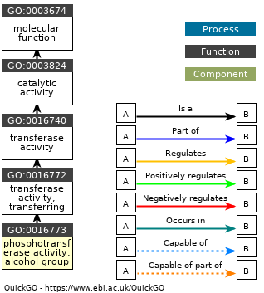
MF1 = GO:0003824 - Catalytic activity
MF4 = GO:0016773 - Phosphotransferase activity alcohol group as acceptor
Definition: Catalysis of the transfer of a phosphorus-containing group from one compound (donor) to an alcohol group (acceptor).

Slide 40
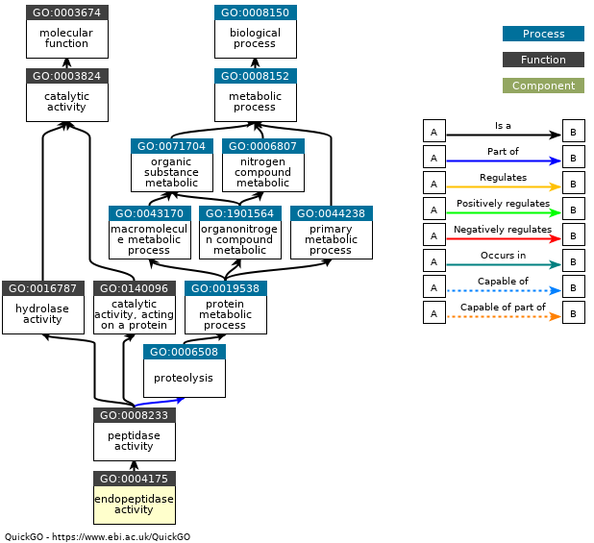
MF1 = GO:0003824 - Catalytic activity
MF4 = GO:0004175 - Endopeptidase activity
Definition: Catalysis of the hydrolysis of internal, alpha-peptide bonds in a polypeptide chain.

Slide 41
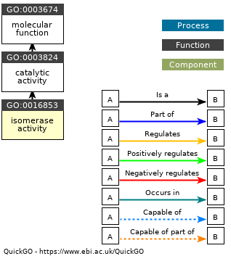
MF1 = GO:0003824 - Catalytic activity
MF2 = GO:0016853 - Isomerase activity
Definition: Catalysis of the geometric or structural changes within one molecule. Isomerase is the systematic name for any enzyme of EC class 5.

Slide 42
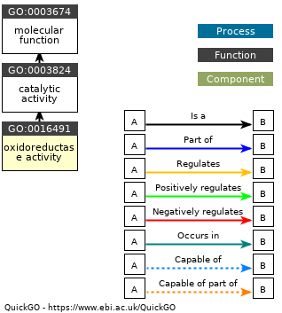
MF1 = GO:0003824 - Catalytic activity
MF2 = GO:0016491 - Oxidoreductase activity
Definition: Catalysis of an oxidation-reduction (redox) reaction, a reversible chemical reaction in which the oxidation state of an atom or atoms within a molecule is altered. One substrate acts as a hydrogen or electron donor and becomes oxidized, while the other acts as hydrogen or electron acceptor and becomes reduced.

Slide 43
BP1 = GO:0065007 – Biological regulation Definition: Any process that modulates a measurable attribute of any biological process, quality or function.

Slide 44
Terminal Term in Results? | GO Term Number | GO Term Name | Ontology | Depth | COVID vs. Other | COVID Survived vs. Deceased P-Value
No | GO:0065007 | Biological regulation | Biological Process | 1 | Yes | None
No | GO:0050789 | Regulation of biological process | Biological Process | 2 | Yes | None
Yes | GO:0050794 | Regulation of cellular process | Biological Process | 3 | Yes | None

Slide 45
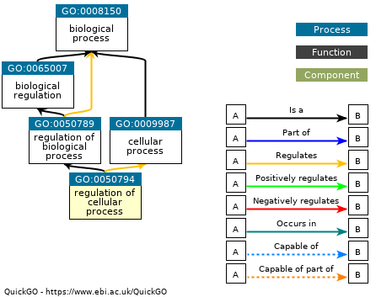
BP1 = GO:0065007 - Regulation of cellular process
BP3 = GO:0050794 - Regulation of cellular process
Definition: Any process that modulates the frequency, rate or extent of a cellular process, any of those that are carried out at the cellular level, but are not necessarily restricted to a single cell. For example, cell communication occurs among more than one cell, but occurs at the cellular level.

Slide 46
MF1 = GO:0005488 – Binding Definition: The selective, non-covalent, often stoichiometric, interaction of a molecule with one or more specific sites on another molecule.

Slide 47
Terminal Term in Results? | GO Term Number | GO Term Name | Ontology | Depth | COVID vs. Other | COVID Survived vs. Deceased P-Value
No | GO:0005488 | Binding | Molecular Function | 1 | Yes | None
No | GO:0043167 | Ion binding | Molecular Function | 2 | Yes | None
No | GO:0097159 | Organic cyclic compound binding | Molecular Function | 2 | No | 0.002
No | GO:0036094 | Small molecule binding | Molecular Function | 2 | No | 0.006
No | GO:0003676 | Nucleic acid binding | Molecular Function | 3 | No | 0.011
No | GO:1901265 | Nucleoside phosphate binding | Molecular Function | 3 | No | 0.007
No | GO:0000166 | Nucleotide binding | Molecular Function | 4 | No | 0.007
No | GO:0035639 | Purine ribonucleoside triphosphate binding | Molecular Function | 4 | No | 0.010
No | GO:0017076 | Purine nucleotide binding | Molecular Function | 5 | No | 0.009
No | GO:0046914 | Transition metal ion binding | Molecular Function | 5 | No | 0.000
No | GO:0030554 | Adenyl nucleotide binding | Molecular Function | 6 | No | 0.029
No | GO:0032555 | Purine ribonucleotide binding | Molecular Function | 6 | No | 0.004

Slide 48
Terminal Term in Results? | GO Term Number | GO Term Name | Ontology | Depth | COVID vs. Other | COVID Survived vs. Deceased P-Value
Yes | GO:0003677 | DNA binding | Molecular Function | 4 | No | 0.035
Yes | GO:0003723 | RNA binding | Molecular Function | 4 | No | 0.001
Yes | GO:0000287 | Magnesium ion binding | Molecular Function | 5 | No | 0.001
Yes | GO:0008270 | Zinc ion binding | Molecular Function | 6 | No | 0.001
Yes | GO:0005524 | ATP binding | Molecular Function | 8 | No | 0.014

Slide 49
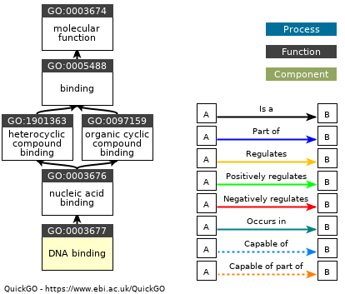
MF1 = GO:0005488 – Binding
MF4 = GO:0003677 – DNA binding
Definition: Any molecular function by which a gene product interacts selectively and non-covalently with DNA (deoxyribonucleic acid).

Slide 50

MF1 = GO:0005488 – Binding
MF4 = GO:0003723 – RNA binding
Definition: Interacting selectively and non-covalently with an RNA molecule or a portion thereof.

Slide 51
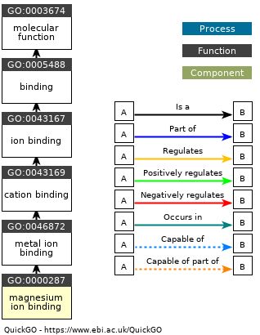
MF1 = GO:0005488 – Binding
MF5 = GO:0000287 – Magnesium ion binding
Definition: Interacting selectively and non-covalently with magnesium (Mg) ions.

Slide 52
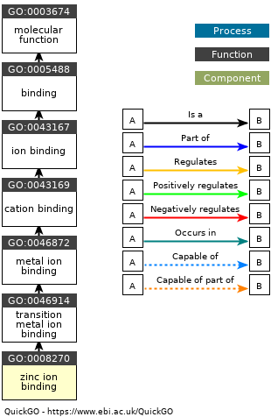
MF1 = GO:0005488 – Binding
MF6 = GO:0008270 – Zinc ion binding
Definition: Interacting selectively and non-covalently with zinc (Zn) ions.

Slide 53
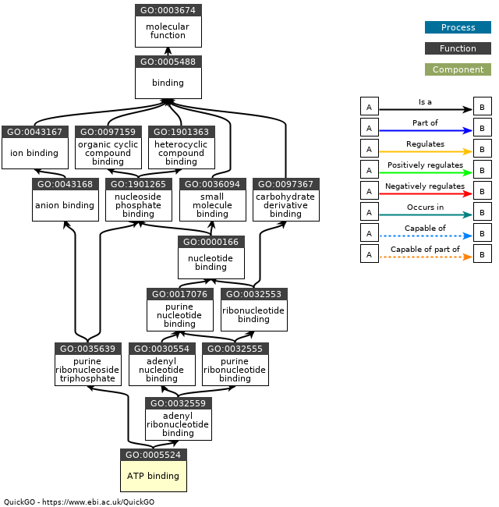
MF1 = GO:0005488 – Binding
MF8 = GO:0005524 – ATP binding
Definition: Interacting selectively and non-covalently with ATP, adenosine 5'-triphosphate, a universally important coenzyme and enzyme regulator.

