Slide 1
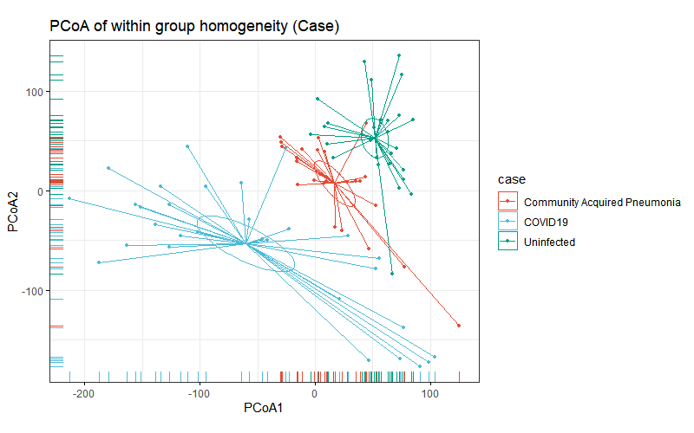
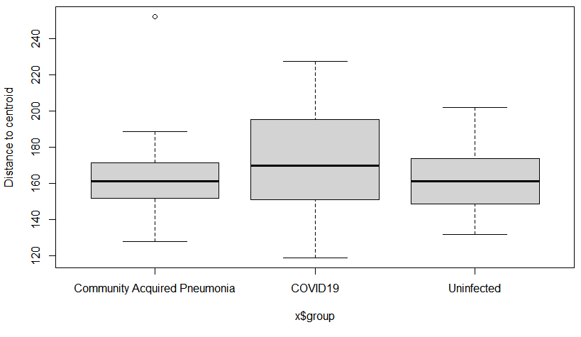
Multivariate homogeneity of groups dispersions (variances) Testing
By Case Type
Homogeneity of multivariate dispersions
Call: betadisper(d = dis, group = sam$case)
No. of Positive Eigenvalues: 85
No. of Negative Eigenvalues: 0
Average distance to median:
Community Acquired Pneumonia COVID19 Uninfected
162.2 172.7 162.8
Permutation test for homogeneity of multivariate dispersions
Permutation: free
Number of permutations: 999
Response: Distances
Df Sum Sq Mean Sq F N.Perm Pr(>F)
Groups 2 2090 1044.95 1.6774 999 0.176
Residuals 83 51704 622.94
Tukey multiple comparisons of means 95% family-wise confidence level
Fit: aov(formula = distances ~ group, data = df)
$group
diff lwr upr p adj
COVID19-Community Acquired Pneumonia 10.507981 -5.391143 26.407104 0.2611432
Uninfected-Community Acquired Pneumonia 0.597927 -15.657884 16.853738 0.9957611
Uninfected-COVID19 -9.910054 -25.181202 5.361095 0.2737801

Slide 2
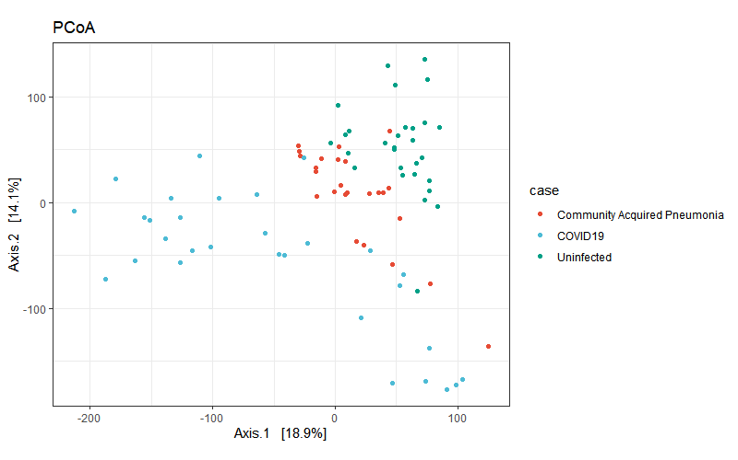
Homogeneity of multivariate dispersions (betadisper)

Slide 3
