Slide 1
CTI League
Disinformation
2020-05-13
TTPs: Tactics, Techniques, Procedures Counters

Slide 2
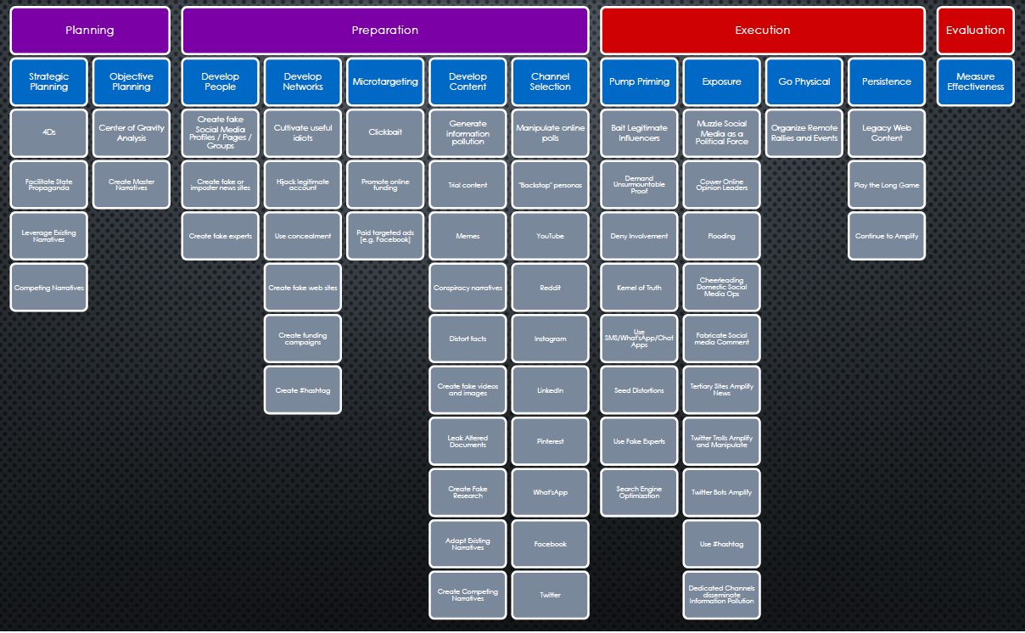
AMITT - Disinformation Tactics/Techniques

Slide 3


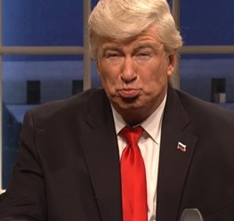
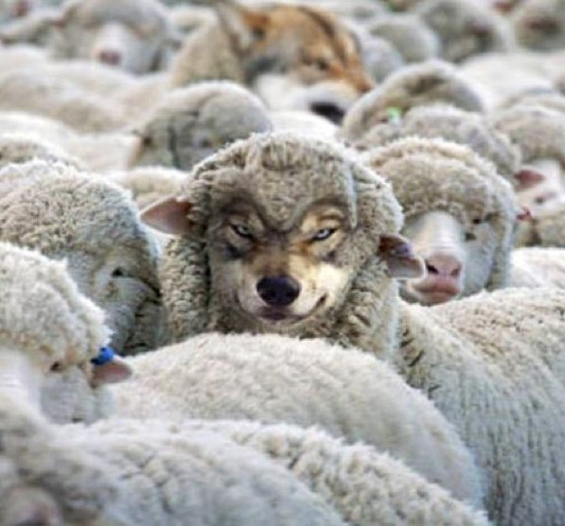
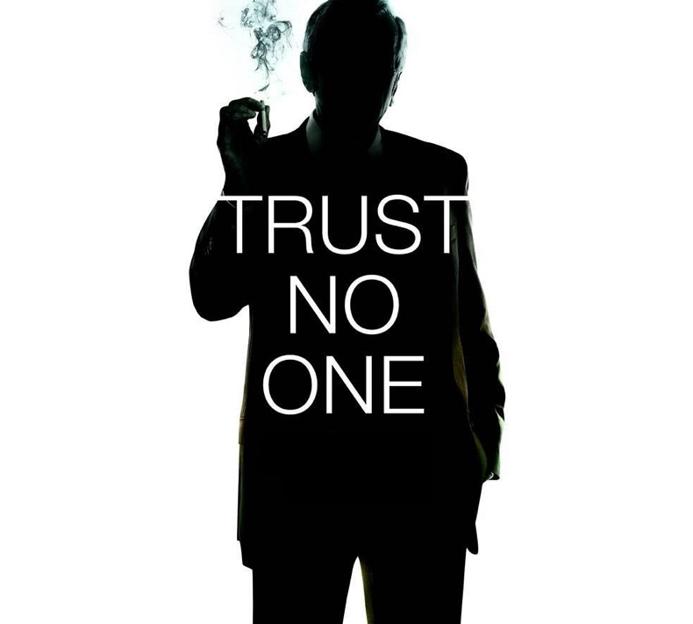

TYPES OF ACCOUNTS
Bots
Parody
Spoof
Camouflage
Deep cover
Takeover
Notes:
https://medium.com/@timboucher/adversarial-social-media-tactics-e8e9857fede4
Bots: Bulk purchase, mostly amplifiers, little-to-no original content
Parody: Clearly counterfeit account used to satirize or diminish image
Spoof: Counterfeit account which closely copies real account.
Camouflage: False account which mimics community of real accounts
Deep Cover: False account accepted as real for long periods of time
Takeover: Real account hijacked by adversary

Slide 4
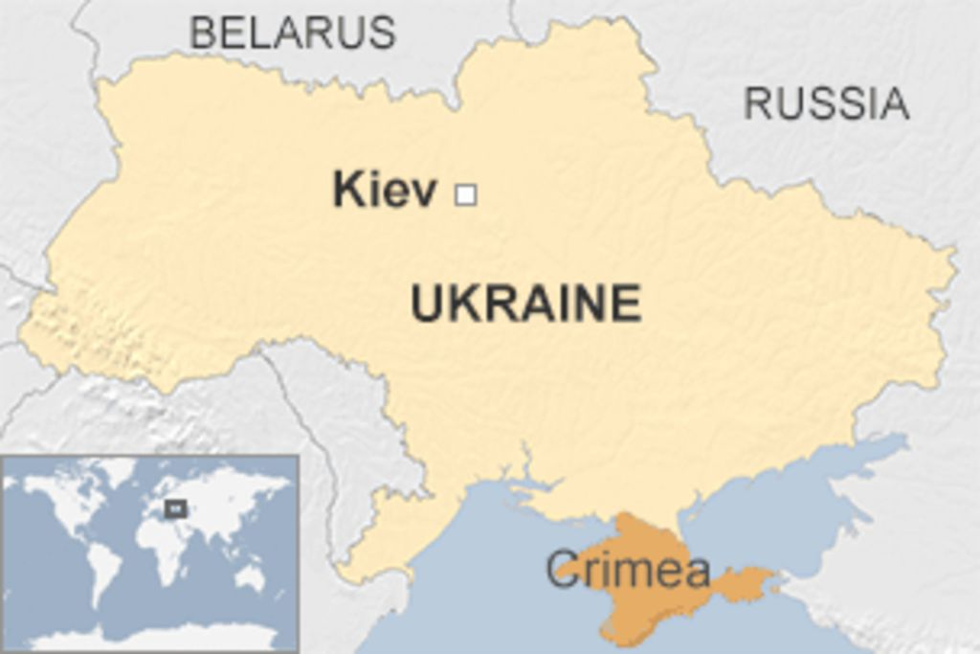
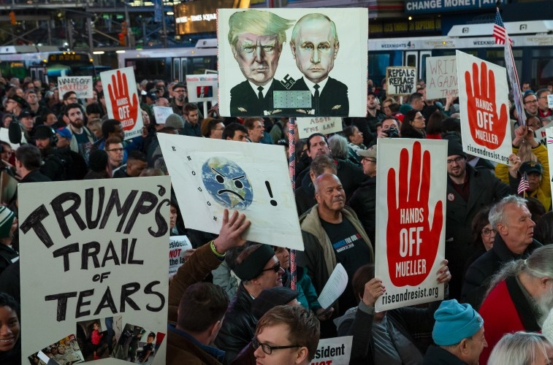
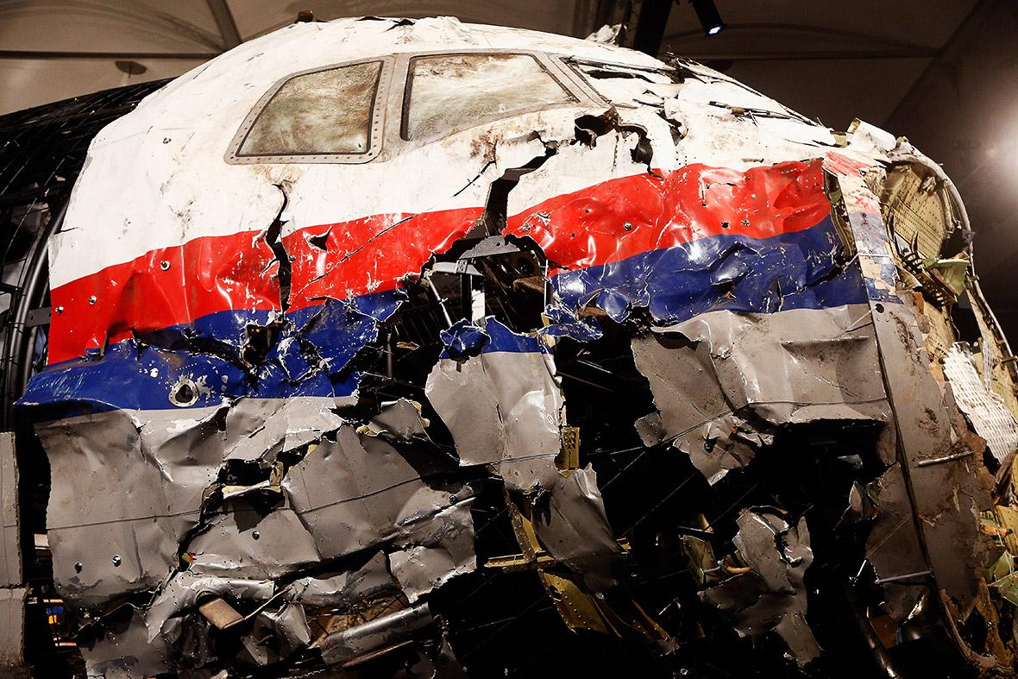
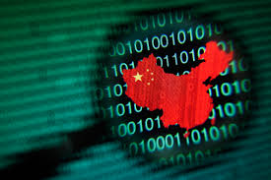
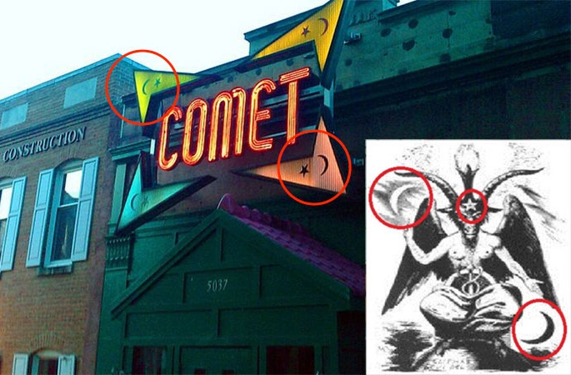
STRATEGIES
Distort
Divide
Distract
Dismiss
Dismay
Notes:
The social strategies for mass population influence can be divided into five categories: Distort, Distract, Dismay, Dismiss, and Divide.
•Distort the facts. We’re not invading the Ukraine; we’re rescuing/protecting ethnic Russians.
•Dismiss: Critics and uncomfortable facts. Make counter-accusations. We’ve seen this one used often by China. Every time the U.S. accuses China of stealing our intellectual property via illicit hacking, China retorts by first dismissing the accusation and then stating that they’re the targets of U.S. hacking.
•Distract from the main issue. MH-17 was a tragedy. Why is a commercial airliner flying over a war zone?
•Divide: Reduce trust, create confusion, and provoke populations. It’s not an accident when two groups at polar opposite ends of the political spectrum “magically” have competing events at the same time and place.
•Dismay: Ad-hominem – make personal attacks, insults and accusations. This one is particularly interesting because by even addressing these attacks, you lend them credence. Think about Pizzagate. Making a preposterous claim suggesting that political elites have a secret sex dungeon full of kids is very hard to defend against without lending the accusations credence.
•
------------------------------------------------------
Reference: Nimmo, Ben. 19 May 2015. “Anatomy of an Info-War: How Russia’s Propaganda Machine Works, and How to Counter it.” StopFake.org 01 December 2018<https://www.stopfake.org/en/anatomy-of-an-info-war-how-russia-s-propaganda-machine-works-and-how-to-counter-it/ >
Social graph: Dr. Kate Starbird, via https://twitter.com/katestarbird/status/954805298652332032

Slide 5
STAGE-BASED MODELS ARE USEFUL
RECON | WEAPONIZE | DELIVER | EXPLOIT | CONTROL | EXECUTE | MAINTAIN
Persistence | Privilege Escalation | Defense Evasion | Credential Access | Discovery | Lateral Movement | Execution | Collection | Exfiltration | Command and Control
Notes:
The cyber attack model (top), with its extension, the ATT&CK model (bottom) looked promising.
Misinformation has rapid feedback, can target quickly…
ATT&CK phases:
* Persistence – Any access, action, or configuration change to a system that gives an adversary a persistent presence on that system. Adversaries will often need to maintain access to systems through interruptions such as system restarts, loss of credentials, or other failures.
• Privilege Escalation – The result of techniques that cause an adversary to obtain a higher level of permissions on a system or network. Certain tools or actions require a higher level of privilege to work and are likely necessary at many points throughout a remote operation.
• Defense Evasion – Techniques an adversary may use for the purpose of evading detection or avoiding other defenses.
• Credential Access – Techniques resulting in the access of, or control over, system, domain, or service credentials that are used within an enterprise environment.
• Discovery – Techniques that allow an adversary to gain knowledge about a system and its internal network.
• Lateral Movement – Techniques that enable an adversary to access and control remote systems on a network. Often the next step for lateral movement is remote execution of tools introduced by an adversary.
• Execution – Techniques that result in execution of adversary-controlled code on a local or remote system.
• Collection – Techniques used to identify and gather information, such as sensitive files, from a target network prior to exfiltration.
• Exfiltration – Techniques and attributes that result or aid in an adversary removing files and information from a target network. This category also covers locations on a system or network where an adversary may look for information to exfiltrate.
• Command and Control – Techniques and attributes of how adversaries communicate with systems under their control within a target network. Examples include using legitimate protocols such as HTTP to carry C2 information.

Slide 6
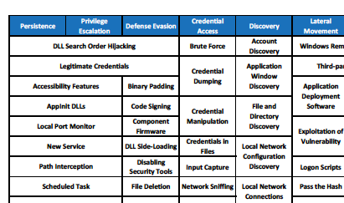
WE EXTENDED THE ATT&CK FRAMEWORK
Notes:
Mapping phases to techniques - really useful
Each Tactic stage has a pick-list of Techniques - really useful

Slide 7
POPULATING THE FRAMEWORK: HISTORICAL ANALYSIS
Campaigns
e.g. Internet Research Agency, 2016 US elections
Incidents
e.g. Columbia Chemicals
Failed attempts
e.g. Russia - France campaigns

Slide 8
HISTORICAL CATALOG: DATASHEET
Summary: Early Russian (IRA) “fake news” stories. Completely fabricated; very short lifespan.
Actor: probably IRA (source: recordedfuture)
Timeframe: Sept 11 2014 (1 day)
Presumed goals: test deployment
Artefacts: text messages, images, video
Related attacks: These were all well-produced fake news stories, promoted on Twitter to influencers through a single dominant hashtag -- #BPoilspilltsunami, #shockingmurderinatlanta,
Method:
Create messages. e.g. “A powerful explosion heard from miles away happened at a chemical plant in Centerville, Louisiana #ColumbianChemicals”
Post messages from fake twitter accounts; include handles of local and global influencers (journalists, media, politicians, e.g. @senjeffmerkley)
Amplify, by repeating messages on twitter via fake twitter accounts
Result: limited traction
Counters: None seen. Fake stories were debunked very quickly.

Slide 9
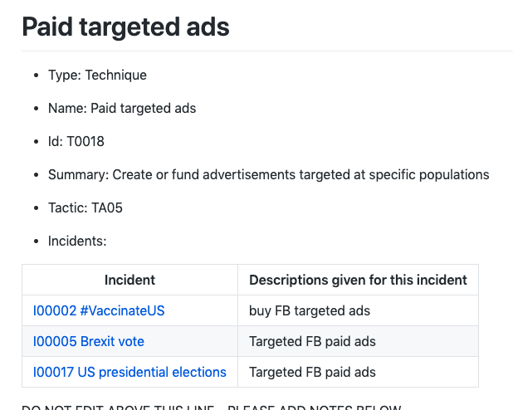
FEEDS INTO TECHNIQUES LIST
Notes:
STIX /TAXII works for this, makes sense
… and we have to start filling these out…

Slide 10
POPULATING TECHNIQUES: INCIDENT ANALYSIS
Top-down (strategic): info ops
What are misinformation creators likely to do? What, where, when, how, who, why?
What do we expect to see?
What responses and impediments to responses were there?
Bottom-up (tactical): data science
Unusual hashtag, trend, topic, platform activity?
Content from ‘known’ trollbots, 8/4chan, r/thedonald, RussiaToday etc
What are trackers getting excited about today?
Notes:
TODO: Ways, means, ends in here
Lots of secondary questions, e.g. what artifacts are they likely to leave when they do it?

Slide 11
AMITT PHASES AND TACTIC STAGES
Planning | Strategic Planning
 | Objective Planning
Preparation | Develop People
 | Develop Networks
 | Microtargeting
 | Develop Content
 | Channel Selection
Execution | Pump Priming
 | Exposure
 | Go Physical
 | Persistence
Evaluation | Measure Effectiveness
https://github.com/cogsec-collaborative/amitt_framework

Slide 12
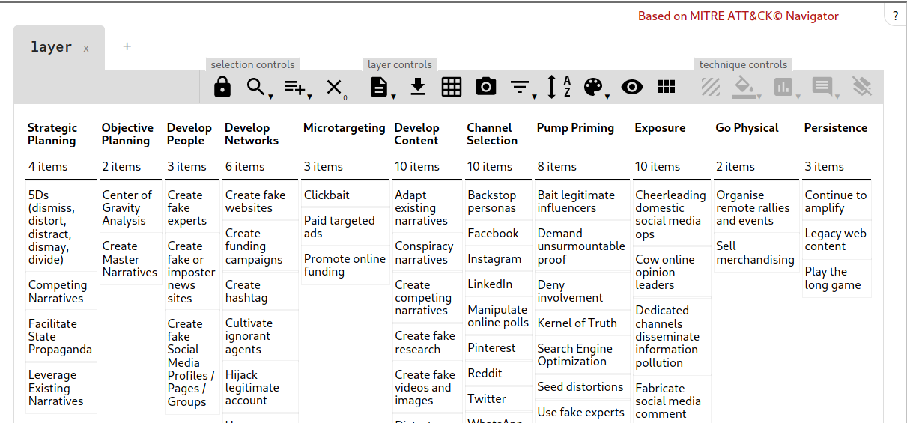
Techniques: AM!TT Navigator
https://cogsec-collab.org/project/amitt_navigator/

Slide 13
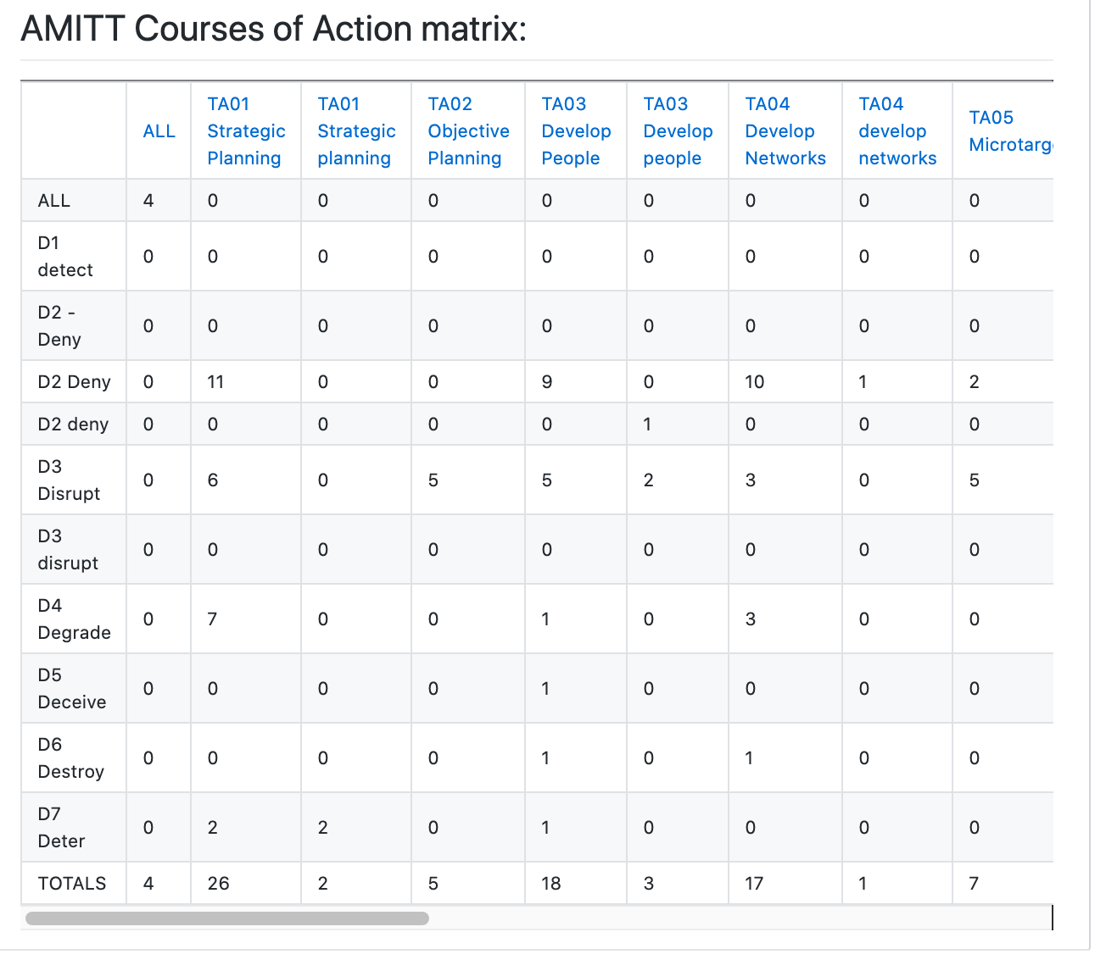
Tactic-level counters...

