Slide 1
CTI League
Disinformation
2020-05-16
Countermeasures

Slide 2
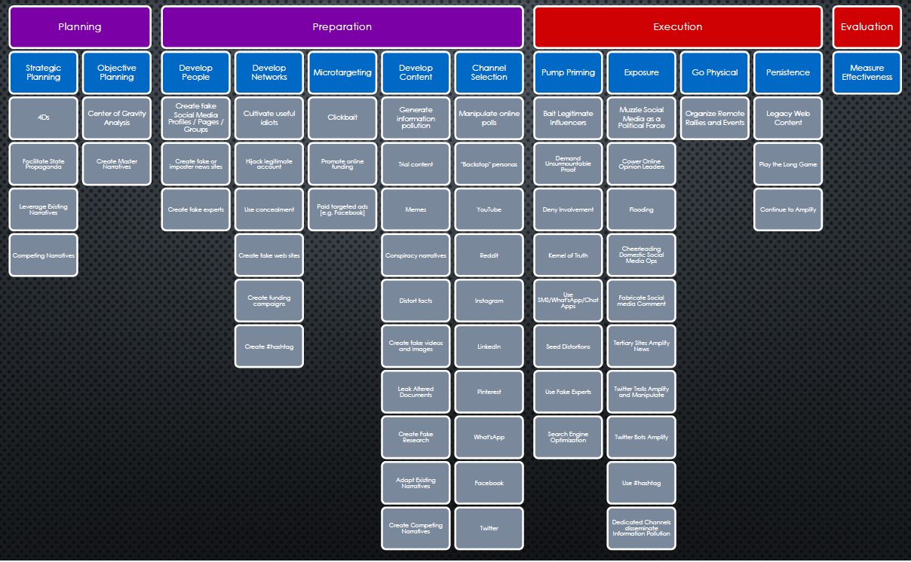
AMITT - Disinformation Tactics/Techniques

Slide 3
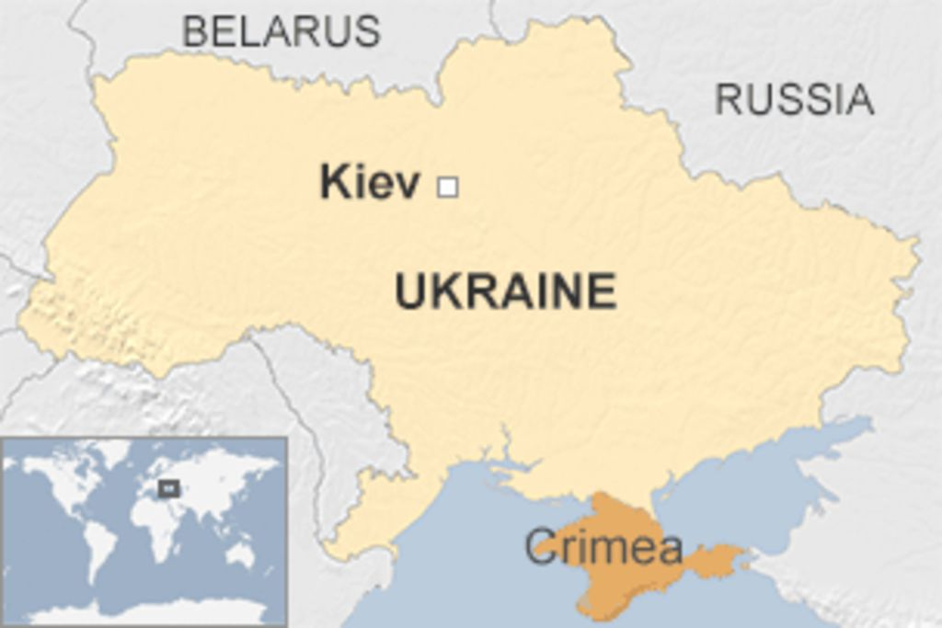
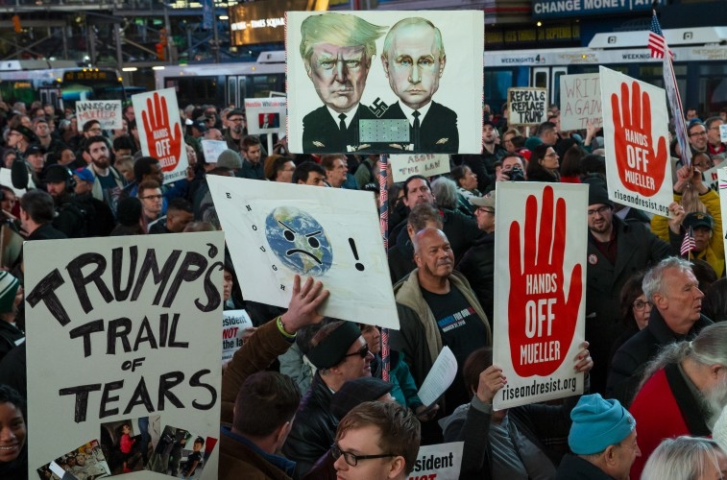
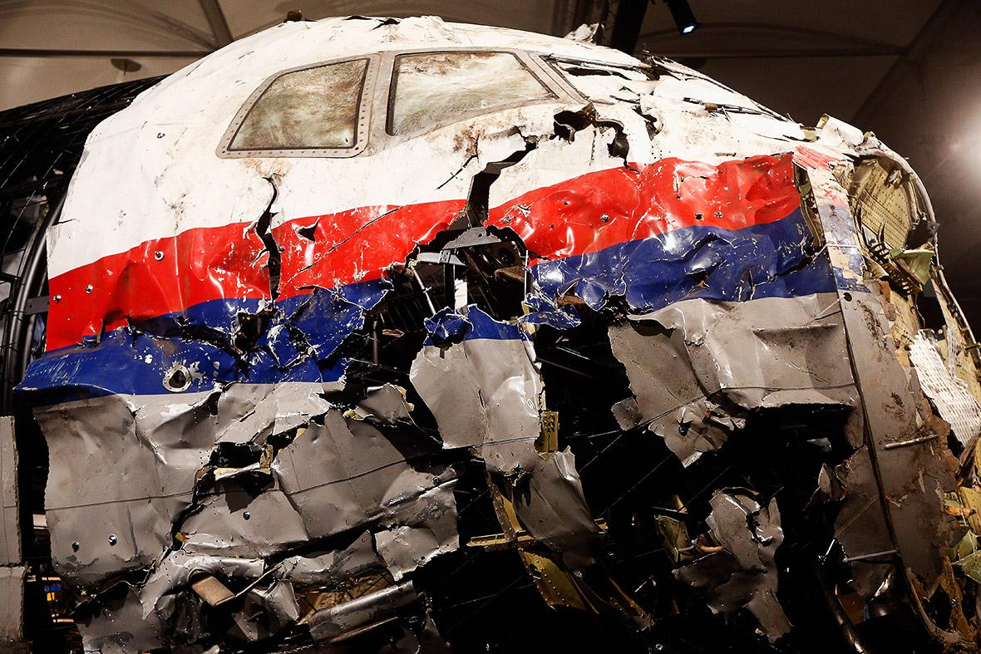
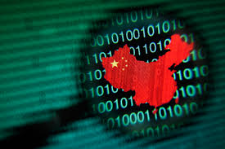
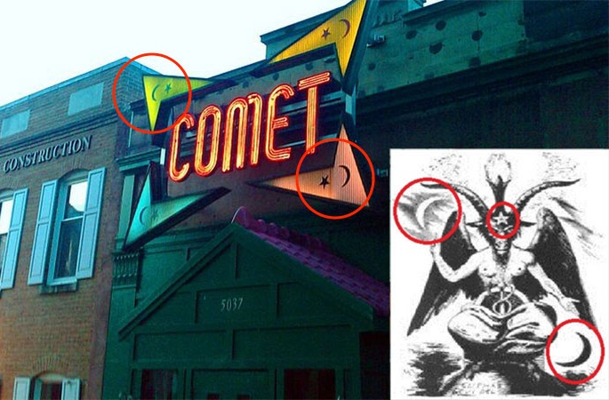
STRATEGIES
Distort
Divide
Distract
Dismiss
Dismay
Notes:
The social strategies for mass population influence can be divided into five categories: Distort, Distract, Dismay, Dismiss, and Divide.
•Distort the facts. We’re not invading the Ukraine; we’re rescuing/protecting ethnic Russians.
•Dismiss: Critics and uncomfortable facts. Make counter-accusations. We’ve seen this one used often by China. Every time the U.S. accuses China of stealing our intellectual property via illicit hacking, China retorts by first dismissing the accusation and then stating that they’re the targets of U.S. hacking.
•Distract from the main issue. MH-17 was a tragedy. Why is a commercial airliner flying over a war zone?
•Divide: Reduce trust, create confusion, and provoke populations. It’s not an accident when two groups at polar opposite ends of the political spectrum “magically” have competing events at the same time and place.
•Dismay: Ad-hominem – make personal attacks, insults and accusations. This one is particularly interesting because by even addressing these attacks, you lend them credence. Think about Pizzagate. Making a preposterous claim suggesting that political elites have a secret sex dungeon full of kids is very hard to defend against without lending the accusations credence.
•
------------------------------------------------------
Reference: Nimmo, Ben. 19 May 2015. “Anatomy of an Info-War: How Russia’s Propaganda Machine Works, and How to Counter it.” StopFake.org 01 December 2018<https://www.stopfake.org/en/anatomy-of-an-info-war-how-russia-s-propaganda-machine-works-and-how-to-counter-it/ >
Social graph: Dr. Kate Starbird, via https://twitter.com/katestarbird/status/954805298652332032

Slide 4
AMITT PHASES AND TACTIC STAGES
Planning | Strategic Planning
 | Objective Planning
Preparation | Develop People
 | Develop Networks
 | Microtargeting
 | Develop Content
 | Channel Selection
Execution | Pump Priming
 | Exposure
 | Go Physical
 | Persistence
Evaluation | Measure Effectiveness
https://github.com/cogsec-collaborative/amitt_framework

Slide 5
Counters

Slide 6
Mitigations & Counters
Countermeasures are that form of military science that, by the employment of devices and/or techniques, is designed to impair the operational effectiveness of enemy activity. Countermeasures can be active or passive and can be deployed preemptively or reactively.
JP 3-13.1 , Information Operations - Joint Chiefs of Staff

Slide 7
Finding Countermeasures
Existing
Tactic-based
Technique-based
Doctrine-based

Slide 8
Effects
Detect: find them
Deny: stop them getting in
Disrupt: interrupt them
Degrade: slow them down
Deceive: divert them
Destroy: damage them
Deter: discourage them

Slide 9
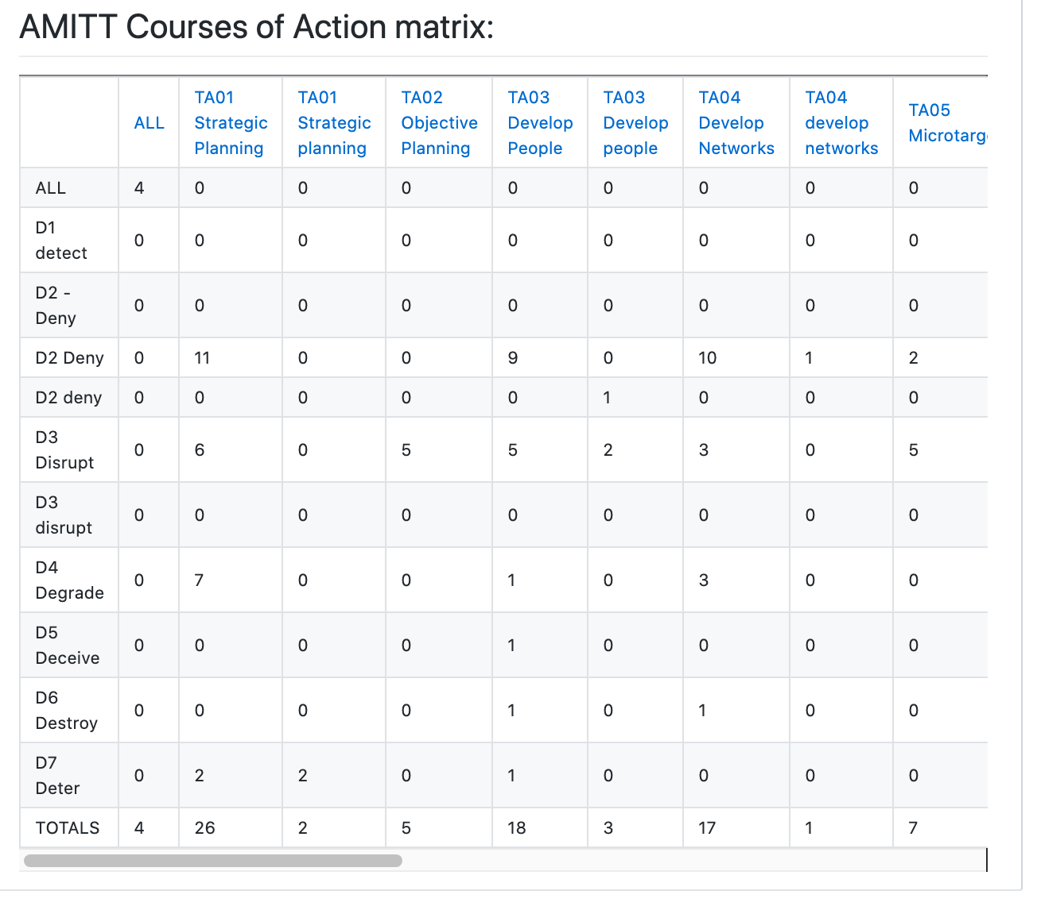
Tactic-level counters...

Slide 10
Critical Elements
Resources
Infrastructure
Execution
Time

Slide 11
Countermeasure
C00066 - Co-opt hashtag and drown it out
Tactic: TA 09 Exposure
Technique: T0055 - Use Hashtag
Response: Disrupt
Actor: Academic, Activist, Corporation, Nonprofit, Government , Agency, Law Enforcement, Military, News Media Platform, Social Network Platform

Slide 12
Critical Elements
Resources
Infrastructure
Execution
Time

