Slide 1
CTI League
Disinformation
2020-06-27
Threat Hunting with
AMITT Framework
Notes:
This training isn’t about the details - which tools, etc; but about the problem in a constructive manner; think about the pieces, and how to deal with those pieces. How to create a hunt plan etc. Need to be able to ask the right questions, and think about the problem in the right way. (NB this is the first, most important part of data science, and intel analysis too: the questions at the front, and the explanation and actions at the end).

Slide 2
AMITT PHASES AND TACTIC STAGES
Planning | Strategic Planning
 | Objective Planning
Preparation | Develop People
 | Develop Networks
 | Microtargeting
 | Develop Content
 | Channel Selection
Execution | Pump Priming
 | Exposure
 | Go Physical
 | Persistence
Evaluation | Measure Effectiveness
https://github.com/cogsec-collaborative/amitt_framework
Notes:
AMITT is a phase-based model - someone prepares the thing then does the thing. Come to Red Team Wednesday to learn more about this.

Slide 3
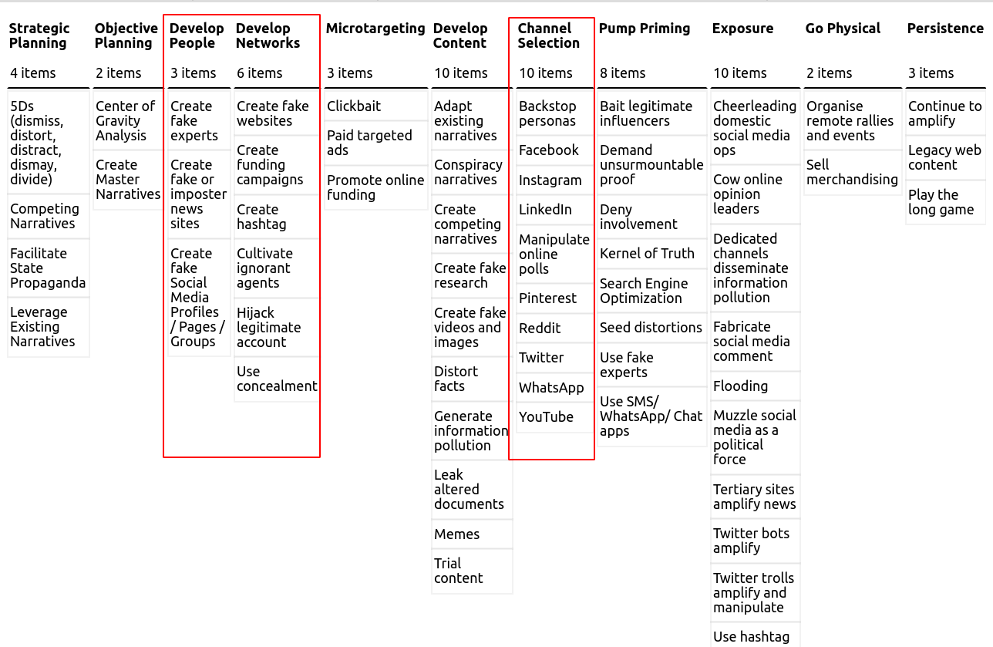
Techniques: AM!TT Navigator
https://cogsec-collab.org/project/amitt_navigator/
Notes:
We’re looking at people, networks and channels here.

Slide 4
Develop People
Create, Buy or Steal
How old is the account?
When was the first post? First relevant post?
What platforms are they registered on?
How active is the account? Any major gaps?
Languages?
Email in HIBP?
User Behaviour
Bots!
Trolls, Parody, Spoof, etc
Real user vs deep cover
Backstopping is time consuming and expensive
Experts and appeal to authority
Google dorks
Notes:
No other way to get accounts than create, buy or steal them. Look at this to see how the adversary is acting: when was it created, is a bot, is is rented, or pwned? What type of behaviour does it have (parody etc), is it backstopped: this tells us about the resources of the actor, and where the campaign might be going.

Slide 5
Develop Network
Hashtags build cross-platform networks
Audience building is a social activity
Engage users, follow-back, re-post popular content
Who is the disinformant’s target audience?
Who engages with the disinformant?
Social media groups are technical instantiations of social groups
Twitter Boogs ≈ Reddit Boogs
Websites, funding campaigns
When was it created?
Who is it affiliated with? Influencers?
Mainstream content happens in the clearnet
Notes:
Think about how these campaigns happen across platforms. This is a social activity. Folks are the same on twitter and reddit - same narratives and ingroup dynamics as other humans, but need to think about what they look like in each network.
E.g. there will be key phrases in narratives. Signature behaviours across platforms; e.g. when Instagram accounts were banned, the old accounts went but the verbiage was the same in new accounts because the groups needed signals to find each other.

Slide 6
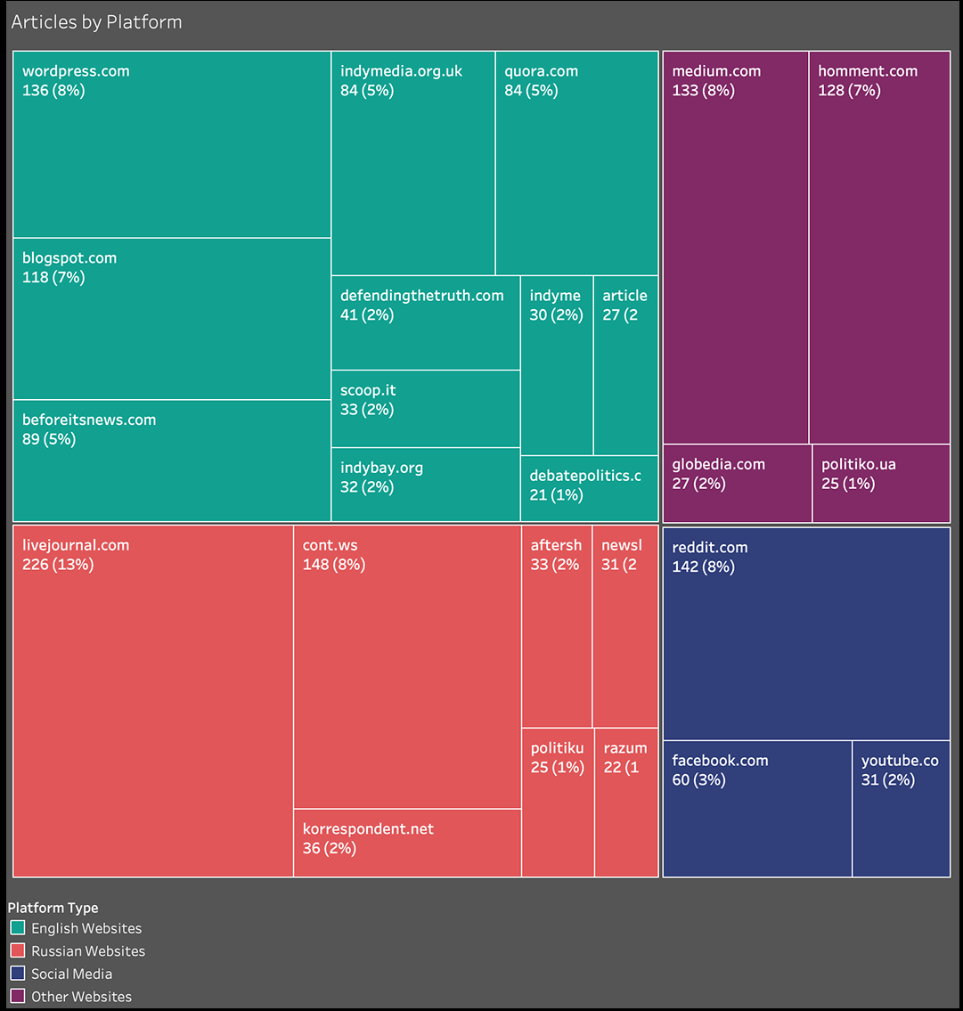
Channel Selection
Social Media as Log Sources
Facebook, Twitter, IG…
Methodical, structured examination of data sources
Communication as Events
The medium changes
The messages must not change else cross-platform community breaks
https://secondaryinfektion.org/report/the-techniques/
Notes:
Can’t look at just one channel - e.g. just one log source. E.g. Sekondary Infektion there were lots of leaks etc in the shadows - not because not public, but because they were small. If just looking at twitter, seeing the tail end of work. Also look at regions, e.g. WeChat is important in some regions but not others. Coordination is in open blogs etc in Russia, Iran etc (for nationstate work) - might need language translators, or automatic translators, using keyword searches in different languages… whilst being mindful of regional differences. But… have to get it right in main areas first.
NB comes back to domains - social media is data and info being delivered; domains is data and information at rest, making money. Once you find this, you find the infrastructure, the money, the people, the links.

Slide 7
Disinformant Hunting
People Assumptions
Bots are predictable. Humans are less predictable.
If we see accounts on Twitter acting in particular way there might also be account on Reddit acting that way.
There’s a timeline we can try to reconstruct.
Network Assumptions
Disinformants have a target audience. We can identify who they try and interact with and examine those groups across different platforms.
Channel Assumptions
Disinformation campaigns necessarily use similar language, content, personas across platforms so that individuals can identify each other
Notes:
Looking at three of the tactics, and we’ve built some assumptions about how an attacker works with them. For threat hunting, we need a hypothesis: it might be biased or incorrect, but it’s a start at investigating. Work to disprove each assumption/ hypothesis (that’s why we use Analysis of Competing Hypotheses and Argument Mapping techniques). Argument mapping = arguments for, against; evidence for, against; mindmap of these, which shows where we need to continue to collect. (book recommendation: Structured Analytic Techniques, by Richard Heuer)

Slide 8
Tools & Next Steps
Scrapers
Prioritize platforms
Number of user
Types of communities
Tactic/techniques based playbooks
Work with CVE to build actor profiles
Upcoming Trainings
Intro the Hive: Disinfo Incident Management with [Name Redacted]
Disinfo Data Science with [Name Redacted]
Notes:
Incidents: get data - then have a group brainstorming session; collect hypotheses, then prove/ disprove them. An assessment isn’t factual, it’s probabilistic: highly likely etc… e.g. ICD203 (https://www.dni.gov/files/documents/ICD/ICD%20203%20Analytic%20Standards.pdf)… then you have an assessment of the most probable course of events, most probably actors. E.g. is this randos or state-sponsored? Strategic objectives? Does this have an application to a known strategic objective? Why now?
Future training: analytic methodologies and structured analytical techniques.

