Slide 1
CTI League
Disinformation
2020-05-06
TRUE? OPINION? INAUTHENTIC? WHAT ARE WE CHASING?
Digital Harm Training

Slide 2
DIGITAL HARMS
Physical harm | e.g. bodily injury, damage to physical assets (hardware, infrastructure, etc).
Psychological harm | e.g. depression, anxiety from cyber bullying, cyber stalking etc
Economic harm | financial loss, e.g. from data breach, cybercrime etc
Reputational harm | e.g. Organization: loss of consumers; Individual: disruption of personal life; Country: damaged trade negotiations.
Cultural harm | increase in social disruption, e.g. misinformation creating real-world violence.
Political harm | e.g. disruption in political process, government services from e.g. internet shutdown, botnets influencing votes
(List from https://dai-global-digital.com/cyber-harm.html)
Notes:
We’re looking for, and trying to reduce, harms. In this deployment, we’re specifically looking for medical harms. This is important because this year, social media companies, politicans etc shifted their definition of ‘bad’ from immediate calls for violence to the idea of digital harms where the effects might be delayed.

Slide 3
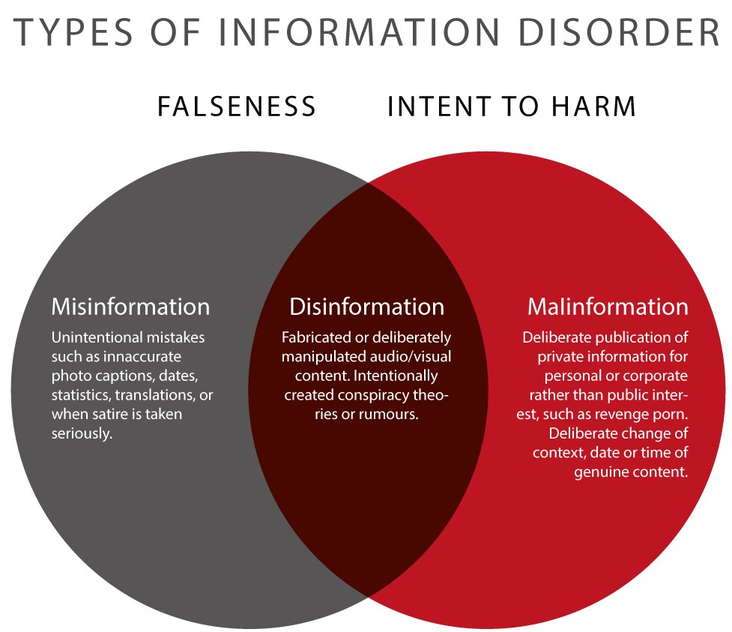
Disinformation - a working definition
“deliberate promotion… of false, misleading or mis-attributed information
focus on creation, propagation, consumption of disinformation online
We are especially interested in disinformation designed to change beliefs in a large number of people”
Notes:
It’s false. It’s intentional. It’s at scale. And the falsehood might not be in the content - the content, or the original poster’s intentions, might be clean, but the reuse, or amplification etc might be designed to create harm. Alway look for the harms, and the motivations for those harms.
Quote is misinfosec; Image is from First Draft’s work on Information Disorder (Clare Wardle, 2017)

Slide 4
Practical: deciding whether to start an incident
Is this potentially doing harm?
Is that intentional? (changes how you respond)
Are demographics etc being targeted?
Is this medically-related?
Is this part of something we’ve seen already (e.g. known medical scam types)
Is the content false, or is the falsehood elsewhere?
Fake groups, fake profiles, fake amplification etc
Is our team the best one to respond to this?
Is someone else already tracking and responding to this?
Is it e.g. phishing rather than disinformation?
Do we have the resources to respond?
Notes:
Satire and conspiracies - sometimes used as a gateway drug into more worrying groups.

Slide 5
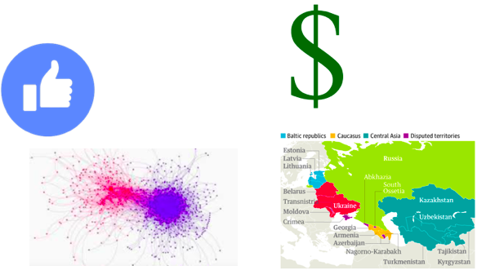
Where is this coming from?
Online discussion:
opinion
conspiracies
protest
nazis
all the above
Attention gain
Sharks, satire and other LOLs
Financial gain
Follow the money
Power gain
Follow the divisions
Geopolitical gain
countries
Blahblahblahblah
Notes:
“How to best determine between Fact (or fake fact) and opinion (which may be protected speech)”

Slide 6
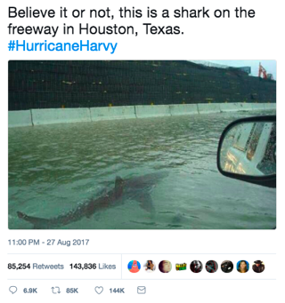
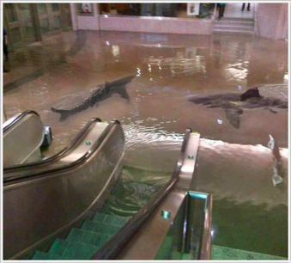
Doing it for the LOLs
Ignore, unless it’s DDOSing something we care about

Slide 7
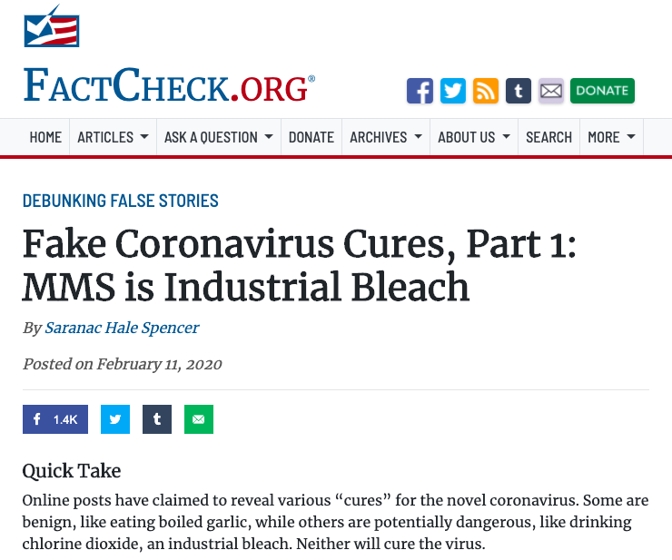
Doing it for Money
Covid19 huckers are selling:
T-shirts
“Cures”
Blood
Views and clicks
And a bunch of other stuff
Follow the money...

Slide 8
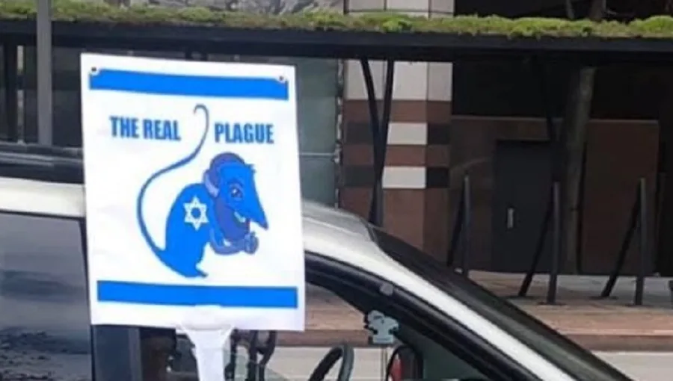
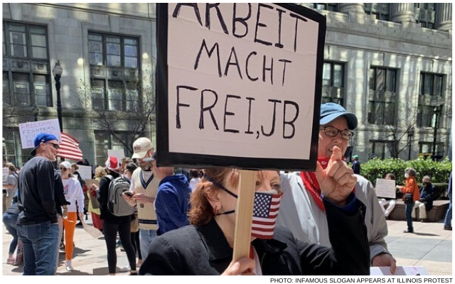
Power-motivated: Targetting, or not targetting? Harms or not Harms?

Slide 9

Geopolitically-motivated:
Westphalian Sovereignty
Each nation has sovereignty over its own territory and domestic affairs
Principal of non-interference in another country’s domestic affairs
Each state is equal under international law

Slide 10
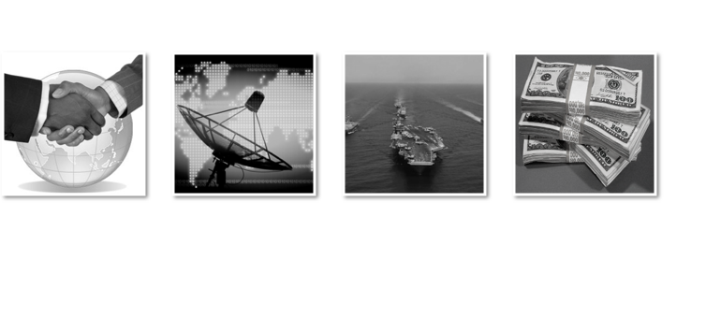
National instruments of Influence

Slide 11
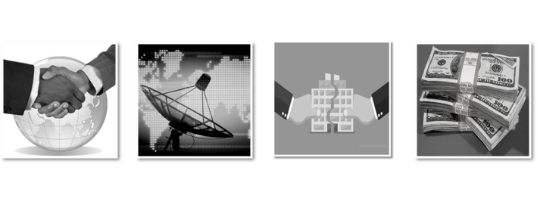
Business instruments of Influence

Slide 12
Information threats to Countries
Democracy
Require common political knowledge
Who the rulers are
Legitimacy of the rulers
How government works
Draw on contested political knowledge to solve problems
Vulnerable to attacks on common political knowledge
Autocracy
Actively suppress common political knowledge
Benefit from contested political knowledge
Vulnerable to attacks on the monopoly of common political knowledge
Notes:
Democracy
Require common political knowledge
Who the rulers are
Legitimacy of the rulers
How government works
Draw on contested political knowledge to solve problems
Vulnerable to attacks on common political knowledge

Slide 13
Covid19 Themes
Covid isn’t serious
Covid doesn’t exist
Individual medical targets
Medical scams
MMS prevents
Alcohol prevents
etc
Origin myths
Escaped bioweapon
Country x created Covid
US soldiers took Covid to China
Resolution myths
Country y has a Covid cure
Crossover with conspiracies
Covid and 5G
Covid and antivax / anti-Gates
Helicopters spraying for covid
Depopulation conspiracy
Crossover with ‘freedom rights’
Anti- stayathome
2nd amendment
anti-immigration
Usual far-rightwing groups
Geopolitics
China, Iran: covert + overt
“Blue check” disinfo
Notes:
Master narratives list:https://docs.google.com/spreadsheets/d/1yoiHNNSkNq5HoNEFiSrYTAE3nuFnp9wMBMcsh-TRx_w/edit#gid=398450894

Slide 14
Ethics of: Start, Track, Store, Counter
Should you start an incident? - covered above
What and who are you tracking? - above
What should you store and where?
No PII in the open
If it’s people, only store what you need for as long as you need it
Countering
First, do no harm. Think before acting. Escalate the decision if you’re unsure

Slide 15
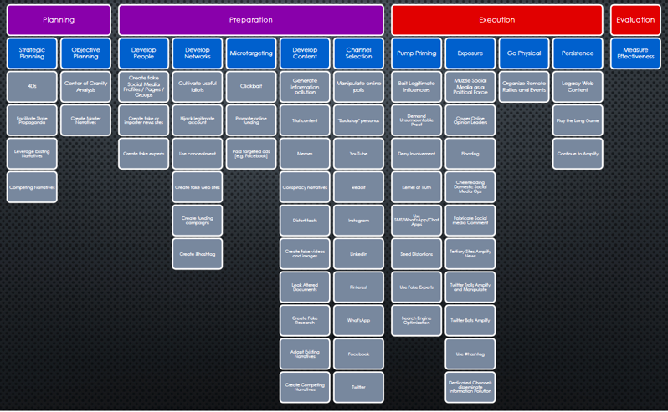
TRACKING AND COUNTERING: AMITT TTPs
Notes:
This is why we have objects and TTPs.

Slide 16
“What are we chasing” wishlist
Cleaned-up master narratives list
Datastore entries for repeat offender groups, pages, URLs, hashtags etc
Counters list trimmed-down and easy-to-use for this deployment

