Slide 1
CTI League
Disinformation
2020-05-23
Discussion: Data Sources

Slide 2
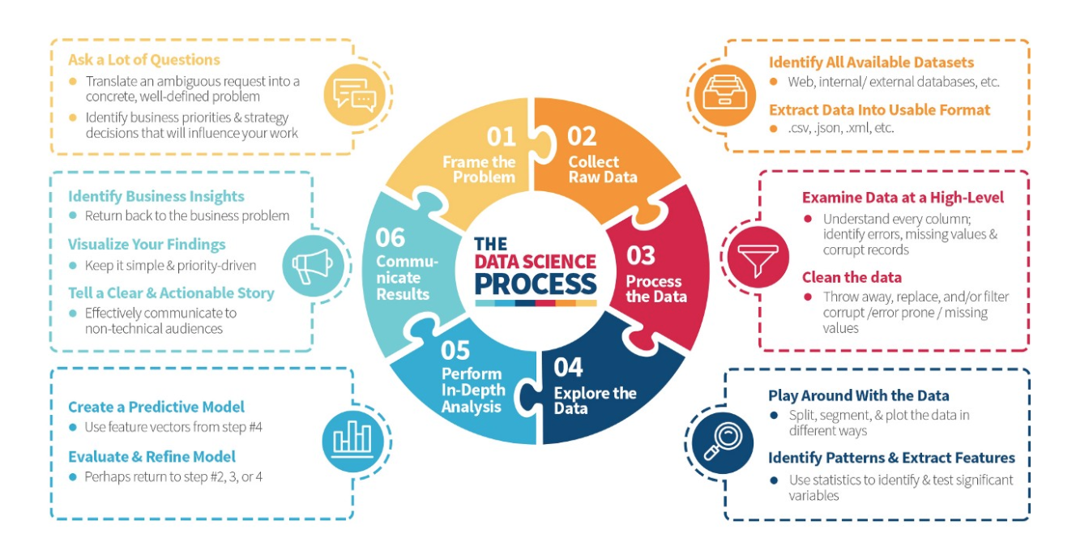
Data Science
https://medium.com/the-mission/deconstructing-data-science-breaking-the-complex-craft-into-its-simplest-parts-15b15420df21
Notes:
Read the blogpost btw - it’s a lovely description of what happens in data science.

Slide 3
“Frame The Problem”
What are we starting with?
Initial artifact, theme, narrative, lead
What’s our “research question”?
What do and don’t we care about here?
What’s more and less important to us (if we have limited resources)?
What are we trying to produce and for whom?
Enough evidence that we can identify who to pass it to, and give them enough to either act or start their own investigation
Enough evidence and information to take action ourselves

Slide 4
“Collect Raw Data”
Identify all available datasets
Existing collections: check the list in the BigBook
NB their collection isn’t your collection: be aware of biases, data gaps etc
Social media feeds: searches, APIs, and spreadsheets
Extract data into usable format
A spreadsheet entry isn’t a MISP object…

Slide 5
Input data: alerts and canaries
Typical alerts:
New narrative
local or world event
Anomalous or significant-sized online activity
Command signals from known disinformation groups (e.g. qanon)
Typical starting artefacts:
Image
Message, e.g. tweet, facebook post, SMS
URL
“Canaries” = known producers or early adopters of many disinformation campaigns.
E.g. known conspiracy / extremist / target etc groups

Slide 6
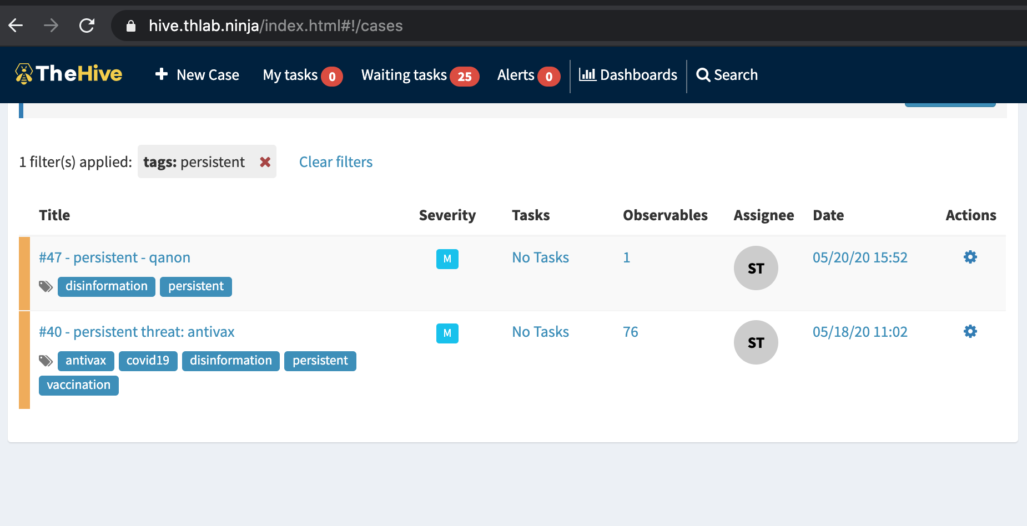
Dataset: Curated Canaries

Slide 7
Disinformation Data Streams
Botsentinel: themes “trollbots” are promoting
Hamilton68 - public version is feeds from official Russian sites (embassies, RT etc), not trolls.
Ryerson University covid19 misinformation portal
Botswatch dashboard Botswatch dashboard
Indiana University OSOME Decahose
Facebook Datafeed
Uni Arkansas COSMOS Covid19 list

Slide 8
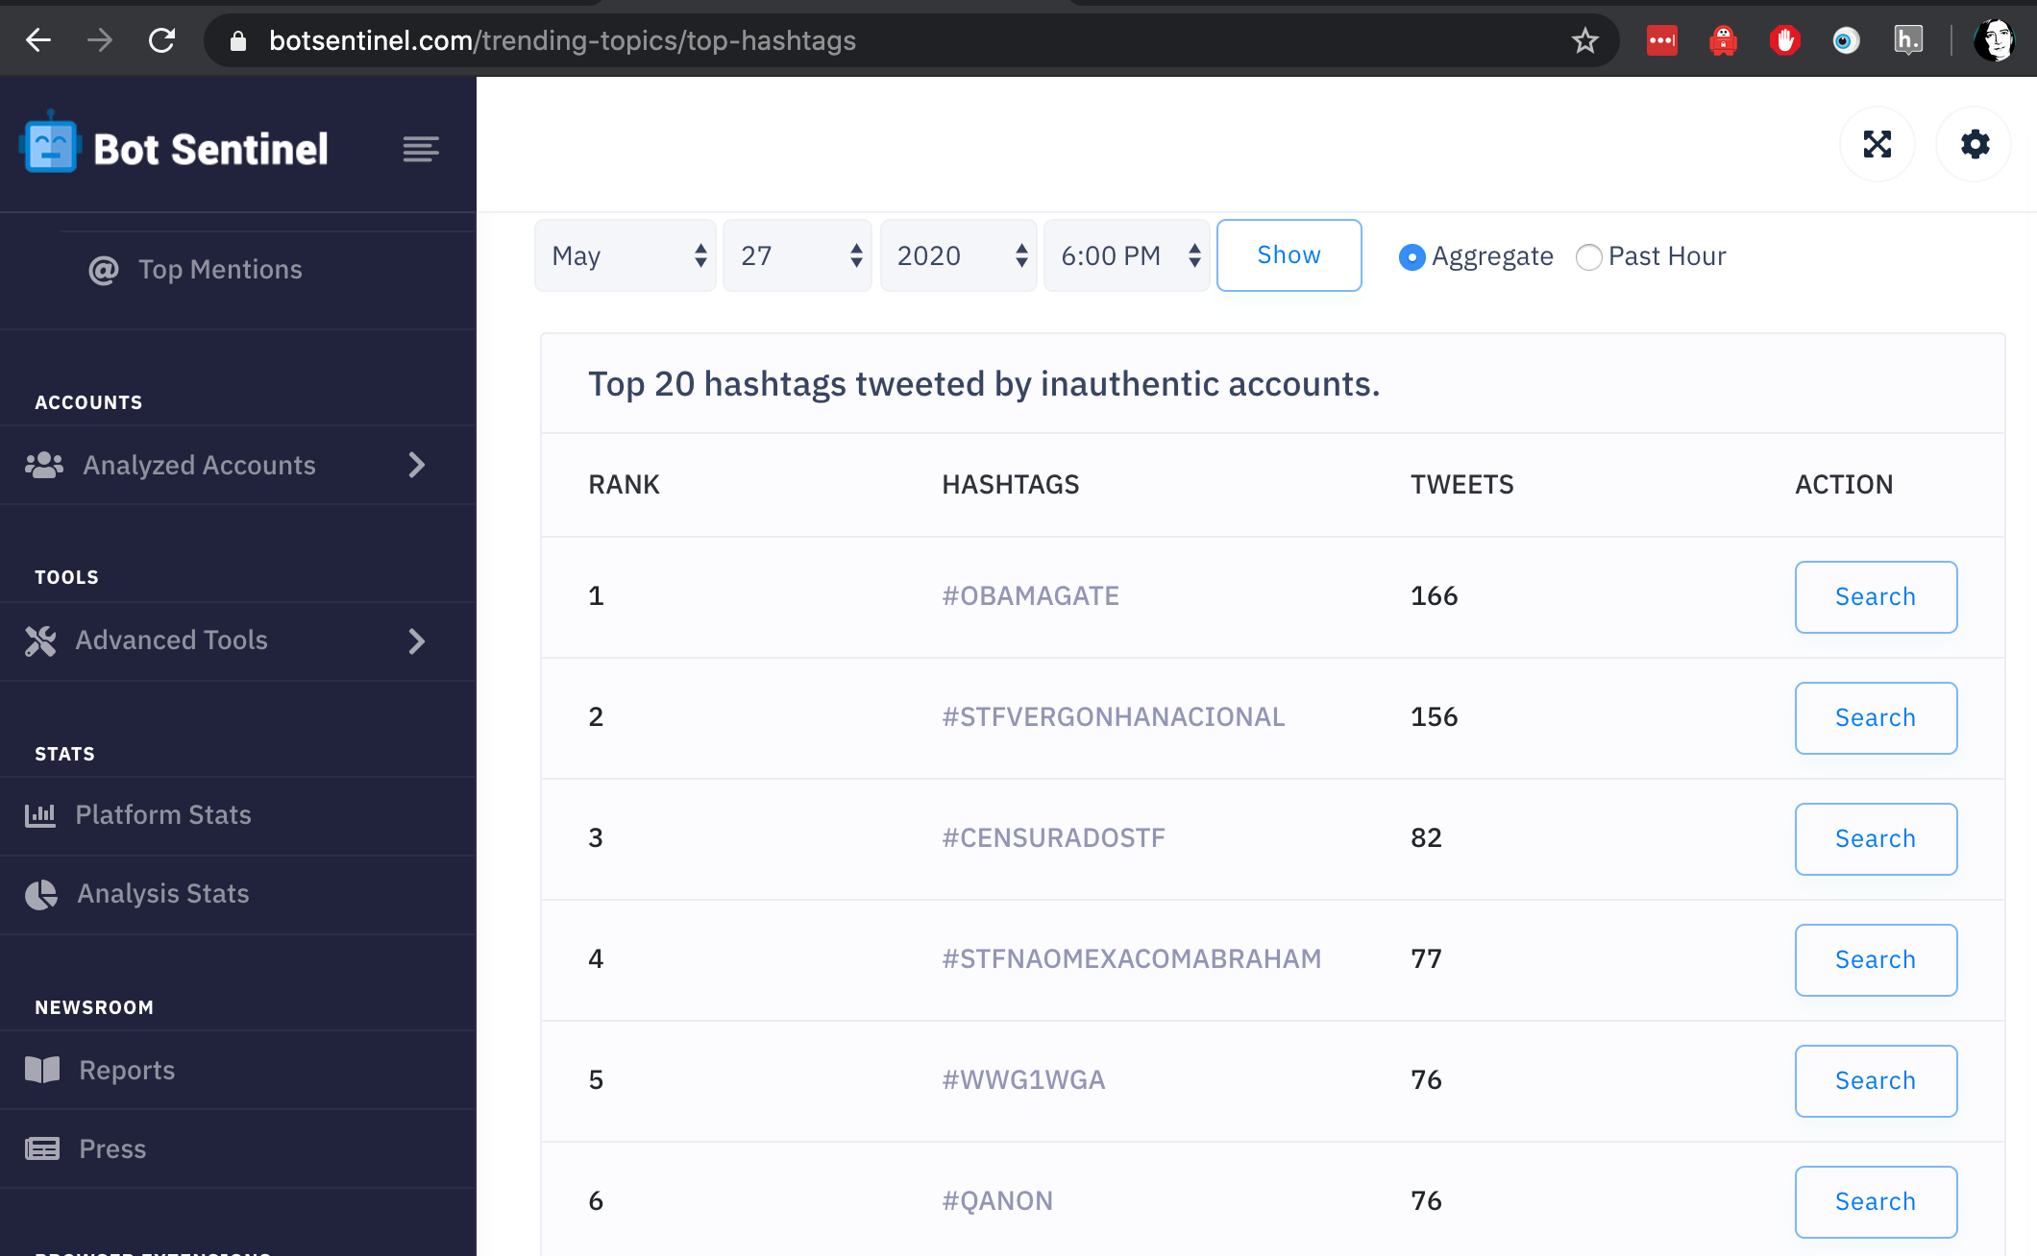
Data Stream: Botsentinel

Slide 9
Disinformation Narratives
Wikipedia list of Covid19 rumours
WHO Covid19 myths list - narratives
EuVsDisinfo database https://euvsdisinfo.eu/disinformation-cases/
Ryerson Claimwatch dashboard
CMU IDEAS Center list of Covid19 disinformation narratives
Indiana Hoaxy (twitter, articles)

Slide 10
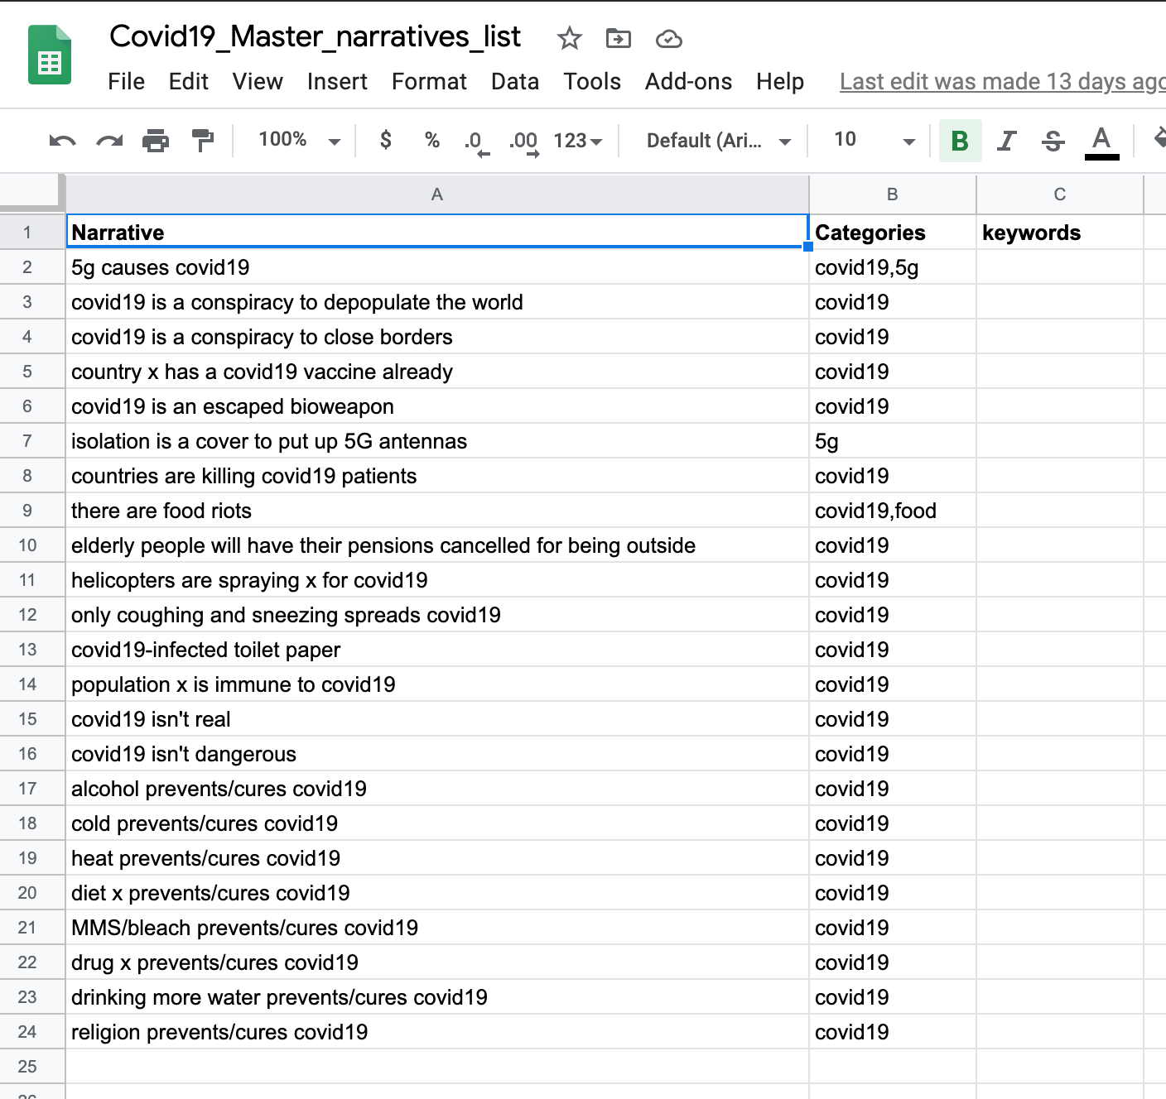
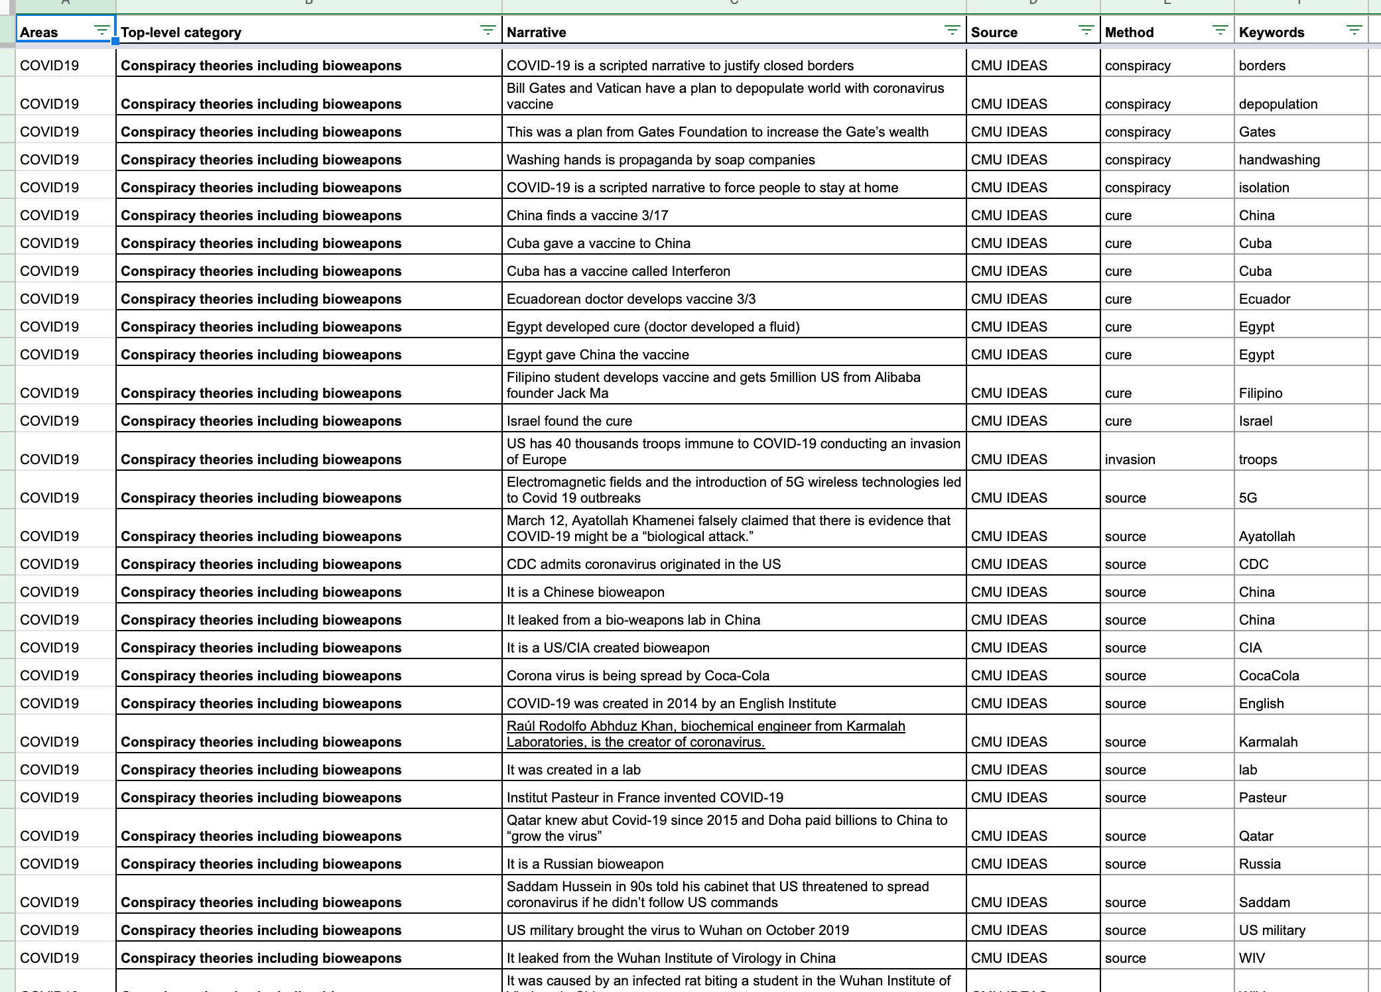
Dataset: Narratives master list
https://docs.google.com/spreadsheets/d/1yoiHNNSkNq5HoNEFiSrYTAE3nuFnp9wMBMcsh-TRx_w/edit#gid=398450894
Notes:
https://docs.google.com/spreadsheets/d/1yoiHNNSkNq5HoNEFiSrYTAE3nuFnp9wMBMcsh-TRx_w/edit#gid=398450894 and https://data.cogsec-collab.org/dataset/covid19-cases/resource/9a423ab1-7600-4545-ada3-5c849e1a5dee#{}

Slide 11
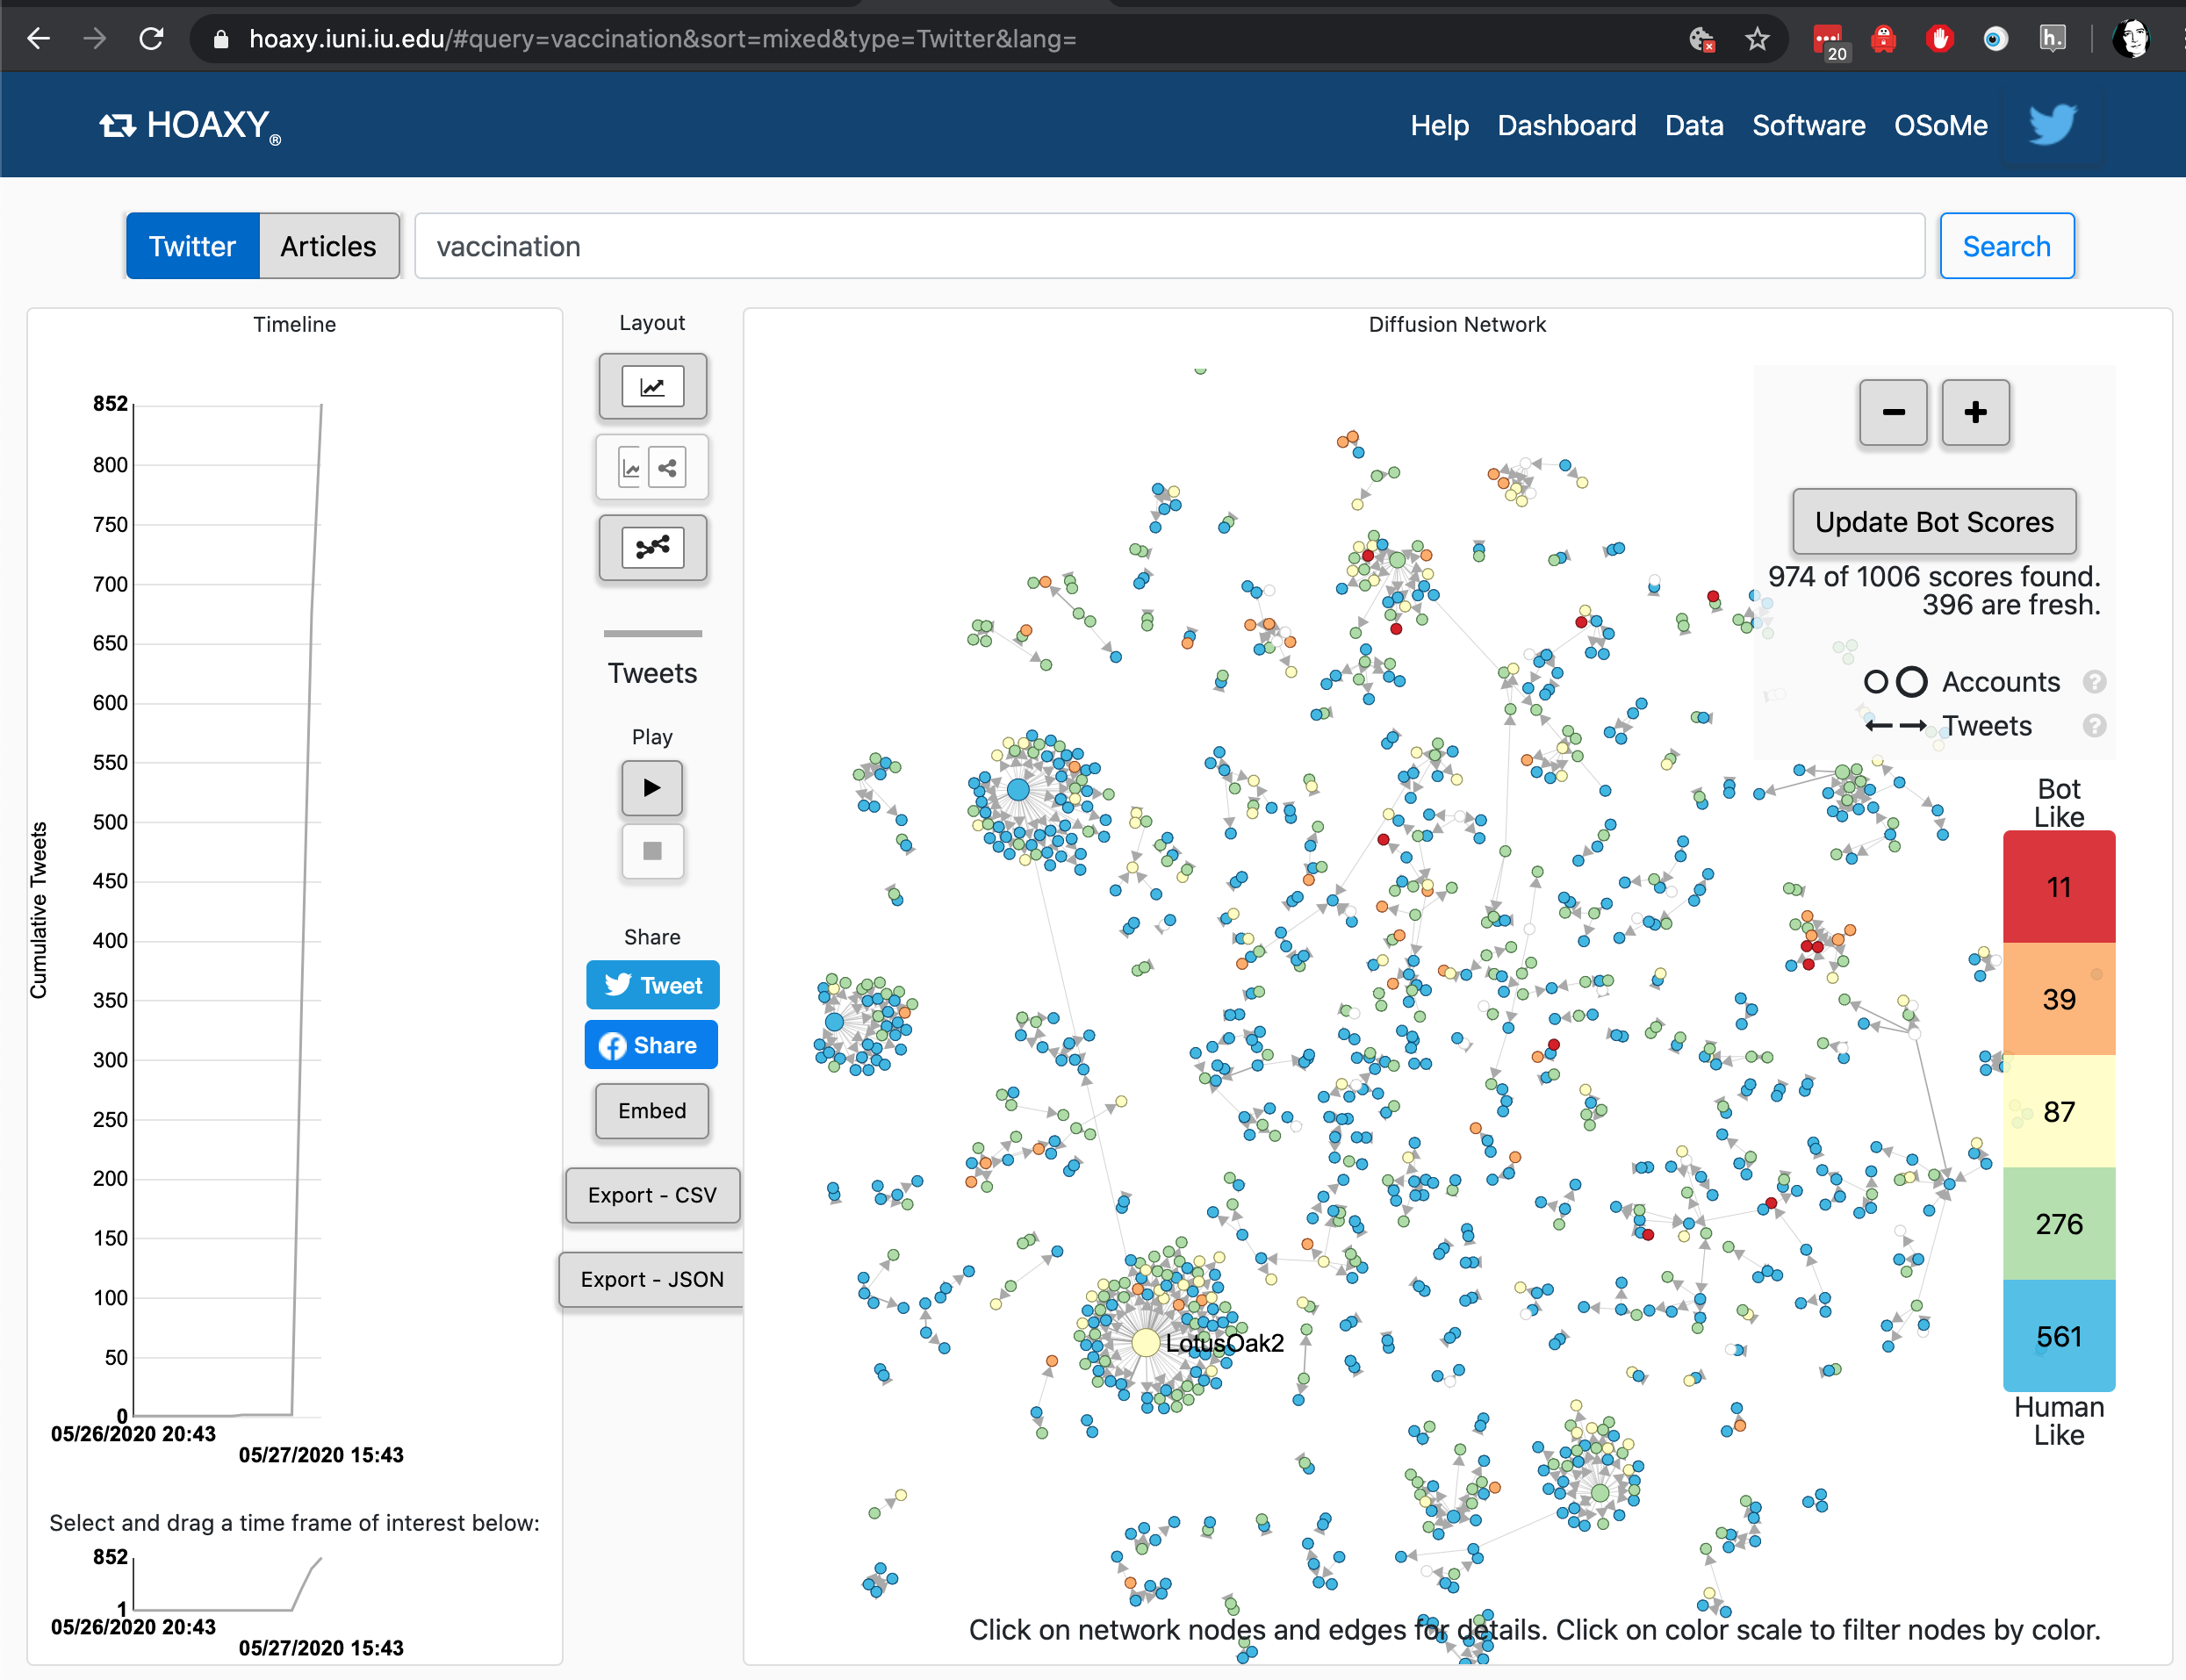
Online data tools
Notes:
https://hoaxy.iuni.iu.edu/#query=vaccination&sort=mixed&type=Twitter&lang=
Hoaxy uses Gephi - we have instructions for how to run twitter through that in the BigBook too.

Slide 12
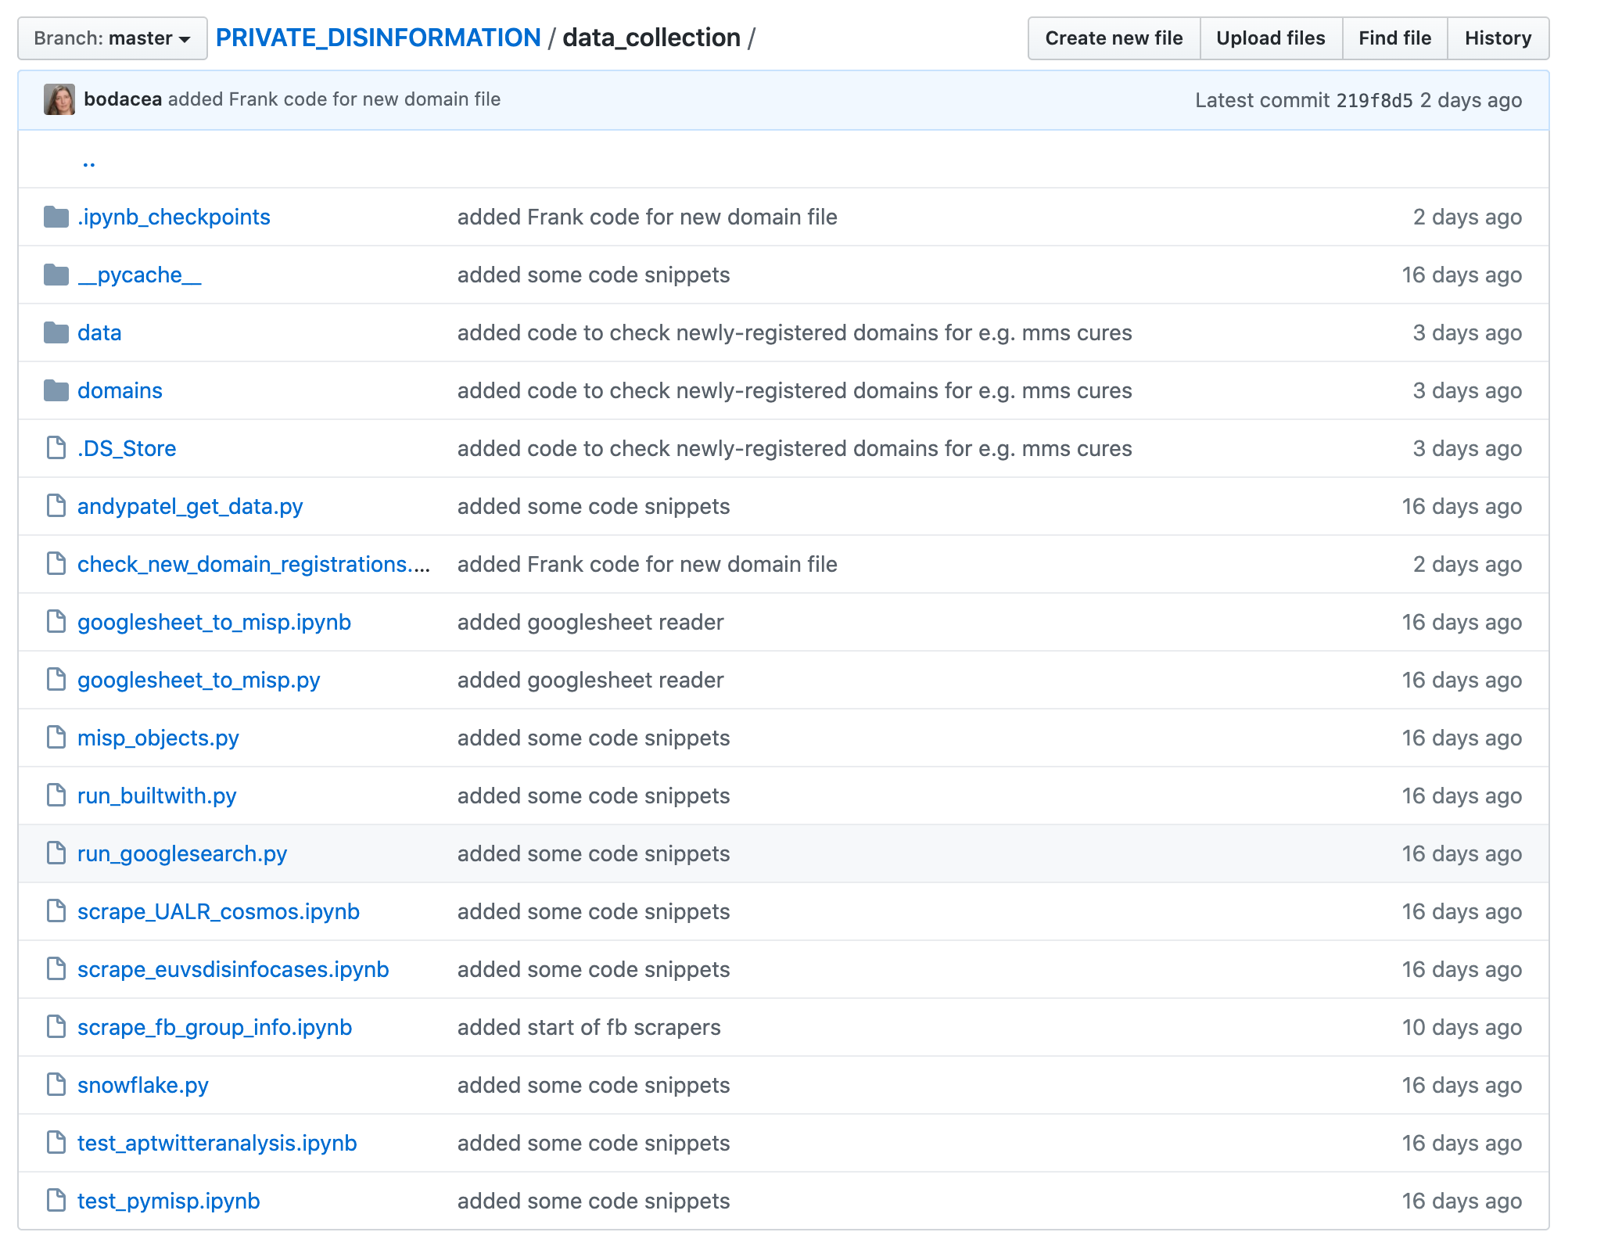
Local data tools
Search:
Google
Twitter
URLs
Ad tags
(Facebook)
...

Slide 13
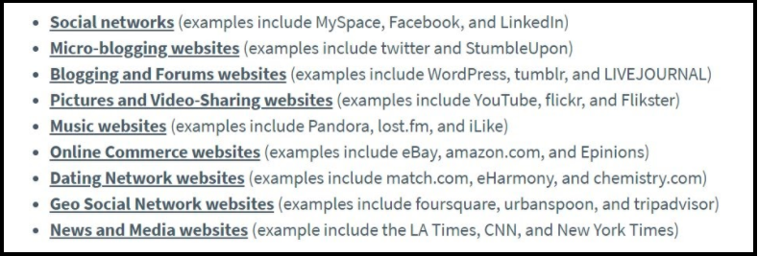
Yeah… we’ve got all this lot to think about...
Notes:
List from Chris Burgess post

Slide 14
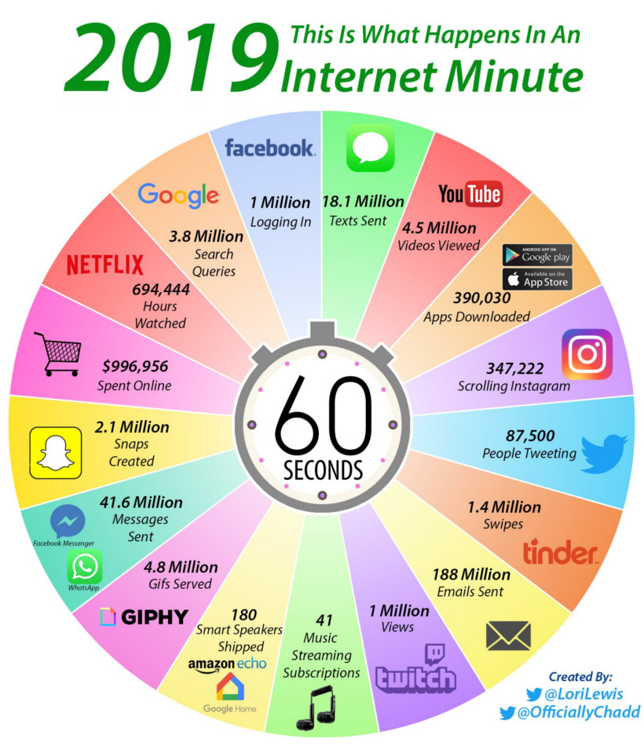
Later: the three ‘V’s, automation/ augmentation
Notes:
See Global digital report 2019, We Are Social

Slide 15
Getting it into the system
HIVE observables / MISP bots
DKAN folders
Googledrive

Slide 16
Back to the Data Science
https://medium.com/the-mission/deconstructing-data-science-breaking-the-complex-craft-into-its-simplest-parts-15b15420df21
Notes:
Read the blogpost btw - it’s a lovely description of what happens in data science.

Slide 17
Over to you…
… or we go to the BigBook...

