Slide 1
CTI League
Disinformation
2020-07-04
Data Science for Disinformation Response
Notes:
Welcome. This training is loosely based around the post https://docs.google.com/document/d/1PZnfbZXBxor3rdg_Rik9yC5QbP-JoAjx1IfVyue676g/edit# and is designed to frame a training route for people wanting to do tactical disinformation data science.

Slide 2
Data Science 4 Disinformation Response series
TBA Introduction to the disinformation team
2020-05-06 What are we chasing? Digital harm training
TBA getting set up for disinformation data science
2020-05-27 Data sources (process, sources, stores)
2020-07-04 Disinfo Data Science examples
TBA Social text analysis
TBA Image data analysis
TBA Relationships as data
TBA Extending your analysis with machine learning skillz
TBA Communicating results (style, narratives, visualisations)
Notes:
AKA DS4DR

Slide 3
Why this series?
Set the art for real-time disinformation data science
Train disinfo team in useful data science skills
Get feedback and new ideas on what we do
Practice my university course

Slide 4
Wheels in wheels in whee…..
Threat intelligence: “information an organization uses to understand the threats that have, will, or are currently targeting the organization. This info is used to prepare, prevent, and identify cyber threats looking to take advantage of valuable resources. “
Intelligence analysis: “process of taking known information about situations and entities of strategic, operational, or tactical importance, characterizing the known, and, with appropriate statements of probability, the future actions in those situations and by those entities”
OSINT: “intelligence produced from publicly available information that is collected, exploited, and disseminated in a timely manner to an appropriate audience for the purpose of addressing a specific intelligence requirement.”
Data science: “the field of study that combines domain expertise, programming skills, and knowledge of mathematics and statistics to extract meaningful insights from data”
Notes:
TI definition: https://www.forcepoint.com/cyber-edu/threat-intelligence
IA definition: https://www.recordedfuture.com/definition-of-intelligence-analysis/ - cool cool, looks like situation awareness definitions of old. E.g WTF is going on, what’s targetting us, what can we do about it?
OSINT definition: https://www.rand.org/content/dam/rand/pubs/research_reports/RR1900/RR1964/RAND_RR1964.pdf (which talks about how OSINT processing used to be simple: translation, then all-source analysis)
Data science is still debated, e.g. wikipedia says “Data science is an inter-disciplinary field that uses scientific methods, processes, algorithms ... in managing a digital data collection. There is still no consensus on the definition of data science and it is considered by some to be a buzzword.”

Slide 5
Bugger that - the TL;DR versions
Threat intelligence:
“what are our recent, current and future threats?“
Intelligence analysis:
“WTF is going on, who’s involved, and what are our best guesses about now and the future?”
OSINT:
“Using public data, what can we tell the people who can do something, in time for them to do it?”
Data science:
“I’ve got skillz, questions and data: what’s happening?”
Bonus question: can we do this quickly?
Notes:
It’s all detective work really.

Slide 6
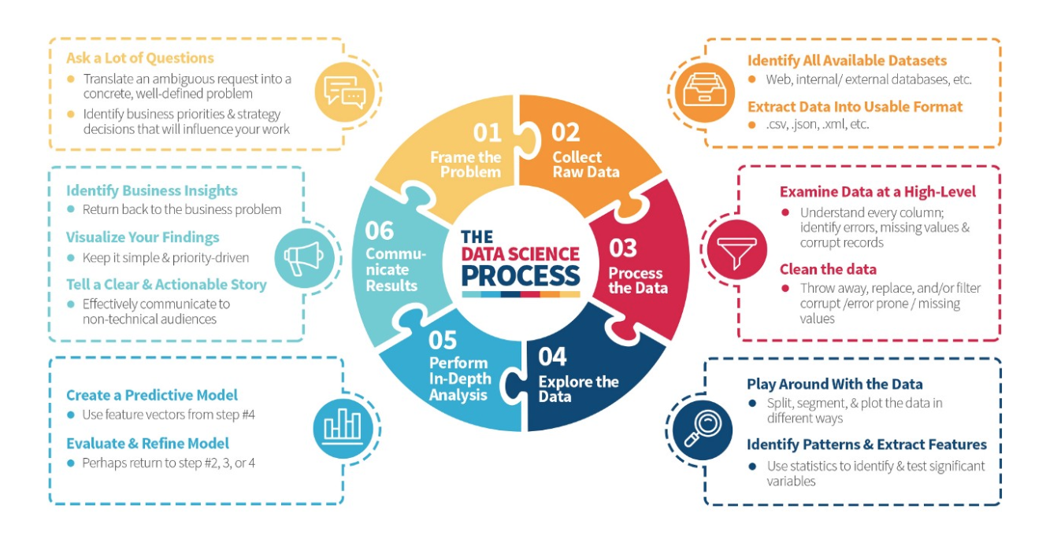
Recap: Data Science is a Process
https://medium.com/the-mission/deconstructing-data-science-breaking-the-complex-craft-into-its-simplest-parts-15b15420df21
Notes:
Read the blogpost btw - it’s a lovely description of what happens in data science.

Slide 7
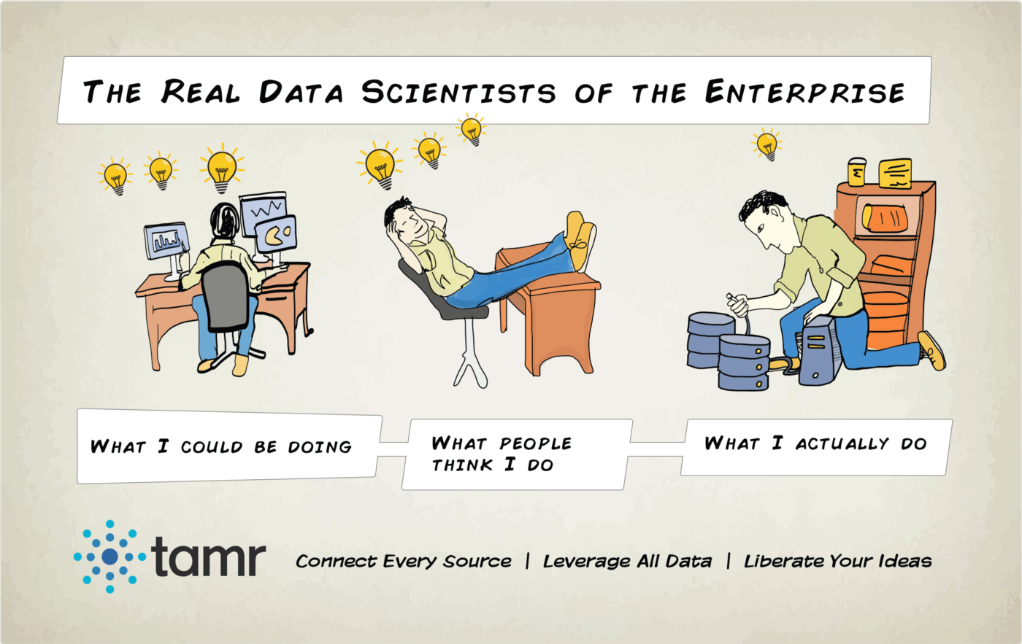
Recap: Data Science is a team sport
Problem people
(CDOs)
Data strategy
Business analysis
Backend people
Data architecture
Data engineering
Software development
Frontend people
Data analysis
Machine learning
Data visualisation
Notes:
https://towardsdatascience.com/a-new-definition-of-data-science-in-academic-programs-2d48ad6db8b7
https://www.altexsoft.com/blog/datascience/how-to-structure-data-science-team-key-models-and-roles/

Slide 8
Recap: Starting an Incident
Harms: physical, psychological, economic, reputational, cultural, political
Disinformation vs Misinformation vs Malinformation = false + intent to harm
Motivations: attention, money, power, geopolitics, all the above
Nationstate harms: DIME, common political knowledge
Business harms: DIME
Medical harms: Covid19 themes
Incident start criteria
Potential harm, falsehood, are we best team to deal with this?
“First, do no harm”: Ethics of starting incidents, tracking, storing and countering
Incident start points
Artefacts (image, message, url, ad/ad tag, command signal…)
Events (new narrative, local/world event, anomalous activity…)

Slide 9
Recap: “Frame The Problem”
What are we starting with?
Initial artifact, theme, narrative, lead
What’s our “research question”?
What do and don’t we care about here?
What’s more and less important to us (if we have limited resources)?
What are we trying to produce and for whom?
Enough evidence that we can identify who to pass it to, and give them enough to either act or start their own investigation
Enough evidence and information to take action ourselves

Slide 10
Recap: Get the data
Process
Identify available relevant datasets (or proxies)
Identify biases, gaps etc
Spider out and collect more (on so many sites…)
Extract data into usable format (CSV, json, MISP etc)
Sources
Input data: alerts and canaries (we get in vs we watch)
Disinformation data streams (Hamilton68, Botsentinal etc)
Disinformation narratives lists (EuVsDisinfo, WHO Int etc)
Search (Online data tools, online search, APIs, OSINT)
Stores
Hive, Misp, Dkan, Googledrive, Github, ...
Notes:
Canaries = know producers, early adopters or amplifiers of signals

Slide 11
DS4DR: Tactical Disinformation Data Science

Slide 12
Tactical Data Science? It’s about deadlines
Strategic - weeks/months/years.
Issue focussed. e.g. long-form journalism, SJ’s work on agriculture supply chains and covid. [Stanford Internet Observatory, UWashington, Shorenstein Center, Bellingcat, DFRlab, Grafika].
Operational - days/weeks.
Project focussed. Usually embedded in dev team. Support behaviour/ hypothesis-driven development, lean enterprise (pruning value trees etc). [AI/ML-based disinformation tool companies].
Tactical - hours/days.
Incident focussed. Includes many data journalists. [NY Times, CTI League team, some of MLSEC, some of the crisis-mappers].
Notes:
We could also divide disinformation data scientists by the things that they care about:
Academics - long deadlines, care about papers and reputation
Academics working on techniques - UIndiana
Academics analysing actors and issues - DFRlab, strategic
Government agencies / military - strategic
Commercial interests -

Slide 13
(Some) Tactical Tasks
Credibility/ Verification
Fact-checking: verify article, image, video etc doesn’t contain disinformation.
Source-checking: verify source (publisher, domain etc) doesn’t distribute disinformation.
Network detection
Pinkslime finding: find inauthentic website networks
Network finding: find inauthentic account networks (including botnets)
Activity analysis
Detect computational amplification
Detect fake accounts
Look at patterns of account creation dates for popular messages
Detect, track and analyse narratives
Notes:
Fact-checking is hard, and usually needs a team of fact-checkers, up-to-date knowledge etc.
Source-checking: This is why we label and track URLs. Several groups already publish labelled lists of domains.
Source networks: Some work on “pink slime” exists.

Slide 14
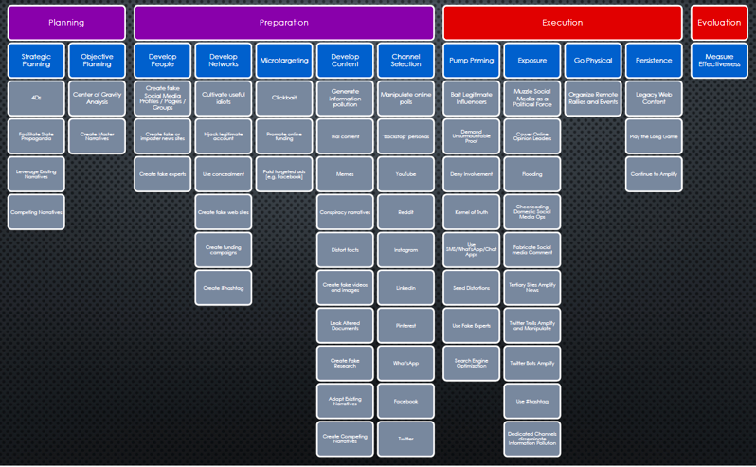
Tactical Tasks = detecting AMITT techniques
Notes:
… and countering, and measuring…

Slide 15
A Walk Outside

Slide 16
Outside Disinfo Datascience Topics
General
Network detection and analysis
Account/activity analysis
Narrative tracking
Machine Learning: classification
Tweet classification
GPT2 language generation / detection:
Article text classification (on the Kaggle dataset)
Article text classification (not Kaggle)
Deepfake detection
Machine Learning: other
Temporal analysis

Slide 17
There’s a lot of strategic OSINT right now...
Fireeye looking at Iranian network: Network of Social Media Accounts Impersonates U.S. Political Candidates, Leverages U.S. and Israeli Media in Support of Iranian Interests
Graphika tracking GRU network: From Russia With Blogs
DFRlab on MyRan commercial operation: Facebook shut down commercial disinformation network based in Myanmar and Vietnam
Vice reporting, unknown researcher on targetted deepfakes: Deepfakes by BJP in Indian Delhi Election Campaign

Slide 18
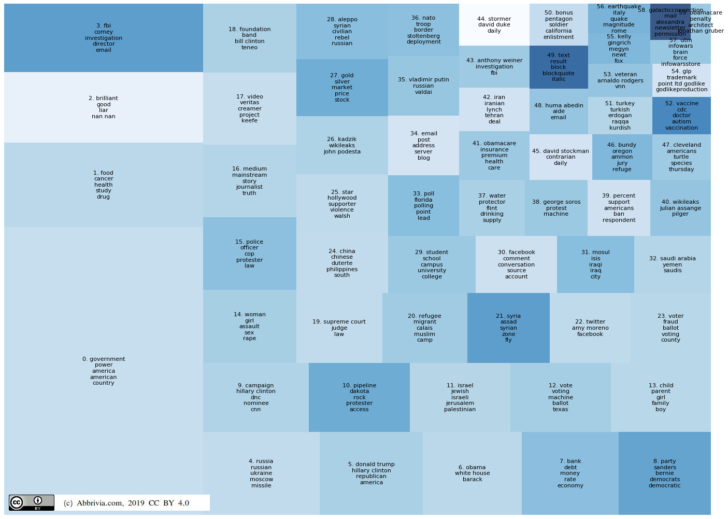
Machine Learning: Test Datasets
Kaggle “getting real about fake news”
NBC’s Russian twitter
Fivethirtyeight’s russian-troll-tweets
(Topic model: https://www.kaggle.com/mrisdal/fake-news/discussion/116839)
Notes:
A lot of the work out there gets tested on one of these three datasets. There are *lots* of student projects on the Kaggle dataset, because it’s a classic text-based classification problem…
NB 538 dataset created with Salesforce’s Social Studio ($1000/month)
If you really want to get into topic modelling: https://www.kaggle.com/arthurtok/spooky-nlp-and-topic-modelling-tutorial

Slide 19
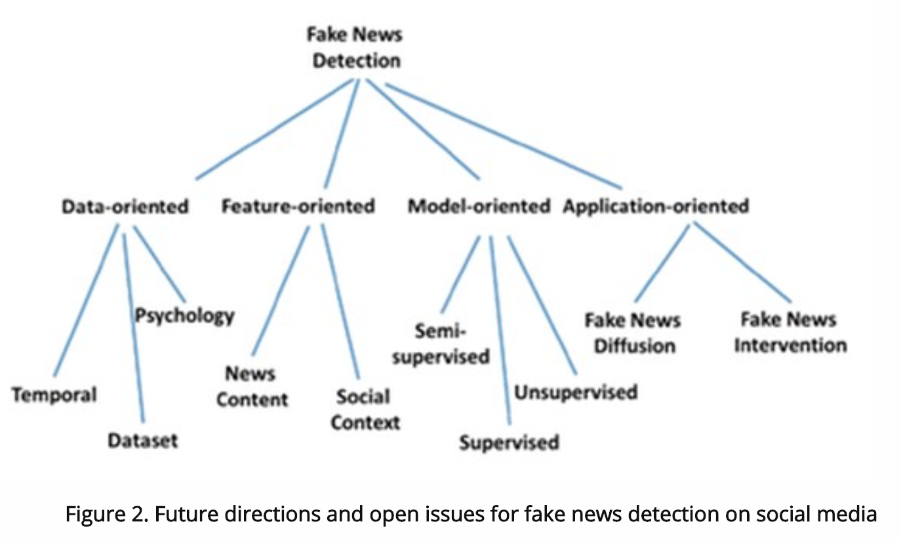
OMG all the Kaggles: Shu and Liu summary
Notes:
https://www.kdnuggets.com/2017/10/guide-fake-news-detection-social-media.html

Slide 20
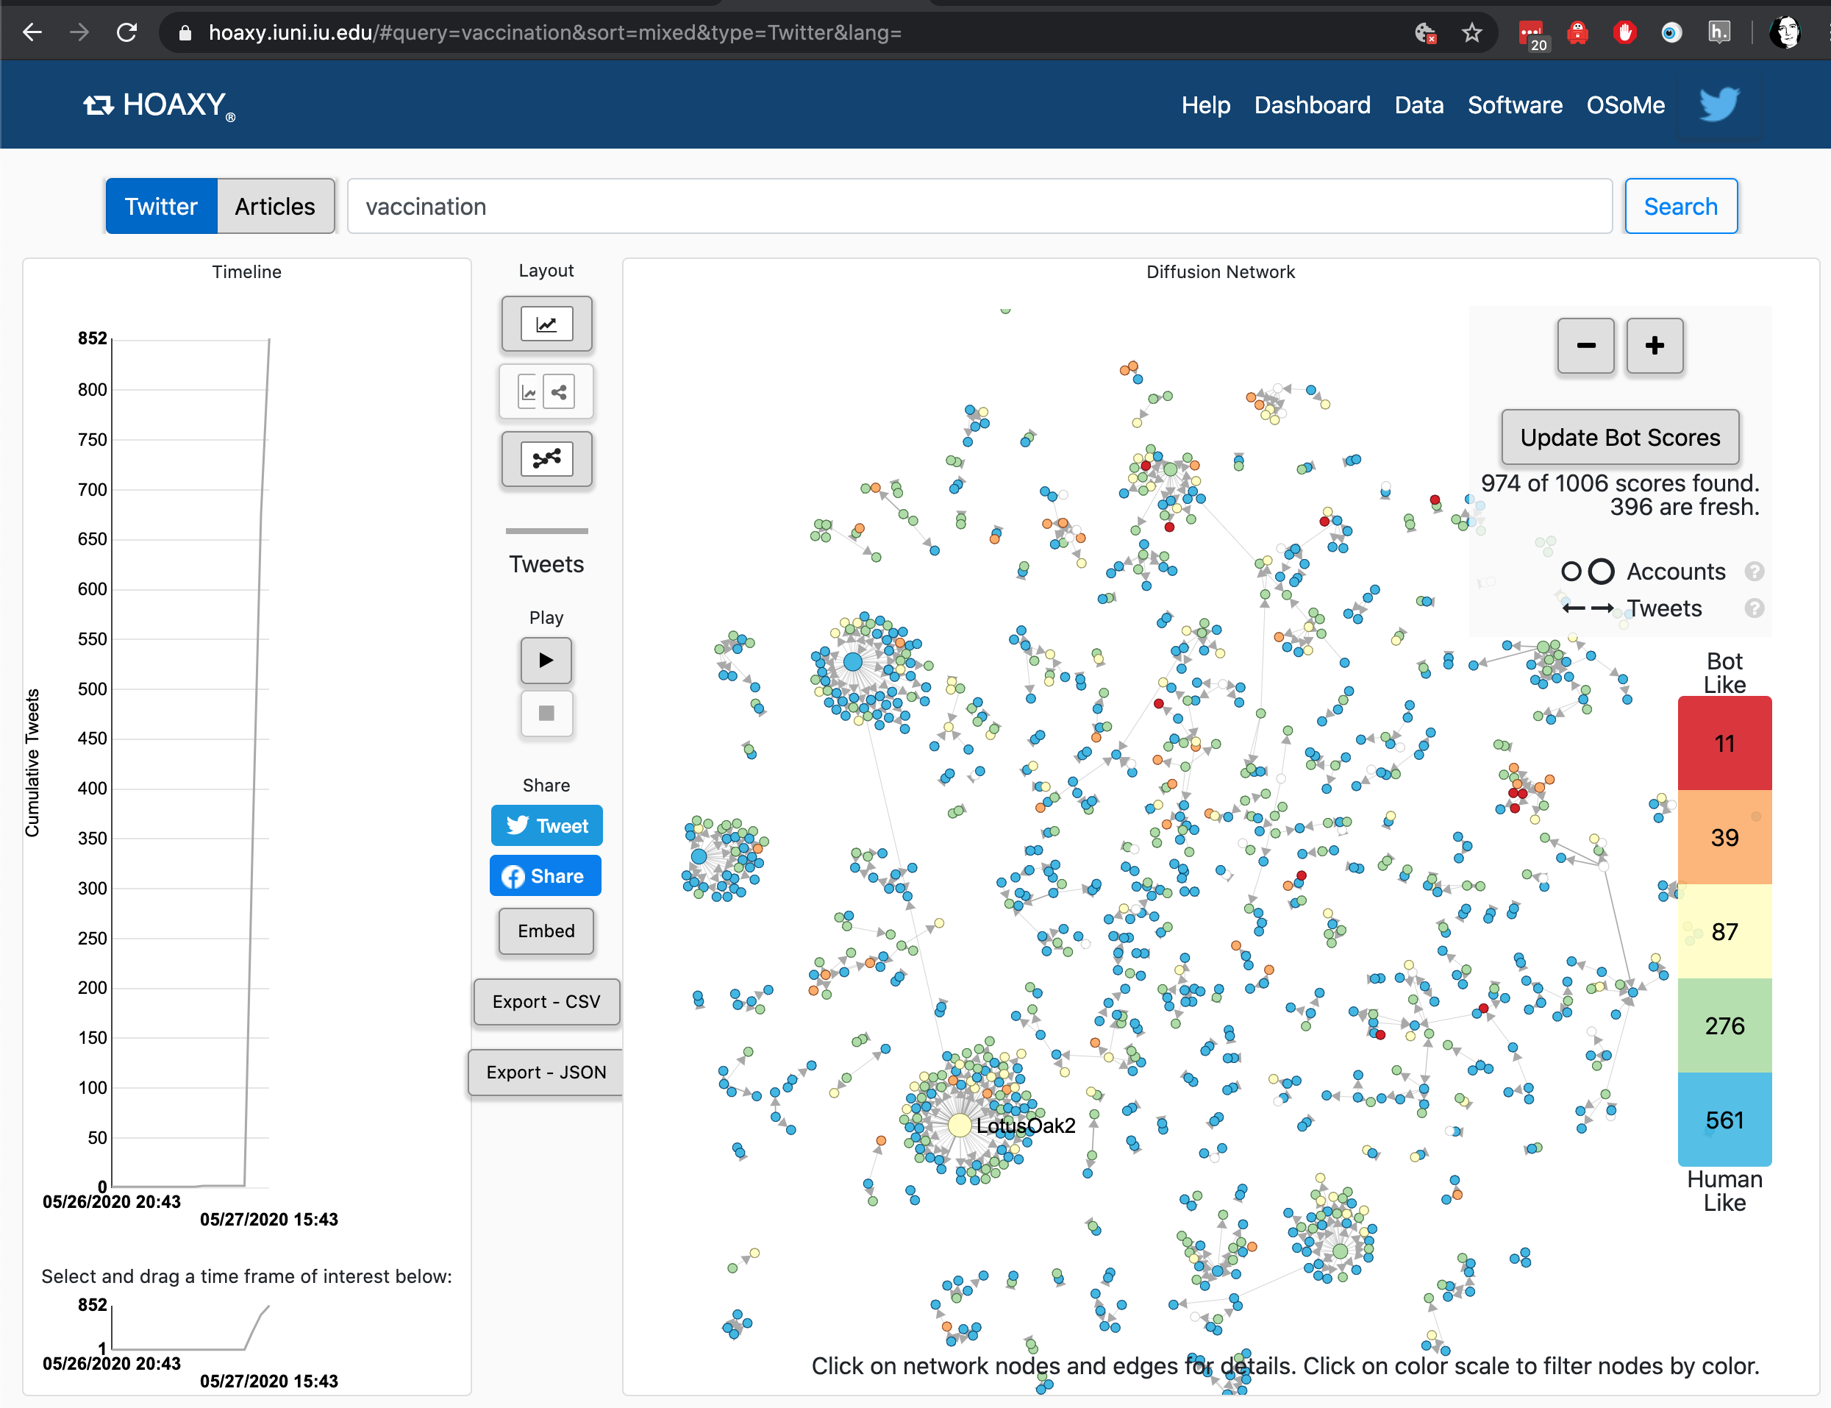
UIndiana data tools
Notes:
https://hoaxy.iuni.iu.edu/#query=vaccination&sort=mixed&type=Twitter&lang=
Hoaxy uses Gephi - we have instructions for how to run twitter through that in the BigBook too.

Slide 21
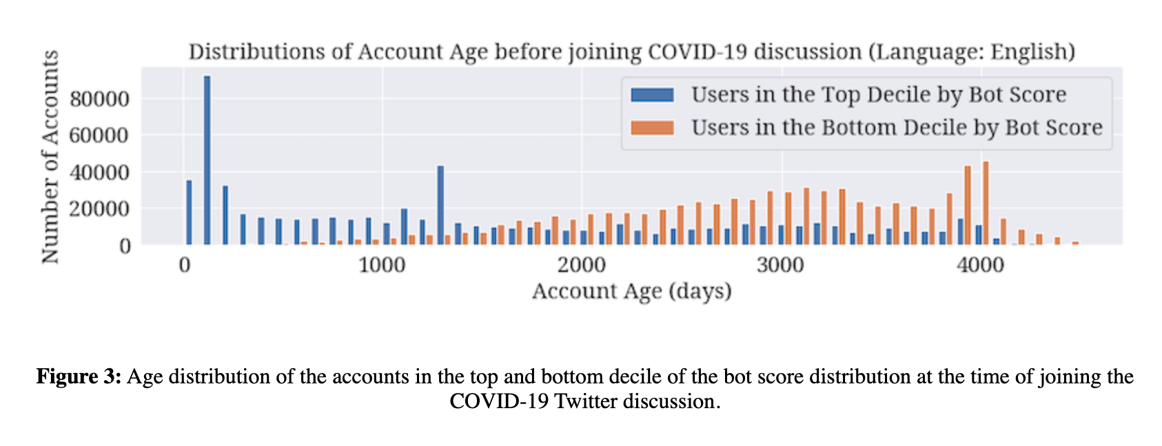
Example: [Name Redacted] on Covid19 disinfo
Notes:
https://firstmonday.org/ojs/index.php/fm/article/view/10633/9548

Slide 22
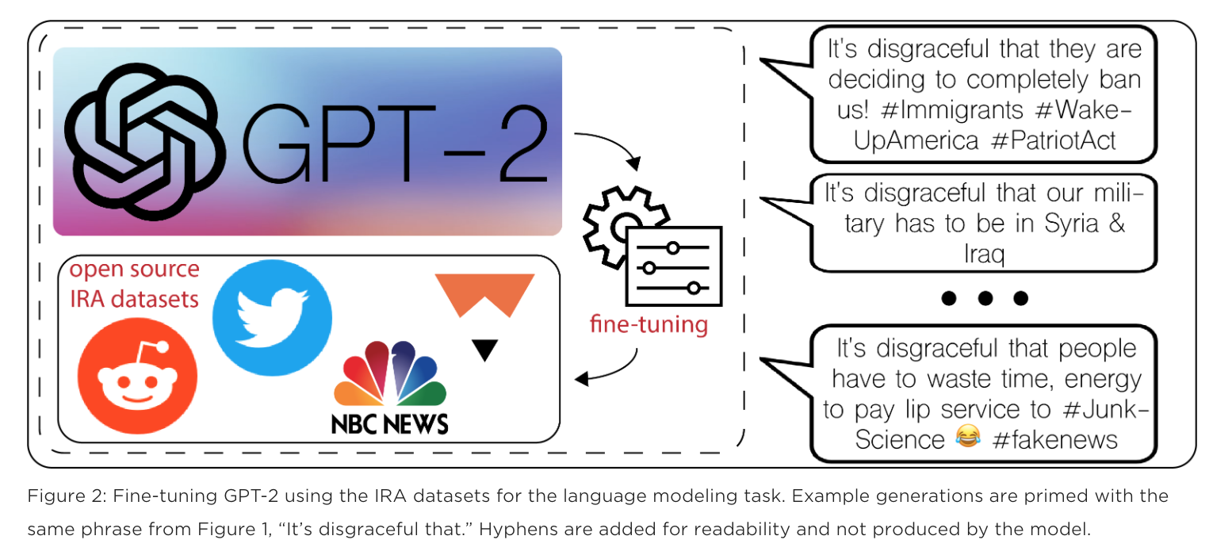
Generating to understand: Fireeye and GPT2
Notes:
[Name Redacted], [Name Redacted], [Name Redacted]
https://www.fireeye.com/blog/threat-research/2019/11/combatting-social-media-information-operations-neural-language-models.html

Slide 23
CTI Disinfo Team

Slide 24
Where are we right now?
We have OSINT
And data science help
And data collection
And a growing toolkit
But need to keep growing our data science practice

Slide 25
Over to You…

