Slide 1
CTI League
Disinformation
2020-07-25
Data Science 4 Disinfo Response:
Text Analysis
Notes:
Welcome. This training is designed to frame a training route for people wanting to do tactical disinformation data science. Why this series? To:
Set the art for real-time disinformation data science
Train disinfo team in useful data science skills
Get feedback and new ideas on what we do
Practice [Name Redacted] university course
So as always, all comments, corrections, additions welcomed. Released CC-by-SA: please use this work yourself, but please also attribute it back to the CogSecCollab.

Slide 2
Data Science 4 Disinformation Response series
2020-07-15 Introduction to the disinformation team
2020-05-06 What are we chasing? Digital harm training
TBA getting set up for disinformation data science
2020-05-27 Data sources (process, sources, stores)
2020-07-04 Disinfo Data Science examples
2020-08-05 Social text analysis
TBA Image data analysis
2020-07-11 Relationships as data
TBA Extending your analysis with machine learning skillz
TBA Communicating results (style, narratives, visualisations)
Notes:
AKA DS4DR

Slide 3
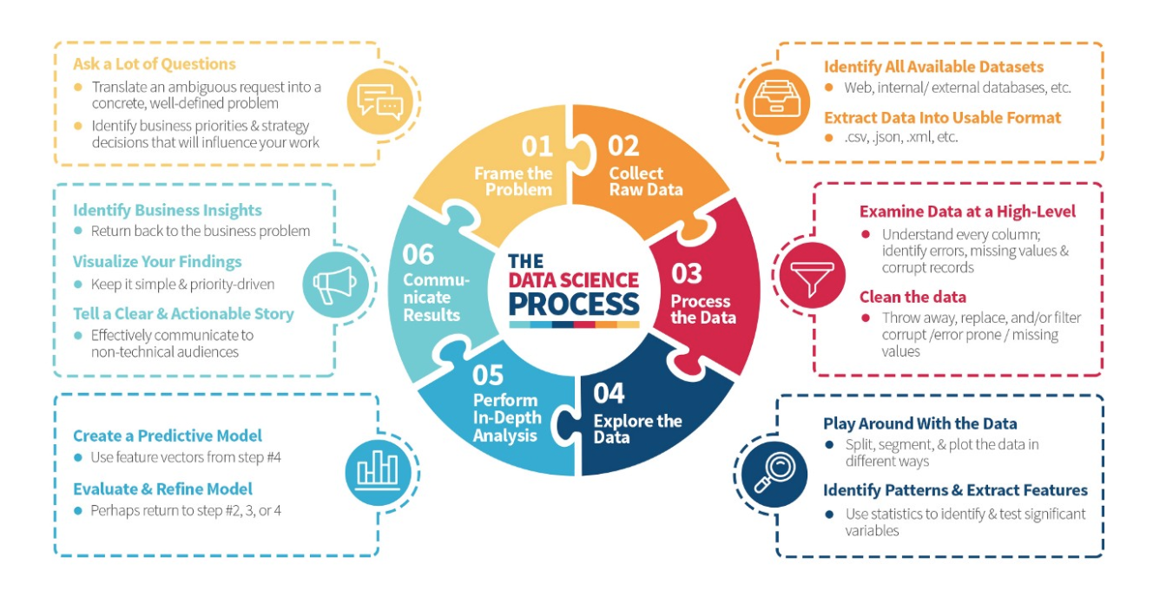
Recap: Data Science is a Process
https://medium.com/the-mission/deconstructing-data-science-breaking-the-complex-craft-into-its-simplest-parts-15b15420df21
Notes:
Read the blogpost btw - it’s a lovely description of what happens in data science.

Slide 4
Recap: (Some) Tactical Tasks
Credibility/ Verification
Fact-checking: verify article, image, video etc doesn’t contain disinformation.
Source-checking: verify source (publisher, domain etc) doesn’t distribute disinformation.
Network detection
Pinkslime finding: find inauthentic website networks
Network finding: find inauthentic account networks (including botnets)
Activity analysis
Detect computational amplification
Detect fake accounts
Look at patterns of account creation dates for popular messages
Detect, track and analyse narratives
Notes:
Fact-checking is hard, and usually needs a team of fact-checkers, up-to-date knowledge etc.
Source-checking: This is why we label and track URLs. Several groups already publish labelled lists of domains.
Source networks: Some work on “pink slime” exists.

Slide 5
What Can We Do With Text?

Slide 6
Text Processing
Information retrieval
Search
Named entity recognition
Learning
Classification
Clustering
Topic identification/ topic following
Sentiment analysis
Network analysis (words, people etc)
Comprehension
Natural language processing
Translation
Truthiness
Gisting
Creation
Text generation

Slide 7
Data sources
Anywhere there’s text, e.g.
Social media: Twitter, Facebook, Reddit, Youtube, Instagram, Medium etc
Websites: https://commoncrawl.org/ extracts and saves text
Wikipedia / Wikidata
Documents
[Check the sources list in the BigBook]

Slide 8
Common Tools
Python libraries:
Scikit-Learn
NLTK
Gensim
Spacy
Standalone Tools:
GPT2 / GPT3
Weka
Notes:
Longer list: http://en.wikipedia.org/wiki/Social_network_analysis_software

Slide 9
All Text is Data

Slide 10
Let’s get some raw text
"RT @Loli99704518: @francis66675984 @rafapal Pues sí. Ya podríamos los españoles tomar ejemplo de los serbios. El covid forma parte de un en… RT @KateShemirani: Oh really? Just like with radiation poisoning then. Put enough symptoms down on the diagnosis sheet and you can just abo… RT @KateShemirani: Oh really? Just like with radiation poisoning then. Put enough symptoms down on the diagnosis sheet and you can just abo… @AlbertoRodNews Recordemos #5Jul Día de la independencia y brote del COVID-5G en un desfile sin tapabocas, pensaron que el uniforme era inmune 🧫 RT @KateShemirani: Oh really? Just like with radiation poisoning then. Put enough symptoms down on the diagnosis sheet and you can just abo… RT @Walletwalking1: @Sterling2143 @AAureilus Anyone noticed COVID symptoms are same as 5G exposure. What have they been rolling out in the… RT @ADDiane: Let's tell the people who won't wear masks that it's not for covid, it's for tricking the facial recognition software that dee… Discourse "
import pandas as pd
import json
# Read dataset into a Pandas dataframe
infile = '20200711140613_covid-5g_tweets.json'
with open(infile) as json_file:
jdata = json.load(json_file)
df = pd.DataFrame.from_dict(jdata, orient='index')
df.reset_index(level=0, inplace=True)
df.columns = ['url', 'text']
# stick all the tweets together so we can look
# at them as one big text chunk
alltext = [' '.join(df['text'].to_list())]

Slide 11
One way to look at text: meanings
Syntax: the structure of sentences, a.g. Grammar
Noun-verb order (e.g. German verbs go at the end of a sentence)
Tenses, cases, gender agreements in languages that use them
Semantics: the meanings of sentences
Sensemaking
“Just like with radiation poisoning then”, “Fruit flies like an apple”
Pragmatics: the meaning of sentences, in context
Adding history
Resolving anaphora and filling in other missing information
Notes:
See e.g. https://www.writersdigest.com/write-better-fiction/semantics-vs-syntax-vs-pragmatics-grammar-rules

Slide 12
Text as “bags of words”
Sentences:
“Oh really?”,
”Just like with radiation poisoning then.”
Words: “just”, “like”, “with”, etc
Trigrams: “jus”, “ust”, “st “, “t l”, “ li”, “lik” “ike”
Bigrams: “just like”, “like with”, “with radiation”, “radiation poisoning”
Stopwords: “with”, “on”, “then”, “what”, “have”, “they”, “been”, “out”, “in”, “the”, etc
"RT @KateShemirani: Oh really? Just like with radiation poisoning then. Put enough symptoms down on the diagnosis sheet and you can just abo… RT @Walletwalking1: @Sterling2143 @AAureilus Anyone noticed COVID symptoms are same as 5G exposure. What have they been rolling out in the… RT @ADDiane: Let's tell the people who won't wear masks that it's not for covid, it's for tricking the facial recognition software that dee… Discourse "

Slide 13
Scikit-Learn’s default English stopwords
['a', 'about', 'above', 'across', 'after', 'afterwards', 'again', 'against', 'all', 'almost', 'alone', 'along', 'already', 'also', 'although', 'always', 'am', 'among', 'amongst', 'amoungst', 'amount', 'an', 'and', 'another', 'any', 'anyhow', 'anyone', 'anything', 'anyway', 'anywhere', 'are', 'around', 'as', 'at', 'back', 'be', 'became', 'because', 'become', 'becomes', 'becoming', 'been', 'before', 'beforehand', 'behind', 'being', 'below', 'beside', 'besides', 'between', 'beyond', 'bill', 'both', 'bottom', 'but', 'by', 'call', 'can', 'cannot', 'cant', 'co', 'con', 'could', 'couldnt', 'cry', 'de', 'describe', 'detail', 'do', 'done', 'down', 'due', 'during', 'each', 'eg', 'eight', 'either', 'eleven', 'else', 'elsewhere', 'empty', 'enough', 'etc', 'even', 'ever', 'every', 'everyone', 'everything', 'everywhere', 'except', 'few', 'fifteen', 'fifty', 'fill', 'find', 'fire', 'first', 'five', 'for', 'former', 'formerly', 'forty', 'found', 'four', 'from', 'front', 'full', 'further', 'get', 'give', 'go', 'had', 'has', 'hasnt', 'have', 'he', 'hence', 'her', 'here', 'hereafter', 'hereby', 'herein', 'hereupon', 'hers', 'herself', 'him', 'himself', 'his', 'how', 'however', 'hundred', 'i', 'ie', 'if', 'in', 'inc', 'indeed', 'interest', 'into', 'is', 'it', 'its', 'itself', 'keep', 'last', 'latter', 'latterly', 'least', 'less', 'ltd', 'made', 'many', 'may', 'me', 'meanwhile', 'might', 'mill', 'mine', 'more', 'moreover', 'most', 'mostly', 'move', 'much', 'must', 'my', 'myself', 'name', 'namely', 'neither', 'never', 'nevertheless', 'next', 'nine', 'no', 'nobody', 'none', 'noone', 'nor', 'not', 'nothing', 'now', 'nowhere', 'of', 'off', 'often', 'on', 'once', 'one', 'only', 'onto', 'or', 'other', 'others', 'otherwise', 'our', 'ours', 'ourselves', 'out', 'over', 'own', 'part', 'per', 'perhaps', 'please', 'put', 'rather', 're', 'same', 'see', 'seem', 'seemed', 'seeming', 'seems', 'serious', 'several', 'she', 'should', 'show', 'side', 'since', 'sincere', 'six', 'sixty', 'so', 'some', 'somehow', 'someone', 'something', 'sometime', 'sometimes', 'somewhere', 'still', 'such', 'system', 'take', 'ten', 'than', 'that', 'the', 'their', 'them', 'themselves', 'then', 'thence', 'there', 'thereafter', 'thereby', 'therefore', 'therein', 'thereupon', 'these', 'they', 'thick', 'thin', 'third', 'this', 'those', 'though', 'three', 'through', 'throughout', 'thru', 'thus', 'to', 'together', 'too', 'top', 'toward', 'towards', 'twelve', 'twenty', 'two', 'un', 'under', 'until', 'up', 'upon', 'us', 'very', 'via', 'was', 'we', 'well', 'were', 'what', 'whatever', 'when', 'whence', 'whenever', 'where', 'whereafter', 'whereas', 'whereby', 'wherein', 'whereupon', 'wherever', 'whether', 'which', 'while', 'whither', 'who', 'whoever', 'whole', 'whom', 'whose', 'why', 'will', 'with', 'within', 'without', 'would', 'yet', 'you', 'your', 'yours', 'yourself', 'yourselves']
Notes:
from sklearn.feature_extraction import text
xxx = list(text.ENGLISH_STOP_WORDS)
xxx.sort()
print('{}'.format(xxx))

Slide 14
Word Importance: Named Entity Recognition
Finds names of people, organisations, locations etc in text
Can use to create social graphs
import spacy
nlp = spacy.load('en_core_web_sm')
sentence = "Bill Gates is selling 5G Covid19 data to Microsoft"
doc = nlp(sentence)
for ent in doc.ents:
print(ent.text, ent.label_)
Bill Gates PERSON
5 CARDINAL
Microsoft ORG
Notes:
See https://www.geeksforgeeks.org/python-named-entity-recognition-ner-using-spacy/

Slide 15
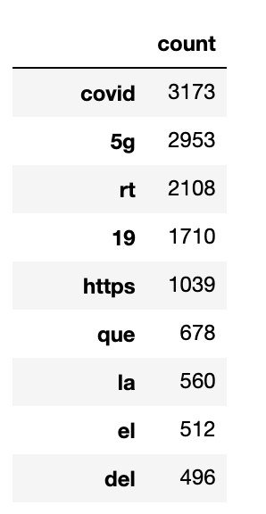
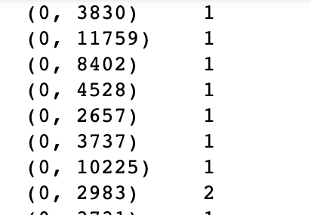
Okay, let’s grab some text
from sklearn.feature_extraction.text import CountVectorizer
count_vect = CountVectorizer(stop_words='english')
word_counts = count_vect.fit_transform(df['text'])
Notes:
# if you want to look at bigrams, try
count_vect = CountVectorizer(ngram_range =(2, 2))

Slide 16
Word Importance: TFIDF
TF: Term Frequency
Word count / (number of words in this document)
“How important (0 to 1) is this word in this document?”
IDF: Inverse Document Frequency
1 / (number of documents this word appears in)
“How common is this word in this corpus?”
TFIDF: how important is this word in this document, in this corpus?
TFIDF = TF * IDF
Important in doc * rare = really important

Slide 17
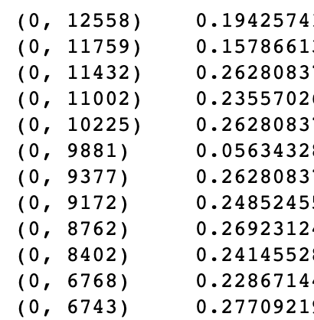
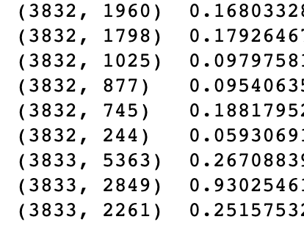
TFIDF: Scikit-learn
from sklearn.feature_extraction.text import TfidfTransformer
tf_transformer = TfidfTransformer(use_idf=True)
tf_features = tf_transformer.fit_transform(word_counts)
Notes:
(word 2849 is ‘dalje’ btw)

Slide 18
Sentiment: (some of) the feels
Word-based: give (some) words positive/negative scores
Use an existing ‘sentiment dictionary’
Score some words, use machine learning on the rest
Document-based: score documents and use machine learning
‘positive’/’negative’ for each sentence
Semantic/pragmatic: use natural language processing
Satire is hard to detect
“Nice work bro!”
Emoticons are a language too
Very positive
Positive
Neutral
Negative
Very negative
Notes:
Examples: https://monkeylearn.com/sentiment-analysis/
Why always 5 things on a scale? Because it’s a Likert scale
Again semantics might matter: aspect-based sentiment analysis = working out *what* people are happy, sad etc about.

Slide 19
Sentiment Dictionaries
>:/ -1
>:[ -1
>:\ -1
>:] 1
>:D 1
>:L -1
>:O -1
>:o -1
>:P 1
>:X -1
>;) -1
>;] 1
>[ -1
>\ -1
Wordstat: https://provalisresearch.com/products/content-analysis-software/wordstat-dictionary/sentiment-dictionaries/
Sentiwordnet: https://github.com/aesuli/SentiWordNet
Emoticon sentiment lexicon: http://people.few.eur.nl/hogenboom/files/EmoticonSentimentLexicon.zip
Notes:
https://www.quora.com/Is-there-a-free-online-sentiment-analysis-service-for-social-media-accounts

Slide 20
Other things to look at….
Text as Vectors (“word vectors”)
Classification and clustering algorithms (LDA, SVMs, deep learning etc)
Natural language processing and the NLTK library
Applications in disinformation response
Notes:
Classic modularity algs: https://www.cs.cmu.edu/~ckingsf/bioinfo-lectures/modularity.pdf

Slide 21
Over to You…

