Slide 1
CTI League
Disinformation
2020-08-20
Data Science 4 Disinfo Response:
Setting up tech
Notes:
Welcome. This training is designed to frame a training route for people wanting to do tactical disinformation data science. Why this series? To:
Set the art for real-time disinformation data science
Train disinfo team in useful data science skills
Get feedback and new ideas on what we do
Practice [Name Redacted] university course
So as always, all comments, corrections, additions welcomed. Released CC-by-SA: please use this work yourself, but please also attribute it back to the CogSecCollab.

Slide 2
Data Science 4 Disinformation Response series
2020-07-15 Introduction to the disinformation team
2020-05-06 What are we chasing? Digital harm training
2020-08-20 getting set up for disinformation data science
2020-05-27 Data sources (process, sources, stores)
2020-07-04 Disinfo Data Science examples
2020-08-05 Social text analysis
TBA Image data analysis
2020-07-11 Relationships as data
TBA Extending your analysis with machine learning skillz
TBA Communicating results (style, narratives, visualisations)
Notes:
AKA DS4DR

Slide 3
What Tech Do We Need?
Notes:
Jupyter. Terminal window. Starting notebooks. Pip install.

Slide 4
DS4DR Technologies
Python
Jupyter notebooks
Python libraries
Analysis
Gephi
Online tools
crowdtangle

Slide 5
Jupyter Notebooks

Slide 6
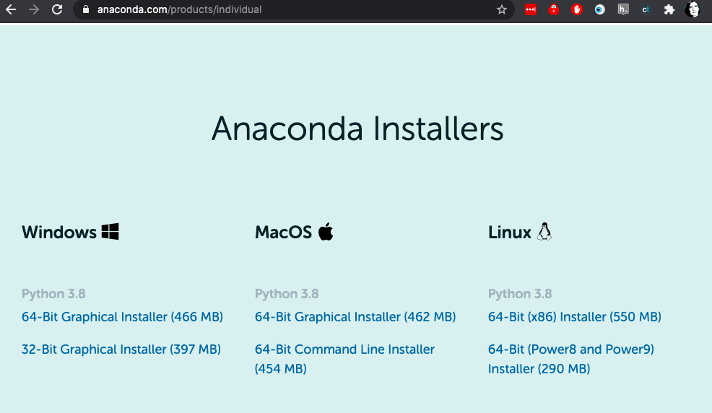
Do this the easy way...
https://www.anaconda.com/products/individual
Notes:
https://www.anaconda.com/products/individual - if you’re not sure what to choose, grab the graphical installer for the machine you’re on.
Click “continue” a lot. And yes, you do want the PyCharm IDE (I write python code using SublimeText, but PyCharm really is a lovely tool, and again if you’re not sure, just use it).

Slide 7
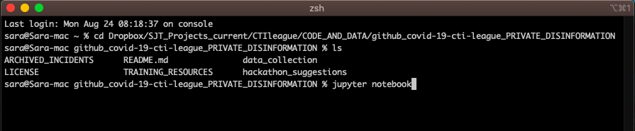
Starting Jupyter
Open a terminal window
Move to the directory you want to run code from
Type “jupyter notebook”
Notes:
All the code examples (both Python and R) for this course are in iPython notebooks, so you’ll need to know how to open one.
cd (“change directory”) is the terminal window command to change directory.
●“cd ~” takes you to your ‘top’ directory, where typing “ls” (mac) or “dir” (windows) will show you directories like Desktop, Downloads or Documents.
●“cd dir1/dir2/dir3” takes you ‘down’ directories, to dir3 which is below dir2 which is below dir1. This is the terminal equivalent of starting in one directory, then clicking on dir1, dir2 then dir3.
●“cd ..” takes you ‘up’ directories: for instance, “cd ..” in dir3 will take you to dir2.
●“pwd” (mac) or “dir” (windows) will show you which directory you are in at the moment. If you get lost, “cd ~”.
Now sometimes this will go wrong… Google search, and your friendly community, are your friends here.

Slide 8
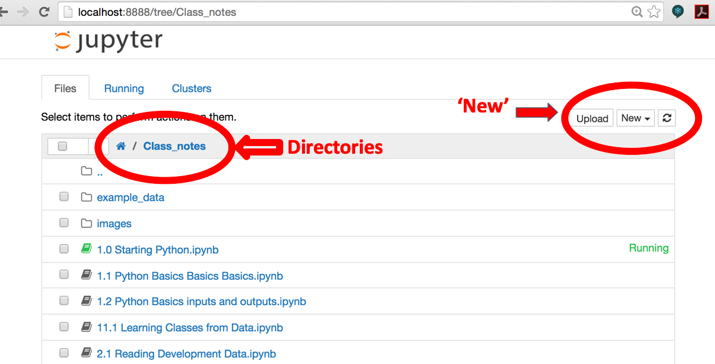
What you get: the Jupyter Dashboard
Notes:
A browser window will open. In it you’ll see a list of files - the ones in the directory you typed “Jupyter notebook” from. You can open most of these in Jupyter. Some of them will make sense.
iPython starts with the Dashboard view. This lists all the files in the directory that you called iPython from, including directories. If you accidentally delete this view, open a web browser and type “localhost:8888” in the address window to get back to it.
Things you need to know about in here:
The “New” button on the top right hand side. Click on this, then “Python 3”, to create a new iPython notebook file.
The file listing. Click on any file or directory to open it.
The current directory (the grey bar above the files list): click on this to go back up from a directory.
Jupyter notebooks are files that contain both formatted text and code; depending on how you set up your notebooks, they can run code written in Python, R or several other languages.
Jupyter notebooks were originally called ipython notebooks: they’ll be called this in many places online, but apart from the name change, they’re fundamentally the same thing: text and code, mixed together, and any instructions for ‘ipython notebook’ will work for ‘jupyter notebook’ too.

Slide 9
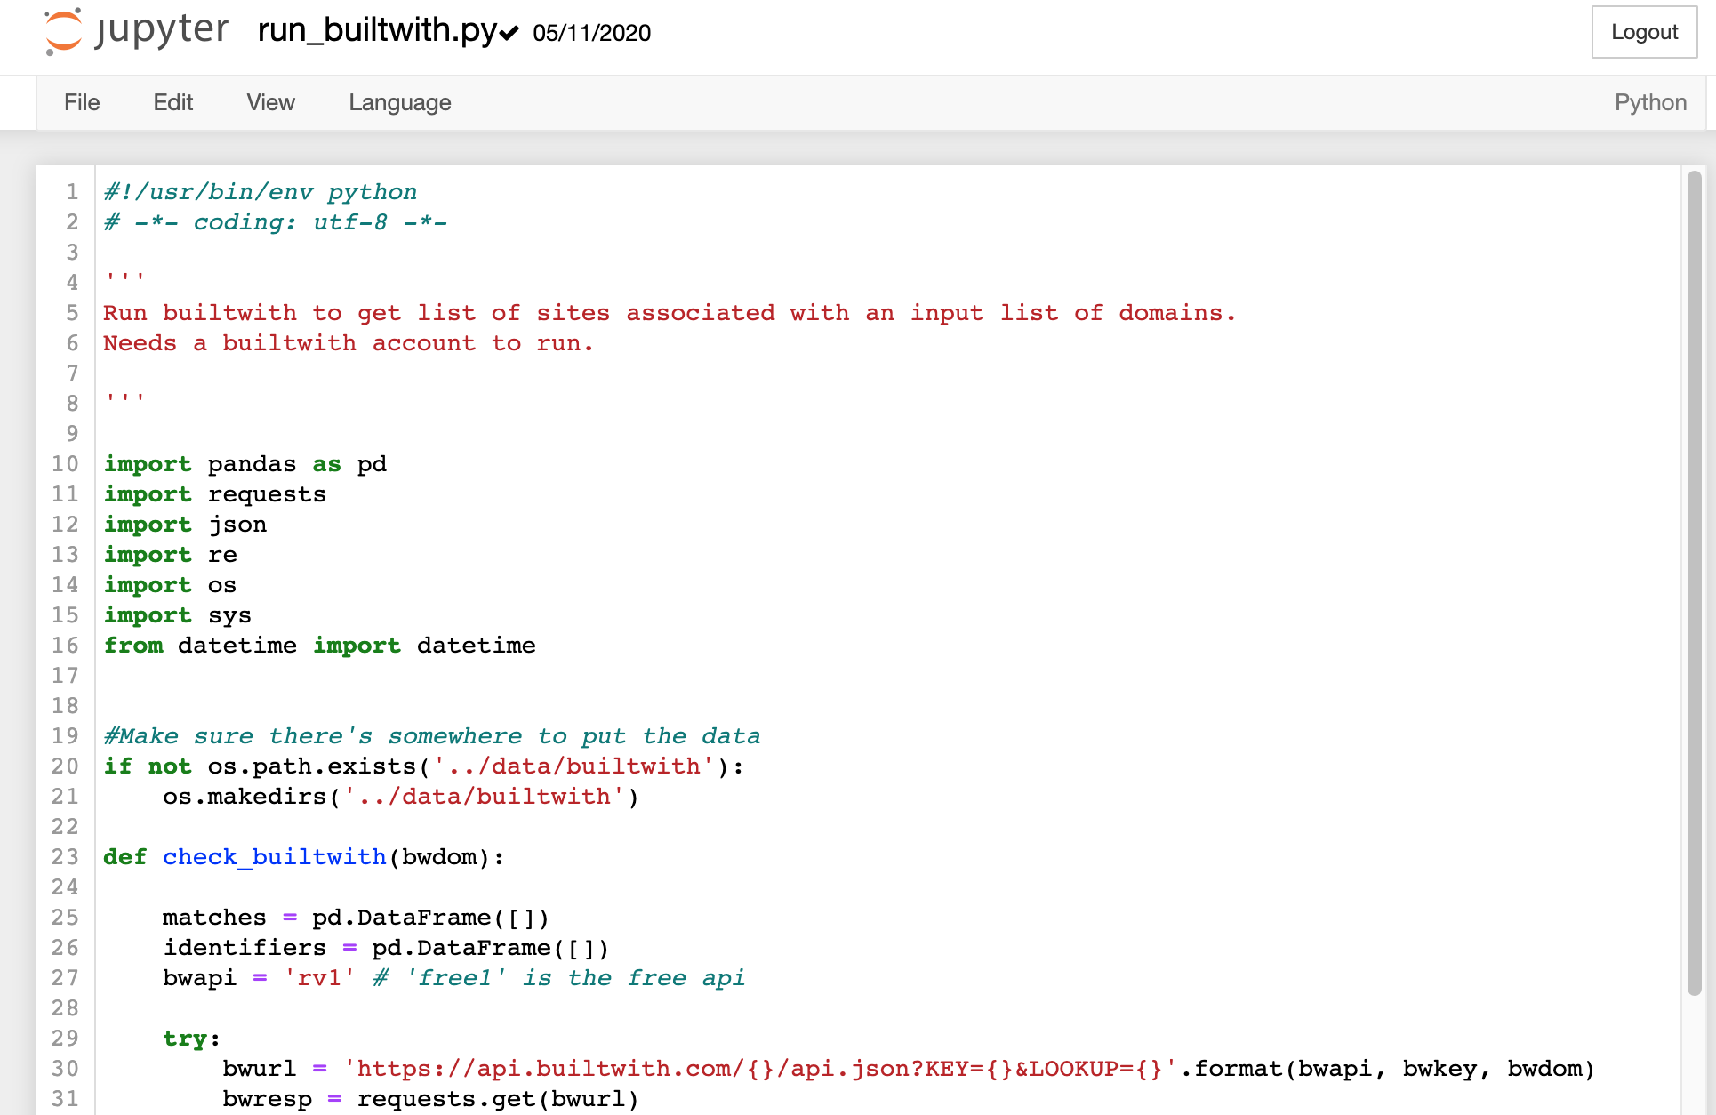
Code file in Jupyter
Notes:
If you open up (click on the filename in the jupyter dashboard) a code file in jupyter, you’ll see this. The code, handily colour-coded to show comments, variables etc.

Slide 10
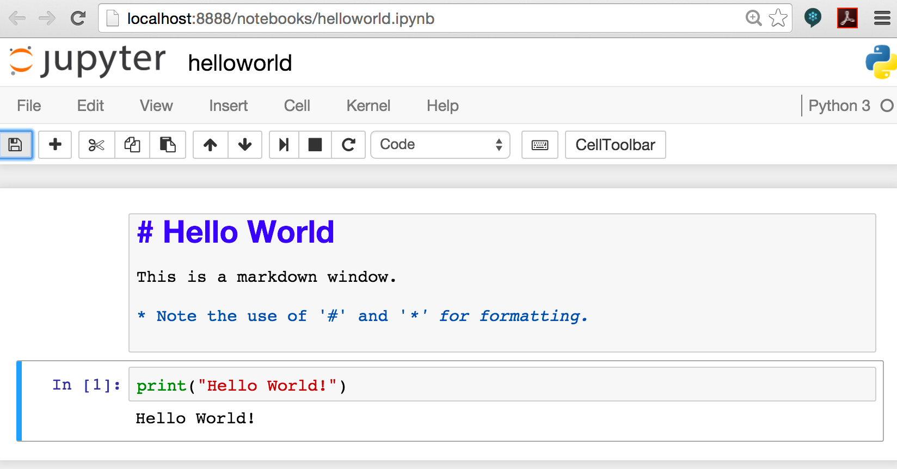
Jupyter notebook in Jupyter
Notes:
And this is what you see when you open an iPython file.
The grey boxes are called ‘cells’.
You create a new cell by clicking ‘Insert’ on the top menu.
You change the cell type (to ‘Markdown’, or ‘Code’) by clicking the box that currently says ‘Code’
You run a cell by clicking in the cell, then clicking ‘cell’ -> ‘run cells’.
You change your file’s name by clicking the name to the right of jupyter
You save your shiny new file by clicking ‘File’ -> ‘Save and Checkpoint’.

Slide 11
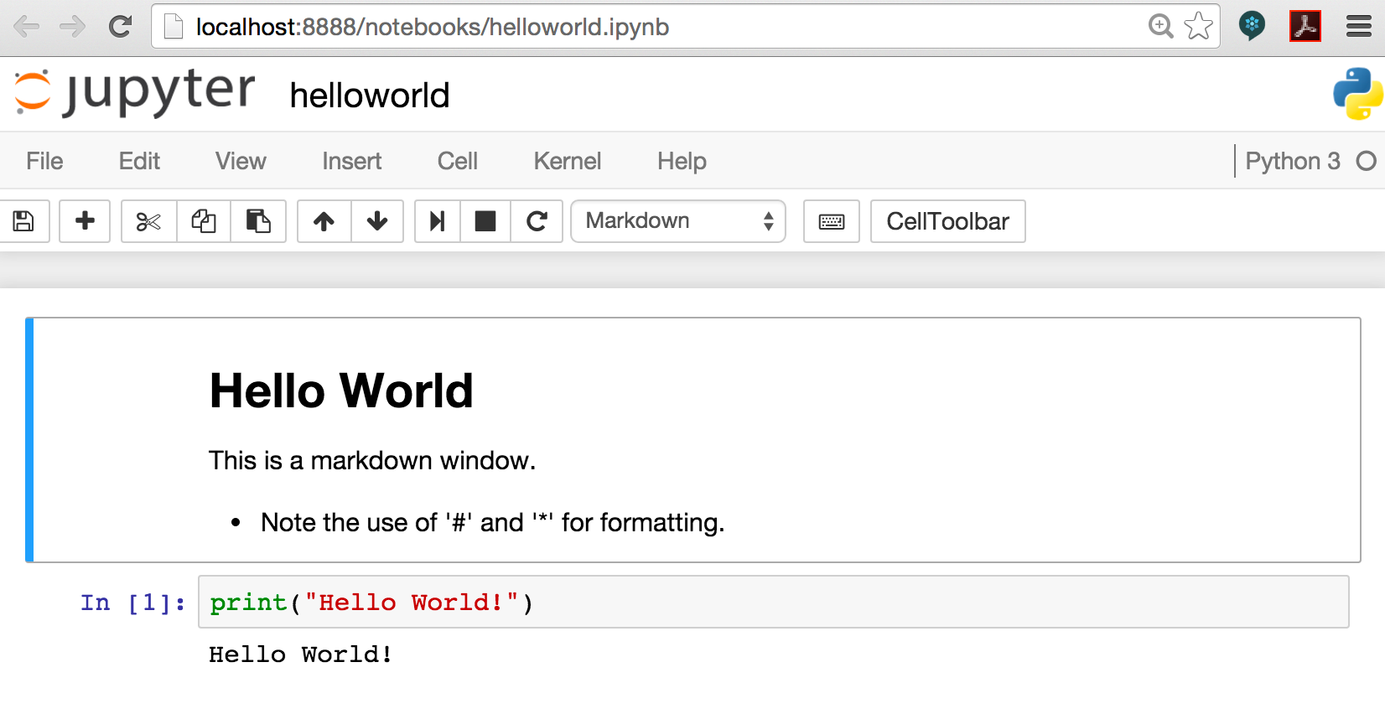
Jupyter Notebook: Print View
Notes:
Don’t panic if your notebook looks like this when you open it. iPython has helpfully converted your markup cells into the way you’d see them if you printed the notebook. To edit any of these cells, click in the cell (you should then see the markdown code, ready to edit).

Slide 12
Over to You…

